Slide 1




Superstore Sales Analysis Dashboard
Power BI Dashboard – Task 4,
Data Analyst Internship
Created By- Jassmesh Singh Kochhar

Slide 2
Objective
To design an interactive dashboard using Power BI for analyzing sales performance, profit trends, and key business metrics using the Superstore dataset.
To analyze sales, profit, and category performance using Power BI.
Design an interactive dashboard that enables business stakeholders to extract actionable insights.
Use slicers, filters, and visuals for a seamless data exploration experience.

Slide 3
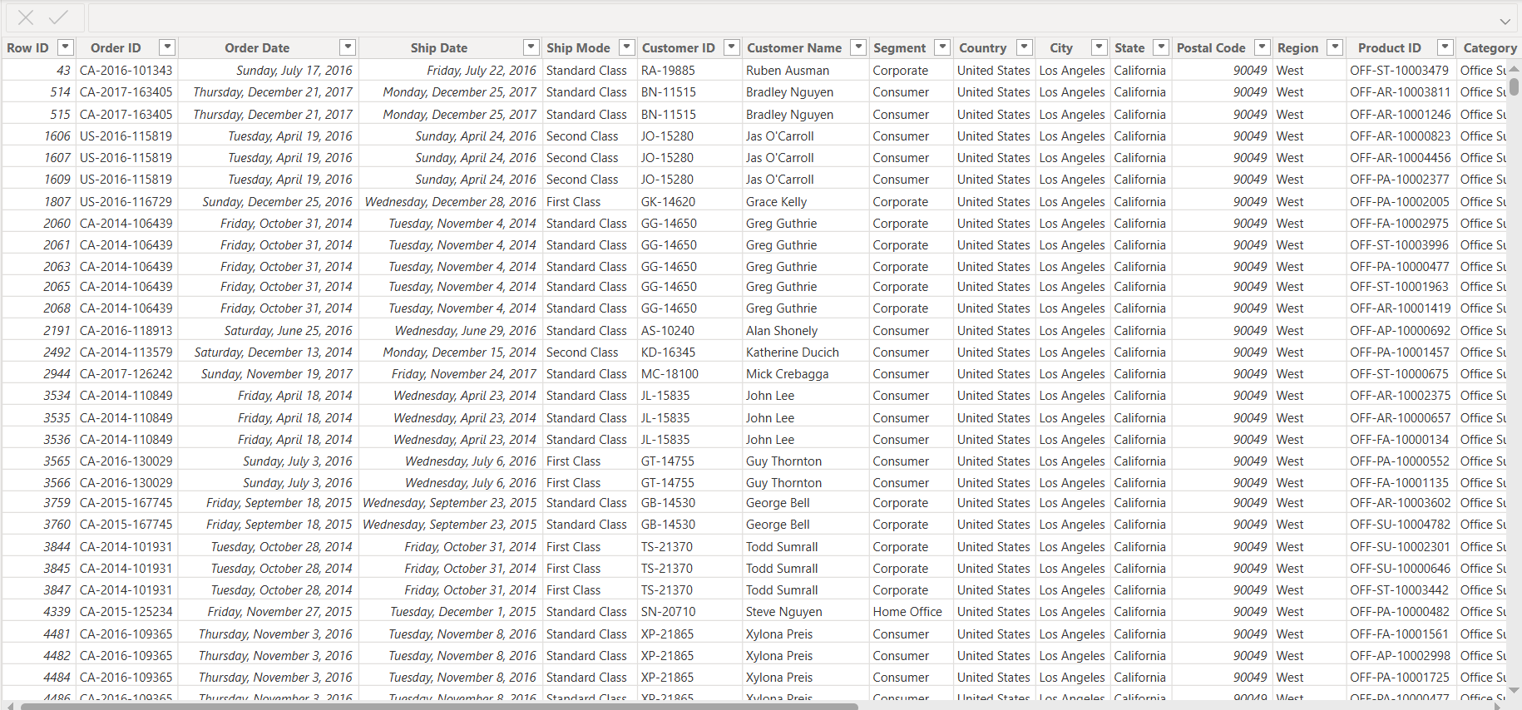

Dataset Summary
Source: Kaggle – Sample Superstore Dataset
Records: ~10,000 rows
Time Period: 2014–2017
Key Fields:
Sales, Profit, Discount, Quantity
Order Date, Ship Date
Category, Sub-Category, Region, Segment

Slide 4
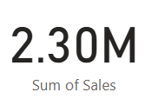
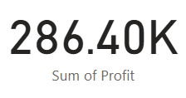
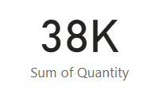
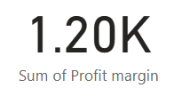
Key Performance Indicators(KPIs)
Total
Quantity
Total
Profit Margin
Total Sales
Total Profit

Slide 5
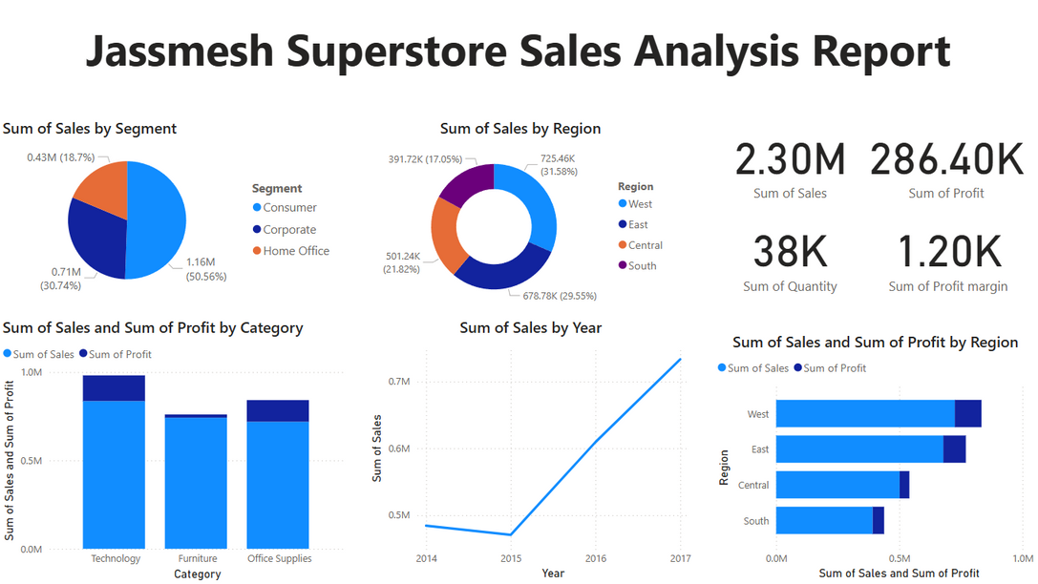

Dashboard Design Overview
01
Integrated slicers for dynamic filtering (Region, Segment, Category)
02
Time-series line charts for sales and profit trends
03
Bar charts for top-performing categories
04
Heatmap for profit by region and sub-category
05
Visual consistency with a clean color theme

Slide 6
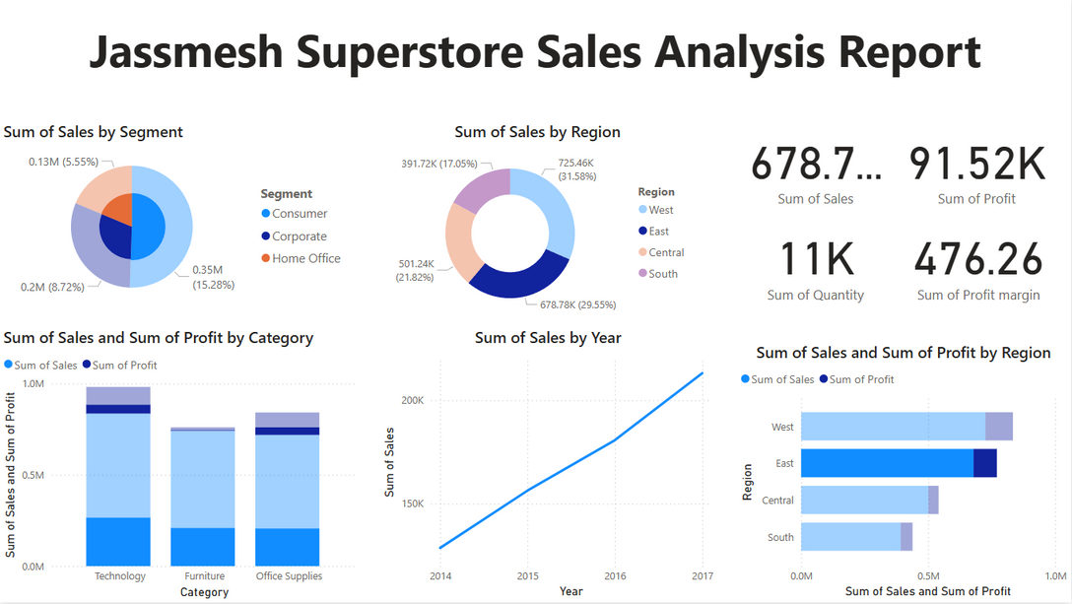
Interactivity & User Experience
Multi-level filters via slicers for flexible analysis
Tooltip pop-ups on hover for detail-on-demand
Drill-down functionality for year → month views
Clean layout with a focus on clarity and readability
Optimized responsiveness for various screen sizes

Slide 7
Insights Gained
The West region consistently delivers the highest profit.
December shows peak sales across years.
Office Supplies is the most sold category, while Technology is the most profitable.
Certain Sub-Categories underperform despite high sales—indicating margin issues.
Losses observed in products with high discounts.

Slide 8



Tools & Techniques Applied
Power BI: Visualization, DAX, Interactive filtering
Data Analysis: Identifying KPIs, trends, and insights
Design Thinking: Clean layout and intuitive UX
Data Cleaning: Removing nulls, adjusting data types
Storytelling with Data: Translating numbers into insights

Slide 9
Challenges & Learnings
Challenges
Learnings
Selecting relevant KPIs from large dataset
Managing interactivity without clutter
Designing layout that balances visuals & usability
Best practices in dashboard layout and color theming
Importance of clarity in communicating insights
Power of drill-throughs, slicers, and tooltips for stakeholders

Slide 10
Conclusion
Created an interactive, insightful dashboard with key business metrics
Delivered an end-to-end analytical solution using Power BI
Learned essential skills in data storytelling and stakeholder communication
Call-to-Action View the full dashboard and project here: https://github.com/Jassmesh/superstore-powerbi-dashboard-task4

