Slide 1
FYP Progress

Slide 2

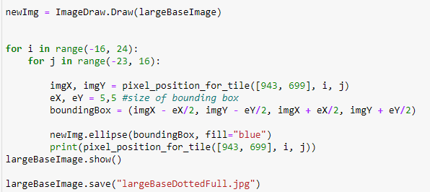
Sprint 1
Testing if the value calculated for tile width and length was accurate
To test if the value worked, some code was written that would draw ellipses on the corners of the tiles. If the ellipses aligned then it was accurate

Slide 3
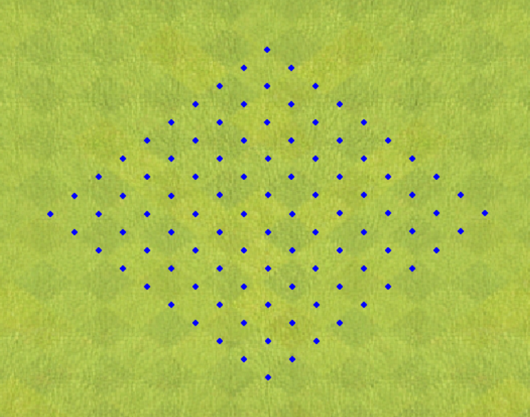
Sprint 1
Example of code being run. Tile width and length of 30.

Slide 4
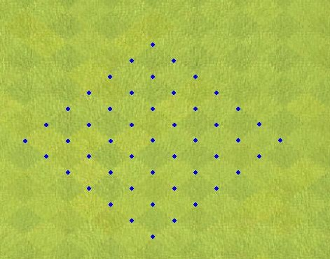
Sprint 2
Using trial and error to get a better value for the tile width and length
Following up with trying to actually calculate a value through more conventional methods.
Value of 38 aligned well

Slide 5
Sprint 2 – Continued
Trial and error approach worked but would be better to get a value through calculation
Method that looks at when there a ‘jumps’ in the RGB value. Store coordinates and display them
Take the coordinates of the first jump and off the last jump and use the distance formula : √ (Y2 – Y1)² + (X2 – X1)²
Unfortunately, none of the results from this worked as well as the 38 from trial and error.
It was best to move on because of limited amount of time.

Slide 6
Sprint 3 – Current Sprint
Continue using the 38 value from earlier and increase the size of the loop so that it covers the entire map.
After increasing the size of the loop, it was seen that gradually the ellipses started to move away from the corners of the tiles.
This is shown in the next slide

Slide 7
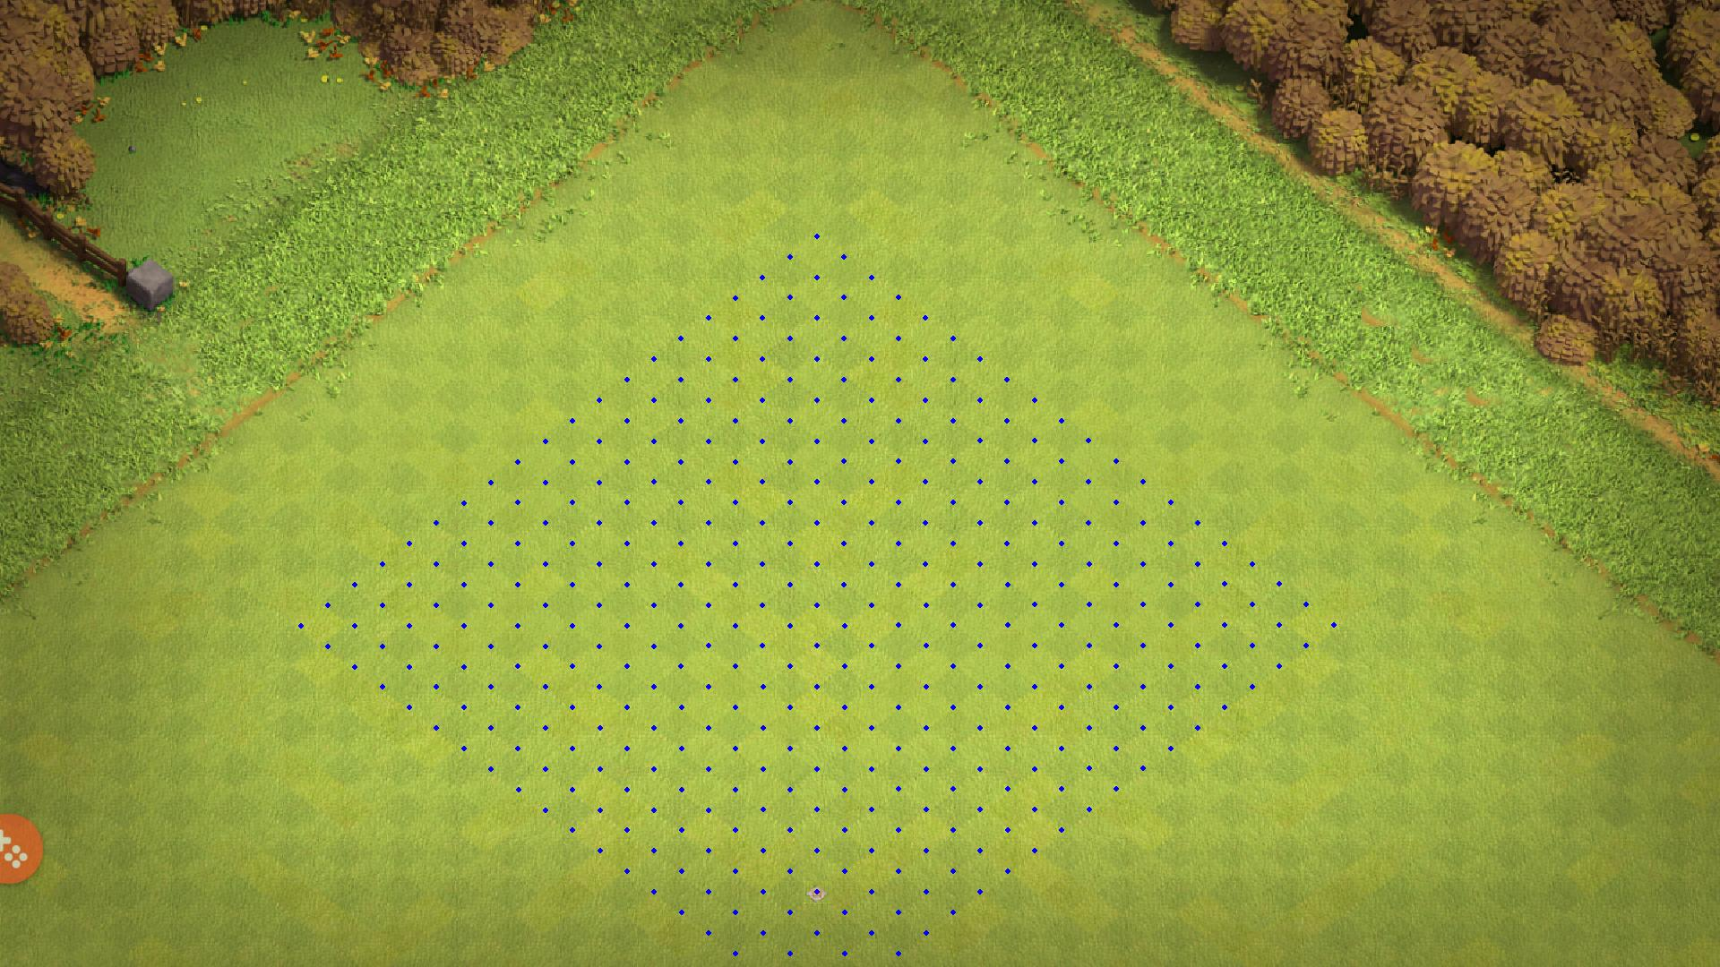

Slide 8
Sprint 3
Once the loop had covered the entire map, a new value would be needed for the tile that would align the through the whole map.
Trial and error approach again, 38.6 was the value that worked best
Next slide shows full image.

Slide 9


Slide 10
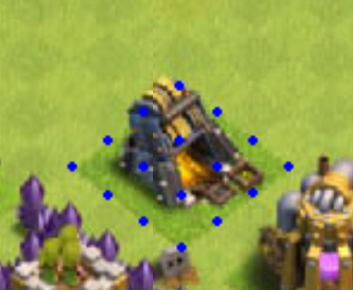
What’s next ?
With a value for the tiles, the next step would be to pull out specific parts of the map i.e. the different buildings and other objects.

