Slide 1


MLSA : FULL STACK INTERNSHIP
By Pratham Jasuja
2300290120166 || CS 2nd C

Slide 2
Table of contents
01
Introduction
03
Website Preview
05
Conclusion
Basic preview what i have done
Some preview of my project made by me
Concluded the experience and outcome
02
Projects Made
04
Description
06
Thank You
List of projects I made
Brief description of projects i made and what tech i used in it

Slide 3


Introduction
Most recently, I had the opportunity to participate in a MLSA Full-stack Web Development Internship, which allowed me to gain hands-on experience in building full-stack applications and integrating cloud technologies.

Slide 4

PROJECTS MADE
Style a basic webpage(Easy-Level Project):I styled a basic webpage using CSS, adding color, fonts, and spacing to improve its look and readability. I organized elements with margin, padding, and border properties, creating a cleaner, more user-friendly layout. This easy project helped me understand CSS fundamentals in web design.
Simple Calculator(Intermediate-Level Project): I developed a basic calculator using JavaScript that performs essential arithmetic operations like addition, subtraction, multiplication, and division. It includes an interface where users input numbers and select the desired operation. Through JavaScript's decision-making structures, the app dynamically evaluates the inputs, executing the correct operation and displaying the result instantly.

Slide 5

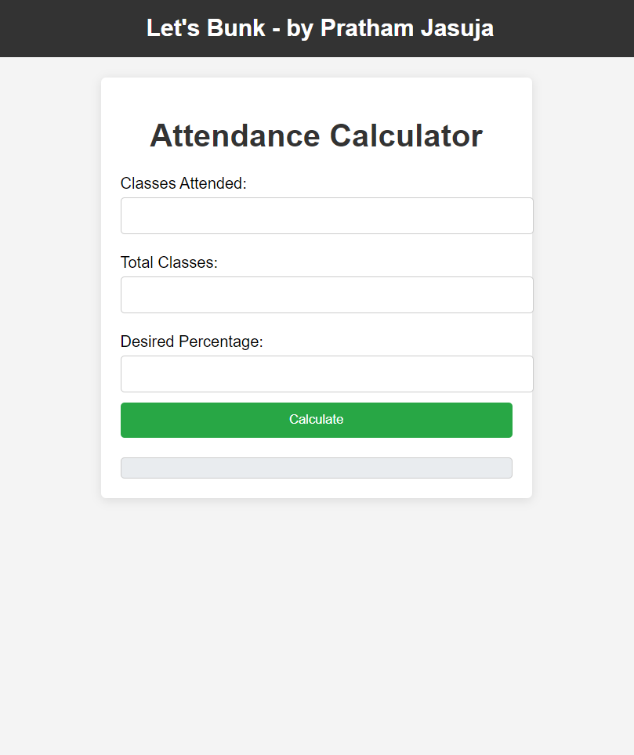
Website Preview
Style a basic webpage

Slide 6
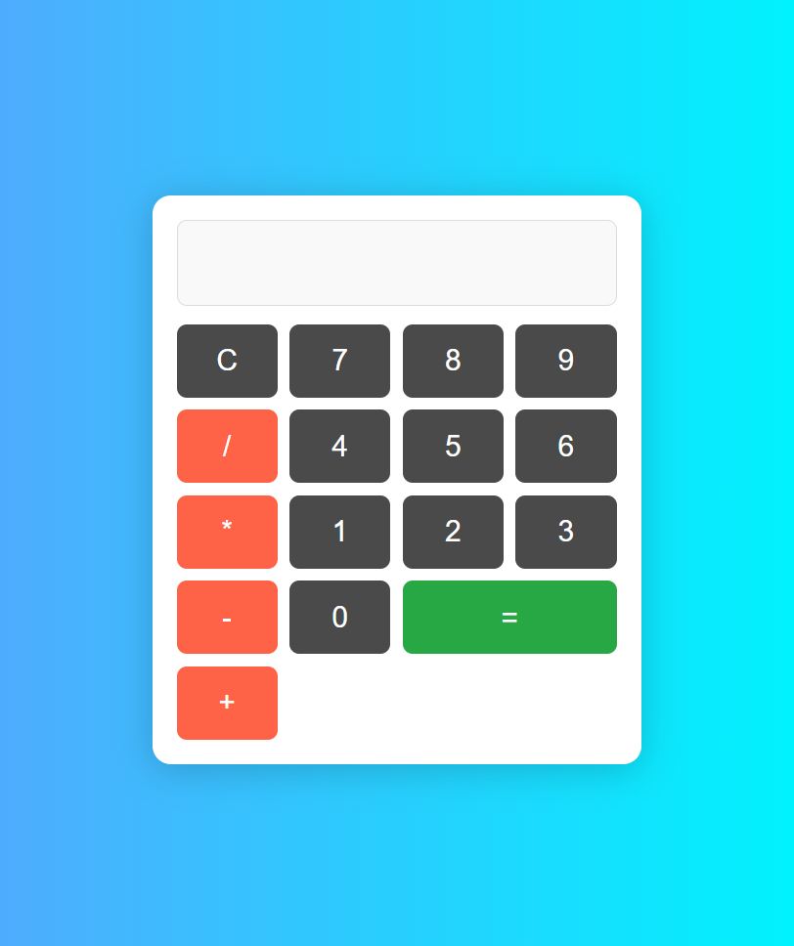
Website Preview
Simple calculator

Slide 7



Description
Style a basic webpage
Simple Calculator
The project is made using plain HTML and CSS in Visual Studio Code. To complete this project I took stock images from freepik used MDN Guides for any help.
This project is developed using a basic calculator using JavaScript that performs essential arithmetic operations

Slide 8


Conclusion
Overall, the Full-stack Web Development Internship was an enriching experience that significantly improved my technical skills. I gained practical knowledge in both frontend and backend development, cloud integration with Azure, and completed challenging projects. This internship has equipped me with the confidence and expertise to take on more complex full-stack development tasks in the future.

Slide 9


Thank
You

