Slide 1
Slide: 1

Slide 2
Introduction to Skyscrapers
Skyscrapers are tall, continuously habitable buildings that have become symbols of modern urbanization and architectural innovation.

Slide 3
History of Skyscrapers
Skyscrapers have a rich history dating back to the late 19th century, with the Home Insurance Building in Chicago often credited as the first skyscraper.

Slide 4
Design and Architecture
Skyscrapers feature unique designs and architectural elements, such as steel frames, curtain walls, and innovative structural systems.

Slide 5

Construction of Skyscrapers
Building skyscrapers requires careful planning, advanced engineering techniques, and the use of specialized construction equipment to ensure safety and stability.

Slide 6
Iconic Skyscrapers Around the World
From the Burj Khalifa in Dubai to the Empire State Building in New York City, iconic skyscrapers showcase the ingenuity and creativity of architects and engineers.

Slide 7
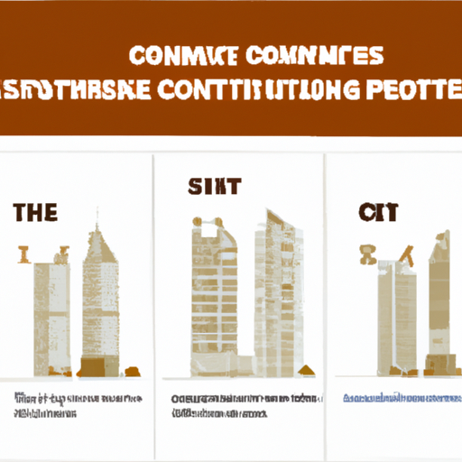
Summary
Skyscrapers are marvels of modern engineering and design, shaping the skylines of cities around the world and pushing the boundaries of what is possible in construction.

