Slide 1
YGT HOLDING · DIGITAL TRANSFORMATION
Export Platform — Progress Report
What was planned · time given · what was delivered in 4 months
Built solo with AI assistance · February – June 2026
Notes:
Thank you for the time. This is a short, honest report of the export platform: what we set out to build, how much time we had, what is done after four months, and what I added along the way. I'll walk through the actual export process at the end so you can see it the way the team uses it every day.

Slide 2
ROADMAP V1.0 — FEBRUARY 2026
The Original Plan
• One unified Django + React platform to replace Excel, phone calls and WhatsApp across the whole value chain.
• Five interconnected projects:
– P1 Greenhouse · P2 Transport · P3 Export · P4 Contracts · P5 Finance
• Planned timeline: 12 months.
• Planned team (per roadmap): 2–3 developers + 1 data analyst + 0.5 QA.
• Defined priority order: P3 Export first — highest operational pain, most data available, every other project depends on it.
Notes:
The original roadmap is one platform covering the whole value chain in five projects, planned over twelve months for a team of two to three developers plus an analyst. The plan itself said to build Export first, because it is the biggest daily pain and everything else depends on its data. I followed that priority.

Slide 3
Time & Resources — Plan vs. Reality
 | Planned (roadmap) | Actual
Team | 2–3 developers + analyst + QA | 1 developer + AI
Timeline | 12 months | ~4 months so far
Discovery / planning | Interviews + analysis up front | Compressed — coding began mid-March
Timeline
• Late February 2026 — planning started.
• Mid-March 2026 — coding started (the learn-the-business / discovery window was very short).
• End May – early June 2026 — first results reviewed. → roughly 3.5–4 months of actual build.
Notes:
Two numbers to keep in mind for the rest of this. First, the team: the plan assumed two to three developers and an analyst — this was built by one person with AI assistance. Second, the time: planning started late February, coding mid-March, and we are reviewing at the end of May. That is under four months of build, with a very short window up front to learn the business in detail. I mention this not as an excuse — the result stands on its own — but so the scope is judged against the time and the people that were actually behind it.

Slide 4
DELIVERED IN ~4 MONTHS
~40%
of the full 12-month, 5-project scope
• The highest-priority project — P3 Export — is ~90% complete and in daily production use.
• Delivered solo + AI what the plan budgeted for a 2–3 person team over a longer horizon.
• Value is front-loaded exactly as the roadmap intended: highest-pain project first.
Notes:
The headline: in under four months, roughly forty percent of a twelve-month, five-project plan is done. But it is not a flat forty percent everywhere — the work was concentrated where it matters most. The Export project, the one the roadmap said to do first, is about ninety percent complete and already running in daily use. So the most important and most-used part of the whole plan is essentially live.

Slide 5
Completion by Project
P3 Export
90%
Core platform — in production, used daily by 9 roles
P5 Finance / Executive
40%
Executive dashboards built; ERP / 1C integration pending
P4 Contracts
35%
Contracts + invoices + debt view; document auto-gen pending
P1 Greenhouse
30%
Harvest planning + blocks; mobile PWA + analytics pending
P2 Transport
5%
Not started — fleet registry / GPS
Notes:
Breaking the forty percent down by project. Export is at ninety percent and in production. The executive and finance dashboards are about forty percent — the screens exist, the accounting-system integrations are still ahead. Contracts is about thirty-five percent — contracts, invoices and the debt view are in, the document auto-generation is the next big piece. Greenhouse is early, and Transport has not started. This is deliberate: highest-value first, exactly as the plan ordered it.

Slide 6
NOT IN THE ORIGINAL PLAN
Scope Added During the Project
• Kanban boards + Tasks — requested by management mid-project.
• "Sheet" — a Google-Sheets-style grid, built to win real user adoption (next slide).
• "My Tasks" personal board for each role's daily work.
• Feedback module + Worklog / time tracking.
• Configurable role & field permissions + delegated user management.
• Error tracking (Sentry) and a full audit log.
Notes:
A large part of the four months went into things that were not in the original plan. Some were asked for during the project — the kanban boards and tasks. Others came from talking to the people who actually use the system every day. The biggest of these is the spreadsheet view, which I'll explain on the next slide.

Slide 7
SOLVING THE #1 PROJECT RISK: USER ADOPTION
Why the Spreadsheet View
• The roadmap flagged "user resistance" as the highest-likelihood risk.
• Employees were clear: they would not move off their familiar spreadsheets.
• Solution: build a spreadsheet-style interface — the platform feels familiar, but the data is now connected, validated and real-time.
• Same way of working the team already knows — with the control a single source of truth gives.
• This is an adoption strategy, not a rebuild of Excel: behind the grid sits the full lifecycle, permissions, quota and reporting engine.
Notes:
I want to be honest about the spreadsheet view, because at first glance it can look like we just rebuilt Excel. We did not. The biggest risk to this whole project was that people would refuse to leave their spreadsheets — the roadmap itself listed this as the number-one risk. The team told me directly they would not switch. So I made the platform feel like what they already know, while underneath it is connected, validated, and a single source of truth. This is how we get real adoption instead of people quietly going back to their own files.

Slide 8
The Export Process, End to End
The operational role views — what the 9 daily users actually see (distinct from the admin configuration view).
Notes:
Now I'll show the actual export process, screen by screen, the way the team sees it when they log in — not the admin view. This is a single shipment travelling from harvest, through documents and customs, to sale and final report. Each screen here is a real, working part of that flow.

Slide 9
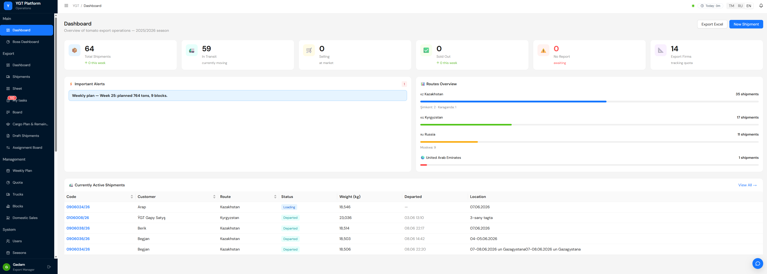
Dashboard
Daily landing page for every role — key stats, alerts (missing reports, quota, document queue), active shipments and routes.
PUT SCREENSHOT HERE
SCREEN: Home / Dashboard (right after login) · login as export_manager
Notes:
Daily landing page for every role — key stats, alerts (missing reports, quota, document queue), active shipments and routes. (Capture instruction on the slide: SCREEN: Home / Dashboard (right after login) · login as export_manager)

Slide 10
Daily Harvest & Draft Creation
Supply side: harvest entered per block, then turned into one-truck shipment drafts — the start of the export pipeline.
PUT SCREENSHOT HERE
SCREEN: Daily Harvest board / Draft pool · login as loading_dept_head or export_manager
Notes:
Supply side: harvest entered per block, then turned into one-truck shipment drafts — the start of the export pipeline. (Capture instruction on the slide: SCREEN: Daily Harvest board / Draft pool · login as loading_dept_head or export_manager)

Slide 11
The Sheet — Main Working Surface
Spreadsheet-style grid all 9 roles work in. Inline editing, frozen rows/columns, copy/paste, undo, per-cell comments — but every change is validated and shared in real time.
PUT SCREENSHOT HERE
SCREEN: Shipments → Sheet view · login as export_manager (NOT admin)
Notes:
Spreadsheet-style grid all 9 roles work in. Inline editing, frozen rows/columns, copy/paste, undo, per-cell comments — but every change is validated and shared in real time. (Capture instruction on the slide: SCREEN: Shipments → Sheet view · login as export_manager (NOT admin))

Slide 12
Kanban Board — Phase Tracking
Each shipment flows through 7 phases (Plan → Prep → Docs → Load → Transit → Dest → Close), with average time-in-phase per column.
PUT SCREENSHOT HERE
SCREEN: Shipments → Board (Kanban) · login as export_manager
Notes:
Each shipment flows through 7 phases (Plan → Prep → Docs → Load → Transit → Dest → Close), with average time-in-phase per column. (Capture instruction on the slide: SCREEN: Shipments → Board (Kanban) · login as export_manager)

Slide 13
Shipment Detail — 13-Step Lifecycle
Full record of one shipment with the 13-step timeline, weights, firm splits, documents and status history.
PUT SCREENSHOT HERE
SCREEN: open any shipment → Detail (show the 13-step timeline) · login as export_manager
Notes:
Full record of one shipment with the 13-step timeline, weights, firm splits, documents and status history. (Capture instruction on the slide: SCREEN: open any shipment → Detail (show the 13-step timeline) · login as export_manager)

Slide 14
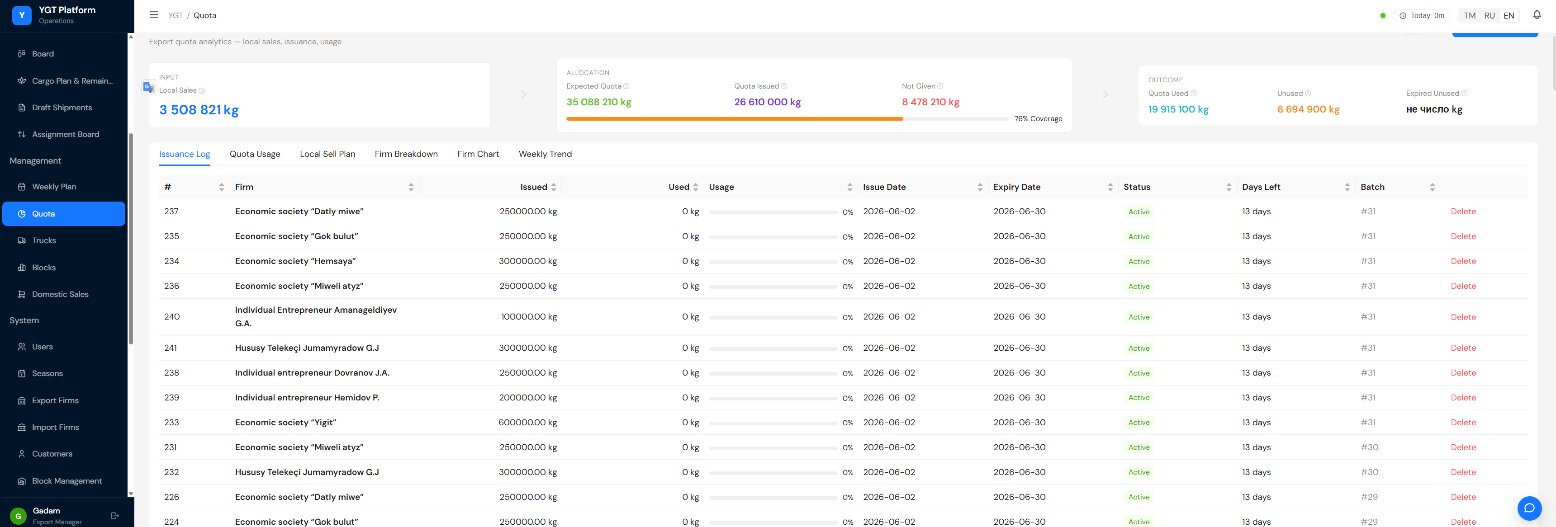
Quota Management
Government 1:10 quota tracking per firm — usage, remaining balance, per-firm progress and alerts.
PUT SCREENSHOT HERE
SCREEN: Quota dashboard · login as export_manager
Notes:
Government 1:10 quota tracking per firm — usage, remaining balance, per-firm progress and alerts. (Capture instruction on the slide: SCREEN: Quota dashboard · login as export_manager)

Slide 16
Weekly Harvest Planning
Block × day planning grid — plan vs. actual, feeding the export pipeline.
PUT SCREENSHOT HERE
SCREEN: Weekly harvest planning grid · login as export_manager
Notes:
Block × day planning grid — plan vs. actual, feeding the export pipeline. (Capture instruction on the slide: SCREEN: Weekly harvest planning grid · login as export_manager)

Slide 17
My Tasks
Each employee's personal board: to-do / in progress / blocked / done-today, drawn from tasks assigned across shipments.
PUT SCREENSHOT HERE
SCREEN: My Tasks board · login as any role that has tasks
Notes:
Each employee's personal board: to-do / in progress / blocked / done-today, drawn from tasks assigned across shipments. (Capture instruction on the slide: SCREEN: My Tasks board · login as any role that has tasks)

Slide 18
Comments & Collaboration
Threaded comments with @user / @role mentions attached to specific cells — replaces the WhatsApp coordination.
PUT SCREENSHOT HERE
SCREEN: open the Comments drawer on a Sheet cell · login as export_manager
Notes:
Threaded comments with @user / @role mentions attached to specific cells — replaces the WhatsApp coordination. (Capture instruction on the slide: SCREEN: open the Comments drawer on a Sheet cell · login as export_manager)

Slide 19
Executive Dashboard
Management view: revenue, outstanding debt by firm, firm-risk matrix, route profitability and quota status.
PUT SCREENSHOT HERE
SCREEN: Boss / executive dashboard · login as director or boss
Notes:
Management view: revenue, outstanding debt by firm, firm-risk matrix, route profitability and quota status. (Capture instruction on the slide: SCREEN: Boss / executive dashboard · login as director or boss)

Slide 20
Contracts & Invoices
Contract registry and invoice tracking with the outstanding-debt breakdown.
PUT SCREENSHOT HERE
SCREEN: Contracts list + Invoices · login as export_manager or finansist
Notes:
Contract registry and invoice tracking with the outstanding-debt breakdown. (Capture instruction on the slide: SCREEN: Contracts list + Invoices · login as export_manager or finansist)

Slide 21
Admin & Permissions
Configurable role/page/field permissions, reference data, seasons and audit log — the administration layer behind the operational views.
PUT SCREENSHOT HERE
SCREEN: Admin → Permissions / Users · login as admin
Notes:
Configurable role/page/field permissions, reference data, seasons and audit log — the administration layer behind the operational views. (Capture instruction on the slide: SCREEN: Admin → Permissions / Users · login as admin)

Slide 22
HONEST REMAINING SCOPE
What's Left on the Roadmap
• P4 — Document auto-generation engine (CMR, invoice, customs, fito, CT-1, TIR): the daily 2–3 hours of manual filling.
• P2 — Transport & Fleet: truck/driver registry, availability board, GPS tracking.
• P1 — Greenhouse depth: mobile/offline harvest input, yield analytics.
• P5 — Finance integrations: Logo Tiger ERP (read) and 1C credit data.
• P3 — Polish and full-season hardening as real volume hits the system.
Notes:
I want to be clear about what is not done yet, so there are no surprises. The biggest remaining piece is the document auto-generation — the two to three hours of manual filling every day. Then transport and fleet, greenhouse depth, and the accounting integrations. The work is well-understood; it is a question of time and priority from here.

Slide 23
Summary
• In ~4 months, solo + AI: ~40% of a 12-month, 5-project plan.
• The core export platform (P3) is ~90% done and in daily production use.
• Significant unplanned scope added on top — kanban, tasks, collaboration, the spreadsheet view — much of it to drive real adoption.
• The full export process is live in the operational role views, end to end.
• Remaining work is well-scoped: documents, transport, greenhouse depth, finance integrations.
Notes:
To summarise: in under four months, one person with AI built about forty percent of a twelve-month, five-project plan — with the core export platform live and in daily use, plus a lot of extra work to make sure people actually adopt it. The full export process is working end to end in the operational views I just showed. The remaining work is clear and scoped. Thank you — I'm happy to take questions or walk through any screen in more detail.

