Slide 1
Meet the Collab Creators Team
Team Name: Collab Creators
Team Leader & member: Jasveer Singh
Email: 24f3004133@ds.study.iitm.ac.in
24f3004133@ds.study.iitm.ac.in
Phone: +91-9752730062,7909730062

Slide 2
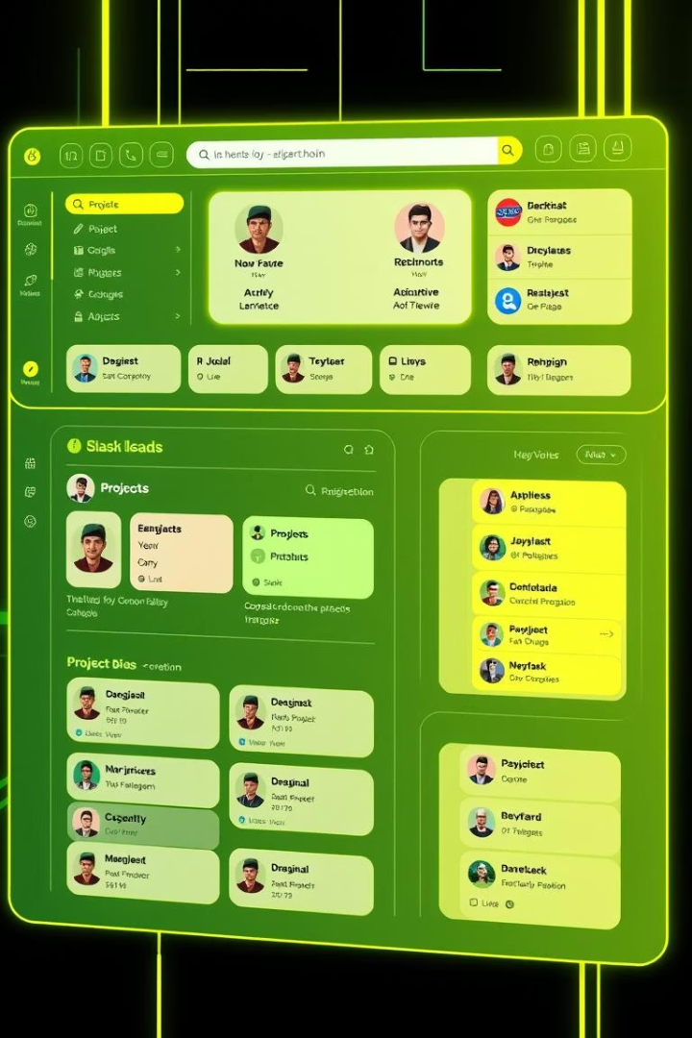
Project Overview: COLLAB-SPHERE
Project Name
Tagline
COLLAB-SPHERE
From Idea to Impact — Together!
Subtitle
A Student-Friendly Open Source Collaboration Platform

Slide 3
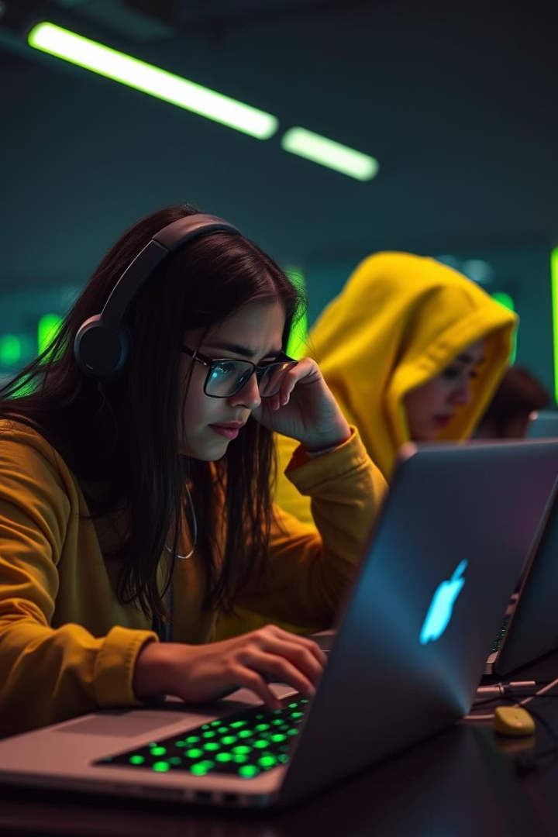
Challenges Students Face in Open Source
Where to Start?
Finding Beginner Projects
Unclear entry points for beginners
Lack of accessible, friendly projects
Teamwork & Discussions
No central platform for collaboration
Goal: Simplify open-source contribution for students

Slide 4
COLLAB-SPHERE: Our Solution
Create Accounts
Share Project Ideas
"I'm Interested" Button
Discussion Boards
Easy student registration and login
Facilitate real-time collaboration
Specify skills needed for teamwork
Connect with project teams seamlessly

Slide 5





Core Features of COLLAB-SPHERE
Student Login/Signup
Project Discussion Boards
Listed Skill Requirements
"I'm Interested" Button
Filter/Search Projects

Slide 6
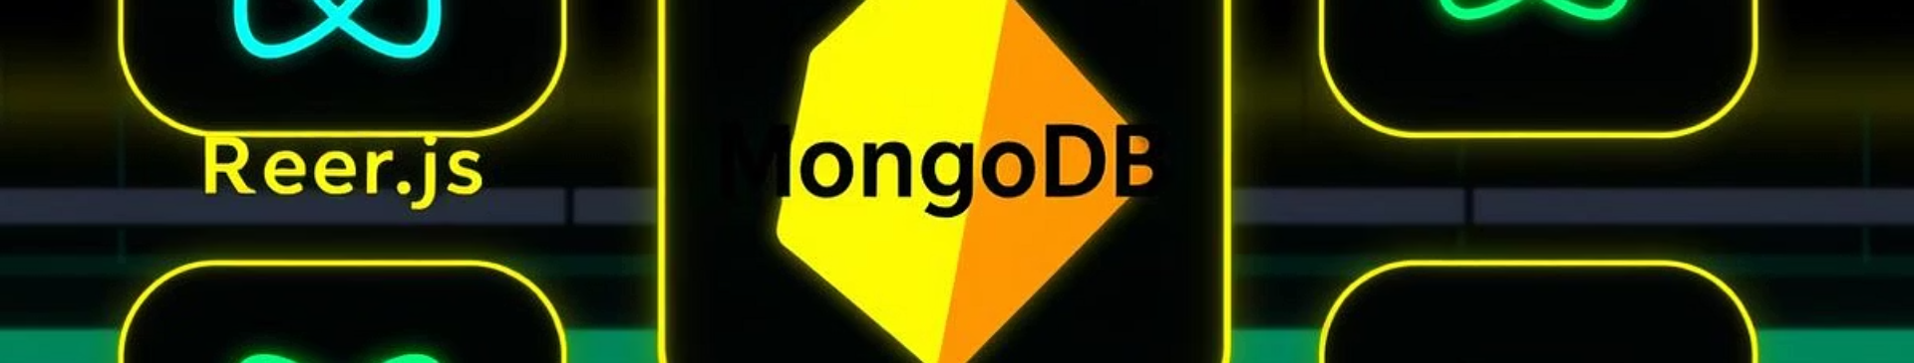
Technology Stack
Frontend
HTML, CSS, JavaScript, React
Backend
Node.js, Express.js
Database
MongoDB
Authentication
Firebase/Auth0 (to be finalized)
Version Control
Git & GitHub

Slide 7
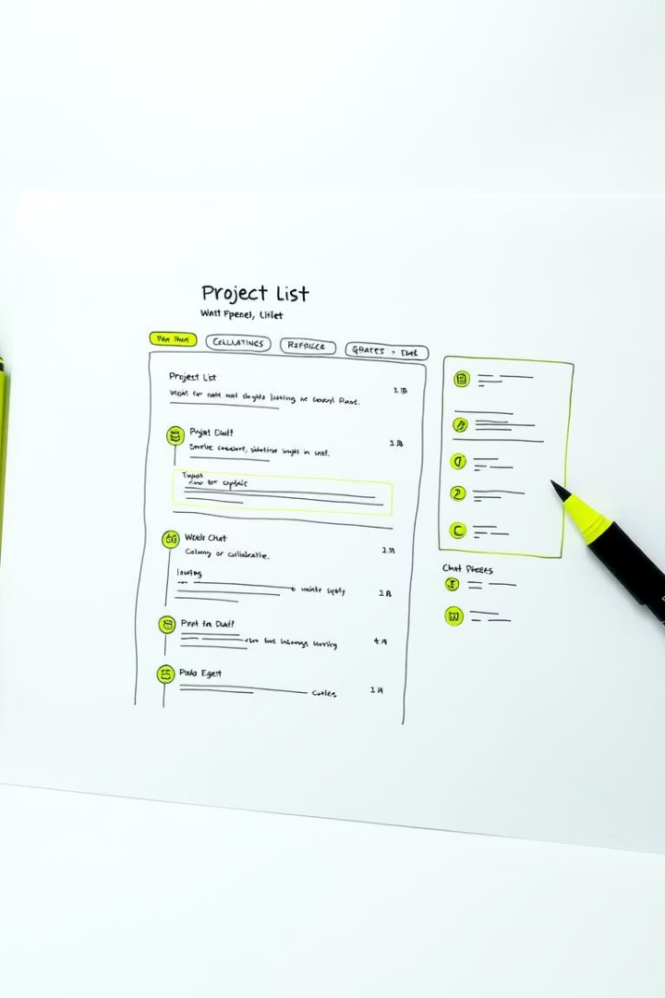
Pre-Alpha Wireframe Sketch
Homepage with project lists
Individual project post with “I'm Interested”
Discussion area below project details

Slide 8






User Flow Overview
Visit Homepage
Sign Up / Log In
Browse Projects
Click “I’m Interested”
Join Discussion
Collaborate & Contribute

Slide 9
Future Enhancements
GitHub Repo Integration
Contributor Badges & Certifications
AI-Powered Project Matching
Team Formation Suggestions
Project Moderation Dashboard

Slide 10
Thank You!
Empowering students to enter open-source confidently
Contact: 24f3004133@ds.study.iitm.ac.in
Phone: +91-7909730062,9752730062
Connect on GitHub: /Jasveer140206
& LinkedIn : /jasveer1402
Let's build the future together with COLLAB-SPHERE!

