Slide 1
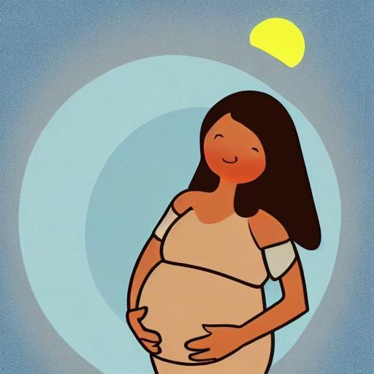
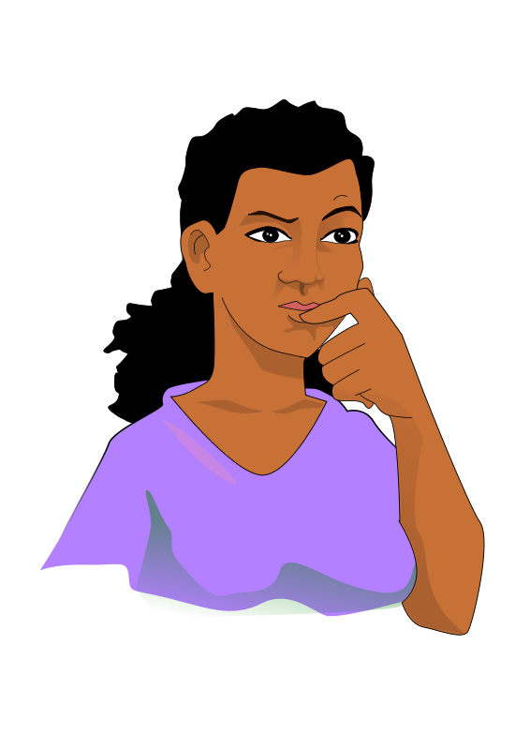


LUNA
Health for the whole family
How to use this app
Start learning

Slide 2
Page 2

Slide 3
This is my Textbox
Right Aligned Text
Right Aligned Text

Slide 4
Luna
Health for the Whole Family
How to use this app
Start learning

