Slide 1
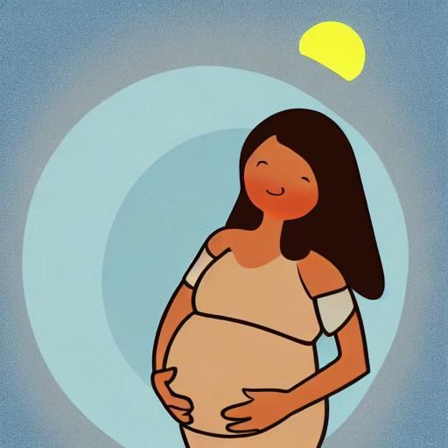
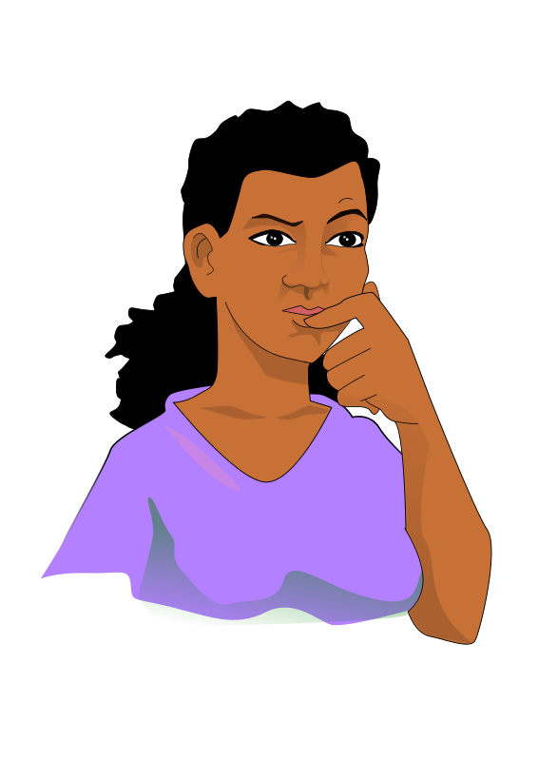


LUNA
Health for the whole family
How to use this app
Start learning

Slide 2
Te4423
4234
stText
Page 2

Slide 3
Luna
Health for the Whole Family
How to use this app
Start learning

