Slide 1
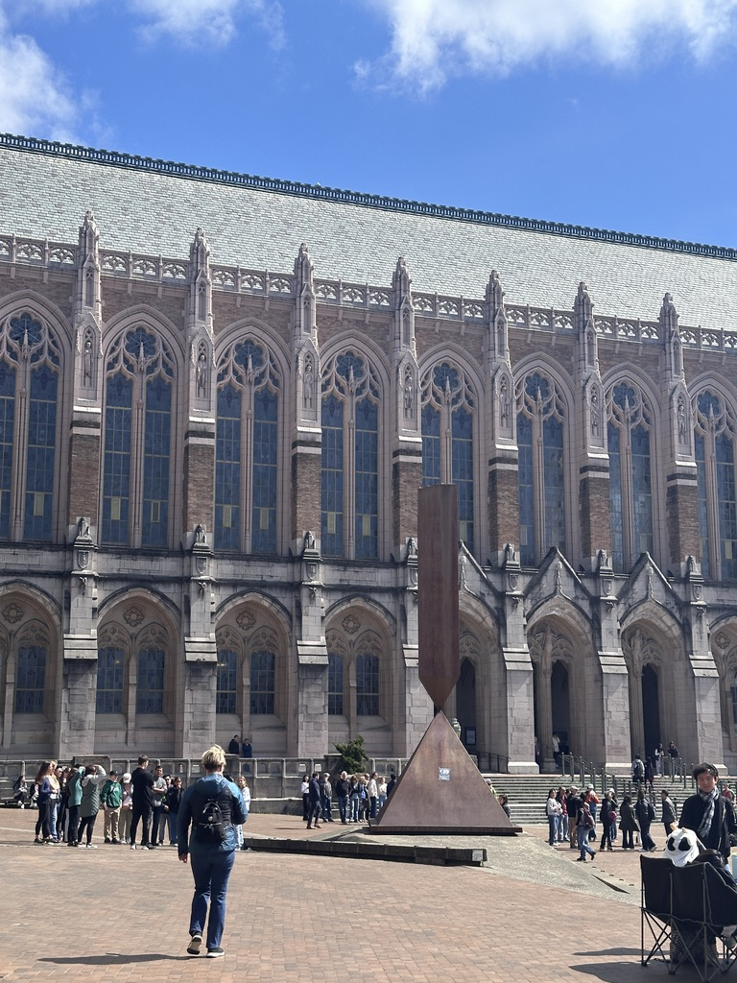
space sapce
line break
line break

