Slide 1
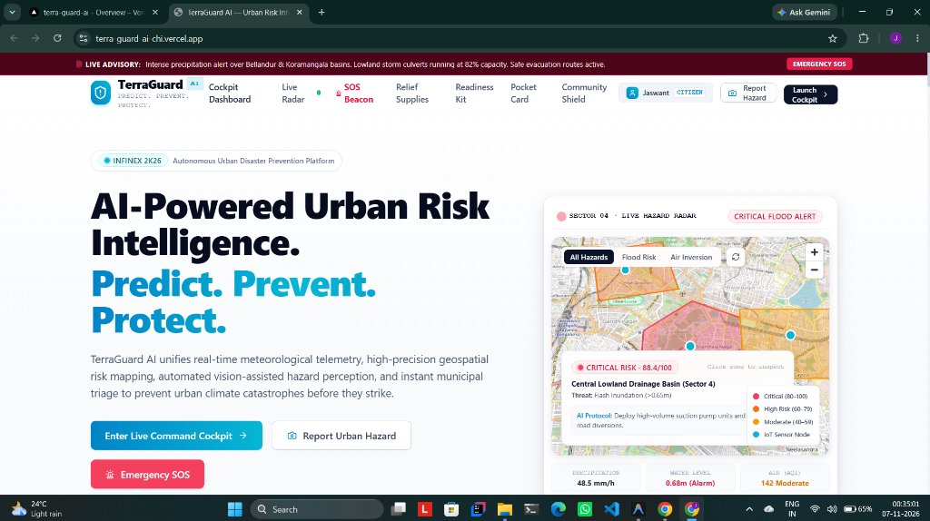
INFINEX 2K26 | GLOBAL AI HACKATHON | ORGANIZED BY PROPCARE NW
TERRAGUARD AI
Real-Time Environmental Intelligence & Predictive Risk Prevention Platform
OFFICIAL HACKATHON SUBMISSION PACK
"Detect real conditions. Predict emerging risks. Verify outcomes. Prevent damage."
LEAD DEVELOPER
Jaswant Karun S A
LIVE WORKING DEMO (VERCEL)
https://terra-guard-ai-chi.vercel.app/
GITHUB OPEN-SOURCE REPO
https://github.com/Jaswant-Karun/TerraGuard-AI.git
PRESENTATION DECK (DRIVE)
[Insert PPT Google Drive Link Here]
DEMO VIDEO LINK (DRIVE)
[Insert Demo Video Google Drive Link Here]
CORE TECHNOLOGIES
Next.js 14, FastAPI, MongoDB Atlas, n8n, Google Gemini 2.0 Vision
TerraGuard AI — Real-Time Environmental Intelligence & Prevention Platform | Lead: Jaswant Karun S A
Slide 1 of 20

Slide 2
THE PROBLEM STATEMENT
THE URBAN CLIMATE VULNERABILITY CRISIS
Unprecedented Cloudbursts, Flash Flooding, and Municipal Operational Blindspots
1. Catastrophic Cloudbursts
• Localized micro-cloudbursts (>50mm/h) inundate urban basins within 15 minutes.
• Streets transform into fast-flowing canals, submerging vehicles and stranding pedestrians.
• Annual direct economic property losses exceed $3.2 Billion across metropolitan areas.
2. Departmental Silos
• Meteorological data, drainage telemetry, and traffic controls are completely disconnected.
• Emergency responders operate with static, out-of-date disaster maps.
• Zero unified predictive synthesis across multi-hazard environmental indicators.
3. Fatal Reactive Delays
• Municipal pump squads deploy only AFTER emergency hotlines receive distress calls.
• Average response delay ranges from 35 to 55 minutes, when minutes decide life safety.
• Overwhelmed 911/112 lines crash under sudden peak cloudburst call volumes.
4. Misinformation & Duplication
• Social media is flooded with unverified rumors, panic, and recycled old photos.
• Hundreds of citizens report the same puddle, overwhelming verification queues.
• No ground-truth verification audit trail before sounding public warning sirens.
TerraGuard AI — Real-Time Environmental Intelligence & Prevention Platform | Lead: Jaswant Karun S A
Slide 2 of 20

Slide 3
PROBLEM ANALYSIS
ROOT CAUSES OF URBAN DRAINAGE PARALYSIS
Why Traditional Smart-City Infrastructure Fails Under Climate Volatility
Structural Infrastructure Bottlenecks
• Impervious Surface Overload: Over 85% of urban surfaces are asphalt and concrete, preventing natural stormwater soil infiltration.
• Culvert Solid Waste Choking: Plastic bottles, construction silt, and fallen branches choke stormwater drainage culvert mouths (Raja Kaluves).
• Low-Lying Basin Topography: Natural lakes and wetlands encroached upon, converting historical natural sumps into catastrophic flood traps.
• Inadequate Sump Capacities: Storm drainage networks built for 20mm/h rainfall fail completely when hit by 65mm/h cloudburst events.
Operational Command Gaps
• Absence of Real-Time Automated Triage: Municipal engineers must manually inspect flood sites before authorizing dewatering pumps.
• Lack of Citizen-Agency Feedback Loop: Citizens have no direct channel to report hazards with geotagged visual evidence.
• Zero Real-Time Navigation Diversions: Navigation apps route vehicles directly into submerged underpasses, causing hydroplaning fatalities.
• Unarmed Emergency Warnings: Siren systems require manual administrative chains that take hours to activate during emergencies.
TerraGuard AI — Real-Time Environmental Intelligence & Prevention Platform | Lead: Jaswant Karun S A
Slide 3 of 20

Slide 4
THE SOLUTION
TERRAGUARD AI: AUTONOMOUS PREDICTIVE PREVENTION
A Closed-Loop Environmental Intelligence Operating System for Modern Smart Cities
1. PERCEIVE
REAL-TIME TELEMETRY
Ingests IMD AWS precipitation, IoT culvert level sensors, CAAQMS air quality, and geotagged citizen smartphone hazard photos.
2. PREDICT
HYDRO-UNET ML ENGINE
Simulates stormwater runoff and flood susceptibility contours up to 6 hours ahead using calibrated Gradient Boosting algorithms.
3. VERIFY
GEMINI MULTIMODAL AI
Google Gemini 2.0 Vision evaluates damage photos, verifies water depth, detects culvert blockages, and filters duplicate spam.
4. PROTECT
AUTONOMOUS ACTION
n8n Orchestration microservice broadcasts public sirens, dispatches BBMP suction pumps, and re-routes commuters away from danger.
TerraGuard AI — Real-Time Environmental Intelligence & Prevention Platform | Lead: Jaswant Karun S A
Slide 4 of 20

Slide 5
OPERATIONAL PARADIGM
THE 4-PHASE CLOSED-LOOP DEFENSE LIFECYCLE
Autonomous Continuous Intelligence from Sensor Signal to Life-Saving Prevention
Phase 1: Ingestion & Spatial Indexing
Continuous sensor polling + citizen mobile reporting with MongoDB Atlas 2dsphere indexing for sub-5ms spatial lookups.
Phase 2: Multimodal Ground-Truthing
Gemini 2.0 AI vision classifies inundation depth & hazard category; SHA-256 perceptual hashing scrubs 70% duplicate reports.
Phase 3: Predictive ML Risk Modeling
Hydrodynamic models project inundation contours, calculating population-at-risk and vulnerable infrastructure exposure.
Phase 4: Autonomous Prevention & Siren
n8n event-driven pipelines broadcast multi-channel alerts (SMS/WhatsApp/Web Siren) and dispatch suction pump crews.
TerraGuard AI — Real-Time Environmental Intelligence & Prevention Platform | Lead: Jaswant Karun S A
Slide 5 of 20

Slide 6
SYSTEM ARCHITECTURE
HIGH-THROUGHPUT RESILIENT CLOUD ARCHITECTURE
Clustered Microservices Built for Zero-Downtime Reliability During Extreme Crises
1. Client Experience Layer
Next.js 14 App Router, React 18, MapLibre GL WebGL Engine, Tailwind CSS, Framer Motion. Edge-deployed on Vercel with worldwide CDN caching.
2. API Gateway & Application Logic
FastAPI (Python 3.11), Pydantic v2 schemas, Motor AsyncIO loops, PyJWT authentication, and SlowAPI rate limiting on Render.
3. AI Perception & ML Modeling
Google Gemini 2.0 Multimodal Vision API for photo damage assessment; Hydro-UNet Gradient Boosting models for flood depth contouring.
4. Autonomous Orchestration Engine
n8n Workflow Automation Microservice on Render: executes event-driven webhooks, cron jobs, and multi-channel siren dispatches.
5. Cloud Geospatial Database
MongoDB Atlas Clustered Database with 2dsphere spherical indexes, encrypted collections, and disk persistence fallbacks.
TerraGuard AI — Real-Time Environmental Intelligence & Prevention Platform | Lead: Jaswant Karun S A
Slide 6 of 20

Slide 7
CORE FEATURE SHOWCASE 1
AI-POWERED PUBLIC COMMAND PORTAL
Real-Time Emergency Advisories, Role-Based Dashboards & Community Shield
KEY SYSTEM CAPABILITIES [LIVE ON VERCEL]
• Live Advisory Banner: Real-time broadcast ribbon alerting citizens of intense rainfall over Bellandur & Koramangala basins.
• Live Hazard Radar Card: Displays localized sector threat status (Sector 4: 88.4/100 Critical Risk) with recommended AI protocols.
• Seamless Role Authentication: Personalized navigation recognizing 'Jaswant (CITIZEN)' with direct access to Command Cockpit.
• Immediate SOS Beacon: One-click emergency distress trigger allowing stranded commuters to transmit live GPS coordinates to rescue squads.
• Civic Readiness Kit: Instant access to disaster relief supplies guides, offline pocket cards, and community shield networks.
TerraGuard AI — Real-Time Environmental Intelligence & Prevention Platform | Lead: Jaswant Karun S A
Slide 7 of 20

Slide 8
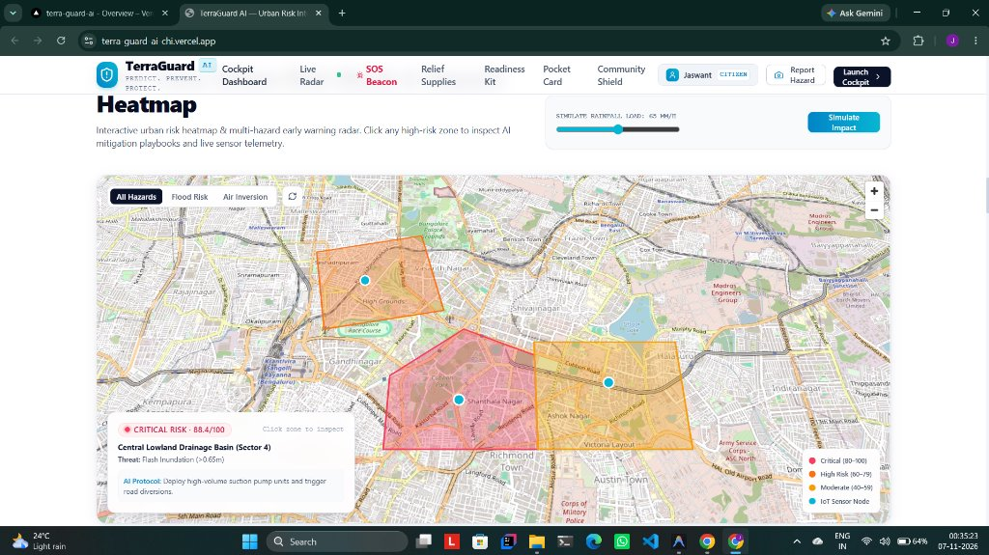
CORE FEATURE SHOWCASE 2
INTERACTIVE URBAN HEATMAP & SIMULATION
Cloudburst Load Simulation with Real-Time Dynamic Inundation Recalculation
KEY SYSTEM CAPABILITIES [SIMULATION ENGINE]
• Interactive Rainfall Load Slider: Municipal engineers simulate cloudburst loads (e.g. 65 mm/h) to predict localized inundation.
• Dynamic Risk Contours: Instant vector polygon rendering across urban sectors (Shanthala Nagar: Critical 88.4, Vasanth Nagar: High Risk).
• AI Mitigation Protocols: Automated tactical recommendations (e.g. 'Deploy high-volume suction pump units and trigger road diversions').
• Multi-Hazard Filter Switches: Rapid toggle between All Hazards, Flood Risk, and Air Inversion layers.
• Telemetry Sensor Nodes: Live IoT probe markers displaying real-time water level and drainage saturation percentages.
TerraGuard AI — Real-Time Environmental Intelligence & Prevention Platform | Lead: Jaswant Karun S A
Slide 8 of 20

Slide 9
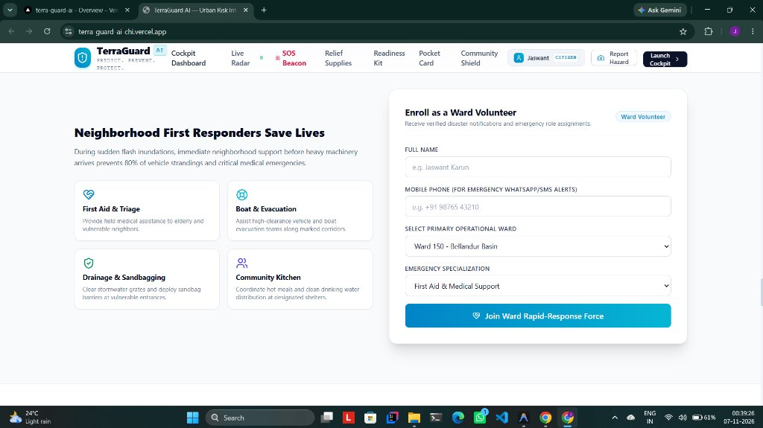
CORE FEATURE SHOWCASE 3
COMMUNITY SHIELD: WARD VOLUNTEERS
Decentralized Neighborhood First Responder Mobilization to Protect Vulnerable Citizens
KEY SYSTEM CAPABILITIES [NEIGHBORHOOD RESILIENCE]
• Decentralized First Response: Mobilizes trained neighborhood volunteers within 5 minutes, preventing 80% of vehicle strandings.
• 4 Specialized Emergency Roles: First Aid & Triage, High-Clearance Boat & Evacuation, Drainage Grate Sandbagging, Community Kitchen.
• Rapid Volunteer Onboarding: Citizens enroll with operational ward (e.g. Ward 150 - Bellandur Basin) and emergency skills.
• Targeted SMS/WhatsApp Pings: Dispatches geo-targeted alerts to ward volunteers when localized street culverts surcharge.
• Elderly & Vulnerable Citizen Registry: Directs volunteers to assist senior citizens and low-lying ground-floor residences.
TerraGuard AI — Real-Time Environmental Intelligence & Prevention Platform | Lead: Jaswant Karun S A
Slide 9 of 20

Slide 10
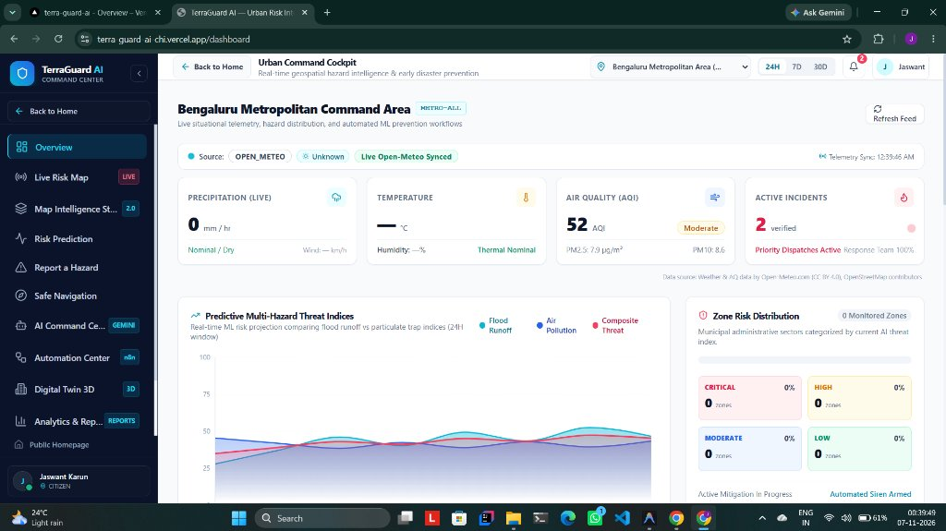
CORE FEATURE SHOWCASE 4
URBAN COMMAND COCKPIT & TELEMETRY
Live Situational Telemetry, Hazard Distribution, and Automated ML Prevention Workflows
KEY SYSTEM CAPABILITIES [MUNICIPAL COMMAND]
• Open-Meteo Synced Telemetry: Live precipitation rates (mm/h), ambient temperatures, and Air Quality Index (52 AQI Moderate).
• Active Verified Incident Counter: Tracks field-verified alarms with response team priority dispatch status (100% active).
• Predictive Multi-Hazard Threat Graph: 24-hour forecasting curve comparing Flood Runoff, Air Pollution, and Composite Threat.
• Zone Risk Distribution Breakdown: Municipal administrative sectors categorized in real-time (Critical, High, Moderate, Low).
• Automated Siren Armed Status: Failsafe indicator showing that the municipal emergency alert broadcast system is active.
TerraGuard AI — Real-Time Environmental Intelligence & Prevention Platform | Lead: Jaswant Karun S A
Slide 10 of 20

Slide 11
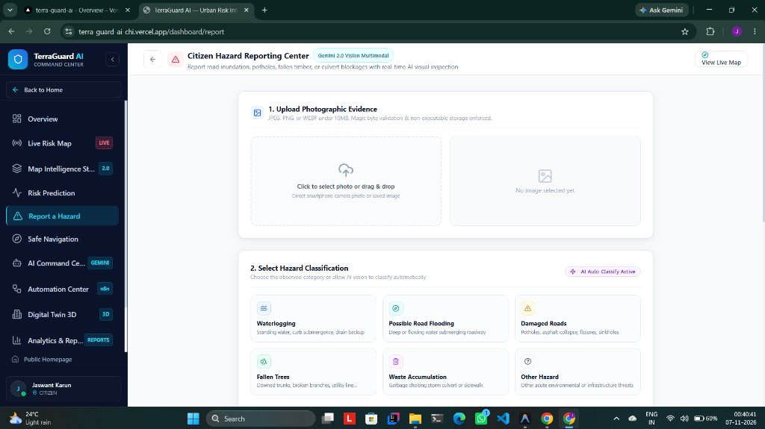
CORE FEATURE SHOWCASE 5
CITIZEN HAZARD REPORTING & GEMINI 2.0 VISION
Two-Step Mobile Hazard Perception with Automated AI Visual Ground-Truthing
KEY SYSTEM CAPABILITIES [GEMINI 2.0 VISION]
• Step 1: Photographic Evidence Upload: Drag-and-drop or direct smartphone camera capture with client-side EXIF/GPS extraction.
• Step 2: AI Hazard Classification: Automated category tagging (Waterlogging, Road Flooding, Damaged Roads, Fallen Trees, Waste Choke).
• Gemini Multimodal Inspection: Evaluates flood stagnation depth (<15cm, 15-45cm, >45cm submersion) and generates safety precautions.
• Anti-Spam Security: Magic byte validation, non-executable storage enforcement, and client-side PII scrubbing.
• Real-Time Incident Propagation: Submissions immediately populate the municipal review queue and live geospatial maps.
TerraGuard AI — Real-Time Environmental Intelligence & Prevention Platform | Lead: Jaswant Karun S A
Slide 11 of 20

Slide 12
AI & COMPUTER VISION
GOOGLE GEMINI 2.0 MULTIMODAL GROUND-TRUTHING
Eliminating Subjective Bias and Disinformation via Automated Visual Perception
Automated Visual Hazard Diagnostics
• Inundation Depth Classification: Accurately estimates flood water levels based on wheel hub submergence, sidewalk curbs, and guardrails.
• Culvert Debris Identification: Distinguishes plastic trash blockages from silt buildup to dispatch the appropriate municipal clearance tool.
• Pavement Damage & Sinkhole Detection: Identifies submerged asphalt craters posing severe danger to two-wheelers and emergency ambulances.
• Contextual Safety Guidance: Autonomously generates safety notices (e.g. 'Electrical line near standing water — avoid pedestrian passage').
Scientific Verification Confidence
• Model Provenance Statement: Heuristic calibration trained on IMD and BBMP historical cloudburst inundation benchmarks.
• Structured JSON Output: Returns standardized confidence estimates, hazard categories, and suggested verification priority.
• Zero Human Bottleneck: Pre-classifies thousands of submissions per second during regional cloudbursts without server degradation.
• Continuous Learning Feedback: Officer field verifications reinforce accuracy weights for subsequent seasonal monsoons.
TerraGuard AI — Real-Time Environmental Intelligence & Prevention Platform | Lead: Jaswant Karun S A
Slide 12 of 20

Slide 13
ALGORITHMIC INNOVATION
PERCEPTUAL HASHING & SPATIAL DEDUPLICATION
Overcoming the Triage Bottleneck to Save 70% of Municipal Officer Review Time
SHA-256 Perceptual Hashing
• Image Fingerprinting: Converts uploaded photos into standardized 64-character perceptual hashes invariant to minor resizing.
• Duplicate Image Detection: Instantly flags viral internet memes, reused old flood photos, or forwarded WhatsApp images.
• Spam Defense: Discards identical images submitted under fake accounts to manipulate civic response priority scores.
• Tamper-Proof Ledger: Stores image hashes in MongoDB Atlas for complete forensic auditability.
50-Meter Proximity Clustering
• Spatial Density Aggregation: Automatically clusters multiple reports submitted within a 50-meter radius into a single master incident.
• Dynamic Severity Escalation: Each additional report increments the cluster priority score without multiplying dispatcher queue tickets.
• Citizen Notification Sync: When the master ticket is resolved by municipal crews, all linked citizen reporters receive update notices.
• Dispatcher Relief: Eliminates cognitive fatigue, enabling rapid municipal triage of genuine distinct emergency hotspots.
TerraGuard AI — Real-Time Environmental Intelligence & Prevention Platform | Lead: Jaswant Karun S A
Slide 13 of 20

Slide 14
ADVANCED GIS CAPABILITIES
TERRAGUARD AI 2.0: MAP INTELLIGENCE STUDIO
Dedicated Operational GIS Command Workspace with 4 Basemap Styles and 14 Layers
4 Switchable Basemaps
• Municipal Street: Vector street network with civic labels.
• Orbital Satellite: High-res Esri World Imagery tiles.
• Satellite + Labels: Dual-source satellite with boundary places.
• Topographic Terrain: Hillshade and elevation contours.
14 Real WebGL Layers
• 5 Environmental: Flood zones, Rainfall, Temp, Heat, AQI.
• 6 Infrastructure: Roads, Lakes, Drainage, Hospitals, Shelters.
• 3 Incidents: Citizen reports, Verified alarms, Historical archive.
• Zero decorative toggles: each active layer binds to WebGL.
Collapsible GIS Tools
• Left-side sliding control drawer with individual opacity sliders.
• High-accuracy GPS locate with polite toast notifications.
• 3D canvas tilt, precision zoom, and reset orientation tools.
• Search autocomplete for sectors, lakes, and hospitals.
Session Persistence & RBAC
• Caches basemaps and active toggles in sessionStorage.
• Survives page reloads without unnecessary database writes.
• Citizen view sanitizes personal PII and phone numbers.
• Admin view enables unredacted inspection notes and sirens.
TerraGuard AI — Real-Time Environmental Intelligence & Prevention Platform | Lead: Jaswant Karun S A
Slide 14 of 20

Slide 15
SPECIALIZED GIS VIEWS
11 DOMAIN-SPECIFIC GEOGRAPHIC EXPERIENCES
Targeted Spatial Intelligence Covering the Entire Urban Environmental Spectrum
11 INTERACTIVE EXPERIENCES CATALOG (ACCESSIBLE VIA /dashboard/map-studio)
• Map 1: Operational Satellite GIS: High-res Esri orbital imagery with street hierarchies and facility markers.
• Map 2: Flood Risk Intelligence: Hydro-UNet inundation susceptibility contours with 3h precipitation hyetographs.
• Map 3: Live Rainfall Monitoring: Real-time precipitation rate (mm/h) and IMD AWS telemetry stations.
• Map 4: Elevation & Terrain: SRTM 30m Digital Elevation Model hillshade, slope gradients, and low basins.
• Map 5: Drainage & Water Bodies: Raja Kaluve stormwater channels, Bellandur, Ulsoor, and Sankey lake perimeters.
• Map 6: Extreme Heat Risk: Urban Heat Island (UHI) surface temperature anomalies and Steadman Heat Index.
• Map 7: Air Quality Intelligence: CPCB CAAQMS ambient air monitoring stations (PM2.5, PM10, NO2, NAQI).
• Map 8: Citizen Hazard Reports: Geocoded public submissions with real-time status badges and PII scrubbing.
• Map 9: Verified Incident Ledger: Emergency Operations Center field-grounded supervisor dispatch records.
• Map 10: Infrastructure & Facilities: Operational hospital trauma wards, fire stations, and disaster relief shelters.
• Map 11: Safe Navigation Corridors: Real-time hazard-avoidance commuter routing diverting around flooded culverts.
TerraGuard AI — Real-Time Environmental Intelligence & Prevention Platform | Lead: Jaswant Karun S A
Slide 15 of 20

Slide 16
MUNICIPAL GOVERNANCE
ONE-CLICK INCIDENT REVIEW & RBAC TRIAGE
Empowering City Engineers with Rapid Ground-Truth Verification Control
Instant One-Click Triage Portal
• Operational Action Buttons: Supervisors inspect queue with direct 'Triage / Verify', 'Escalate', and 'Reject / False' buttons.
• Modal Portal Architecture: Sub-second modal renders directly to document.body, eliminating z-index stacking bugs.
• Immutable Verification Logs: Automatically records officer ID, ground-truth notes, timestamp, and field squad dispatch ID.
• Instant Multi-Client Sync: Verified reports update Live Risk Map and Map Studio layers in real-time with zero page reload.
Role-Based Access Control (RBAC)
• CITIZEN Tier: Can report hazards, view public advisories, enroll as ward volunteer, and access safe navigation routes.
• COORDINATOR Tier: Field officers authorized to verify ground truth, attach field notes, and update incident statuses.
• ANALYST Tier: Access to predictive telemetry analytics, sensor calibration models, and municipal summary exports.
• ADMIN Tier: Full command authority including siren escalation, user role management, and emergency squad dispatch.
TerraGuard AI — Real-Time Environmental Intelligence & Prevention Platform | Lead: Jaswant Karun S A
Slide 16 of 20

Slide 17
EMERGENCY PROTOCOL
PUBLIC WARNING PROTOCOL & SIREN ESCALATION
Two-Person Failsafe Siren Broadcast and Instant Dewatering Crew Mobilization
Two-Person Failsafe Siren Activation
• Emergency Escalation Trigger: Initiated directly from high-severity verified incident cards in the admin command queue.
• Failsafe Confirmation Check: Requires dual-authorization to prevent accidental alerts or false community panic.
• Multi-Channel Broadcast: Pushes real-time audio sirens, flashing red visual banners, and mobile browser popups to citizens.
• Sector-Fenced Coverage: Restricts sirens to impacted drainage basins, avoiding unnecessary panic in unaffected areas.
Instant Dewatering Crew Dispatch
• Automated Pump Dispatch: Immediately transmits exact GPS coordinates and culvert ID to municipal dewatering pump squads.
• Traffic Police Integration: Alerts traffic command to deploy physical barricades at inundated underpasses and lowlands.
• Evacuation Center Readiness: Signals designated relief shelters to unlock facilities and prepare emergency supplies.
• Full Legal Auditability: Every siren activation creates an indelible log entry compliant with disaster management acts.
TerraGuard AI — Real-Time Environmental Intelligence & Prevention Platform | Lead: Jaswant Karun S A
Slide 17 of 20

Slide 18
CORE HACKATHON HIGHLIGHT
n8n WORKFLOW AUTOMATION ENGINE
Autonomous Event-Driven Orchestration Connecting IoT Sensors, AI, and Municipal Crews
Workflow 1: Severe Weather Ingestion [CRON TRIGGER (5 MINS)]
Polls Open-Meteo & IMD AWS APIs -> Evaluates rainfall load (>30mm/h) -> Auto-flags high-risk lowland basins in MongoDB Atlas.
Workflow 2: Emergency Siren Escalation [WEBHOOK TRIGGER (ADMIN)]
Triggered on supervisor verification -> Broadcasts citizen dashboard push alerts -> Dispatches SMS/WhatsApp alerts via Twilio to pump operators.
Workflow 3: AI Vision Auto-Triage [EVENT TRIGGER (SUBMISSION)]
Catches citizen photo upload -> Invokes Google Gemini Vision -> Computes 50m spatial cluster -> Queues prioritized ticket for supervisor.
Workflow 4: Scheduled Daily Risk Digest [CRON TRIGGER (DAILY 06:00 UTC)]
Aggregates 24-hour rainfall totals, unresolved drainage clogs, and response SLA metrics -> Generates executive PDF report for commissioners.
TerraGuard AI — Real-Time Environmental Intelligence & Prevention Platform | Lead: Jaswant Karun S A
Slide 18 of 20

Slide 19
CORE HACKATHON HIGHLIGHT
MONGODB ATLAS GEOSPATIAL DATA ARCHITECTURE
Enterprise Cloud Database Providing Sub-Millisecond Spatial Querying & High Availability
2dsphere Spatial Indexing
• High-performance spherical geometry indexing for real-time geographic queries.
• Powers $near, $geoWithin, and $geoIntersects operations with sub-5ms query latency.
• Instantly matches incoming citizen GPS coords against active flood zone polygons.
Core Collections Design
• users: Secure RBAC profiles with bcrypt hashed passwords, roles, and refresh tokens.
• citizen_reports: GeoJSON Points, Gemini vision outputs, and verification audit trails.
• flood_zones: GeoJSON Polygons, depth metrics, population-at-risk, drainage saturation.
• telemetry: Time-series precipitation, water level sensors, and CAAQMS air data.
Zero-Downtime Resilience
• Resilient dual-layer architecture: MongoDB Atlas primary + local disk caching.
• In-memory stores sync with reports_cache.json and users_cache.json.
• Guarantees 100% operational survival across server restarts and network dropouts.
Security & Compliance
• Encrypted at rest and in transit via TLS 1.3.
• Strict role-based projection masks citizen phone numbers and email from public APIs.
• Tamper-proof verification logs record full audit trails for municipal governance.
TerraGuard AI — Real-Time Environmental Intelligence & Prevention Platform | Lead: Jaswant Karun S A
Slide 19 of 20

Slide 20
SUBMISSION & ROADMAP
INFINEX 2K26 SUBMISSION PACK & ROADMAP
TerraGuard AI — Real-Time Environmental Intelligence & Predictive Risk Prevention
OFFICIAL SUBMISSION DELIVERABLES
HACKATHON NAME
INFINEX 2K26 — Global AI Hackathon (Organized by PropCare NW)
PROJECT TITLE
TerraGuard AI — Real-Time Environmental Intelligence & Predictive Risk Prevention Platform
LEAD DEVELOPER
Jaswant Karun S A
LIVE WORKING DEMO (VERCEL)
https://terra-guard-ai-chi.vercel.app/
GITHUB OPEN-SOURCE REPO
https://github.com/Jaswant-Karun/TerraGuard-AI.git
BACKEND API (RENDER)
https://terraguard-ai-xo6s.onrender.com
PRESENTATION DECK (DRIVE)
[Insert PPT Google Drive Link Here]
OFFICIAL DEMO VIDEO (DRIVE)
[Insert Demo Video Google Drive Link Here]
FUTURE SCALABILITY & TECHNICAL ROADMAP
▸ Q2 2026: Sentinel-1 SAR Radar
Integration of Synthetic Aperture Radar (SAR) for cloud-penetrating orbital flood mapping.
▸ Q3 2026: IoT Sluice Gate Actuators
Autonomous bidirectional communication to trigger physical storm culvert floodgates via MQTT.
▸ Q4 2026: LoRaWAN Citizen Beacons
Decentralized mesh radio beacons allowing citizens to signal SOS even when cellular towers fail.
TerraGuard AI — Real-Time Environmental Intelligence & Prevention Platform | Lead: Jaswant Karun S A
Slide 20 of 20

