Slide 1
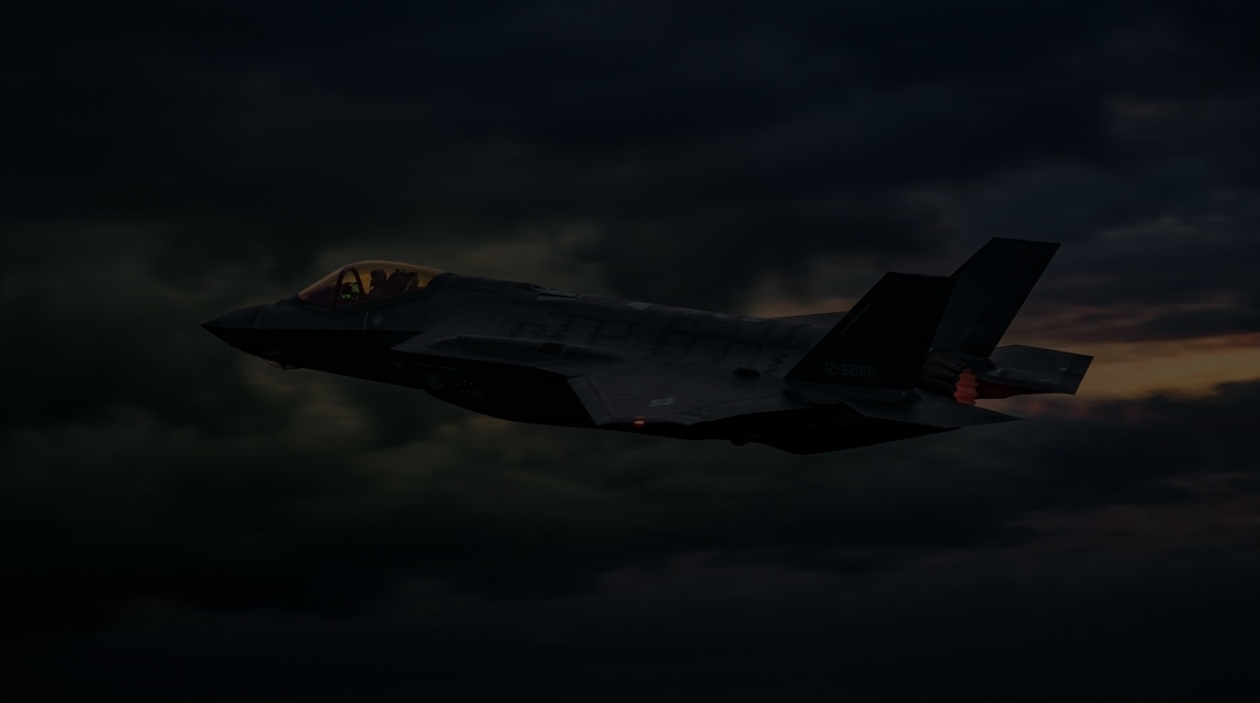
PROBLEM STATEMENT 05 • INTERNAL AGENTIC AI HACKATHON
◈
TRINETRA
Multimodal Intelligence Fusion System
“From Fragmented Information to Strategic Insight.”
Agentic AI Knowledge Graph Builder • Military-Grade Intelligence Fusion Platform

Slide 2
THE INFORMATION GAP
02 / 10
Fragmented information. Disconnected knowledge.
“Critical intelligence exists across scattered reports — but remains disconnected without automated fusion.”
01 // DIFFERENT NAMES
The same entity may appear under different names across isolated reports.
• Aliases & spelling variations
• Inconsistent call-signs
• Siloed records stay unlinked
02 // HIDDEN RELATIONSHIPS
Links and connections are difficult to discover across multi-source reports.
• Cross-document blind spots
• Disjointed unit affiliations
• Isolated observations hide threats
03 // MANUAL ANALYSIS
Cross-report review is time-consuming, manual, and operationally vulnerable.
• 80% time spent sorting memos
• High risk of missed contradictions
• Slow reaction to active developments
THE ROOT CAUSE CASCADE
SCATTERED REPORTS
DISCONNECTED NODES
FRAGMENTED INFORMATION
DISCONNECTED KNOWLEDGE

Slide 3
THE TRINETRA SOLUTION
03 / 10
From reports to connected, queryable insight
“TRINETRA converts multiple unstructured reports into one connected, queryable Knowledge Graph.”
01
MULTIPLE
REPORTS
PDF, DOCX, TXT
& raw imagery
02
DOCUMENT
PROCESSING
OCR & layout
segmentation
03
ENTITY & REL
EXTRACTION
Autonomous zero-
shot NER triples
04
ENTITY
RESOLUTION
Syntactic alias
clustering
05
INFORMATION
FUSION
Multi-source merge
& conflict check
06
KNOWLEDGE
GRAPH
Connected RDF
semantic network
07
NATURAL-LANG
QUERY
GraphRAG multi-
hop reasoning
08
ANSWER + SOURCE
EVIDENCE
Grounded answer
with citations
CONTINUOUS REASONING FLOW (ZERO HALLUCINATIONS)
Every extracted entity, relationship, and GraphRAG answer links directly to page-numbered source evidence. Contradictory reports are flagged autonomously for analyst confirmation.

Slide 4
HOW TRINETRA WORKS
04 / 10
Four steps to connect facts from reports
“Autonomous 4-stage pipeline that unifies multi-source intelligence reports into verified facts.”
01 //
ADD REPORTS
Upload several PDF reports.
Batch multi-format ingestion:
• Intelligence summaries
• Field patrol logs
• Signals intercepts & maps
02 //
FIND FACTS
Find people, groups, events,
equipment, places and links.
Autonomous NER extraction:
• Zero-shot entity recognition
• Spatio-temporal anchoring
• Subject-Predicate-Object triples
03 //
MATCH NAMES
Vehicle 1 / Equipment 1 /
Team A / Event 1 → Match
Entity Resolution Engine:
• Surface alias clustering
• Phonetic & semantic matching
• Cross-source entity linking
04 //
COMBINE
Combine matching facts and
keep links to their sources.
Knowledge Fusion & Provenance:
• Merges into unified node
• Flags contradictory dates/coords
• 100% verifiable page citations
TACTICAL EXECUTION PRINCIPLE:
TRINETRA automates the entire ingestion-to-graph pipeline in seconds, eliminating manual correlation bottlenecks.

Slide 5
FROM TEXT TO CONNECTED KNOWLEDGE
05 / 10
Entities become a source-grounded graph
SEMANTIC FOUNDATION: [ ENTITY ] ──────▶ ( RELATIONSHIP ) ──────▶ [ ENTITY ]
SYNTHESIZED KNOWLEDGE GRAPH VISUALIZATION
SOURCE-GROUNDED TRACEABILITY
▸ Connected Through Evidence
Every relationship in the graph is strictly supported by source documents. No speculative links.
▸ Provenance Preservation
Each edge stores document ID, page number, and source sentence offset for instant analyst verification.
▸ Multi-Hop Reasoning
GraphRAG traces 2-hop and 3-hop connections that analysts cannot spot across multiple distinct PDFs.
▸ Discrepancy Auditing
If Report 01 and Report 03 report conflicting coordinates, a discrepancy badge is flagged autonomously.
Enemy Vehicle A
[EQUIPMENT]
EQUIPPED WITH
Weapon X
[WEAPONRY]
associated with
Unit Alpha
[ORGANIZATION]
MENTIONED IN
Incident Y
[EVENT]
✓ Operational Discovery: Autonomous link established between Weapon X and Incident Y via common node Enemy Vehicle A.

Slide 6
AGENTIC AI WORKFLOW
06 / 10
Specialized agents collaborate across the evidence chain
“Specialized agents transform unstructured reports into structured, connected knowledge.”
01
DOCUMENT
AGENT
Ingests PDF, DOCX,
TXT & map imagery
02
EXTRACTION
AGENT
Zero-shot entity
& triple recognition
03
ENTITY RES
AGENT
Harmonizes aliases
& clusters duplicates
04
KNOWLEDGE
FUSION AGENT
Constructs graph &
audits discrepancies
05
KNOWLEDGE
GRAPH
Decentralized RDF
network topology
06
QUERY
AGENT
GraphRAG multi-hop
reasoning engine
OUT
ANSWER +
EVIDENCE
Grounded answer with
source citations
DECENTRALIZED AGENTIC COLLABORATION PRINCIPLE
Specialized autonomous agents communicate through explicit semantic protocols. Each agent executes a deterministic intelligence task, ensuring 100% auditability and eliminating single points of failure.

Slide 7
FICTIONAL / SYNTHETIC DEMO DATA · TRINETRA IN ACTION
07 / 10
Three reports, one connected view
FICTIONAL / SYNTHETIC DEMO DATA • NO REAL MILITARY LOCATIONS, UNITS OR TARGETING
REPORT 01 (PATROL LOG)
Enemy Vehicle A equipped with Weapon X
📄 Source: Sector Bravo Recon Brief
• Entity: Enemy Vehicle A
• Mount: Weapon X armament
REPORT 02 (SIGNALS INTERCEPT)
Enemy Vehicle A linked to Unit Alpha
📄 Source: Communications Intercept 09
• Entity: Enemy Vehicle A
• Affiliation: Unit Alpha command
REPORT 03 (SURVEILLANCE)
Unit Alpha mentioned in Incident Y
📄 Source: Perimeter Camera Log 14
• Entity: Unit Alpha
• Context: Active at Incident Y
TRINETRA FUSED INTELLIGENCE SYNTHESIS
Unified Knowledge Trajectory:
Vehicle A ──▶ Weapon X • Unit Alpha • Incident Y
• Operational Insight: Automated fusion reveals that Weapon X is linked to Incident Y through common entity Enemy Vehicle A.
• Note: Fictional vehicle and aircraft silhouettes remain secondary to the verifiable evidence graph.

Slide 8
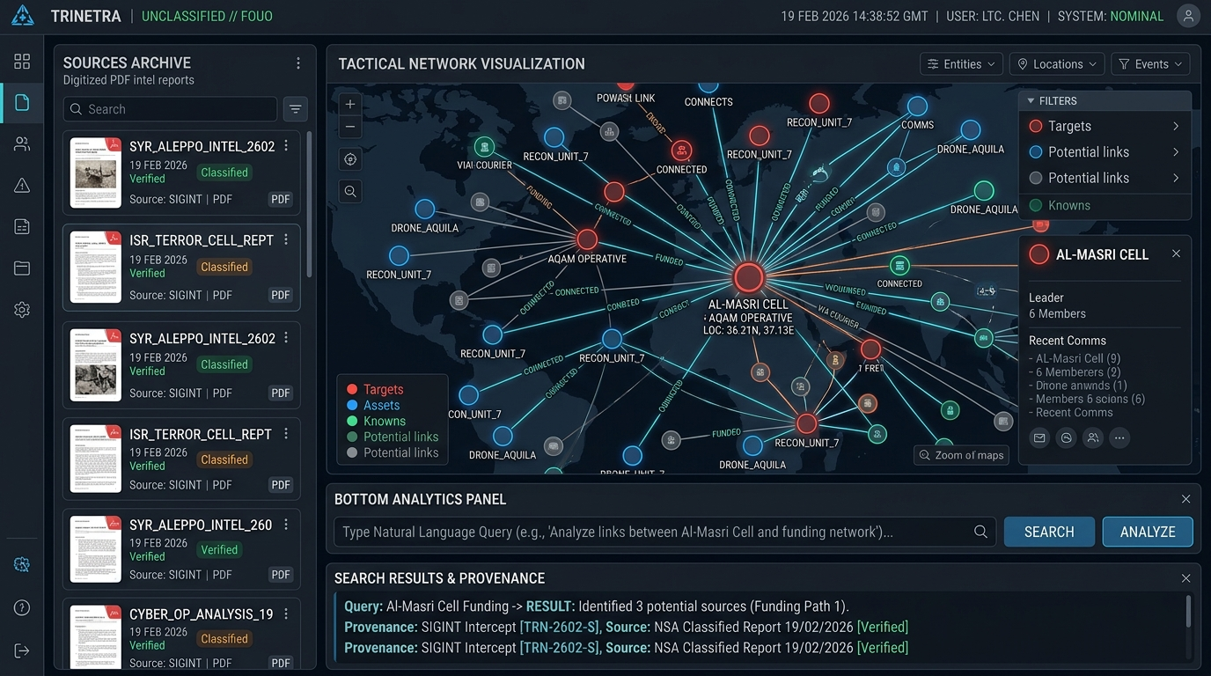
SIMPLE USER EXPERIENCE
08 / 10
One workspace for the analyst
01 — DASHBOARD
Knowledge Graph + Key Statistics
Processing status, entity / relationship counts, and autonomous conflict indicator at a glance.
02 — SOURCES
Upload & Manage Multiple Reports
Drag-and-drop ingestion of multiple PDF reports with interactive split-view text inspector.
03 — ASK TRINETRA
Source-Grounded Natural Language QA
Ask tactical questions and receive answers strictly supported by source citations and page numbers.
FICTIONAL / SYNTHETIC UI MOCKUP • PS-05 ANALYST CONSOLE

Slide 9
FICTIONAL / SYNTHETIC DEMO DATA
09 / 10
LIVE DEMO — END TO END
1. UPLOAD
2. PROCESS
3. EXTRACT
4. RESOLVE
5. FUSE
6. GRAPH
7. ASK
8. ANSWER
EXAMPLE ANALYST QUERY:
“What information is available about Enemy Vehicle A?”
TRINETRA SYNTHESIS & AUDIT RESULT [VERIFIED FICTIONAL EVIDENCE]
• Expected Result: Combined multi-source information, related entities, and supporting report/page references.
• Related Entities: Weapon X (Equipment) • Unit Alpha (Organizations) • Incident Y (Events)
• Evidence Citations:
- Fictional Report 01, p. 2: 'Enemy Vehicle A observed with Weapon X mounts.'
- Fictional Report 03, p. 1: 'Unit Alpha presence confirmed at Incident Y.'
• Guardrail Enforcement: Unsupported query ──▶ INSUFFICIENT SOURCE EVIDENCE (Zero Hallucinations Guarantee)

Slide 10

TRINETRA
THANK YOU
“From Fragmented Information to Strategic Insight.”
JAI HIND 🇮🇳
Connect
Fuse
Discover
Query

