Slide 1

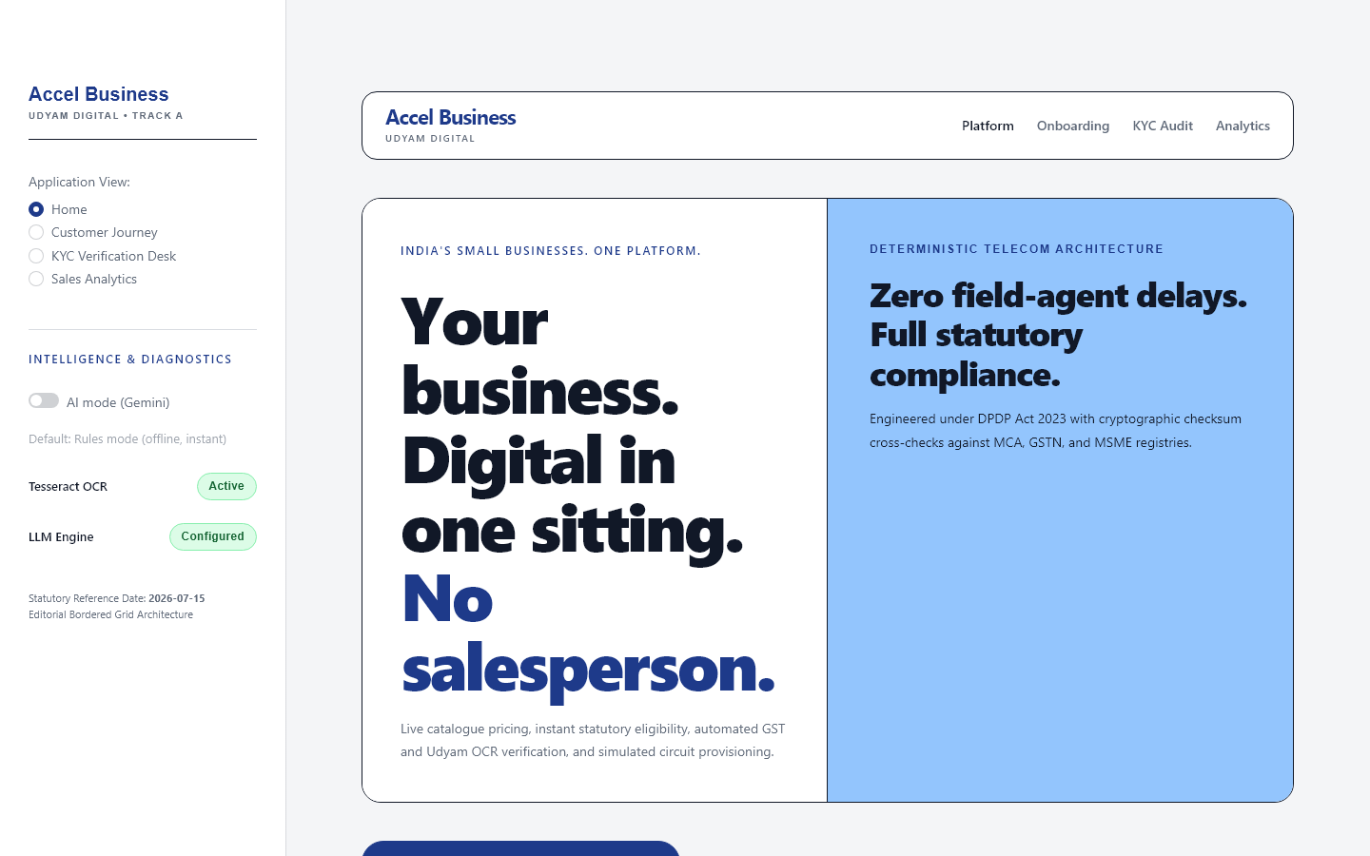
YTL HACKATHON 2026 · ENTERPRISE TRACK A · ACCEL BUSINESS
Udyam Digital: Making small businesses go digital in one sitting.
Autonomous MSME onboarding & service assembly platform for Indian small businesses.
THE BUSINESS CHALLENGE
India's 63M+ MSMEs face a fragmented, slow, multi-vendor onboarding barrier—averaging 17.6 days and 3 status-chase calls per customer across disconnected sales visits and paper KYC.
THE PROPOSED SOLUTION
A unified, rules-first digital journey that discovers needs in vernacular languages, generates instant binding quotes, verifies KYC in-memory, and provides transparent order tracking—all in under 15 minutes.
TARGET CUSTOMER & VALUE PROPOSITION
• Target Audience: Indian MSMEs (micro-retail, kiranas, CA offices, clinics, multi-site branches).
• Core Proposition: Discover, configure, verify, and track business telecom & digital services through one continuous digital sitting—eliminating sales pitches, quotation lag, and paper friction.
LIVE WORKING STREAMLIT PROTOTYPE
Interactive 4-stage onboarding: Advisor → Quote → Smart KYC → Live Tracking. Fully operational offline rules engine with 89 automated tests passing.
15-MIN ONBOARDING
ZERO PAPERWORK
RULES-DRIVEN PRICING
DPDP 2023 ALIGNED

Slide 2
01 · THE PROBLEM & CONVERSION FUNNEL
India's small businesses lose customers between recommendation and activation.
Evidence from case-study synthetic dataset (smb_leads.csv, N=5,000 leads, Apr–Jun 2026). Figures illustrate operational leakage.
1. Total Leads
5,000
100% of stage
Inbound leads
2. Contacted
3,406
68.1% of stage
Initial contact
3. Needs Assessed
1,974
58.0% of stage
Needs captured
4. Quote Accepted
861
43.6% of stage
STEEPEST DROP (-56%)
5. KYC Completed
588
68.3% of stage
Document checks
6. Activated
368
7.4% of stage
Final active SMBs
CRITICAL BOTTLENECK: 56.4% of qualified leads (1,113 businesses) abandon during the 3–5 day delay for manual PDF quotation with opaque product codes. Another 273 qualified quotes drop out during paper-heavy KYC.
7.4% CONVERSION
Overall Lead-to-Activation
Only 368 of 5,000 leads activate. 92.6% leakage occurs across disconnected sales visits and offline paperwork.
17.6 DAYS LAG
Lead-to-Activation Cycle
Average 17.6 days from contact to activation; causes 3 status-chase calls per customer to call centers.
₹15,000 CAC
Cost per Activated SMB
Multiple field visits and manual paperwork create high CAC, unviable for micro-SMBs paying ₹2,500/month.
9.6% vs 2.0%
GSTIN Activation Disparity
Leads with verifiable GSTIN convert 4.8× higher due to structured verification vs informal unverified shops.

Slide 3
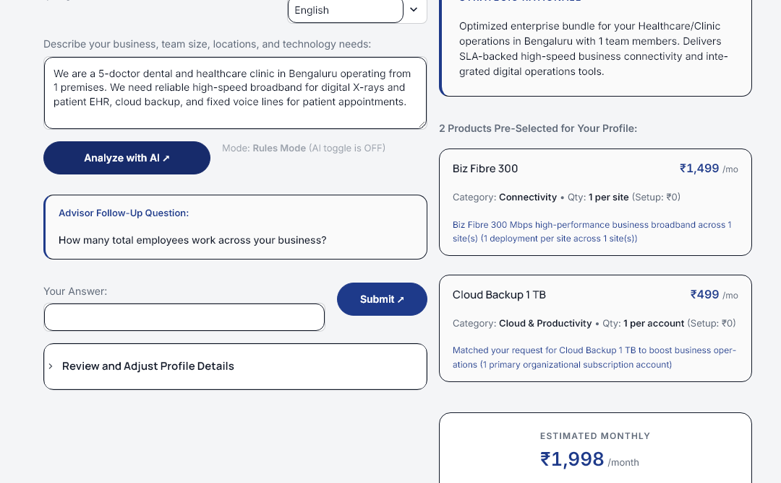
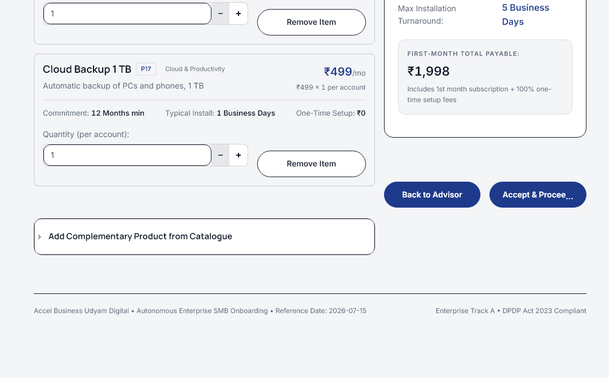
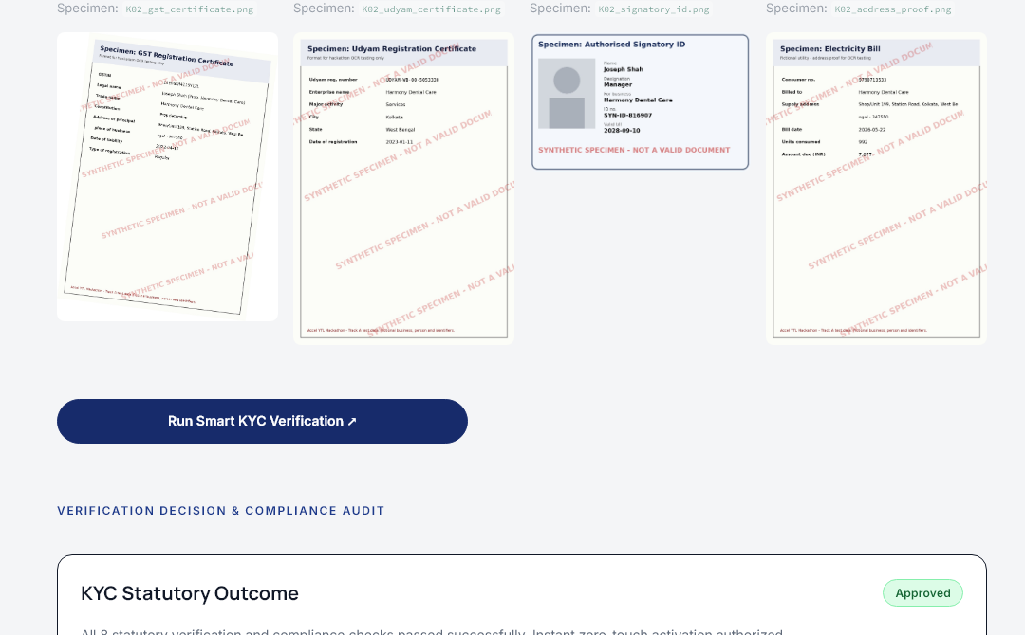
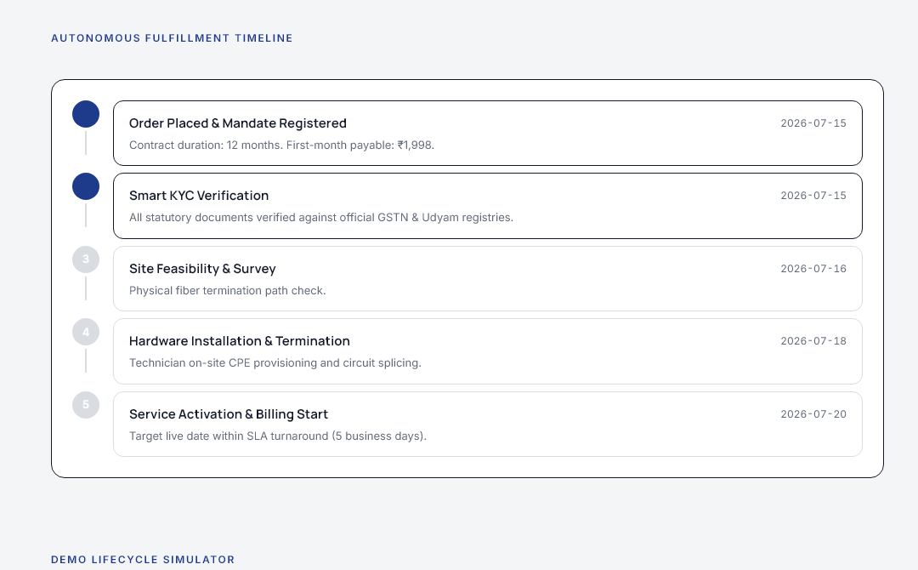
02 · THE SOLUTION & WORKING PROTOTYPE
One digital journey replaces a fragmented onboarding process.
Live Streamlit prototype combines discovery, dynamic quoting, smart KYC, and order tracking in one sitting.
TRADITIONAL: Sales visit (3–5d) → Manual quote (2–4d) → Paper KYC (3–5d) → 3× Status calls → 17.6d Activation
UDYAM DIGITAL: Digital Advisor (3 min) → Instant Quote (1 min) → Digital Smart KYC (3 min) → Order Tracker (<7d Activation)
1. ADVISOR
2. DYNAMIC QUOTE
3. SMART KYC
4. ORDER TRACKER
Multilingual Needs Discovery
• Natural conversation in EN, HI, TA
• Sizing & operational inputs
• Deterministic bundle recommendation
• Replaces sales pitching
Transparent Single Bill
• Instant eligibility across 25 products
• Interactive add-ons & setup fees
• Fixed contract terms up front
• Replaces 3-5 day PDF quotes
In-Memory Document Checks
• Mandatory DPDP consent screen
• Local Tesseract OCR (zero cloud upload)
• GSTIN checksum & mock registry checks
• Replaces paper document courier
Self-Serve Transparency
• 5-stage provisioning timeline
• Dynamic expected activation dates
• Live status reduces call-center chases
• Replaces 3 status calls/customer

Slide 4
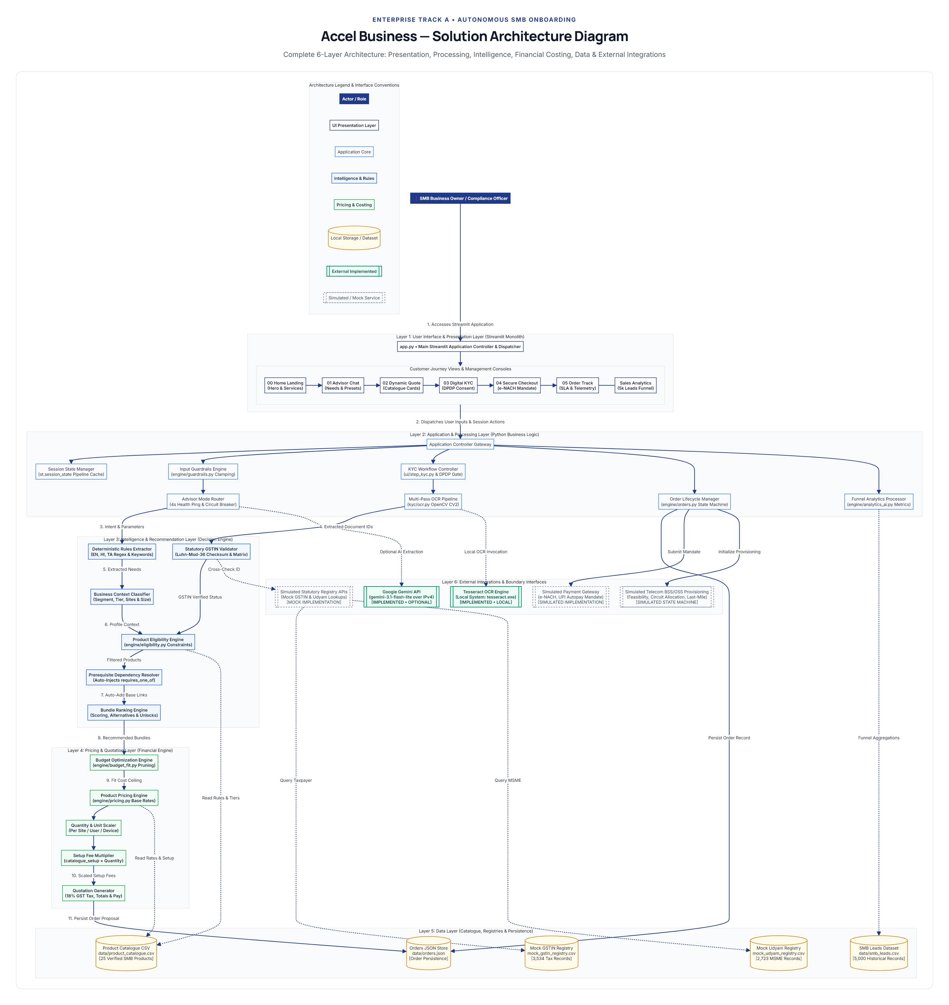
03 · SOLUTION ARCHITECTURE & TECHNICAL DIFFERENTIATION
Rules decide. AI assists. The application remains functional offline.
Modular Python monolith with a deterministic core, local OCR, optional Gemini LLM, and in-memory verification.
1. RULES-FIRST DECISION ARCHITECTURE
Eligibility, product dependencies, bundle ranking, and pricing are strictly controlled by deterministic Python business rules (engine/rules.py) over product_catalogue.csv (25 products). Zero LLM hallucinations of unfulfillable bundles, incorrect pricing, or invalid SLAs.
CORE DIFFERENTIATOR
2. HYBRID AI & RESILIENT OFFLINE FALLBACK
Google Gemini API optionally assists conversational extraction (sidebar toggle default OFF). Operates over forced IPv4 (0.0.0.0), 10s strict timeout, 0 retries. If unavailable, the platform seamlessly falls back to offline multilingual regex/rule extraction with zero UI interruption.
RELIABILITY
3. INTEGRATED CUSTOMER JOURNEY MONOLITH
Recommendation, quoting, KYC, and order tracking run in one continuous Streamlit session state machine. Replaces fragmented enterprise CRMs, quoting portals, and paper couriers with a unified, self-serve or partner-assisted digital experience.
VELOCITY
SYSTEM BOUNDARIES & VERIFIED IMPLEMENTATION STATUS
• SIMULATED: GSTN/Udyam registries (mock CSVs + Luhn-mod-36 checksums), e-NACH mandate, telecom BSS.
• IMPLEMENTED: Localhost Tesseract OCR, in-memory OpenCV decoding, JSON order persistence, 89 test suites.
Verified System Architecture: Streamlit Presentation → Deterministic Engine → Local Tesseract OCR → Optional Gemini IPv4 Transport → Order Persistence.

Slide 5
04 · DATA PRIVACY, SECURITY & DPDP COMPLIANCE
Trust is designed into the onboarding journey.
Architectural alignment with DPDP Act, 2023 & draft DPDP Rules, 2025. (Internal technical evaluation; not formal legal certification).
1. PRIVACY BY DESIGN & PURPOSE LIMITATION
IMPLEMENTED
2. SENSITIVE DATA & LOCAL OCR PROCESSING
IMPLEMENTED
• Affirmative Statutory Consent: Mandatory consent gate before document submission; details purpose, data categories, and 30-day unactivated purge policy.
• Strict Purpose Limitation: Data collected solely for Customer Due Diligence (CDD) under DoT guidelines; zero secondary marketing processing.
• Designated Grievance Redressal: Statutory notice displays designated Grievance Officer contact (grievance-officer@accelbusiness.in).
• In-Memory Document Decode: Uploaded KYC files decoded via OpenCV (np.frombuffer → cv2.imdecode); documents are never written to disk or temp files.
• Localhost Tesseract Execution: Character extraction runs entirely on localhost binary; zero document bytes or biometrics sent to cloud vision APIs.
• UI & Audit Token Masking: mask_identifier() masks GSTIN, Udyam, and Aadhaar numbers to terminal 4 digits across all logs, views, and order states.
3. APPLICATION SECURITY & GUARDRAILS
IMPLEMENTED
4. EXTERNAL BOUNDARIES & PLANNED ROADMAP
SIMULATED | PLANNED
• Input Clamping (engine/guardrails.py): Strict bounds (employees 1–10k, sites 1–500, budget ≤ ₹10L) prevent buffer overflow and UI crashes.
• File Upload Hardening: MIME-type whitelisting (.png, .jpg, .jpeg), 10MB limits, empty-file blocks, and byte-level OpenCV header verification.
• Secret Hygiene & Telemetry Quarantine: Secrets isolated in .env and quarantined in .gitignore; Streamlit usage telemetry disabled (gatherUsageStats = false).
• Gemini Data Boundary [IMPLEMENTED]: Transmits plain requirement text only over IPv4; zero documents, PII, or credentials sent to LLM.
• Encryption at Rest [PLANNED]: data/orders.json currently stores plaintext JSON; field-level AES-256 encryption planned for production persistence.
• RBAC & Gateways [PLANNED]: Role-based access control between subscriber and compliance audit desk; live GSTN/NPCI gateway integrations planned.

Slide 6
05 · COMMERCIAL MODEL & UNIT ECONOMICS
Lower acquisition friction. One bill. Recurring business value.
Standardized bundles capture high-volume MSME segments while digital onboarding cuts acquisition cost by 40%.
STARTER BUNDLE — ₹2,500 / month
MICRO RETAIL & SERVICES (55% OF MSME BASE)
• Kiranas, salons, standalone pharmacies, retail counters
• Broadband for UPI/POS reliability + Business SIM
• WhatsApp business channel + SMS updates
• Single bill, one support helpline, modular toggleable add-ons
• Replaces fragmented consumer SIMs and domestic broadband
ACQUISITION COST OPPORTUNITY: 40% CAC REDUCTION
Current Baseline CAC: ₹15,000 / active SMB → Target Digital CAC: ≤ ₹9,000 (40% saving)
REVENUE-BASED ACQUISITION PAYBACK (GROSS REVENUE BEFORE OPERATING MARGIN)
Bundle | Monthly Price | Current CAC (₹15k) | Target CAC (₹9k) | Payback Speedup
Starter | ₹2,500 / mo | 6.0 Months | 3.6 Months | 40% Faster
Office | ₹6,900 / mo | 2.2 Months | 1.3 Months | 41% Faster
OFFICE BUNDLE — ₹6,900 / month
PROFESSIONAL OFFICES (25% OF MSME BASE)
• CA firms, diagnostic clinics, coaching centres, agencies
• High-uptime enterprise broadband with guaranteed SLA
• Cloud corporate email & secure team storage
• Basic cybersecurity endpoint protection
• Consolidated monthly corporate invoice & dedicated account support
HOW DIGITAL ONBOARDING CUTS OPERATIONAL FRICTION
• Eliminates Manual Quotation: Instant eligibility and pricing remove the 3–5 day sales drafting bottleneck.
• Removes Physical KYC Couriers: In-memory OCR and automated checks avoid repeated document pickups.
• Shifts Field Force to High-Value Deals: Self-serve covers micro-retail and CA offices, letting sales teams focus on multi-site enterprises and manufacturing clients.
Prices indicative based on product_catalogue.csv; deterministic rules set final price & contract.

Slide 7
06 · EXECUTION ROADMAP, KPIS & THE ASK
A measurable three-month pilot can validate the model.
Clear performance milestones, 3-phase commercial scaling, and an actionable pilot proposal for judging approval.
Performance Metric | Current Baseline (Synthetic Case) | Target (Proposed Pilot) | Strategic Commercial Impact
Lead-to-Activation Conversion | 7.4% (368 / 5,000) | 12.0% | +62% conversion via instant quotes and zero paperwork
Activation Lead Time | 17.6 Days | ≤ 7.0 Days | 60% cycle compression from in-memory digital KYC pre-checks
Status-Chase Calls / Customer | 3.0 Calls | ≤ 1.0 Call | Live order tracking eliminates inbound status call overhead
Acquisition Cost (CAC) | ₹15,000 / active SMB | ≤ ₹9,000 | 40% CAC reduction through self-serve & partner onboarding
Six-Month Churn Rate | Q2 Cohort Baseline | ≤ Baseline | Single bill transparency and upfront SLA protect retention
PHASED 12-MONTH COMMERCIAL ROLLOUT
• Phase 1: Pilot (0–3 Months): Two Tier-1 cities, Micro-retail & Office segments. Shadow advisor with field sales to establish live conversion baseline.
• Phase 2: Scale (3–6 Months): Expand to Tier-2 cities, launch local partner-assisted onboarding, and integrate live GSTN/MCA GSP API gateways.
• Phase 3: Expand (6–12 Months): Multi-site retail chains, manufacturing IoT tiers, WhatsApp bot onboarding, and automated predictive provisioning.
THE ASK: APPROVE A THREE-MONTH, TWO-CITY PILOT
✓ 1. Validate Advisor with Live SMBs: Run 500 live MSME interactions across two test cities to tune multilingual intent recognition.
✓ 2. Establish Verified Baseline: Measure empirical conversion, KYC completion, and 6-month retention against traditional manual channels.
✓ 3. Onboard 20 Pilot Partners: Equip local IT dealers and kirana aggregators with the partner-assisted mobile onboarding flow.
Repository: https://github.com/Jaswant2406/accell-business | Status: 89 Tests Passed (100%)

