Slide 1
Lending Club Case Study
Submitted By:
Group Facilitator – Sareddy Jaswanth Reddy
Group Member – Sareddy Jaswanth Reddy

Slide 2
Objective of the Case Study
Understanding of risk analytics in Banking and Financial services.
Understand how data is used to minimize the risk of losing money while lending loans to customers.
Identification of Loan applicants that tend to ‘default’ for paying loans.

Slide 3
CASE STUDY DETAILS
Lending Club is a Consumer Finance Company which facilitates loans to Customers like Personal Loans, Business Loans , Financial Loans and so on.
For the EDA analysis Lending Club case study is taken where in order to solve, following need to be considered.
Business Understanding
Risks
Decision
2. Business Objective

Slide 4
Business Understanding- Risks
Two types of risks are associated with the bank’s decision:
If the applicant is likely to repay the loan, then not approving the loan results in a loss of business to the company.
If the applicant is not likely to repay the loan, i.e. he/she is likely to default, then approving the loan may lead to a financial loss for the company

Slide 5
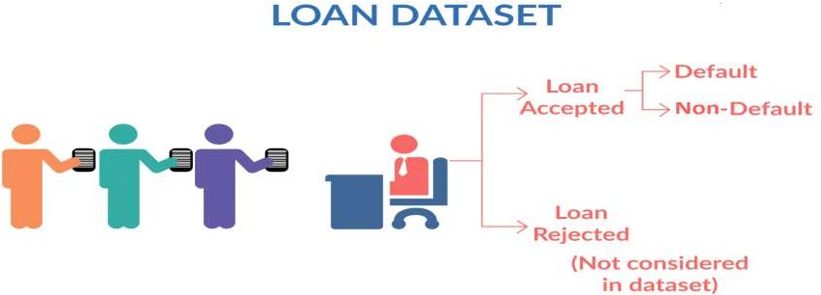
Business Understanding- Decision
When the company receives a loan application, the company has to make a decision for loan approval based on the applicant’s profile.
Loan Accepted
Loan Rejected

Slide 6
Business Objective
Lending loans to ‘risky’ applicants is the largest source of financial loss (called credit loss).
If one is able to identify these risky loan applicants, then such loans can be reduced thereby cutting down the amount of credit loss. Identification of such applicants using EDA is the aim of this case study.
To understand the driving factors/variables behind loan default.

Slide 7
Dataset Analysis Approach
Analysis of two individual columns and there correlation
Insights and Observations
Data Cleaning
Univariate & Segmented Analysis
Bivariate Analysis
Summary
Fix Rows & Columns
Fix Missing values
Standardize values
Fix Invalid values
Filtering Data
Analysis of individual columns separately
Check distribution of each columns
Analysis of grouped categories.

Slide 8
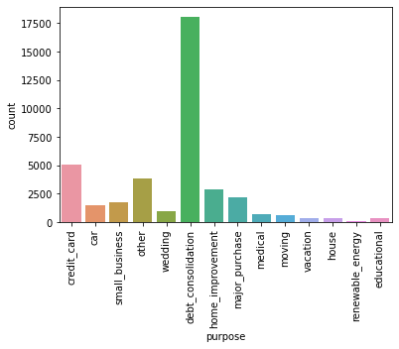
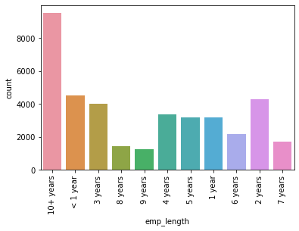
Analysis
Most of the Loans are taken for Debt Consolidation purpose.
Less Loans are taken for Renewable Energy.
Most of the Loans are held by 10+ years of job experience applicants.
Less Loans are held by 9 years of job experience applicants.

Slide 9
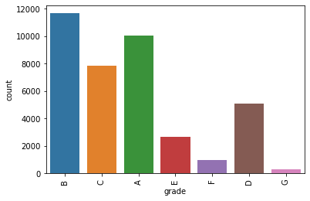
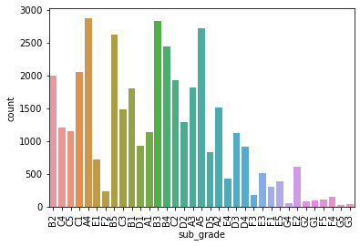
Analysis
Most of the Loans are held by B grade applicants.
Less Loans are held by G grade applicants.
Most of the Loans are held by A4 sub grade applicants.
Less Loans are held by G5 sub grade applicants.

Slide 10
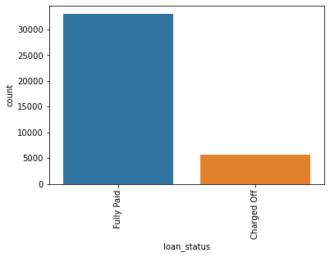
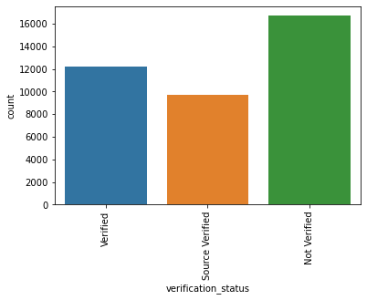
Analysis
Most of the Loans are paid by borrowers.
Few borrowers have skipped paying loans.
Most of the Borrowers Income was not verified by LC.

Slide 11
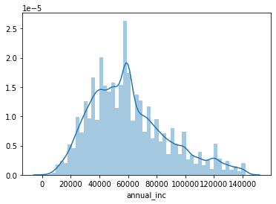
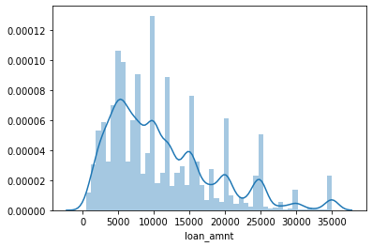
Analysis
Most of the Borrowers annual income lies around 60,000.
Most of the Borrowers loan amount lies between 4000 to 6000 range.

Slide 12
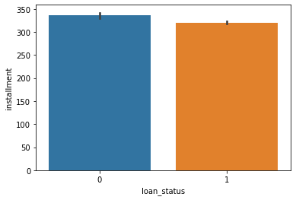
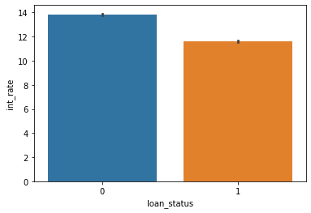
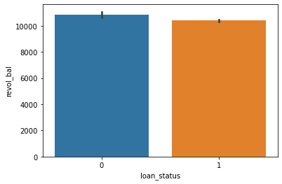
Analysis
More number of installments leads to high chance of loan default
More number of interest rate leads to high chance of loan default
More number of revoling balance leads to high chance of loan default

Slide 13
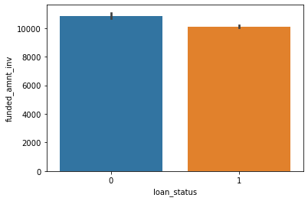
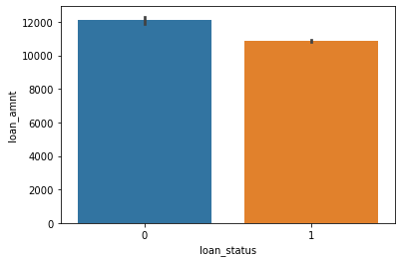
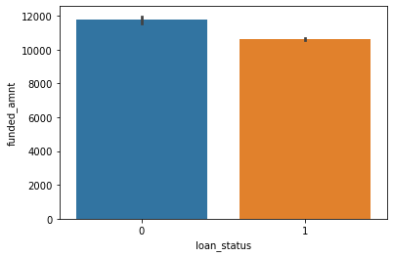
Analysis
Funded amount, Funded amount invested, Loan amount are correlated to each other and they are negatively correlated to loan status . Due to which as more the amount then more chance of loan defaults.

Slide 14
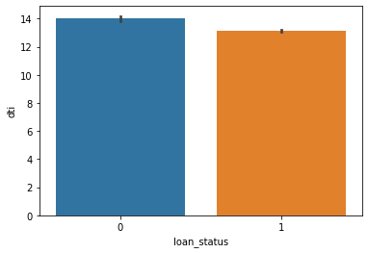
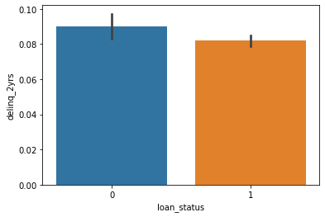
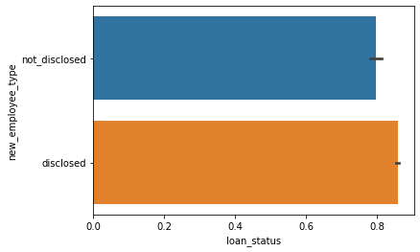
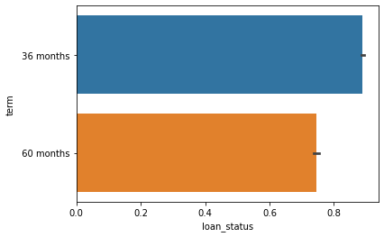
Analysis
Higher Dti & Dti_2yrs based borrowers are more loan defaulters
Borrowers who didn’t disclose their employee role are more loan defaulters
Borrowers who choose more term to pay ,they are high loan defaulters

Slide 15
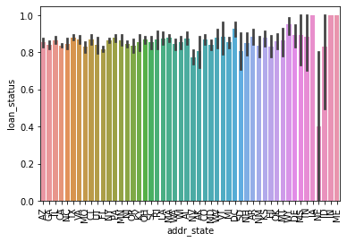
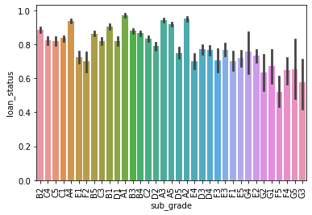
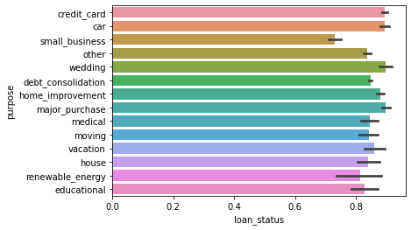
Analysis
High chance of loan defaults for giving loans to NE addressed state.
High chance of loan defaults for giving loans to F5 sub graded borrowers.
High chance of loan defaults for giving loans to Small business.

Slide 16
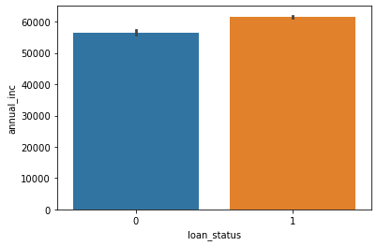
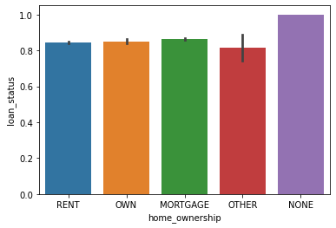
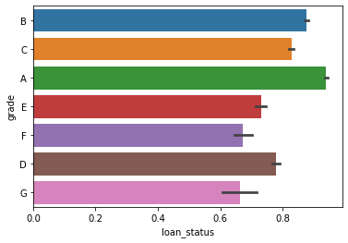
Analysis
High chance of loan defaults for giving loans to low annual income.
High chance of loan defaults for giving loans to not known home ownership borrowers.
High chance of loan defaults for giving loans to G & F grades category.

Slide 17
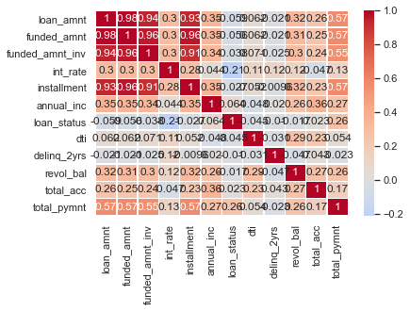
Analysis
Among all parameters annual income highly corelates in positive direction and interest rate in negative direction with loan status.
Loan amount, funded amount, funded amount, installment are highly correlated to each other.
Loan amount, funded amount, funded amount, installment, interest rate are negatively correlated to loan status.
As a overall most of the columns are negatively correlated to loan status.

Slide 18
Conclusions
Lending Loans to below categories would lead to loan defaults:
Not disclosing employee type
Low annual income
Home Ownership status is None
NE stated addressed state
Small Business Purpose
High number of installments
G,F grades especially F5 sub grade category
High number of tenure months(60) to repay loan leads to loan defaults

