Slide 1
Mnemosync
Recall • Reconnect • Reclaim
An AI-Powered Companion for Alzheimer's & Dementia Care

Slide 2
Problem Statement
Dementia & Alzheimer's strip away independence through three core daily struggles:
• Face Blindness (Prosopagnosia): Inability to recognize familiar faces—even family and close friends—leading to extreme social anxiety, isolation, and depression.
• Conversation & Context Loss: Forgetting the context of a conversation minutes after it occurs, causing repetitive questioning and mounting frustration.
• Routine & Promise Deterioration: Failure to remember short-term commitments (e.g., 'I will bring you water') or crucial daily routines (e.g., taking medication), transferring a massive coordination burden to human caregivers.

Slide 3
Proposed Solution
Mnemosync functions as an ambient, non-intrusive 'second brain' for the user:
• Ambient Vision Context: Silently recognizes faces and delivers real-time on-screen reminders of the person's identity and social history.
• Intelligent Transcript Synthesis: Captures and summarizes local audio into concise 'Memory Nuggets' to maintain context.
• Automated Task Extraction: Parses conversation transcripts to identify promised tasks and updates the local 'Memory Dashboard' automatically.
• Resilient Offline Architecture: Utilizes a multi-tier fallback model (Gemini 3 -> Gemini 2.5 -> local browser models) so the user is never left without assistance during network dropouts.

Slide 4
Technology Stack
• Frontend & Routing: React 19, TypeScript, Vite
• Styling & Animations: Modern CSS (Premium dark mode glassmorphism) & Framer Motion
• Primary Model: Google Gemini 3 Flash (High-speed, multi-modal contextual reasoning)
• Secondary Backup: Google Gemini 2.5 Flash (API rate-limit & quota failover protection)
• Local Computer Vision: React Webcam & Face-API.js (Local, offline facial identification)
• Offline Storage (Privacy): IndexedDB (idb) for locally secured, client-side data persistence

Slide 5
System Workflow Architecture
1. Sensory Input
2. Hybrid AI Fail-Safe
3. Privacy DB & Dashboard
📷 Webcam Feed
(Real-time face frames)
Primary: Gemini 3 Flash
- High Context Face ID
- Conversational Synthesis
IndexedDB (Local Storage)
- Zero Cloud Face DB
- Reminders & Task Logs
Backup: Gemini 2.5 Flash
- Rate-limit Protection
- Fallback Event Parsing
🎤 Speech Input
(Web Speech API STT)
React Dashboard UI
- Visual Memory Logs
- Proactive Audio Alerts
- Live Social Nudges
Local Models & Heuristics
- face-api.js Recognition
- Regex Task Extraction

Slide 6
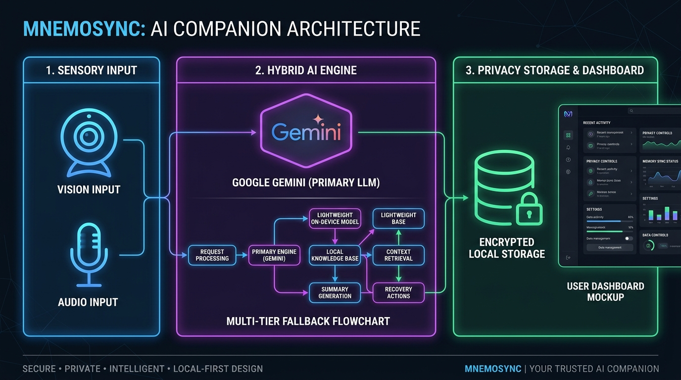
System Workflow Infographic

Slide 7
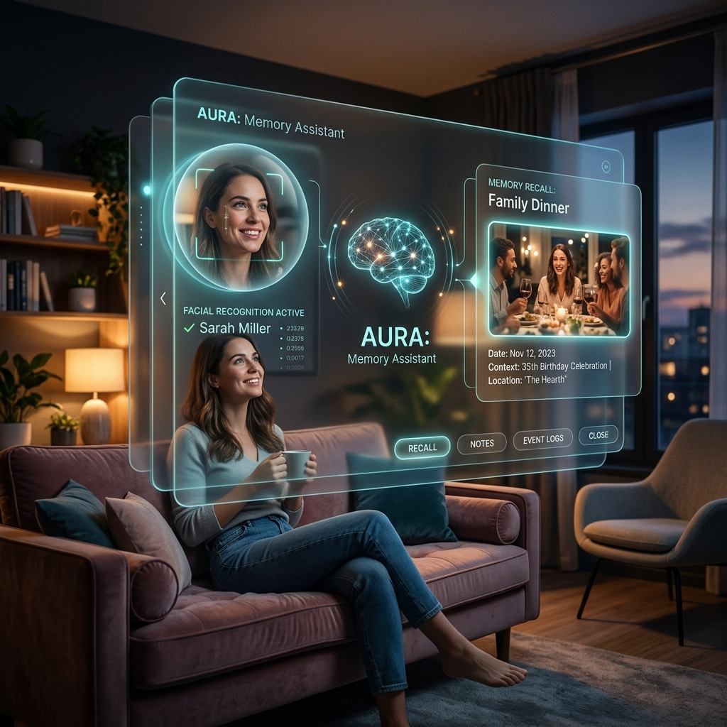
Concept Design & Visual Interface

Slide 8
Expected Impact
• Restores Autonomy: Empowers patients to complete daily tasks and engage with loved ones independently.
• Relieves Caregiver Burnout: Automatically tracks commitments, reducing the need for constant monitoring.
• Scalable & Accessible: Fully software-based, allowing run-time performance on standard tablets and laptops without specialized clinical hardware.
• Privacy-First Approach: Zero-cloud data processing for identified faces ensures medical compliance and absolute personal privacy.

Slide 9
Project Roadmap
• Phase 1: Hackathon Prototype (Completed) Full web prototype, multi-tier AI routing logic, IndexedDB schema structure, and working vision pipeline.
• Phase 2: Mobile Port & Wearable R&D (Months 1-6) Packaging the app via React Native and exploring integration with smart glasses (e.g., heads-up-display interfaces).
• Phase 3: Caregiver Portal & Clinical Testing (Months 6-12) Constructing a secure remote view portal for caretakers and executing pilot studies in memory facilities.
• Phase 4: Smart Home Integration (Year 2+) Connecting Mnemosync to smart home systems to trigger visual alerts on TVs or smart speakers based on task logs.

Slide 10
Team Details
Team Mnemosync
• Jaswanth & Team
Full-Stack & AI Engineers
(Note: You can open this file and edit these names/roles to match your team configuration before submitting!)

