Slide 1

District –wise Service Ready Gram Panchayats as on 31-12-2023
An analysis of broadband connectivity in rural India

Slide 2
Introduction
The BharatNet Project aims to provide high-speed broadband connectivity to rural areas in India.
This analysis focuses on understanding broadband deployment trends at the state level.
Key indicators analyzed include:
- Total Gram Panchayats (GPs) in each state.
- Service Ready Gram Panchayats (GPs) with broadband connectivity.

Slide 3
Data Cleaning and Processing
The dataset underwent preprocessing to ensure accuracy:
- Removed missing values and duplicates.
- Standardized column names for consistency.
- Converted relevant fields to numerical data.
These steps ensured a clean and reliable dataset for analysis.

Slide 4
Key Insights from EDA
- States with the highest number of Gram Panchayats were identified.
- A significant gap exists between total and service-ready Panchayats in many states.
- Some states have achieved near-complete broadband readiness, while others lag behind.
- The distribution of broadband-ready Panchayats is uneven across the country.

Slide 5
Statistical Analysis (T-Test & F-Test)
- T-Test was conducted to compare the mean values of Total vs. Service Ready Gram Panchayats.
- Results indicated a significant difference between these groups.
- F-Test showed variations in the distribution of broadband connectivity across states.
- These tests confirm disparities in broadband availability.

Slide 6
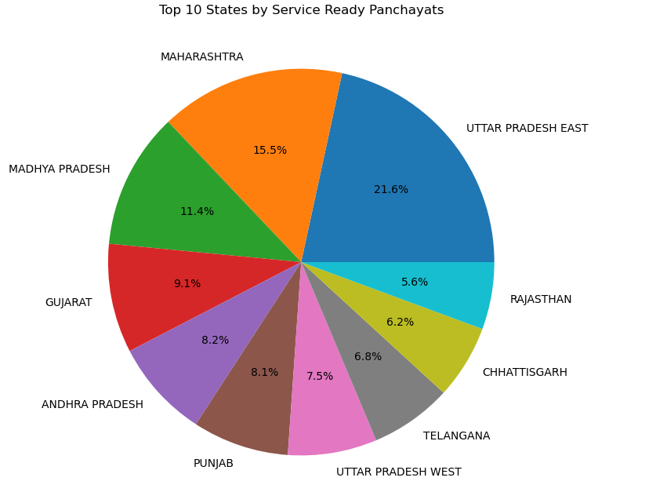
Pie Chart Representation
Uttar Pradesh (East) leads with 21.6%
service-ready panchayats.
Maharashtra (15.5%) & Madhya Pradesh (11.4%) follow.
Gujarat, Andhra Pradesh, Punjab range between 8-9%.
Rajasthan, Chhattisgarh, Telangana, UP (West) contribute below 7%.
Highlights regional variations in digital readiness for policy focus.

Slide 7
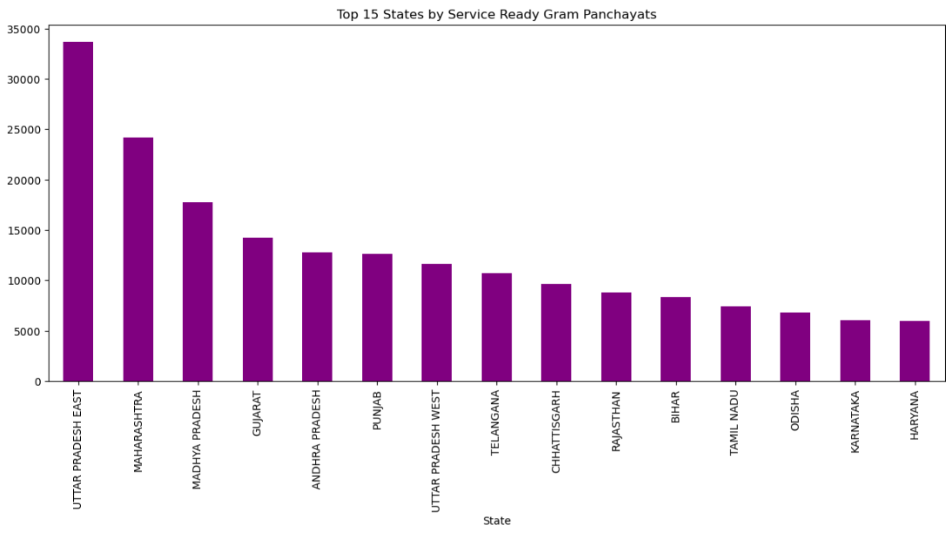
Bar Graph Representation on top 15 Service Ready Gram Panchayats
Uttar Pradesh (East) leads with the highest service-ready Gram Panchayats (~34,000).
Maharashtra & Madhya Pradesh follow with 25,000+ & 18,000+ respectively.
Gujarat, Andhra Pradesh, Punjab have 12,000 - 14,000 each.
Telangana, Chhattisgarh, Rajasthan, Bihar range below 12,000.
Haryana & Karnataka have the least among the top 15 states.

Slide 8
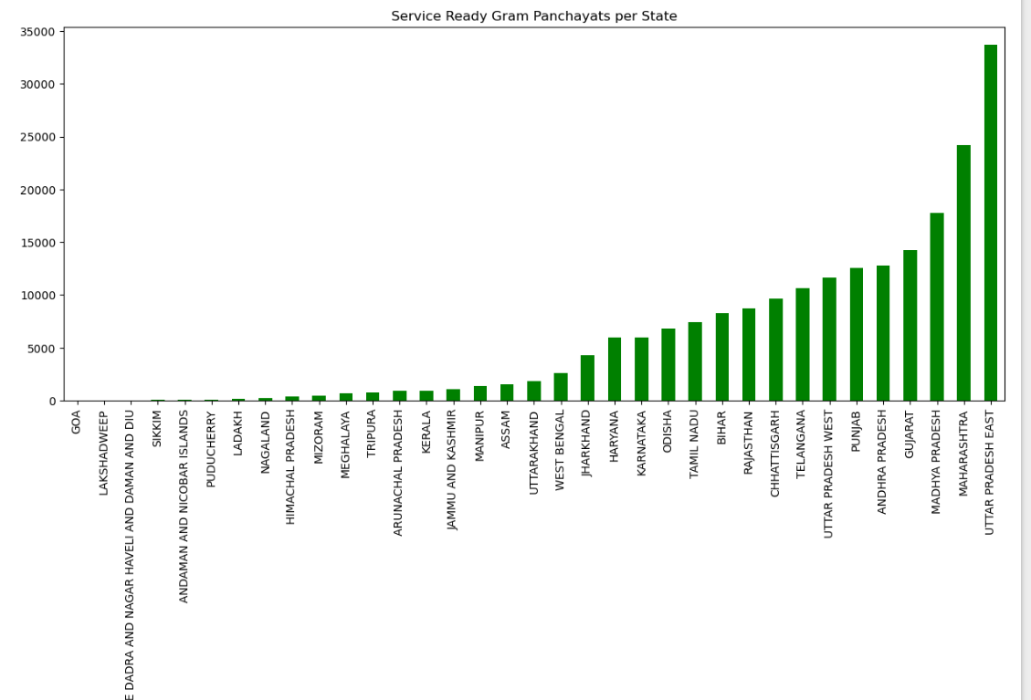
Bar Graph Representation for Service Ready Gram Panchayats per State
Uttar Pradesh (East) has the highest number of service-ready Gram Panchayats, exceeding 34,000.
Maharashtra & Madhya Pradesh are the next highest contributors.
Gujarat, Andhra Pradesh, Punjab also have significant numbers.
Smaller states & UTs (Goa, Lakshadweep, etc.) have very few Gram Panchayats in comparison.
The chart illustrates regional disparities, emphasizing the need for balanced rural connectivity.

Slide 9
Observations from Data Visualizations
- Bar charts revealed states with the highest and lowest broadband-ready Panchayats.
- Stacked bar charts showed relative proportions of service readiness.
- Line plots indicated trends in broadband growth across states.
- Pie charts illustrated percentage distributions of broadband availability.

Slide 10
Conclusion
- The BharatNet Project has made progress but requires further expansion.
- Significant gaps exist between total Panchayats and broadband-ready Panchayats.
- Data analysis highlights the need for targeted interventions in lagging states.
- A data-driven approach can enhance broadband connectivity across rural India.

