Slide 1
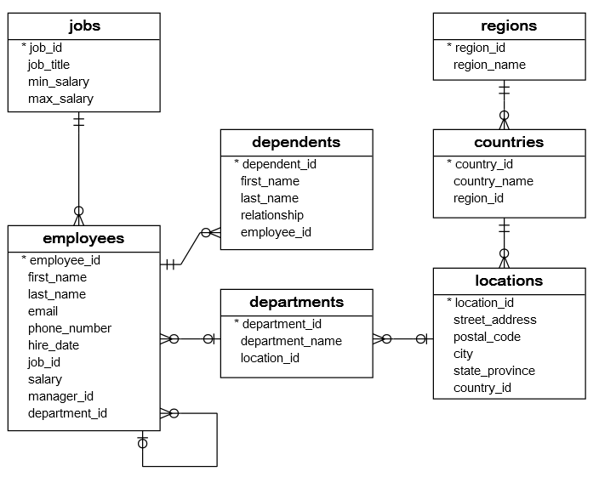
SQL Basics – SELECT, WHERE, ORDER BY, DISTINCT

Slide 2
What is SQL?
👉 SQL (Structured Query Language) is the standard language used to interact with relational databases (like MySQL, PostgreSQL, Oracle, SQL Server).
📌 It helps us create, read, update, and delete data.
📌 Works on relational databases (tables with rows & columns).
📌 Standardized by ANSI/ISO.
Analogy 🎓: Think of SQL as the language you use to talk to your database (just like English for humans).

Slide 3
Where to Begin with SQL?
Learn Basic SQL Syntax → SELECT, INSERT, UPDATE, DELETE.
Understand Data Types → INT, VARCHAR, DATE, etc.
Practice on a DB → MySQL, PostgreSQL, SQLite.
Start Simple Queries → fetch data, filter with WHERE, sort with ORDER BY.
Move to Advanced → JOINs, subqueries, functions, transactions.

Slide 4
Types of SQL Commands
DDL – Data Definition Language
👉 Defines the structure of the database (like creating blueprints).
Examples:
CREATE → create tables/databases.
ALTER → change structure (add/remove columns).
DROP → delete tables/databases.
TRUNCATE → delete all records but keep structure.

Slide 5
CREATE TABLE Students (
StudentID INT,
Name VARCHAR(50),
Age INT
);

Slide 6
Types of SQL Commands
DML – Data Manipulation Language
👉 Used to manipulate the actual data inside tables.
Examples:
INSERT → add new records.
UPDATE → modify records.
DELETE → remove records.

Slide 7
INSERT INTO Students (StudentID, Name, Age)
VALUES (1, 'Ravi', 20);
UPDATE Students
SET Age = 21
WHERE StudentID = 1;

Slide 8
Types of SQL Commands
DRL (sometimes called DQL – Data Retrieval/Query Language)
👉 Used to fetch data from the database.
Examples:
SELECT → retrieve data from tables.

Slide 9
What You’re Seeing in the Diagram
This is an ER Diagram (Entity-Relationship Model) which shows:
Entities (Tables): Represented as rectangles (e.g., employees, jobs, departments).
Attributes (Columns): Listed inside each entity (like employee_id, job_id).
Primary Keys: Marked with a * (unique identifier for each record).
Relationships: Lines connecting tables (1-to-1, 1-to-many, many-to-many).

Slide 10
SELECT Name, Age
FROM Students
WHERE Age > 18;

Slide 11
🎯 Quick Summary
Category | Full Form | Purpose | Examples
DDL | Data Definition Language | Define structure | CREATE, ALTER, DROP, TRUNCATE
DML | Data Manipulation Language | Manage data | INSERT, UPDATE, DELETE
DRL/DQL | Data Retrieval Language | Fetch data | SELECT

Slide 12
Notes:
Task 1 to Create the above schema.
Either in MySQL or Postgress

Slide 13
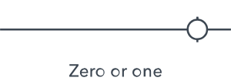


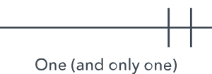



Slide 14
Relationships
Employees → Dependents: One employee can have many dependents, but each dependent belongs to only one employee (1-to-many).
Employees → Departments: Each employee works in one department, but a department can have many employees (1-to-many).
Departments → Locations: A department exists in one location, but a location can have many departments (1-to-many).
Locations → Countries: Each location is in one country, but a country can have multiple locations (1-to-many).
Countries → Regions: Each country belongs to one region, but a region can contain multiple countries (1-to-many).
Employees → Employees (Manager): One employee can manage other employees (self-relationship).

