Slide 1
COMPUTER NETWORKS | CLASSROOM ROLE-PLAY ACTIVITY
TCP 3-Way Handshake
Interactive Physical Role-Play: Client, Router, Server & Packet Transmission
👥 6 Team Performers
Client, Router, Server & 3 Packets
🔀 Physical Packet Flow
Client <-> Router <-> Server Traversal
⚡ 3-Step Handshake
SYN -> SYN-ACK -> ACK Synchronization
Classroom Activity Deck | Explainer Narrator + 6 Role-Play Performers | Computer Networks Course
Notes:
Welcome class! Today, we are demonstrating the TCP 3-Way Handshake through an interactive 6-member network role-play activity. One narrator will explain the technical concepts while six team members physically enact the hosts, network router, and packet control flags moving across the classroom.

Slide 2
01 | OVERVIEW
Introduction & Role-Play Activity Concept
Why a Physical Role-Play?
Visualizing Protocol Mechanics
Key Protocol Parameters
Control Flags & Sequence Math
Role-Play Execution Rules
Classroom Floor Instructions
• Hop-by-Hop Visibility: Shows packets traversing intermediate routers rather than instant abstract delivery.
• Host State Tracking: Demonstrates live state sign changes (CLOSED -> LISTEN -> ESTABLISHED).
• Interactive Learning: Connects theoretical socket code to physical packet movement.
• SYN (Synchronize): Requests starting sequence synchronization from receiver.
• ACK (Acknowledge): Confirms receipt of sequence bytes (Ack = Seq + 1).
• ISN (Initial Seq No): Random 32-bit sequence offset generated by Client (x) and Server (y).
• Packet Performers: Physically carry flag cards and sequence numbers across the classroom floor.
• Router Performer: Inspects destination IP/Port and routes packets between hosts.
• Host Performers: Update state signs immediately upon receiving valid packets.
💡 Fundamental TCP Rule: Application data (e.g. HTTP requests) cannot flow until the 3-Way Handshake successfully transitions both Client and Server to the ESTABLISHED state.
Notes:
Before we begin the physical demonstration, let's review why we perform a role-play. TCP is a stateful protocol operating hop-by-hop. In our classroom activity, packet performers will physically carry control flags across the network router. Both host performers will update their state signs as packets arrive.

Slide 3
02 | CAST & ROLES
Our Network Role-Play: 6 Team Roles
👤 Role 1: Client / Sender
HOST A (INITIATING HOST)
• Function: Initiates connection via socket connect().
• State Signs: CLOSED -> SYN-SENT -> ESTABLISHED.
• Sequence: Generates Initial Seq Number (ISN_c = x).
✉️ Role 2: SYN Packet
STEP 1 PACKET PERFORMER
• Function: Carries initial connection request.
• Flags & Parameters: Flags: [SYN=1, ACK=0], Seq = x, Ack = 0.
• Path: Walks from Client -> Router -> Server.
🔀 Role 3: Router / Switch
INTERMEDIATE NETWORK HOP
• Function: Receives packets on ingress port & forwards to destination.
• Inspection: Verifies packet headers & routes across network.
• Realism: Demonstrates hop-by-hop network traversal.
🖥️ Role 4: Server / Receiver
HOST B (LISTENING HOST)
• Function: Listens on port 443 & processes connection requests.
• State Signs: LISTEN -> SYN-RCVD -> ESTABLISHED.
• Sequence: Generates Server ISN (ISN_s = y).
📩 Role 5: SYN-ACK Packet
STEP 2 PACKET PERFORMER
• Function: Carries Server's response & sequence proposal.
• Flags & Parameters: Flags: [SYN=1, ACK=1], Seq = y, Ack = x+1.
• Path: Walks from Server -> Router -> Client.
✅ Role 6: ACK Packet
STEP 3 PACKET PERFORMER
• Function: Carries final confirmation to establish session.
• Flags & Parameters: Flags: [SYN=0, ACK=1], Seq = x+1, Ack = y+1.
• Path: Walks from Client -> Router -> Server.
🎭 Performers Assigned — Ready to Begin 3-Step Physical Role-Play Demonstration!
Notes:
Let's introduce our 6 role-play performers! Role 1 is the Client Host. Role 2 is the SYN Packet. Role 3 is the Network Router. Role 4 is the Server Host. Role 5 is the SYN-ACK Packet. And Role 6 is the final ACK Packet. Each performer has a specific task during the 3-step exchange.

Slide 4
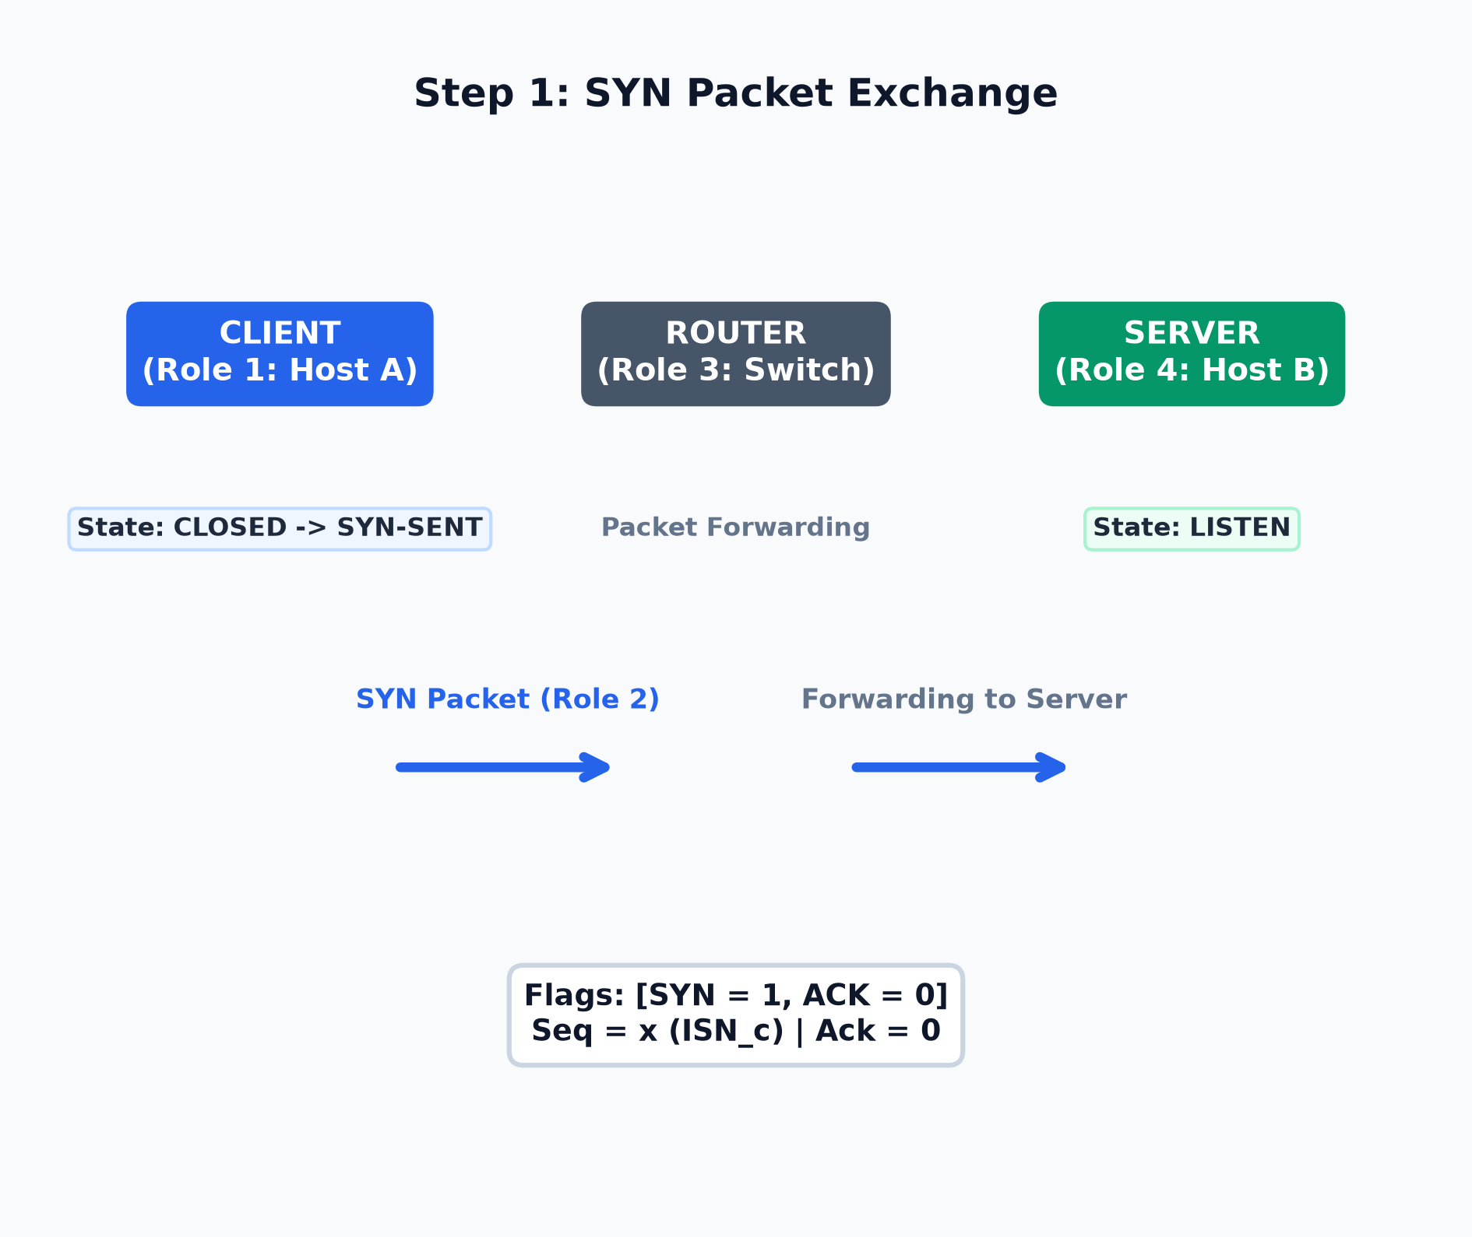
03 | STEP 1: SYN
Step 1: Client Connection Request (SYN Exchange)
Physical Performer Actions (Step 1)
• Client (Role 1) [Initiates Connection]: Calls connect(), generates ISN_c = x (e.g., 1000). Updates state sign: CLOSED -> SYN-SENT.
• SYN Packet (Role 2) [Dispatches Packet]: Holds card: [SYN=1, ACK=0], Seq = x, Ack = 0. Walks from Client to Router.
• Router (Role 3) [Forwards Packet]: Inspects SYN packet on ingress interface and forwards across classroom to Server.
• Server (Role 4) [Receives SYN]: In LISTEN state. Receives SYN, allocates half-open TCB buffer entry in SYN queue.
• Sequence Rule [Consumes 1 Seq Count]: SYN flag consumes 1 sequence number (x). Next expected byte will be x + 1.
Notes:
Step 1 begins! Role 1, the Client, initiates an Active Open. Client hands the SYN Packet (Role 2) to the Router (Role 3). SYN Packet carries Seq=x. The Router forwards SYN Packet to the Server (Role 4). Client updates its state sign to SYN-SENT while Server stays in LISTEN.

Slide 5
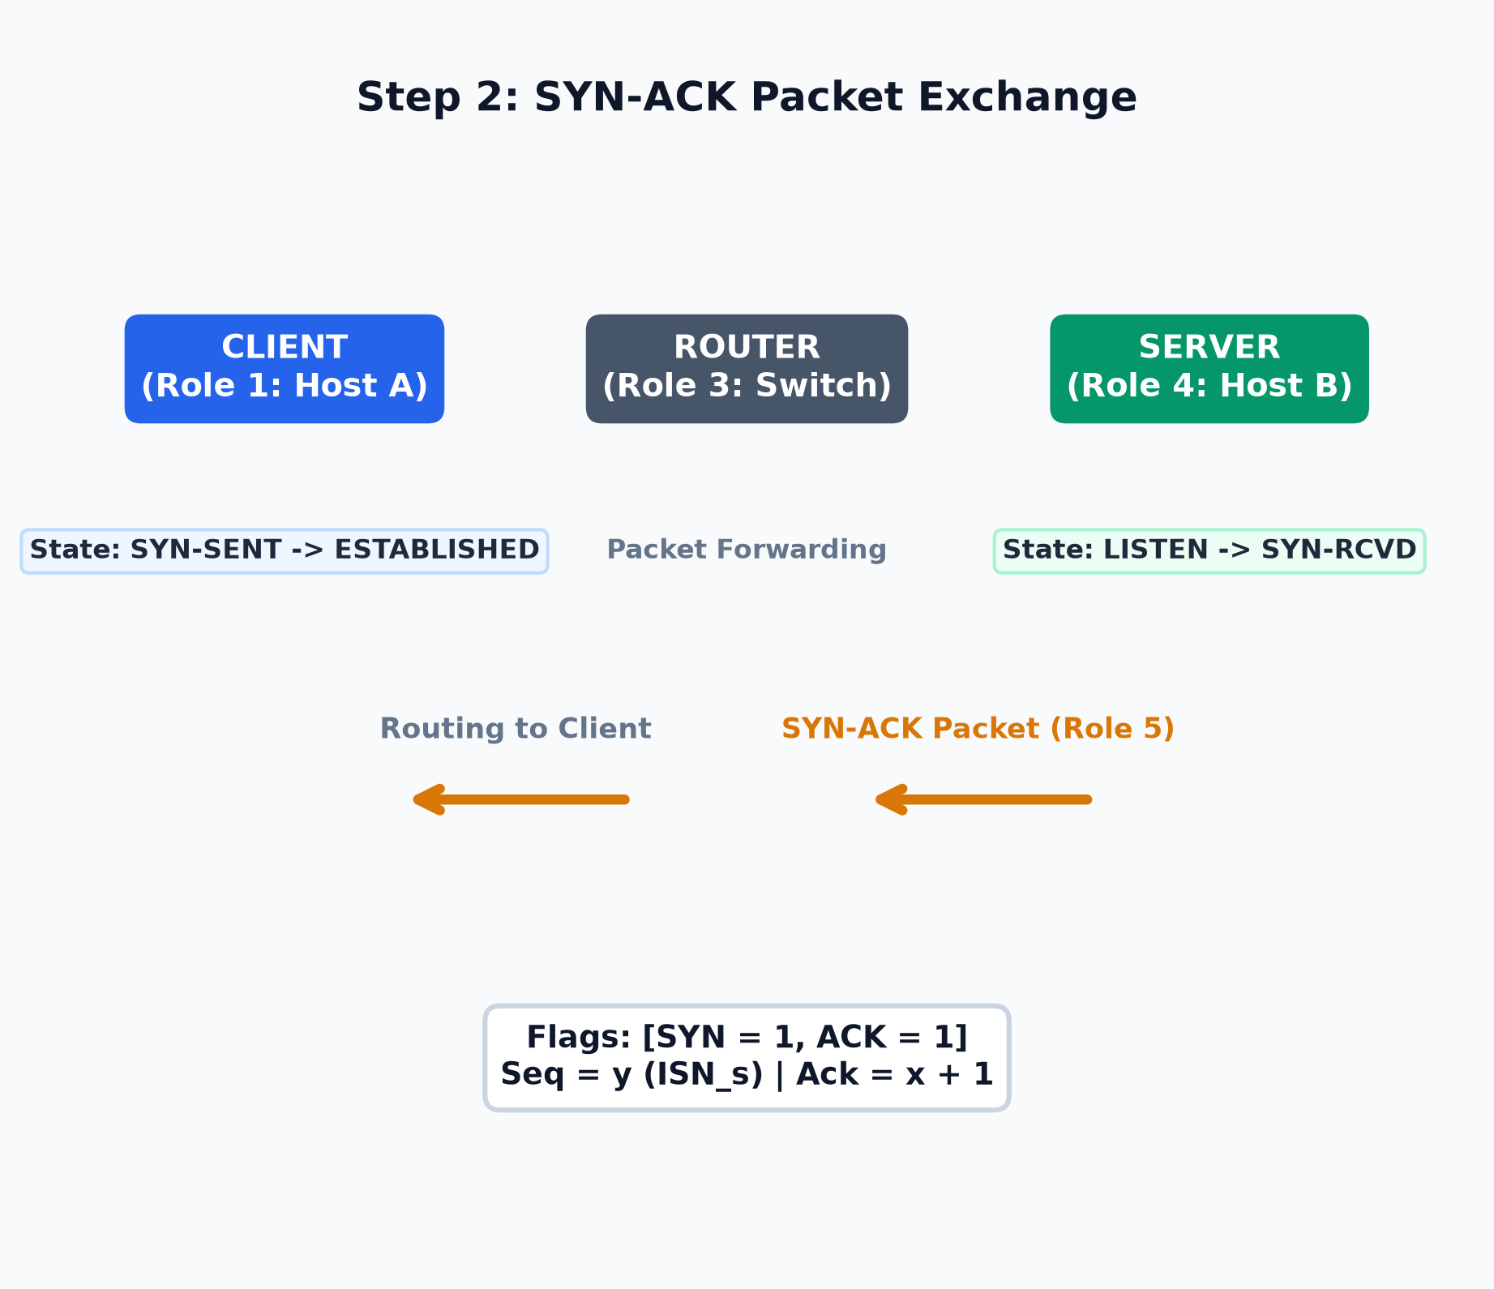
04 | STEP 2: SYN-ACK
Step 2: Server Response & Synchronization (SYN-ACK)
Physical Performer Actions (Step 2)
• Server (Role 4) [Responds & Syncs]: Generates Server ISN_s = y (e.g., 5000) and sets Ack = x + 1. Updates state sign: LISTEN -> SYN-RCVD.
• SYN-ACK Packet (Role 5) [Dispatches Packet]: Holds card: [SYN=1, ACK=1], Seq = y, Ack = x + 1. Walks from Server to Router.
• Router (Role 3) [Routes Back]: Receives SYN-ACK from Server interface and routes back across classroom to Client.
• Client (Role 1) [Receives SYN-ACK]: Verifies Ack = x + 1. Immediately updates state sign: SYN-SENT -> ESTABLISHED!
• Milestone [Client Connected]: Client host is now ready to transmit application payload after final ACK.
Notes:
Now Step 2! Server (Role 4) acknowledges Client's SYN by setting Ack=x+1 and generates its own sequence number Seq=y. Server hands the SYN-ACK Packet (Role 5) to the Router (Role 3). Router delivers it to Client (Role 1). Upon receiving SYN-ACK, Client updates its state sign to ESTABLISHED!

Slide 6
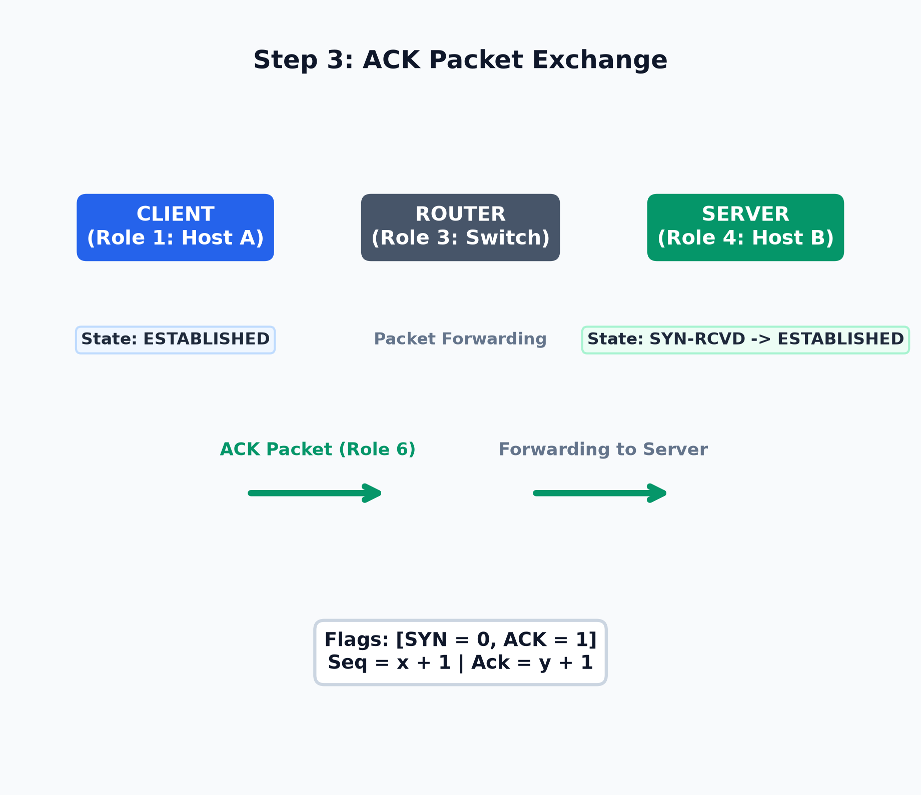
05 | STEP 3: ACK
Step 3: Client Confirms Connection (ACK Exchange)
Physical Performer Actions (Step 3)
• Client (Role 1) [Sends Final ACK]: Sets Seq = x + 1 and Ack = y + 1. Clears SYN flag (SYN=0).
• ACK Packet (Role 6) [Dispatches Packet]: Holds card: [SYN=0, ACK=1], Seq = x + 1, Ack = y + 1. Walks from Client to Router.
• Router (Role 3) [Forwards ACK]: Receives final ACK segment and delivers it to Server interface.
• Server (Role 4) [Completes Handshake]: Receives ACK, verifies Ack = y + 1. Updates state sign: SYN-RCVD -> ESTABLISHED!
• Outcome [Bi-Directional Sync]: Both sockets are now ESTABLISHED. Application data transfer is unlocked!
Notes:
Step 3 finalizes the handshake! Client (Role 1) hands the ACK Packet (Role 6) to Router (Role 3) with Seq=x+1 and Ack=y+1. Router forwards the ACK Packet to Server (Role 4). Server receives ACK and updates its state sign to ESTABLISHED! Both endpoints are now ESTABLISHED!

Slide 7
06 | SUMMARY
Connection Established & Role-Play Activity Summary
1. Physical Packet Traversal
CLIENT <-> ROUTER <-> SERVER
• Router Mediation: Packets physically traveled through intermediate router hop (Role 3).
• Flag Discipline: SYN requested sync; SYN-ACK acknowledged & proposed; ACK confirmed.
• Latency: Complete 3-step physical exchange took 1 Round Trip Time (1 RTT).
2. Sequence & Ack Number Math
BYTE OFFSET AGREEMENT
• Client Offset: Client ISN_c = x -> Server ACK = x + 1 -> Next Client Seq = x + 1.
• Server Offset: Server ISN_s = y -> Client ACK = y + 1 -> Next Server Seq = y + 1.
• Sequence Cost: SYN control flag consumed 1 sequence count without carrying data payload.
3. Host State Machine Alignment
SYNCHRONIZED STATE SIGNS
• Client Path: CLOSED -> SYN-SENT -> ESTABLISHED (Active Open).
• Server Path: CLOSED -> LISTEN -> SYN-RCVD -> ESTABLISHED (Passive Open).
• Final State: Both Client and Server hold 'ESTABLISHED' signs visible to classroom.
4. Transition to Application Data
PAYLOAD TRANSMISSION UNLOCKED
• Session Active: Full-duplex reliable connection is now active between Host A and Host B.
• Application Flow: Client can now transmit HTTP GET request over open TCP socket.
• Role-Play Wrap: Applause for our 6 Role-Play Performers and Narrator!
🎓 Role-Play Activity Conclusion: Our 6 role performers demonstrated how TCP establishes a reliable connection across a network router in 3 physical steps. By synchronizing sequence numbers x and y, both Client and Server reached the ESTABLISHED state. Great job team!
Notes:
To summarize: Our 6 role performers demonstrated how TCP establishes a reliable connection across a network router in 3 physical steps. By synchronizing sequence numbers x and y, both Client and Server reached the ESTABLISHED state. Application data can now flow freely. Great job to our 6 performers!

