Slide 1
CUSTOMER SHOPPING BEHAVIOR REPORT
3,900 purchases reveal a clear path from behavior to growth
Customer shopping data can guide segmentation, merchandising, subscriptions, and marketing decisions.
Notes:
Open with the central idea: the dataset is large enough to move from observed behavior to practical growth decisions.

Slide 2
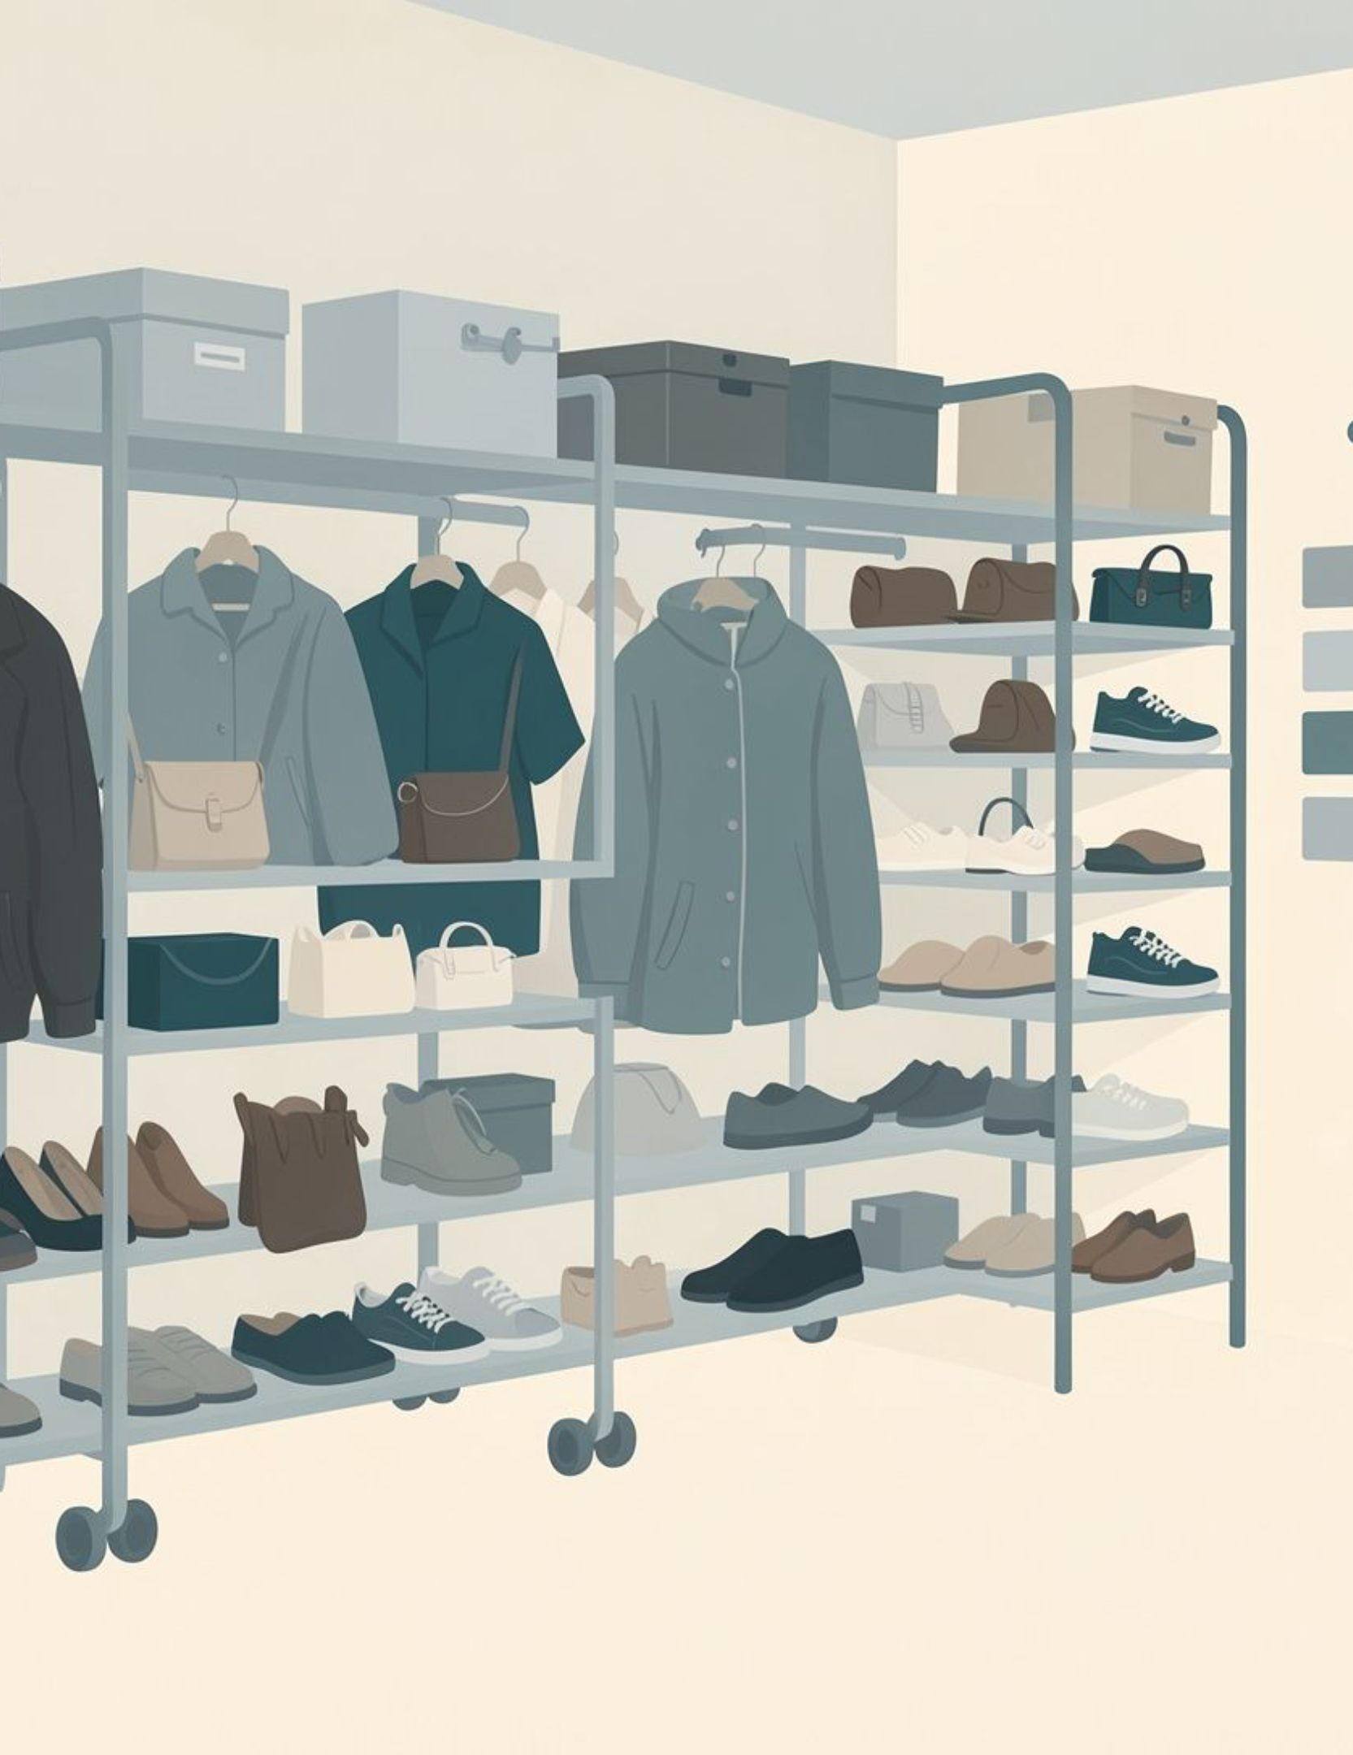
01 · DATASET
The dataset is broad enough to connect shoppers to choices
3,900
18
50
purchases
columns
locations
3,900 purchases across 18 columns, 25 products, 4 categories, and 50 locations
Average purchase amount: $59.76; average review rating: 3.75
37 review ratings were missing and imputed by product-category median
02
Notes:
Establish the foundation: the breadth of the data supports segmentation, category comparisons, and quality checks before any business recommendation.

Slide 3

02 · METHOD
Python made the raw data analysis-ready
Python
PostgreSQL
Power BI
01
02
03
04
Profile
Standardize
Engineer
Load
Loaded and profiled the dataset with pandas
Standardized columns to snake case and checked consistency
Created age groups and purchase-frequency fields
Removed redundant promo-code data and loaded the cleaned frame into PostgreSQL
03
Notes:
Explain the method as a chain of trust: profiling and standardization reduce noise, engineered fields support comparison, and the cleaned frame becomes reusable in PostgreSQL and Power BI.

Slide 4
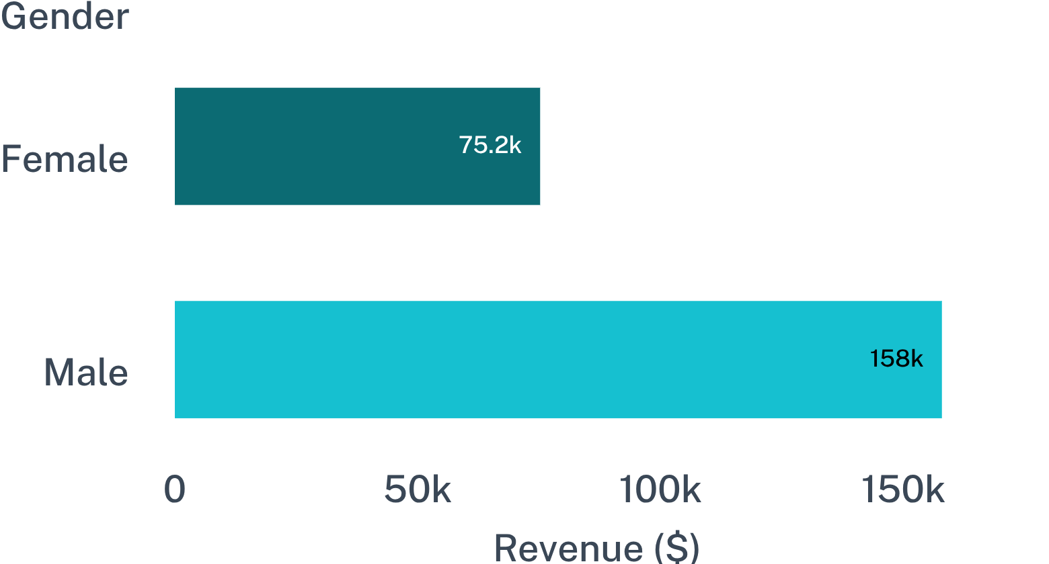
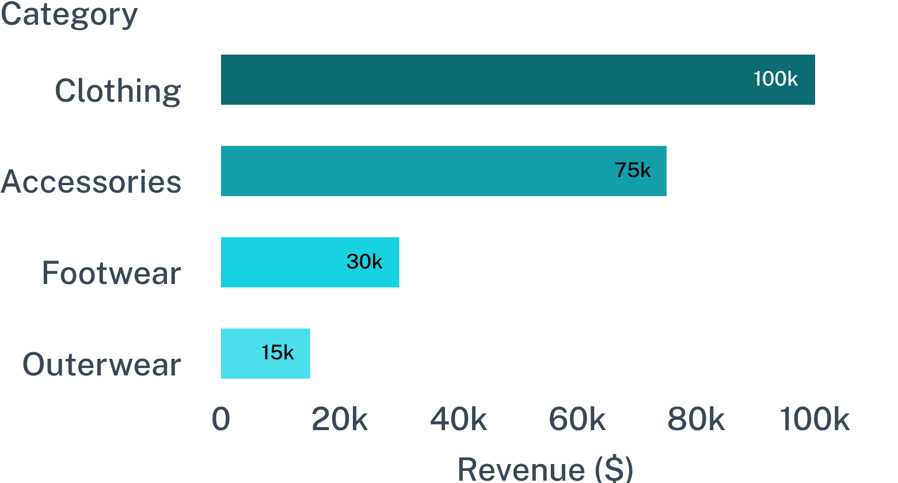
03 · REVENUE MIX
Revenue is concentrated in male shoppers and core categories
Revenue by gender
Revenue by category · approximately
Top category products include Blouse and Pants in Clothing, Jewelry in Accessories, Sandals in Footwear, and Jacket in Outerwear.
04
Notes:
Lead with the scale difference by gender, then show where category revenue concentrates. The product list turns the category pattern into a merchandising starting point.

Slide 5
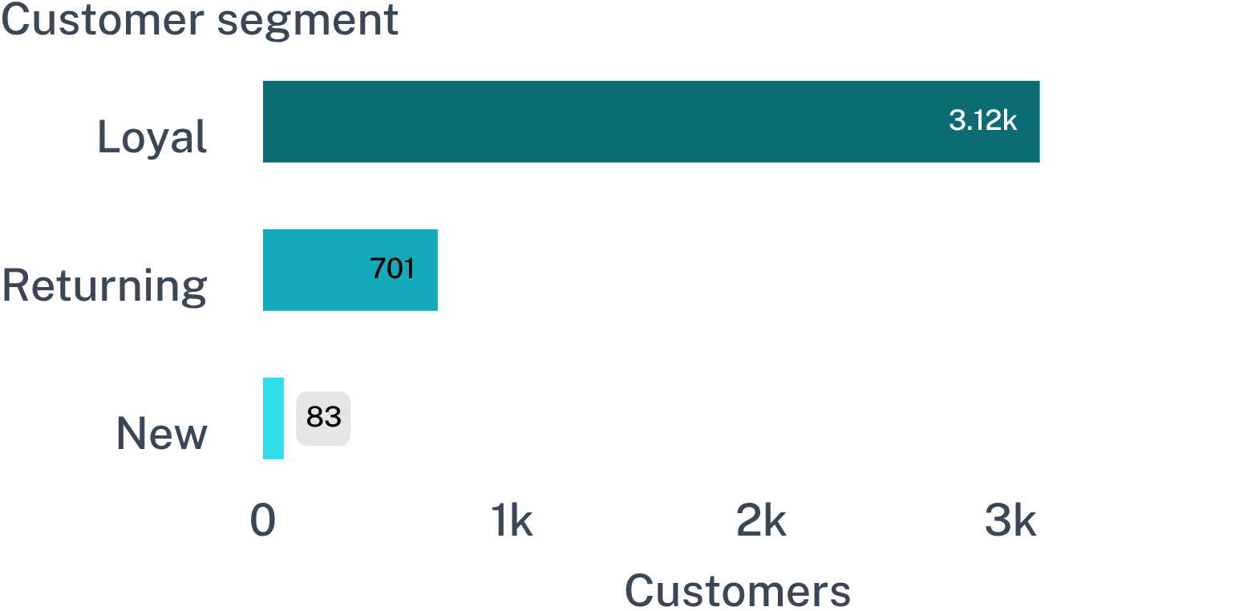
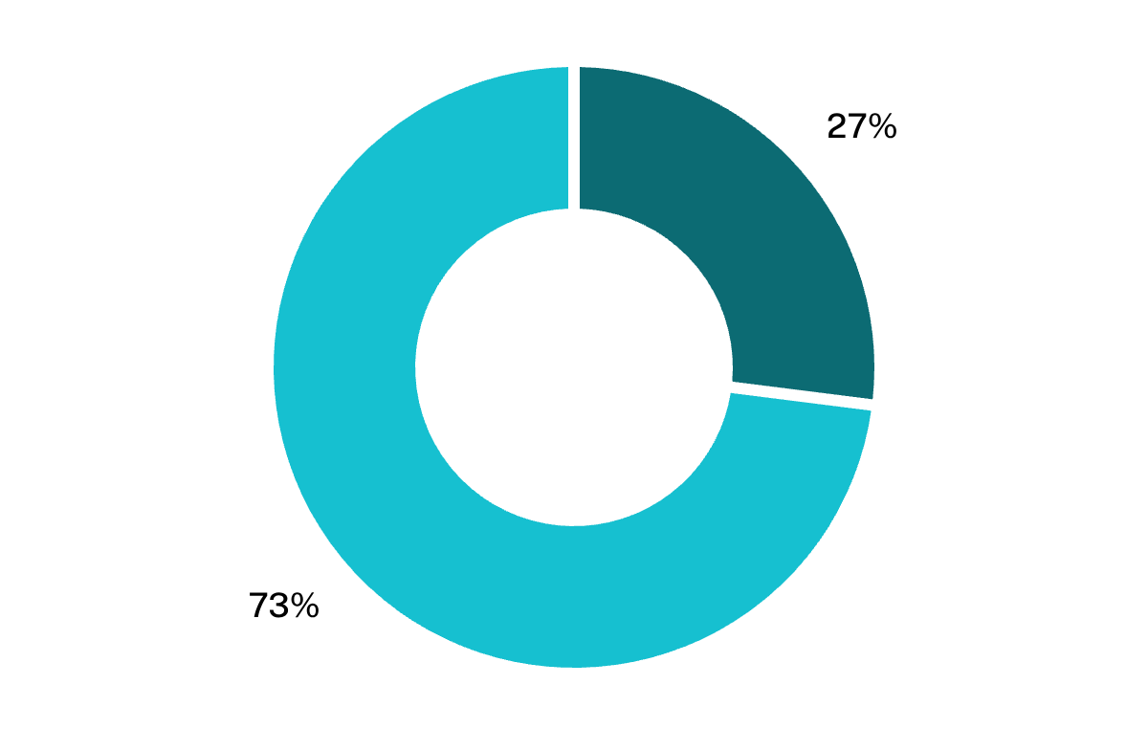
04 · LOYALTY
Loyal customers dominate, but subscriptions lag behind
Customer segments
Subscription mix
Subscriber average spend
Non-subscriber average spend
Immediate question
$59.49
$59.87
Why subscribe?
05
Notes:
The customer base is already loyal, but subscription penetration is only 27%. Because average spend is nearly identical, the opportunity is to create differentiated subscription value rather than simply discounting.

Slide 6
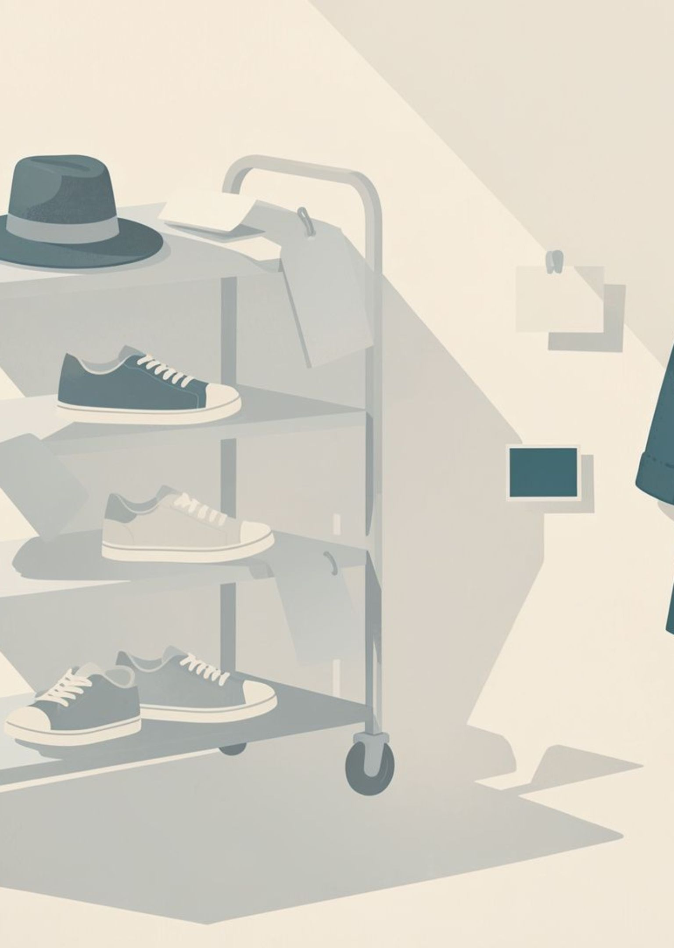
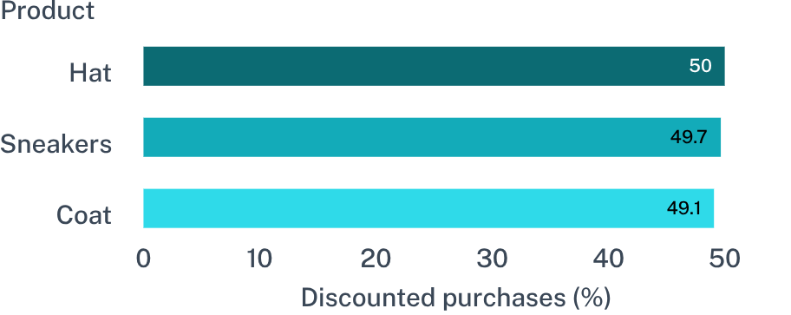
05 · PROMOTION
Discounts can drive high-value purchases, but create dependency
839
customers used discounts while spending above the average purchase amount
06
Notes:
Discounts are associated with valuable purchases, but the product pattern suggests dependency. The business question is whether promotions create incremental demand or simply leak margin.

Slide 7
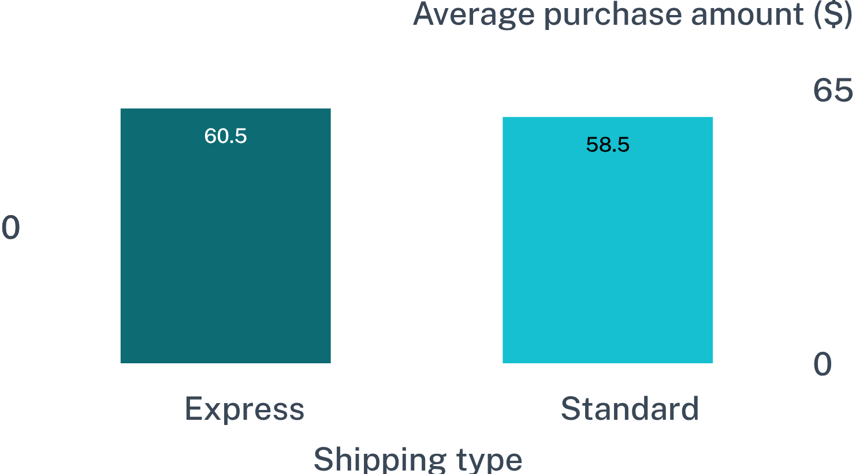
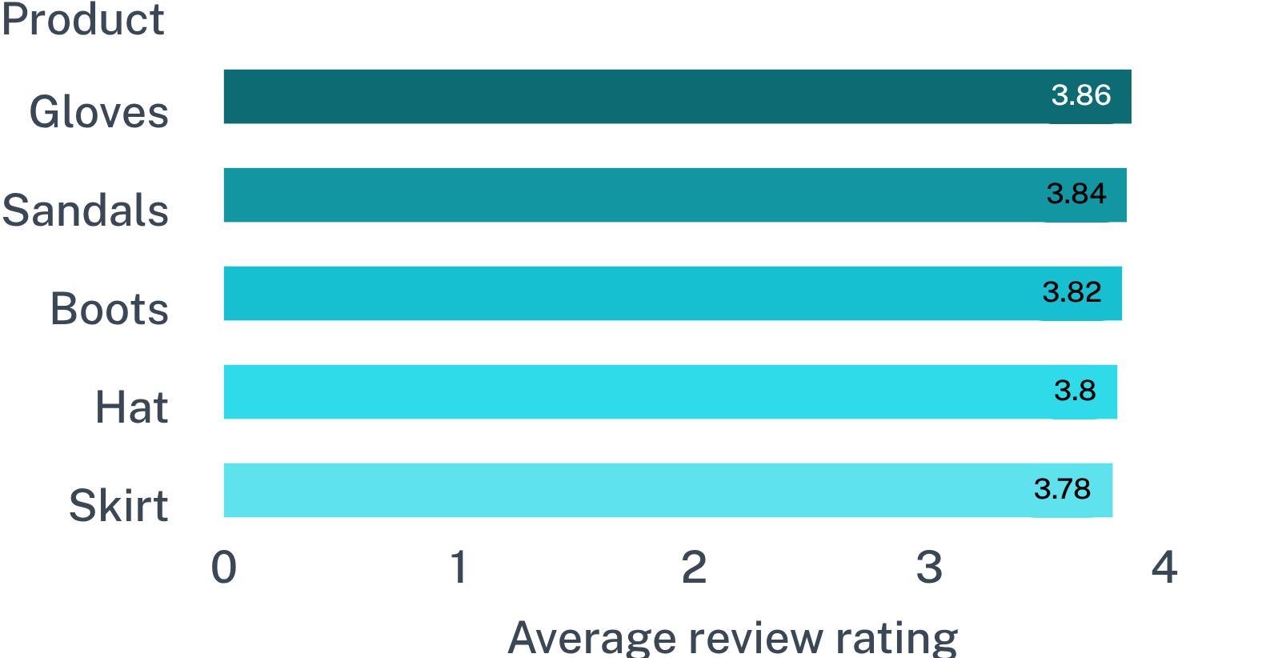
06 · EXPERIENCE TESTS
Small experience differences can be tested quickly
Average purchase amount by shipping type
Top-rated products
Test whether speed and product proof improve conversion or repeat purchase.
07
Notes:
These are small, testable differences rather than final conclusions: express shipping has the higher average purchase amount, and a short list of products provides proof points for targeted merchandising.

Slide 8
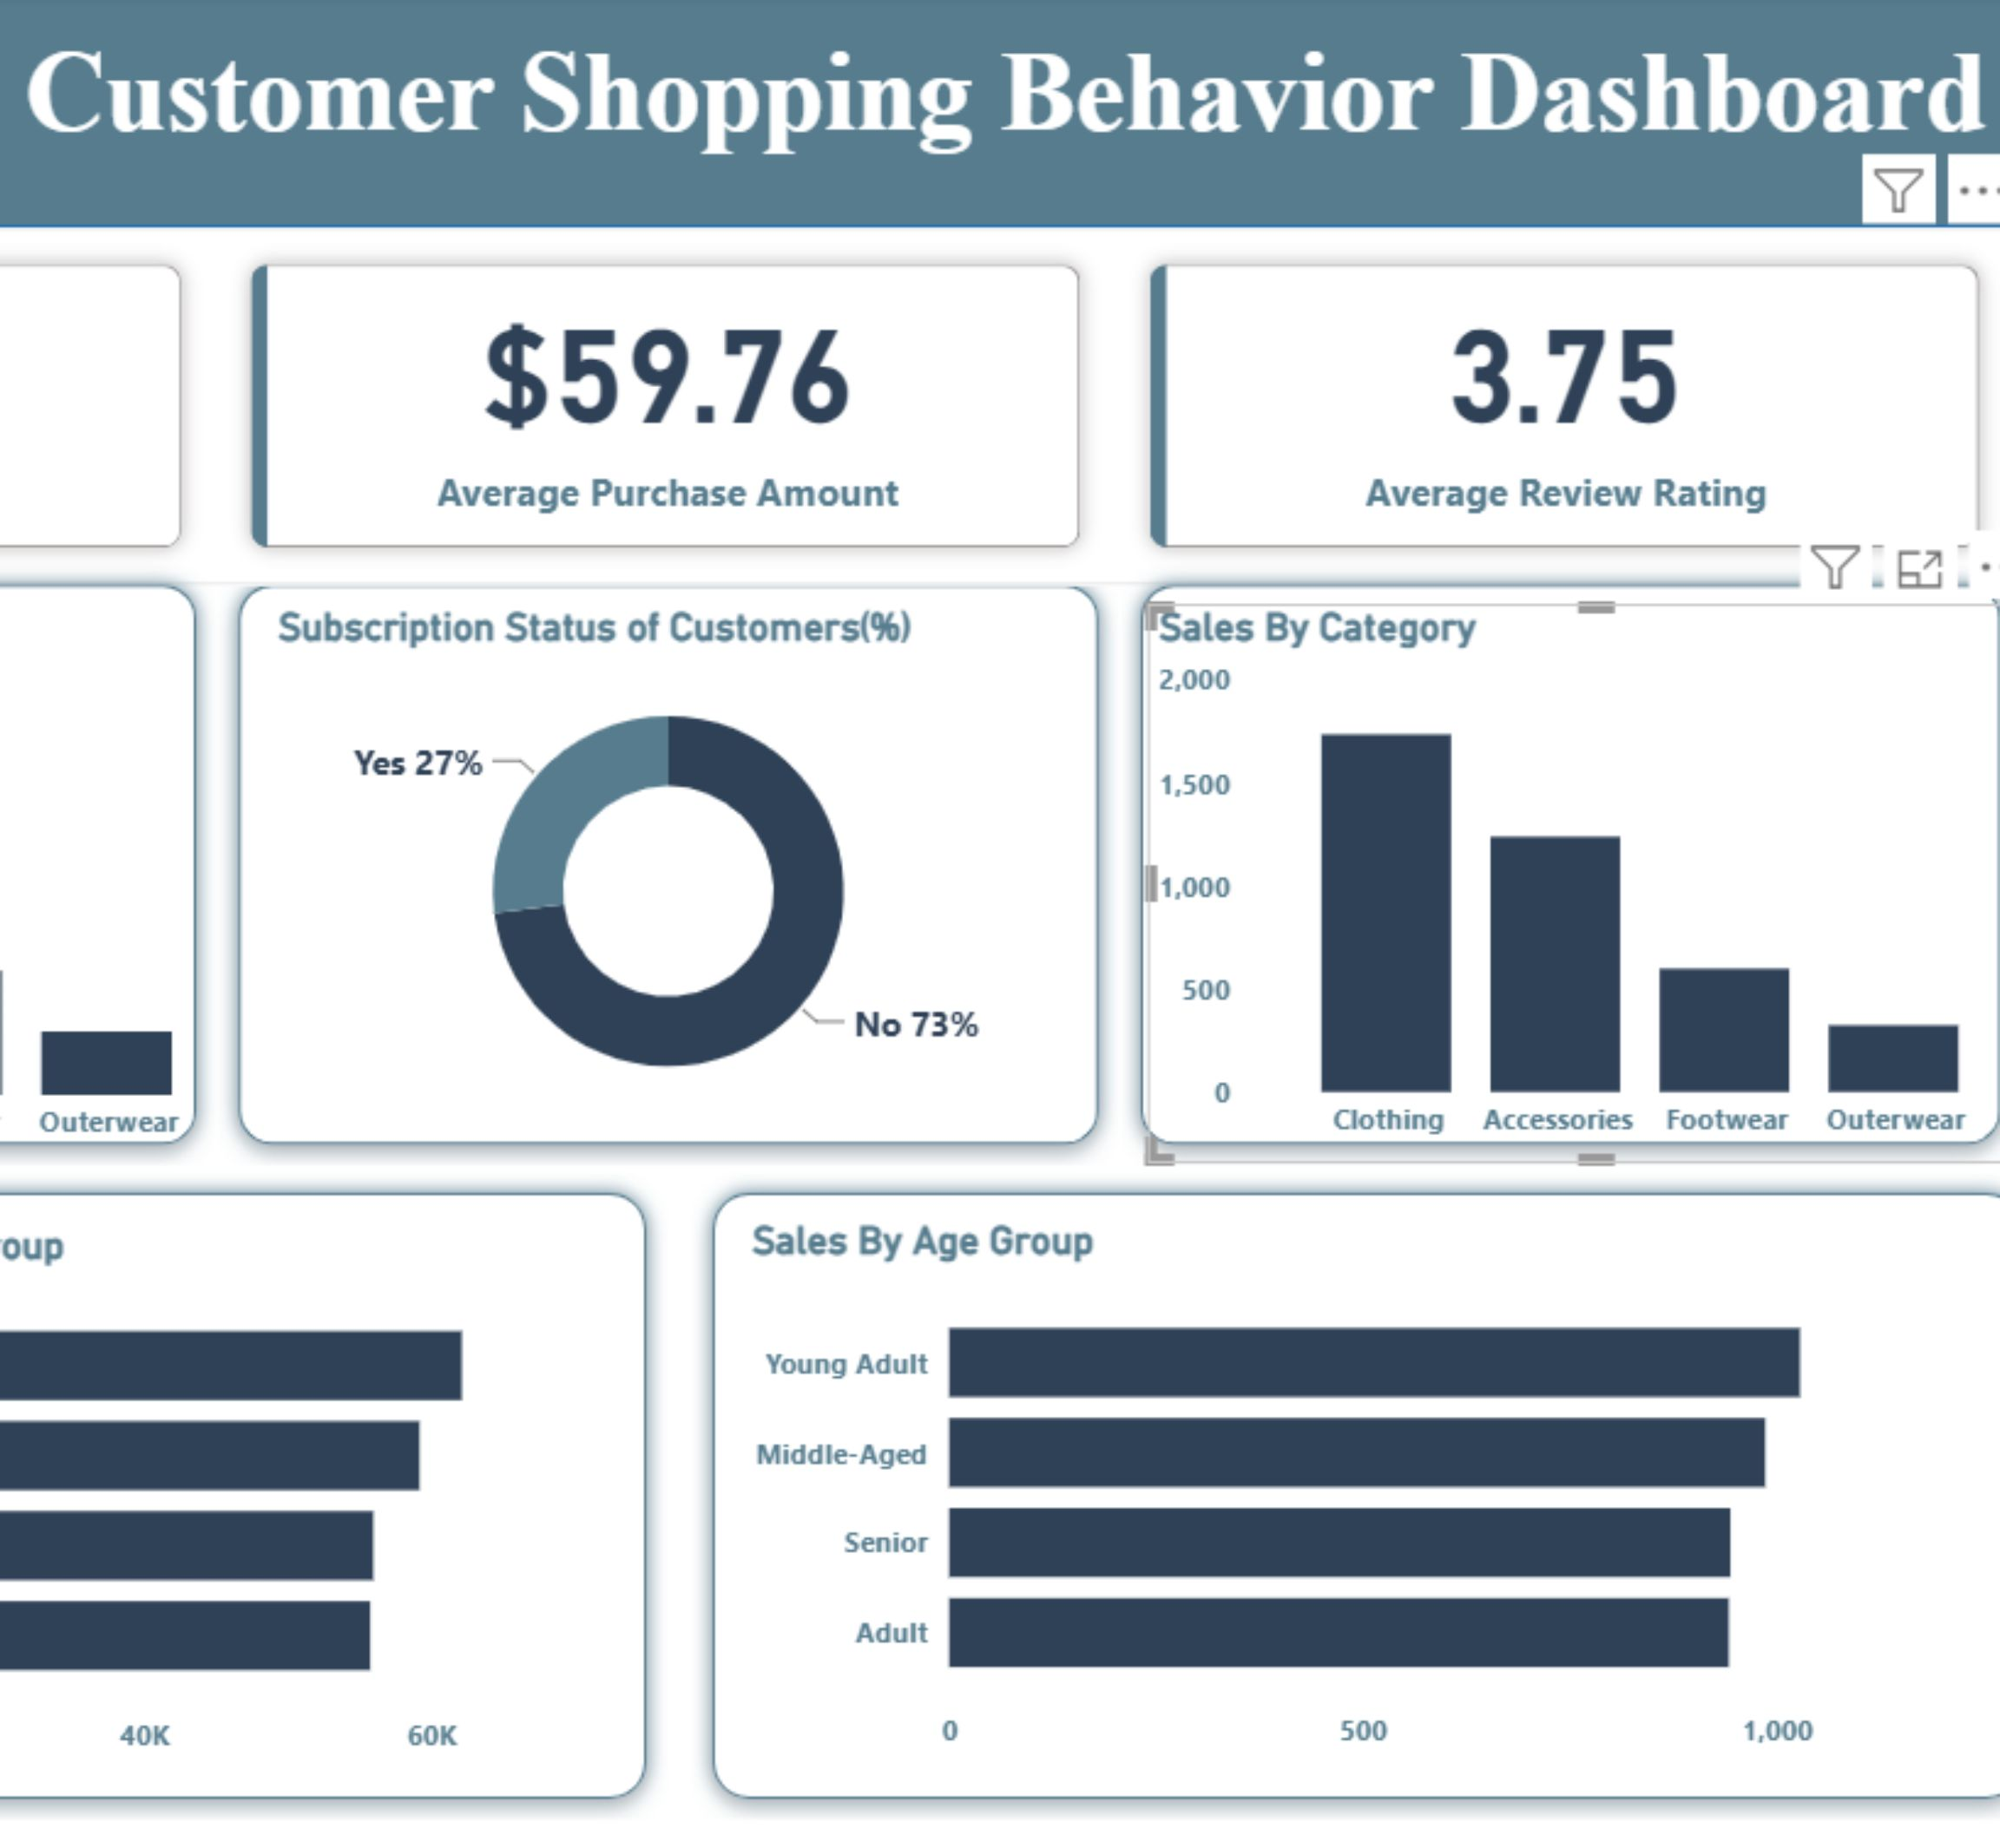
07 · DECISION SURFACE
The Power BI dashboard turns analysis into a decision surface
Filters cover subscription status, gender, category, and shipping type
Cards combine customers, average purchase, rating, subscription mix, category performance, and age-group revenue
08
Notes:
Use the dashboard image prominently. Emphasize that the value is not only presentation: the filters turn the report into a surface for asking targeted business questions.

Slide 9
08 · ACTION
Recommendations should focus on loyalty and profitable growth
01
02
03
04
Boost subscriptions
Move customers forward
Use product proof
Protect margin
Offer exclusive benefits, not blanket discounts
Feature top-rated and best-selling products in targeted campaigns
Review discount policy and target high-revenue age groups and express-shipping users
Reward repeat buyers and move Returning customers toward Loyal
The common thread: convert observed behavior into targeted action, then measure whether growth remains profitable.
09
Notes:
Move from findings to decisions in four moves: build subscription value, deepen loyalty, use proof in campaigns, and keep promotion decisions tied to margin.

Slide 10
09 · OPERATING MODEL
Turn the report into a repeatable growth loop
The project connects data preparation, business analysis, visualization, reporting, and a reusable repository.
Refresh
Check
Refresh the cleaned Python pipeline
Run SQL checks for segments, products, shipping, discounts, and subscriptions
Monitor
Learn
Monitor the Power BI dashboard by audience and category
Launch tests, measure repeat purchase and margin, and feed results back into the model
Notes:
Close by reframing the report as a system rather than a one-time analysis: refresh, check, monitor, learn, and feed the results back into the next cycle.

