Slide 1
Movie Rating Prediction
BDA Course Project
Chandrahas
Jaswanth Krishna

Slide 2
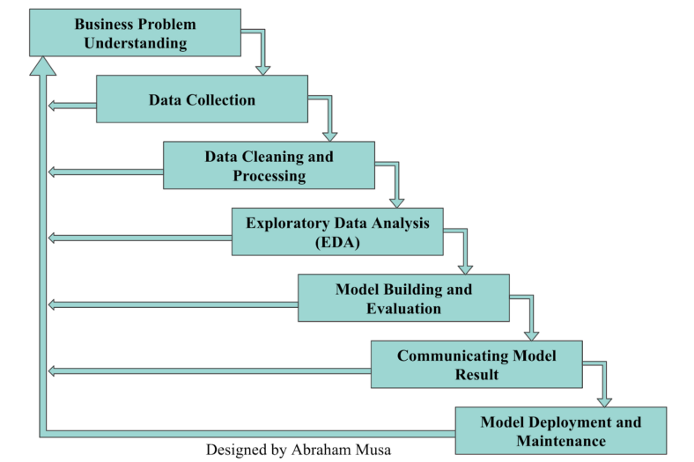
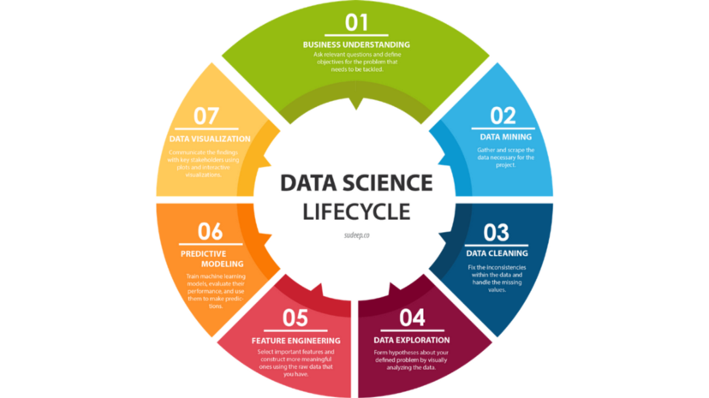
Data Science Life Cycle

Slide 3
Artifact : 1 - Problem Statement

Slide 4
Problem Statement
In today's world, the entertainment industry is continually evolving, and the demand for accurate movie ratings has never been higher.
This project aims to bridge this gap by developing a movie rating prediction system that provides timely, accurate ratings for movies, benefiting the real-time needs of the entertainment industry.
Hadoop scalability and distributed computing capabilities make it an ideal choice for handling the vast amount of data required for movie rating prediction.

Slide 5
Artifact : 2 - Data Collection

Slide 6
Data Collection
We obtained our movie-related data from Kaggle.
We used the "Rotten Tomatoes Movies and Critic Reviews" dataset from Kaggle
This dataset provides a rich set of information, including movie titles, ratings, reviews, release dates, and more, making it ideal for our movie rating prediction project.
Dataset

Slide 7
Artifact - 3 : Data Cleaning and Preparation

Slide 8

Data Cleaning and Preparation
We have created a batch based pipeline
we have two primary functions: genre and encoding, which help us clean and format a dataset containing movie-related information.
Step 1: "genre" Function - Fills missing movie genre data by assigning predefined genres, ensuring each movie has an associated genre.
Step 2: "encoding" Function - Cleans the dataset by removing unnecessary columns, handling missing data with appropriate strategies, encoding categorical data, and reordering columns for analysis.
Data Pipeline
Dadata
Data Base (Mongodb)
Genre
Encoding

Slide 9
Artifact - 4 : Exploratory Data Analysis (EDA)

Slide 10
Hypothesis testing
Null Hypothesis (H0):There is no significant correlation between the runtime of movies and their Tomatometer ratings.
Alternative Hypothesis (H1): There is a significant correlation between the runtime of movies and their Tomatometer ratings.
Pearson Correlation Coefficient: 0.09413008412249388
P-value: 4.276596293677606e-35
As p-value < 0.05. Therefore, we reject the null hypothesis and conclude that there is evidence to suggest a significant correlation between movie runtime and Tomatometer ratings.

Slide 11
Hypothesis testing
Null Hypothesis (H0):There is no significant correlation between movies titles and their Tomatometer ratings.
Alternative Hypothesis (H1):There is a significant correlation between the movies titles and their Tomatometer ratings.
F-statistic: 1.0356329447414823
P-value: 0.28696910171796575
P value >0.05 . We have failed to reject null hypothesis. The is a no significant correlation between between movies titles and their Tomatometer ratings.

Slide 12
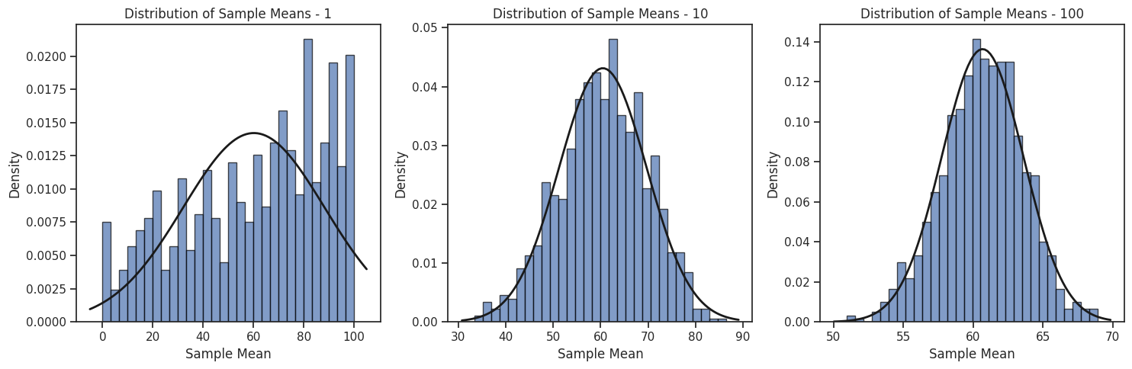
Central Limit Theorem
Here we can see that on increasing number of samples, distribution is getting normal

Slide 13
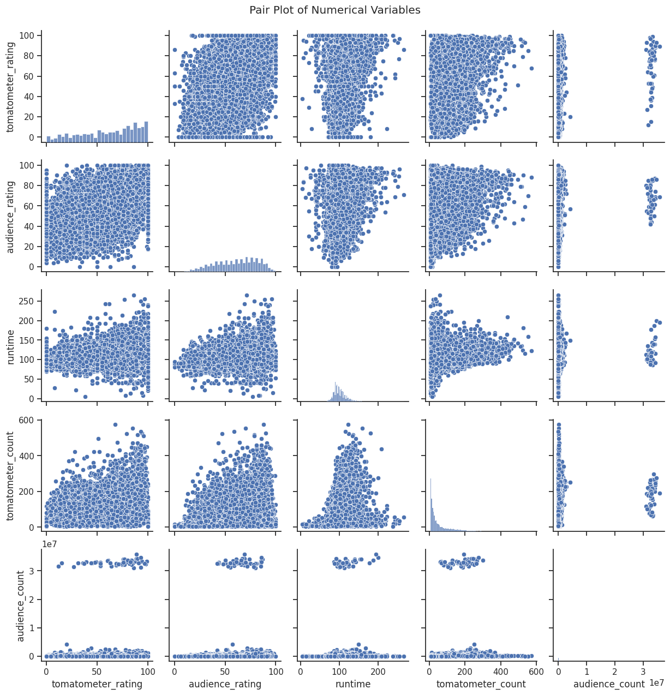
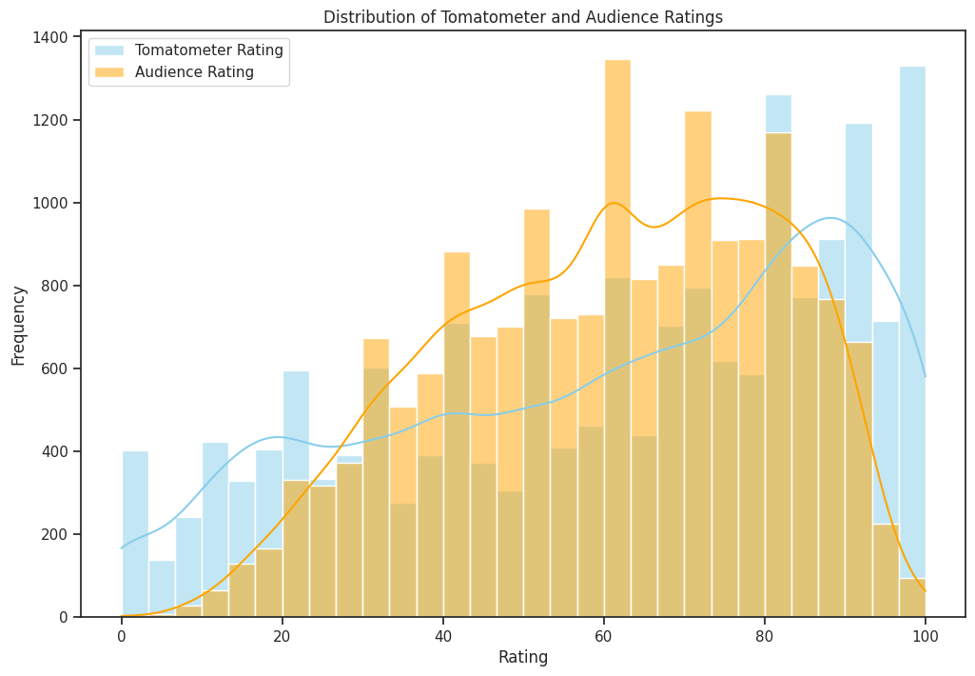
Exploratory Data Analysis (EDA)
left plot : In between numerical attributes, Any two attributes are either zero correlated or correlated with each other.
Right plot : Tomatometer rating and actual rating are close to each other which implies that dataset is useful for predicting ratings.

Slide 14
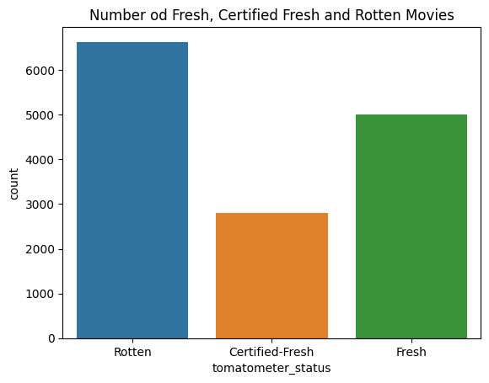
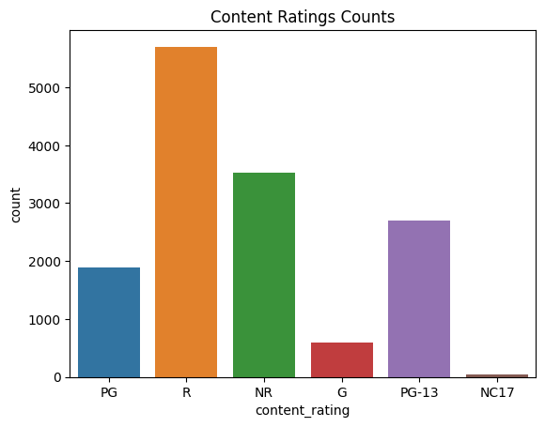
Exploratory Data Analysis (EDA)
These two plots gives the counts of columns tomatometer status and content ratings. Here we can say that data is diverse.

Slide 15
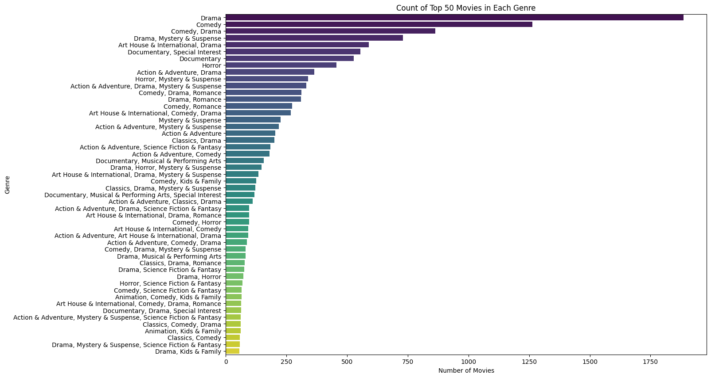
Exploratory Data Analysis (EDA)
This plot is to get the count of existing combination of genres given in the dataset.

Slide 16
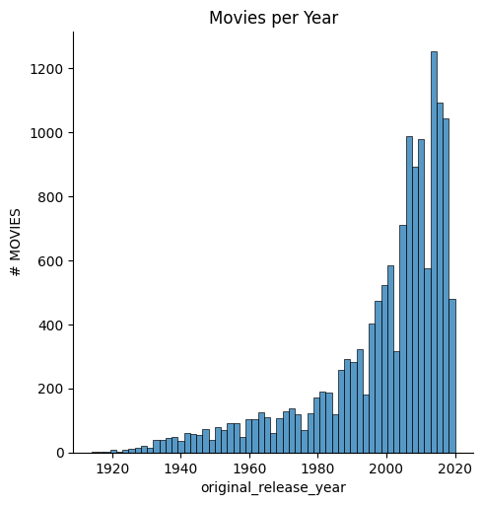
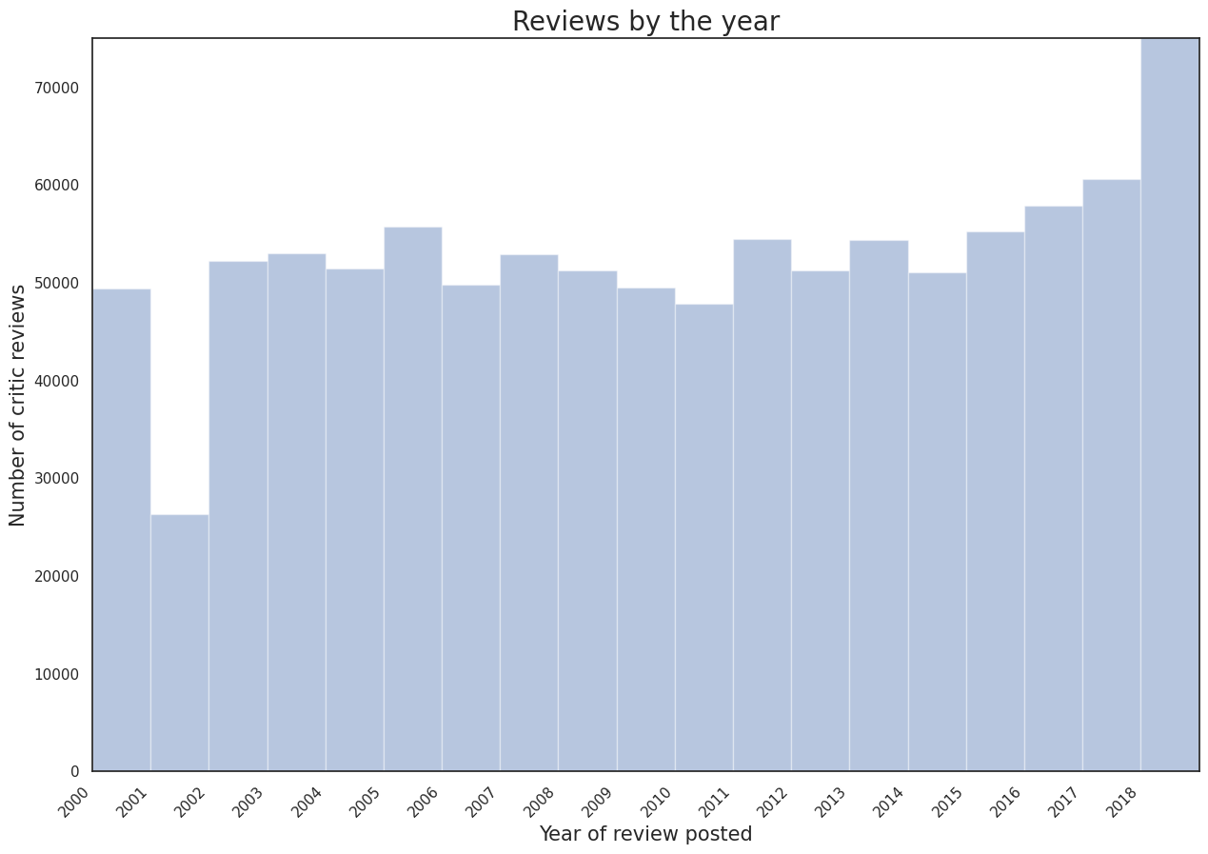
Exploratory Data Analysis (EDA)
Number of reviews and released movies are increasing every year as per the trend from 2000 to 2020

Slide 17
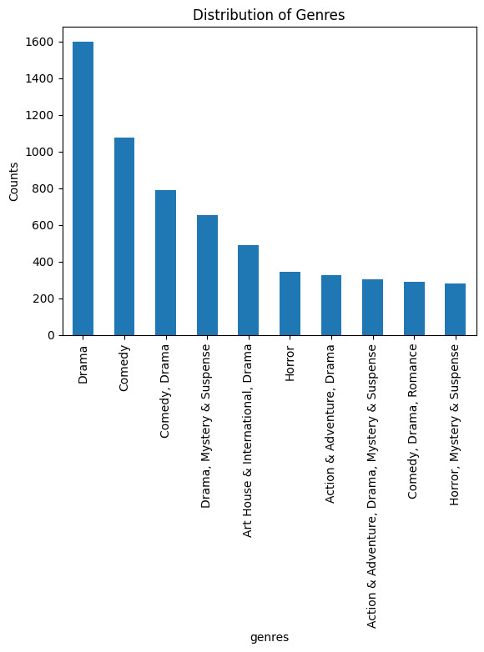
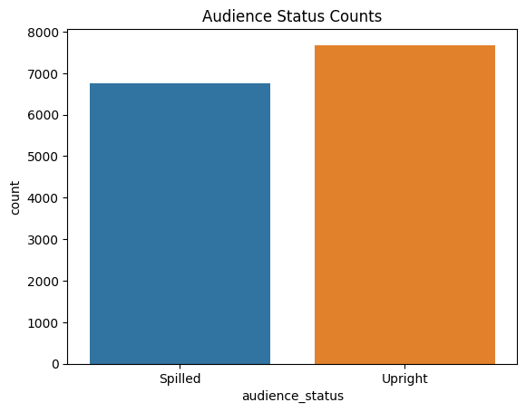
Exploratory Data Analysis (EDA)
Filtered by genre - Drama movies are highest and horror are the lowest.
Filtered by studio names - “Paramount Pictures” released highest number of movies and “Magnolia Pictures “released least.

Slide 18
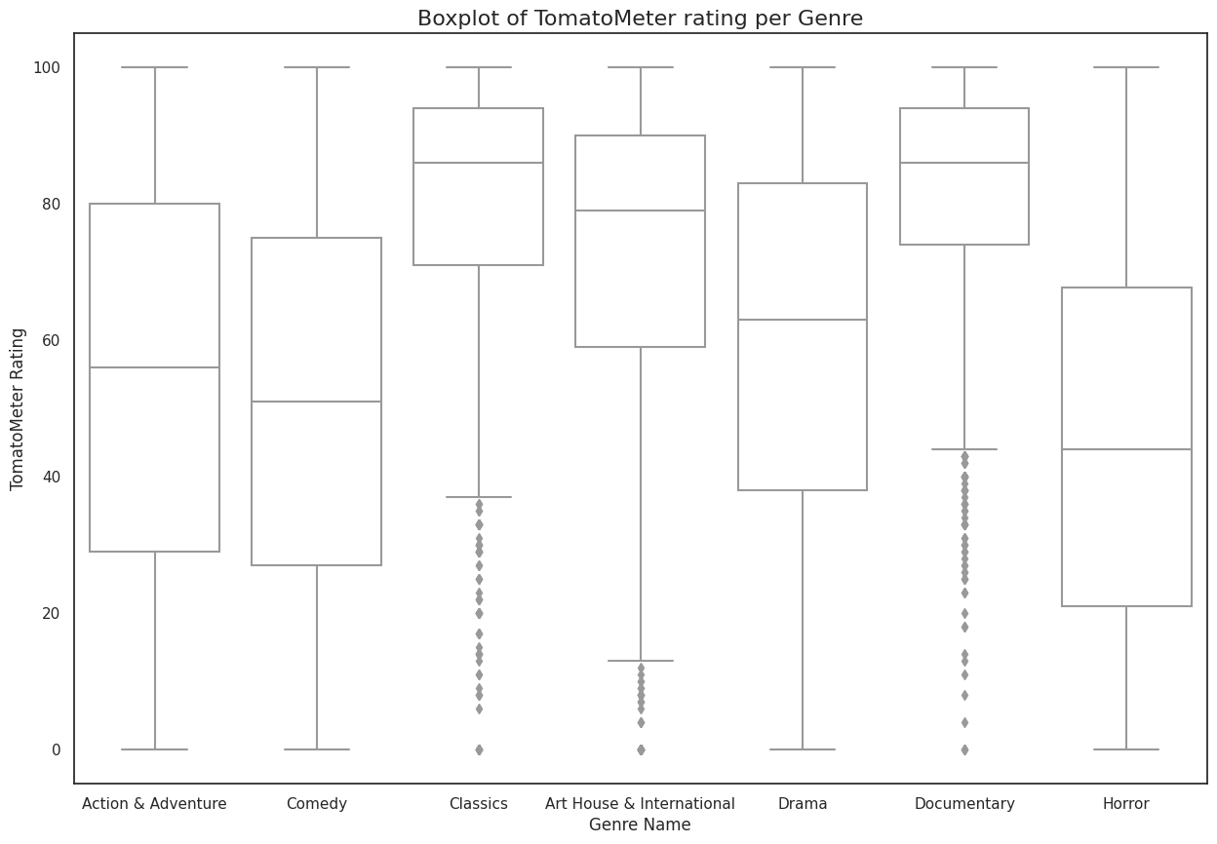
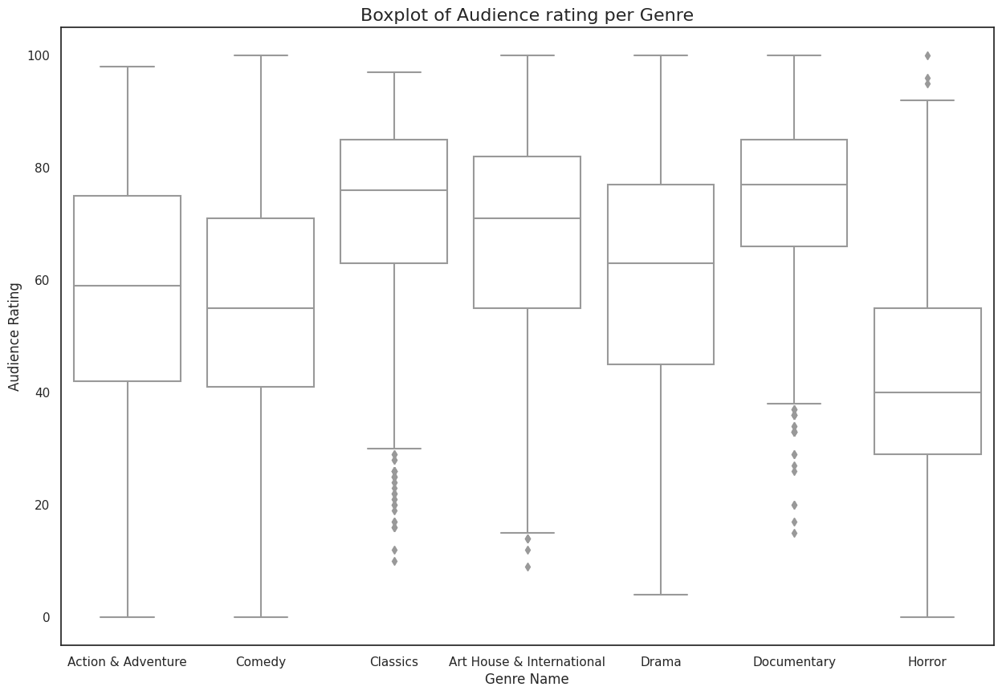
Exploratory Data Analysis (EDA)
Box plot of tomato meter per gener
Box plot of Audience per gener

Slide 19
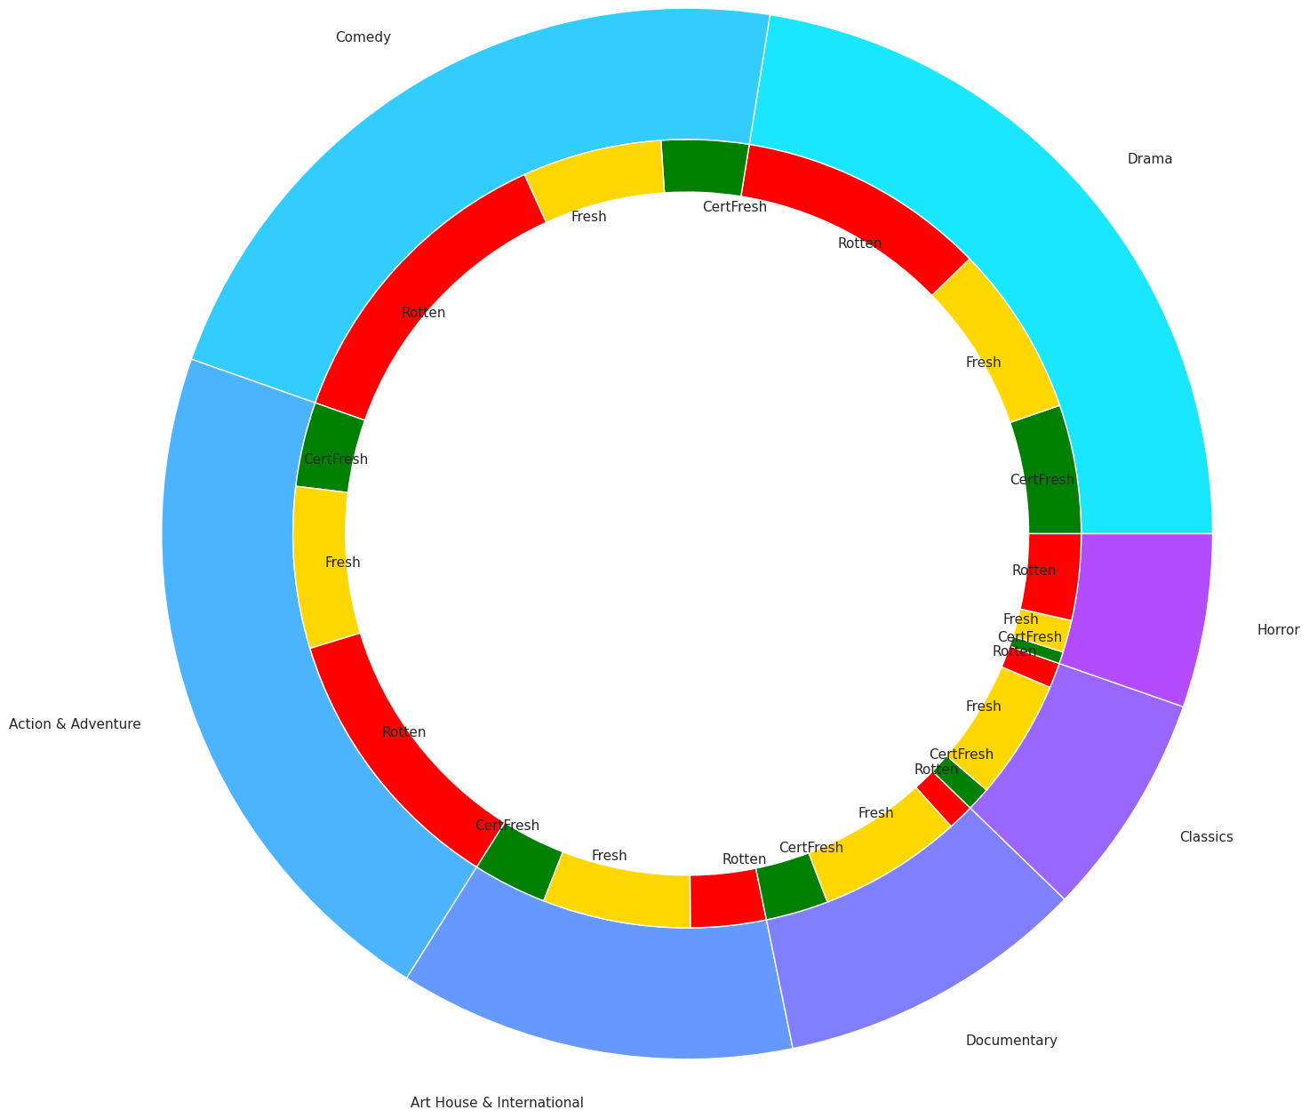
Exploratory Data Analysis (EDA)
Pie chart for the tomatometer count in different categories like Fresh, Rotten, Certified in all the genres.

Slide 20
Analysis
There is evidence to suggest a significant correlation between movie runtime and Tomatometer ratings.
The is a no significant correlation between between movies titles and their Tomatometer ratings.
Increasing number of samples, distribution is getting normal
In between numerical attributes, Any two attributes are either zero correlated or correlated with each other.
Tomatometer rating and actual rating are close to each other which implies that dataset is useful for predicting ratings.
There are over 1750 movies in Drama genre which makes it highest and Drama, kids and fantasy has the least number of movies in the dataset.
Number of reviews and released movies are increasing every year as per the trend from 2000 to 2020
“Paramount Pictures” released highest number of movies and “Magnolia Pictures “released least.
In the box plots of tomatometer rating per genre and audience rating per genre, we can see that there are outliers in only few genres.
From the pie chart on distribution of tomatometer count, Rotten movies are dominated a bit in few genres and equally distributed in other genres.

Slide 21
Artifact - 5 : Model Building and Evaluation

Slide 22
Model Building And Evaluation
Mapper
Reads and preprocesses input data, splitting it into features and labels.
Scales and encodes the features using StandardScaler and OneHotEncoder.
Trains a Random Forest Regressor model on the training data.
Saves the trained model and relevant preprocessing steps.
Outputs the features and actual "tomatometer_rating" for evaluation.
Reducer
Loads the trained Random Forest model that was previously built using the "mapper.py" script.
Reads the test data and makes predictions using the loaded model.
Calculates and prints the coefficient of determination (R-squared) to assess the model's performance.
Saved the trained model for future use.

Slide 23
Artifact - 6 : Communicating Model Results

Slide 24
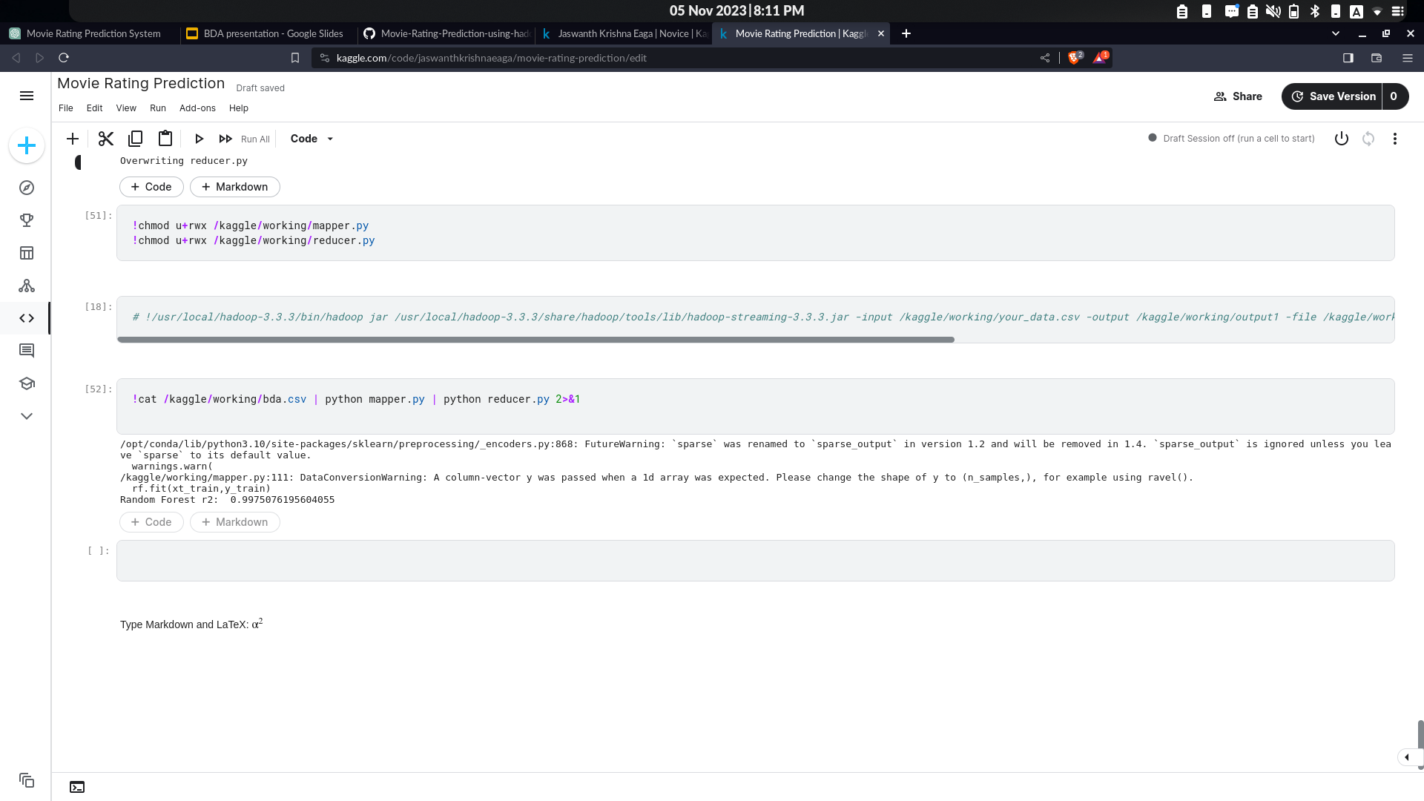
Communicating Model Results
Random Forest Regressor model achieved an r2 score of 99.7 percent
The Hadoop distributed computing capabilities of Hadoop enable us to handle big datasets and complex computations effectively.
Our highly accurate model offers applications such as forecasting movie ratings, gaining insights into audience tastes, and enhancing content recommendations.

Slide 25
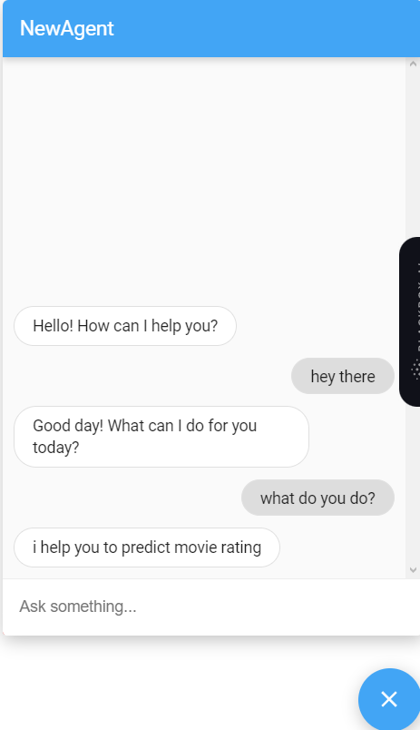
Miscellaneous
We added Dialog Flow, a chatbot that can communicate with the user and help the user on their request. We implemented this using ES dialog flow console.

Slide 26
Artifact - 7 : Model Deployment

Slide 27
Model Deployment
We wrote a flask API for our backend.
In this API, we will load the model and take the model input from API input.
Model will predict the rating in the range of -1 to 1.
We scaled this to 0-100 which is actual ratings range using the same standard scaler used in mapper function.
This new rating will be returned by the API as the predicted rating.

Slide 28
Model Deployment
We deployed our API in render.com
Curl request for the model API -
curl --location 'https://rating-predictor-yknv.onrender.com/predict' --header 'Content-Type: application/json' --data '{
"movie_info": {"content_rating": "PG-13", "genres": "action", "runtime": 109, "tomatometer_status": "rotten", "tomatometer_count": 47, "audience_status": "spilled", "audience_rating": 77, "audience_count": 345642, "tomatometer_top_critics_count": 37, "tomatometer_fresh_critics_count": 12, "tomatometer_rotten_critics_count": 150}
}'
We created a frontend for our model to take the data from the user and pass it to the model. Model will return the prediction and we show it here in the frontend.
Movie rating prediction

Slide 29
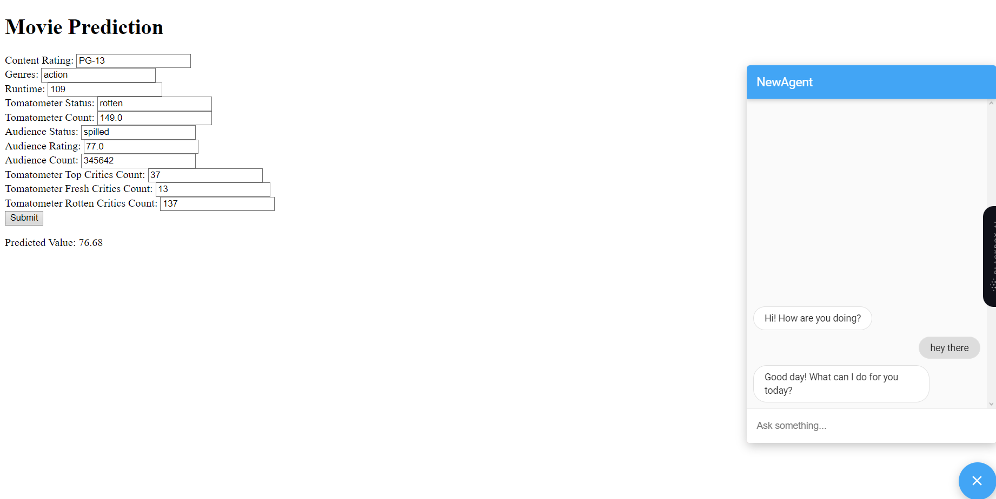
Model Deployment
Here is the frontend for our model.

Slide 30
Thank you

