Slide 1

Vel Tech Rangarajan Dr. Sagunthala R&D Institute of Science and Technology
School of Computing
Department of Computer Science and Engineering
10211CS224 / FULL STACK APPLICATION DEVELOPMENT (JAVA)
PROJECT REVIEW : MILESTONE PROJECT – 2
Date: 21-04-2026
EduTicket-Department Event Booking
SDG: SDG 4 – Quality Education
Presented By:
K.Drona Sai Ganesh– VTU26148– Reg.No.23UECS0971
Courses Handling Faculty:
Dr.K.Seethalakshmi

Slide 2
INTRODUCTION
1
EduTicket is a React JS based web application for online ticket booking of internal department events.
Enables students and faculty to view event details including name, date, time, venue, and ticket price.
Provides seamless online booking functionality with real-time ticket availability tracking.
Implements comprehensive validation to ensure data integrity and user-friendly error messages.
Displays booking confirmation messages with booking summary after successful registration.
Features automatic calculation of total amount based on number of tickets and ticket price.
Implements state management using React hooks for efficient data handling and component communication.
Ensures responsive design and clean code organization for maintainability and scalability.
2
3
4
5
6
7
8
9

Slide 3
PROBLEM STATEMENT
1
2
Manual event registration and ticket booking processes are time-consuming and error-prone.
Students face difficulty accessing event information scattered across different platforms.
Lack of real-time ticket availability tracking leads to overbooking and registration conflicts.
No automated confirmation system results in communication gaps between organizers and participants.
Manual validation of ticket numbers and availability is inefficient and prone to mistakes.
Students cannot easily view comprehensive event details in a single centralized platform.
Event organizers struggle to manage ticket inventory and participant information manually.
Absence of proper error handling causes poor user experience during booking process.
3
4
5
6
7
8
9

Slide 4
OBJECTIVE(S)
1
2
3
To develop a React JS based web application for efficient online ticket booking
To display comprehensive event details including name, department, date, time, venue, and pricing
To implement real-time ticket availability tracking and overbooking prevention
To ensure all input fields are validated with user-friendly error messages
To provide automated booking confirmation with detailed booking summary
4
5
6
7
8
9

Slide 5
PROPOSED SYSTEM
1
A React JS based web application built with Vite for fast development and optimal performance.
Two main modules: Event Details Module displaying event information and Booking Module for ticket reservations.
Event Details Module shows event name, department, date/time, venue, ticket price, and available ticket count.
Booking Module allows users to enter name, email ID, department, and desired number of tickets.
Implements comprehensive validation for mandatory fields, email format, and positive ticket numbers.
Prevents overbooking by automatically checking ticket availability before confirming bookings.
Displays detailed booking confirmation message including user name, event name, quantity, and total amount.
Utilizes React functional components with useState hook for efficient state management and real-time updates.
2
3
4
5
6
7
8
9

Slide 6
PROPOSED SYSTEM ARCHITECTURE
1
2
3
React JS based single-page application with component-based architecture.
Event Details Component displays comprehensive event information to users.
Booking Form Component handles user input with built-in validation logic.
State Management using React useState Hook for managing application state.
Ensures smooth communication between components using props and callbacks.
Implements event handling for user interactions (button clicks, form submissions).
Utilizes conditional rendering to display content based on application state.
Maintains clean separation of concerns with modular functional components.
4
5
6
7
8
9

Slide 7
WORKFLOW
1
User opens the React application in a web browser and views available events.
Event Details Module displays event information with name, date, time, venue, and pricing.
User selects an event and fills the booking form with personal details.
Application validates all inputs: mandatory fields, valid email format, positive ticket numbers.
If tickets are available, system prevents overbooking and allows booking confirmation.
Application displays real-time updated ticket count after successful booking.
Booking confirmation message shows user name, event name, tickets booked, and total amount.
System handles errors gracefully with user-friendly error messages for invalid inputs.
2
3
4
5
6
7
8
9

Slide 8
TECHNOLOGIES USED
Frontend Technologies
React JS – Main framework for building user interface with functional components.
JSX – Syntax extension for writing HTML-like code within JavaScript components.
React Hooks (useState) – For managing component state and side effects.
React Router – For handling navigation and routing between pages.
Axios – For making HTTP requests to backend services.
Styling & Build Tools
CSS3 – For styling components and creating responsive design.
Vite – Modern build tool for development and production builds.
Responsive Design – Ensures application works on desktop and mobile devices.
Development Environment
Node.js – JavaScript runtime for running development server.
npm – Package manager for managing project dependencies.
TypeScript – Optional type checking for JavaScript code quality.
VS Code – Code editor for development.
Web Browser – For running and testing the application.
1
2
3
4
5
6
7
8
9

Slide 9
MODULE DESCRIPTION
Event Details Module
Displays event name, department, date/time, venue, ticket price, and availability.
Shows event information in a user-friendly format for easy understanding.
Allows users to view all event details before making booking decisions.
Ticket Booking Module
Accepts user inputs: name, email ID, department, and number of tickets required.
Validates all inputs with appropriate error messages for invalid data.
Prevents booking more tickets than available through validation logic.
Calculates total amount based on ticket price and quantity selected.
Validation & Error Handling Module
Ensures all mandatory fields are filled before submission.
Validates email format using regex patterns or built-in validation.
Checks that number of tickets is a positive number.
Prevents overbooking by comparing requested tickets with available tickets.
Displays user-friendly error messages for all validation failures.
Booking Confirmation Module
Displays confirmation message after successful booking.
Shows booking summary including user name, event name, quantity, and total amount.
Updates available ticket count in real-time after confirmation.
Provides option to reset form for additional bookings.
1
2
3
4
5
6
7
8
9

Slide 10
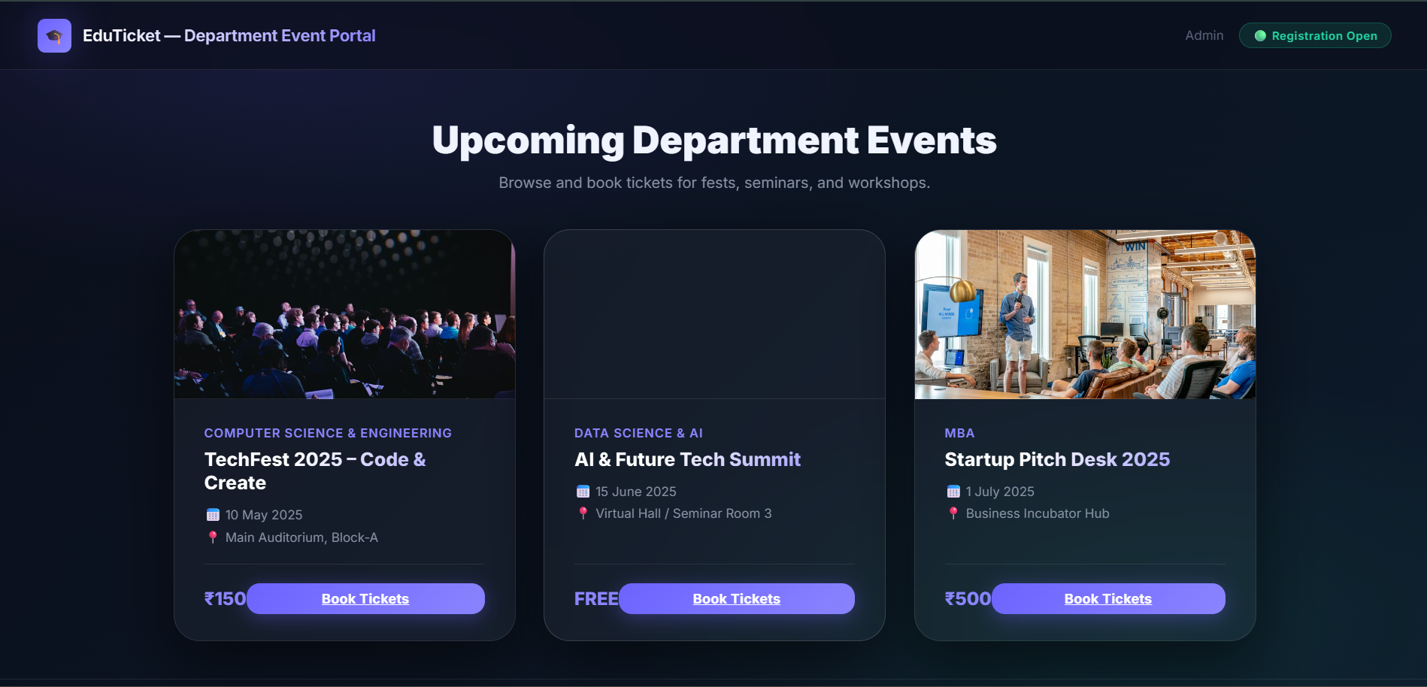
IMPLEMENTATION SCREENSHOTS
1
2
3
4
5
6
7
8
9

Slide 11
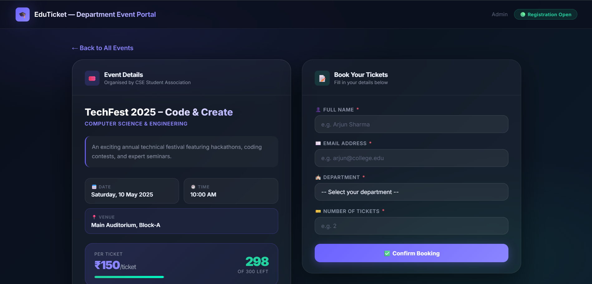
IMPLEMENTATION SCREENSHOTS
1
2
3
4
5
6
7
8(A)
9

Slide 12
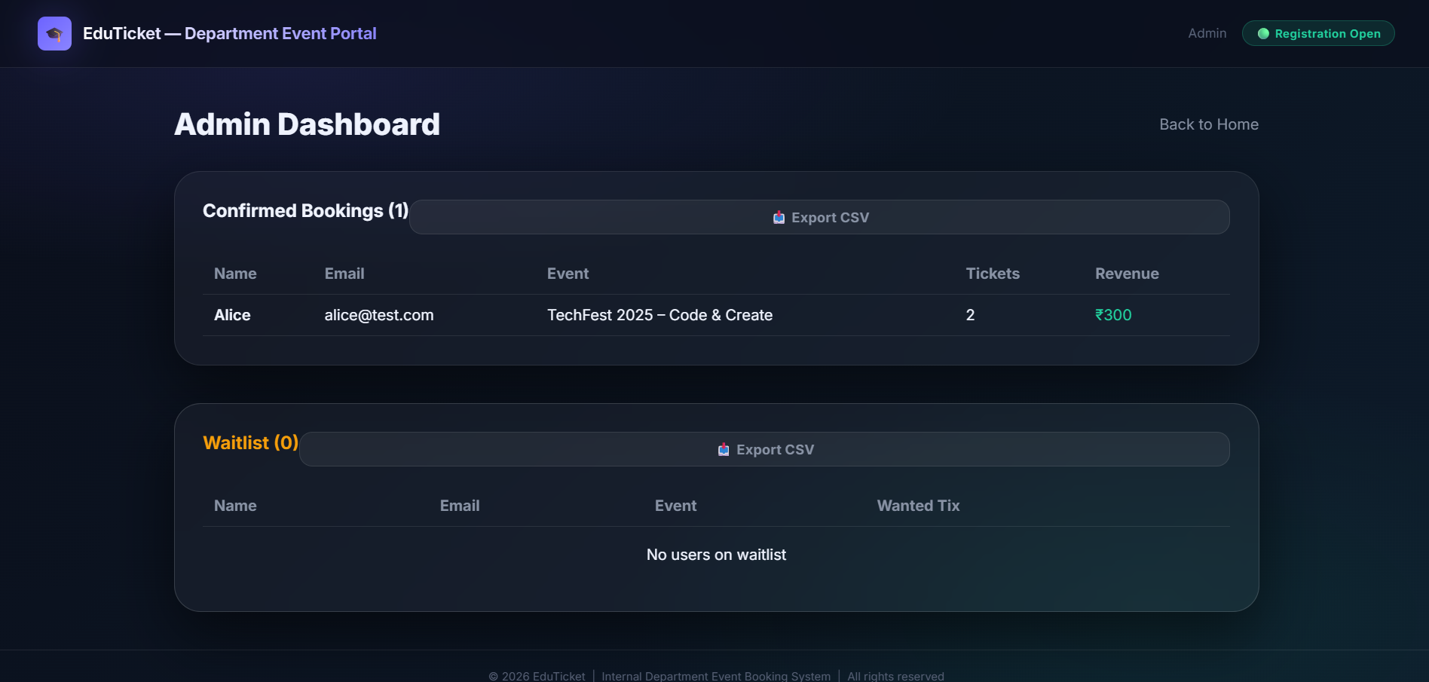
IMPLEMENTATION SCREENSHOTS
1
2
3
4
5
6
7
8(B)
9

Slide 13
ADVANTAGES & LIMITATIONS
ADVANTAGES
Provides a centralized online platform for viewing and booking event tickets.
Eliminates manual registration process with automated online booking system.
Real-time ticket availability tracking prevents overbooking and conflicts.
Comprehensive validation ensures data integrity and improves user experience.
Automated booking confirmation provides instant feedback to users.
Responsive design works seamlessly on desktop and mobile devices.
Modular React component architecture enables easy maintenance and future enhancements.
Reduces communication gaps between event organizers and participants.
LIMITATIONS
Requires JavaScript enabled browser for proper application functionality.
Backend server needed for data persistence and API endpoints.
Email validation only checks format, not actual email delivery.
No payment gateway integration for online payments.
Limited to web platform (can be extended to mobile apps in future).
No real-time notification system (can be added with WebSockets).
No user authentication system (users not required to login).
1
2
3
4
5
6
7
8
9

Slide 14
Thank you

