Slide 1

MEDPHARM360
Team-06

Slide 2
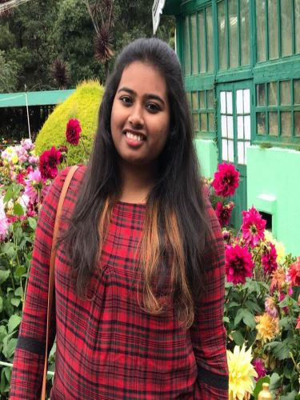
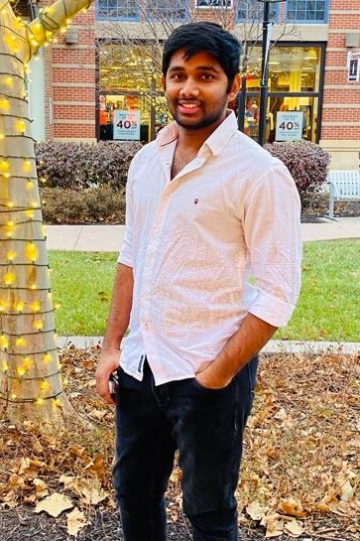

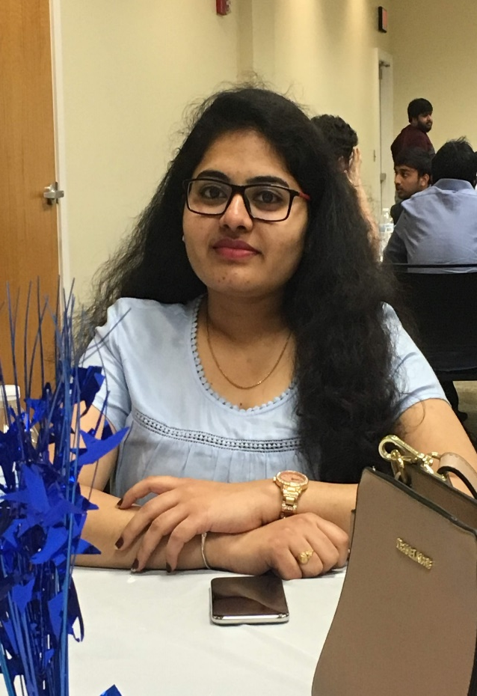
Team Members
Sanjana
Baswapuram
Harshavardhan Reddy Bollam
Jaswanthi Nannuru
Vamshikrishna Reddy Yedalla

Slide 3
Introduction to the problem
It is difficult for patients to go initially to hospitals in a busy life instead, they can make an appointment to see the doctor.
Doctors may not be available at times, so patients can search other doctors again.
Harsha Bollam

Slide 4
Proposed Solution
Booking an online doctor's appointment could make it easy and best for all patients to know the availability of doctors.
MEDPHARM360, an android application is designed in such a way that, by looking at all available doctors, patients can book the appointment at their time.
Not only can patients book their doctor's appointments and they can also store their doctor's health records.
Health records could help patients and doctors tell them how they had their health report and what were all the medications that different doctors had told them.
Harsha Bollam

Slide 5
Features and Completion Status
Features | Completion Status
Doctors can select his available timings | Completed
Patients can book the appointment at Doctors and get their confirmation number | Completed
Patients can enter the health records data into the application | Completed
Doctors can look at the previous health records of their patients with the help of patients appointment confirmation number | In progress
Signup Functionality – New Doctor | Completed
Signup Functionality – New Patient | Completed
Login Functionality - Doctor | Completed
Logout Functionality - Patient | Completed
Harsha Bollam

Slide 6

Mobile Backend Services
Persistent Storage: Back4App
We have used the Back4App as cloud database to store the doctors and patients credentials
We used Back4App to store the Health Records data entered by the Patients.
We used Back4App where Doctor can retrieve all the health records of his patients which are entered by him
Harsha Bollam
Notes:
Back4App is an open source backend that uses Parse framework and helps developers build scalable and extensible applications at a much more rapid pace.

Slide 7
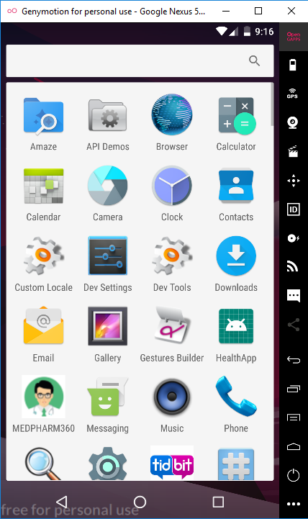
API’s Used for this project
API: We are using android API version of 6.0-API 23 in GENY MOTION.
Device Name: Google Nexus 5X.
Layout: The size of the layout is 1080x1920 with a density of 420.
Vamshi yedalla

Slide 8
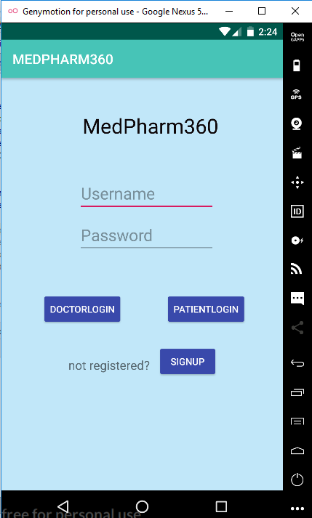
Main Page
Vamshi yedalla

Slide 9
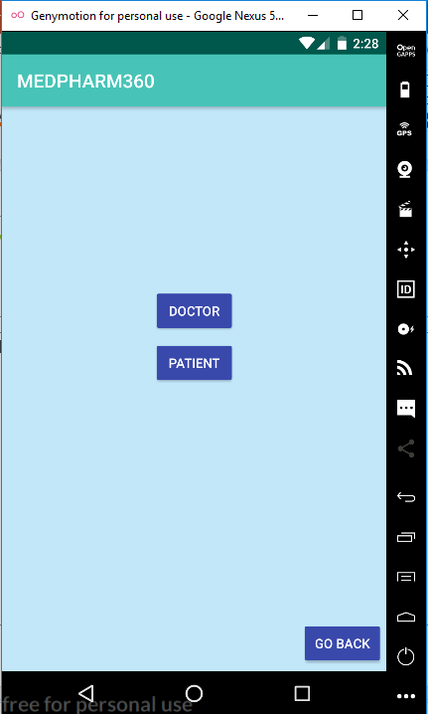
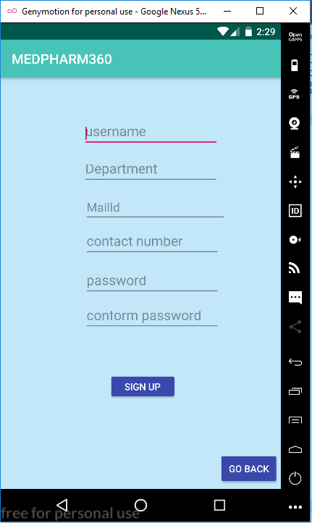
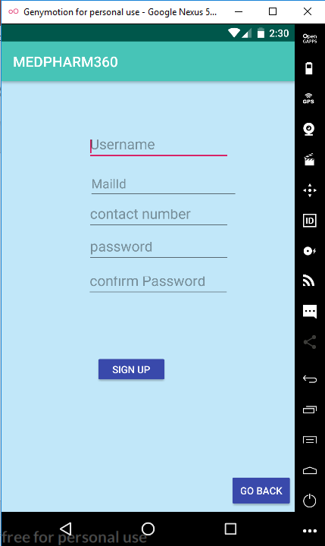
Signup Pages
Vamshi yedalla

Slide 10
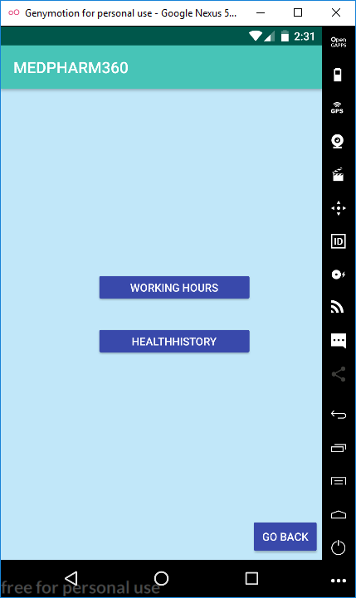
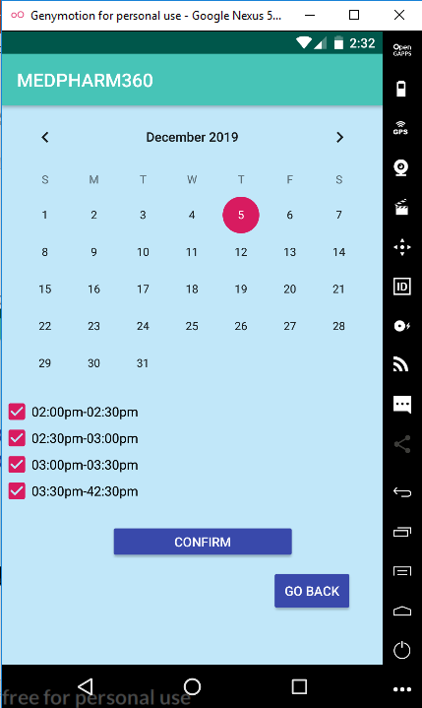
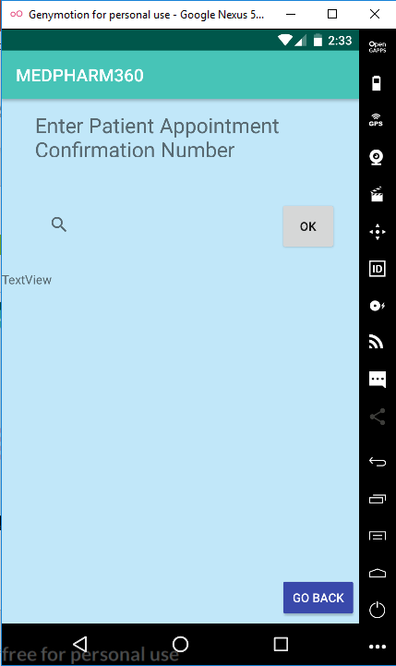
Doctor Availability and Patient Health Record Pages
Vamshi yedalla

Slide 11
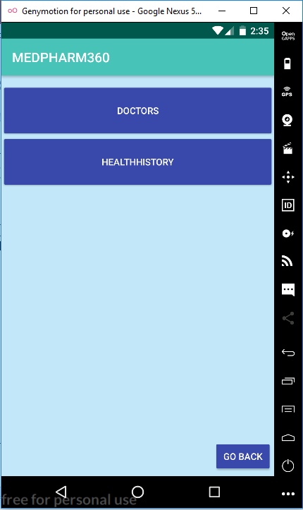
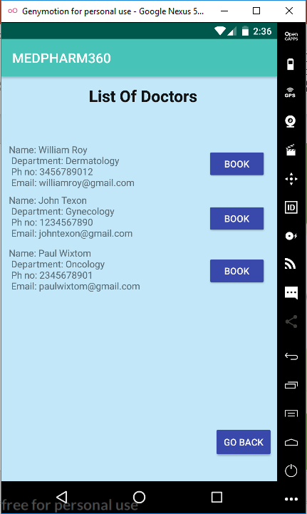
Patient Appointment Confirmation
Jaswanthi

Slide 12
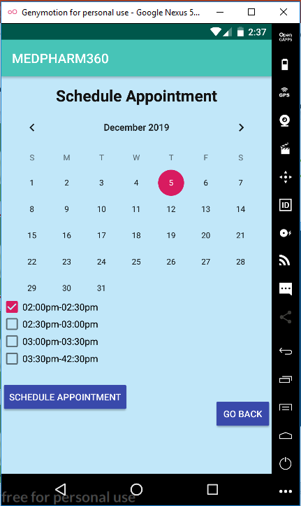
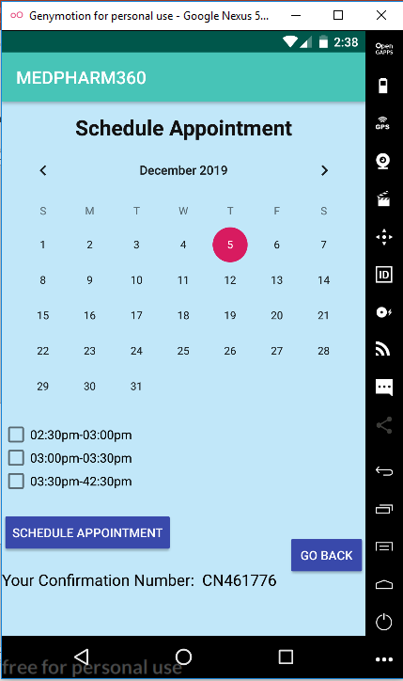
Patient Appointment Confirmation
Jaswanthi

Slide 13
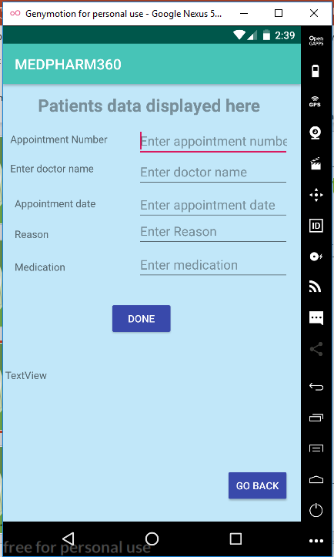
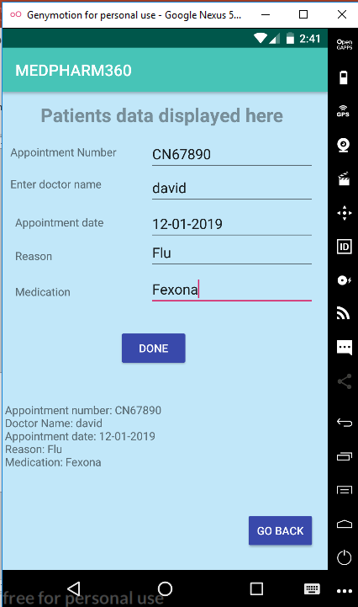
Patients Health Records
Jaswanthi

Slide 14
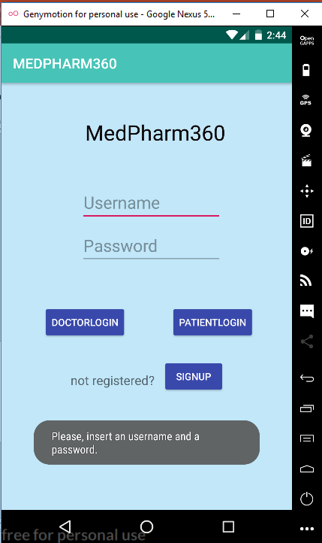
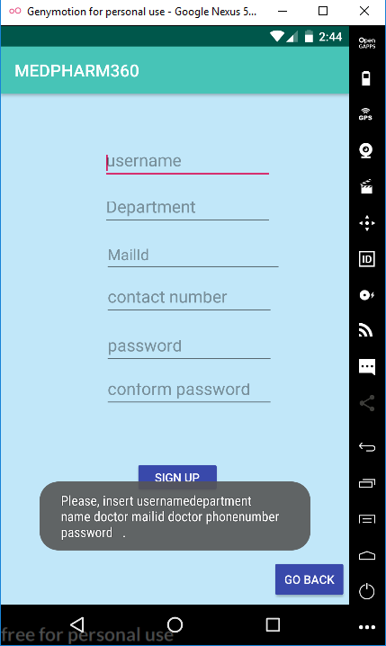
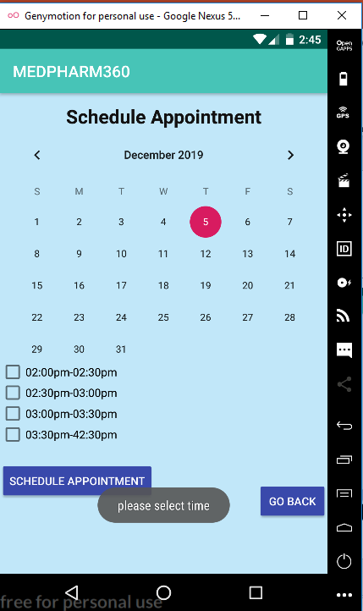
Error Messages
Jaswanthi

Slide 15
Problems Faced
Framing Idea
Understanding and implementing Cloud Database Back4App
Signup and Login Functionality
Reflecting the selected doctor available dates on patient
Storing the health records entered by patients in the database
Retrieving data from database
Sanjana

Slide 16
Future Improvements
Sending appointment confirmation number to their connected mobile device and given email address
Logout and forgot password options
Uploading the health record by the patient instead of entering all the details
Sanjana

Slide 17
Conclusion
This App helps doctors and Patients in either way.
Doctors use this Application to look at the Patients Previous History
Patients use this Application to book the appointment at doctor and also can view their Health Record.
Sanjana

Slide 18
References
https://developer.android.com/
https://dashboard.back4app.com/apidocs/6BESRIXh37rQXA8iFQN1TiRi6P5EJDznxfqg8MEm#introduction
https://stackoverflow.com/
https://www.youtube.com/watch?v=JBsoLYhv3nQ&t=231s
Sanjana

Slide 19

Thankyou!
Any Queries

Slide 20
DEMO Repository Link: https://github.com/sanjanabaswa/MEDPHARM360
Sanjana and Jaswanthi

