Slide 1
DATA AND
ARTIFICIAL INTELLIGENCE
Tableau Training
Course-end Project
©Simplilearn. All rights reserved.
simpli
learn

Slide 2
DATA AND
ARTIFICIAL INTELLIGENCE
Comparison of Region Based on Sales
©Simplilearn. All rights reserved.
simpli
learn

Slide 3
Objectives
Create a dashboard to visualize the sales comparison between two selected regions
©Simplilearn. All rights reserved.
simpli
learn

Slide 4
DATA AND
ARTIFICIAL INTELLIGENCE
Prerequisites
Hierarchy
Parameters
Calculated fields
Dashboard
©Simplilearn. All rights reserved.
simpli
learn

Slide 5
DATA AND
ARTIFICIAL INTELLIGENCE
Industry Relevance
• Hierarchy: It represents the level-wise configuration.
• Parameters: It is a workbook variable such as a number, date, or string that can replace a constant value in a calculation, filter, or reference line.
• Calculated fields: It creates new dimensions, such as segments, or new measures, such as ratios or sums.
• Dashboard: It displays several views and compares a variety of data simultaneously.
©Simplilearn. All rights reserved.
simpli
learn

Slide 6
DATA AND
ARTIFICIAL INTELLIGENCE
Problem Statement
The director of a leading organization wants to compare the sales between two regions. He has asked each region operators to record the sales data to compare by region. The upper management wants to visualize the sales data using a dashboard to understand the performance between them and suggest the necessary improvements.
©Simplilearn. All rights reserved.
simpli
learn

Slide 7
DATA AND
ARTIFICIAL INTELLIGENCE
Tasks to Perform
Perform the below tasks on the dataset provided using Tableau
1. Select Sample Superstore as Dataset
• Use Sample Superstore Dataset
• Select Data
• Use Group by from Data Source Table on a Folder to create a folder to segregate the required data
2. Create a hierarchy called Location
©Simplilearn. All rights reserved.
simpli
learn

Slide 8
DATA AND
ARTIFICIAL INTELLIGENCE
Tasks to Perform
Perform the below tasks on the dataset provided using Tableau
3. Create two parameters: Primary Region and Secondary Region with all regions listed in them.
• Create Parameters for Primary Region and Secondary Region
• Create a Calculated Field for both Primary Region and Secondary Region
4. Create a First Order Date
• Create a Calculated Field and name it as the First Order Date
©Simplilearn. All rights reserved.
simpli
learn

Slide 9
DATA AND
ARTIFICIAL INTELLIGENCE
Tasks to Perform
Perform the below tasks on the dataset provided using Tableau
5. Create a dashboard
• Align all sheets in the dashboard
6. Partition the dashboard to display the below details of Primary Region and Secondary Region
• First Order Date
• Total Sales
• Average Sales per Order
• No. of Customers
• No. of Orders
• No. of Products in Sale
©Simplilearn. All rights reserved.
simpli
learn

Slide 10
DATA AND
ARTIFICIAL INTELLIGENCE
Calculated Fields — Formulas
First Order Date
Total Sales (Primary)
MIN(IF [Region]=[Primary Region] THEN [Order Date] END)
SUM(IF [Region]=[Primary Region] THEN [Sales] END)
Avg Sales / Order
No. of Customers
SUM([P.Sales]) / COUNTD(IF [Region]=[Primary Region] THEN [Order ID] END)
COUNTD(IF [Region]=[Primary Region] THEN [Customer ID] END)
No. of Orders
No. of Products
COUNTD(IF [Region]=[Primary Region] THEN [Order ID] END)
COUNTD(IF [Region]=[Primary Region] THEN [Product ID] END)
Note: Duplicate all fields replacing [Primary Region] with [Secondary Region]
©Simplilearn. All rights reserved.
simpli
learn

Slide 11
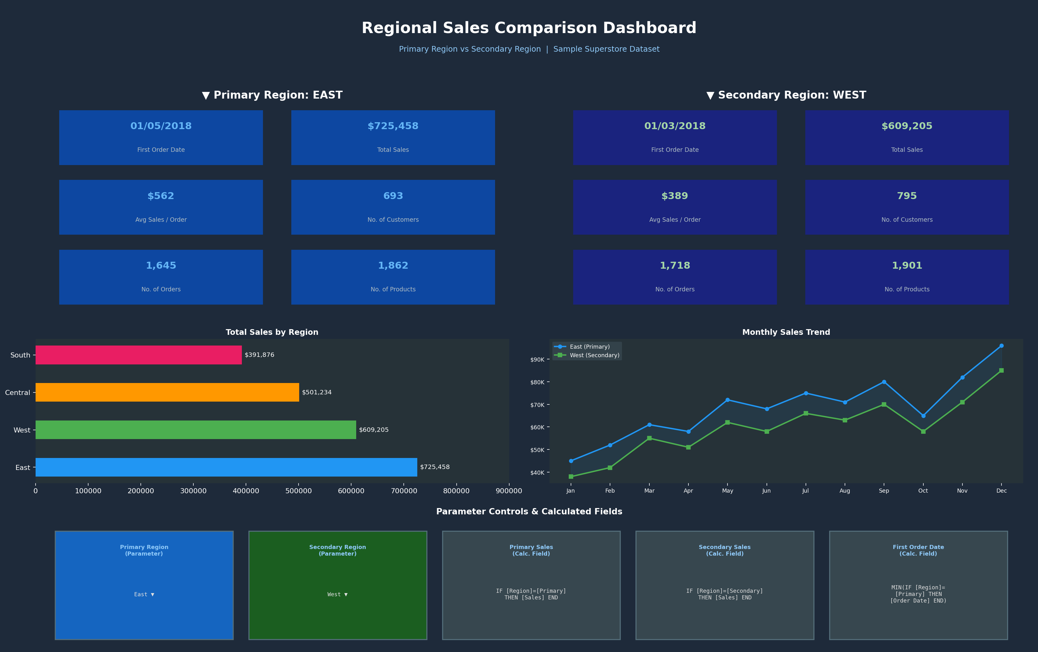
DATA AND
ARTIFICIAL INTELLIGENCE
Dashboard Preview
©Simplilearn. All rights reserved.
simpli
learn

Slide 12
DATA AND
ARTIFICIAL INTELLIGENCE
Project Outcome
• This project is designed to help create a dashboard to visualize the sales comparison between two selected regions.
• In order to increase sales, the organization can take preventive measures using dashboards.
©Simplilearn. All rights reserved.
simpli
learn

Slide 13
DATA AND
ARTIFICIAL INTELLIGENCE
Submission Process
1. Complete the project in Tableau Public
2. Complete each task listed in the problem statement
3. Save and upload the dashboard on Tableau Public
4. Copy the link to the dashboard
5. Take screenshots of the results for each question and the corresponding code
6. Save it as a document, and submit it using the Assessment tab
7. Tap the Submit button (this will present you with three choices)
8. Attach the three files, and then click Submit
©Simplilearn. All rights reserved.
simpli
learn

Slide 14
DATA AND
ARTIFICIAL INTELLIGENCE
Thank You
©Simplilearn. All rights reserved.
simpli
learn

