Slide 1
Banking — Course-End Project 2
Vehicle Loan Default
Prediction
EDA · Logistic Regression · Tableau Dashboard
233,154
41
21.7%
0.618
Total Records
Features
Default Rate
ROC-AUC
Domain: Banking / FinTech | Model: Logistic Regression | Tools: Python · Tableau

Slide 2
Problem Statement & Objectives
Problem
Tasks Performed
Financial institutions incur significant losses due to vehicle loan defaults.
This has led to:
• Tightening of vehicle loan underwriting
• Increased loan rejection rates
• Need for better credit risk scoring
Dataset: 233,154 records with 41 attributes
Goal: Identify determinants of vehicle loan default and build a predictive model.
1. Data inspection — structure, missing values, duplicates
2. Variable renaming to Python standards
3. Missing value treatment (Employment Type)
4. Statistical description of quantitative variables
5. Target variable & category-wise distribution
6. Employment type, Age & ID proof analysis
7. Credit bureau score deep dive
8. Primary & secondary account exploration
9. Logistic Regression + Confusion Matrix + ROC
10. Tableau Dashboard — 6 interactive charts

Slide 3
Dataset Overview & Preliminary Inspection
233,154
41
0
7,661
Total Records
Total Features
Duplicate Records
Missing (Emp. Type)
Key Variable Structure
Missing Value & Cleaning Strategy
Variable | Type | Notes
loan_default | int64 | Target: 0=No Default, 1=Default
disbursed_amount | int64 | Loan amount disbursed to customer
Employment.Type | object | 7,661 missing — fill with mode
PERFORM_CNS.SCORE | int64 | Credit Bureau Score (0–900)
Date.of.Birth | datetime | Used to derive Age feature
PRI/SEC.* columns | int64 | Primary & Secondary account details
no_of_inquiries | int64 | Number of loan enquiries made
✓ Employment.Type → Fill with mode ('Self employed')
✓ No other columns have missing values ✓
✓ No duplicate records found ✓
✓ Column names: replace '.' with '_', lowercase
✓ Date.of.Birth → derive Age (reference: 2018-01-01)
✓ AVERAGE.ACCT.AGE (string) → parse to months

Slide 4
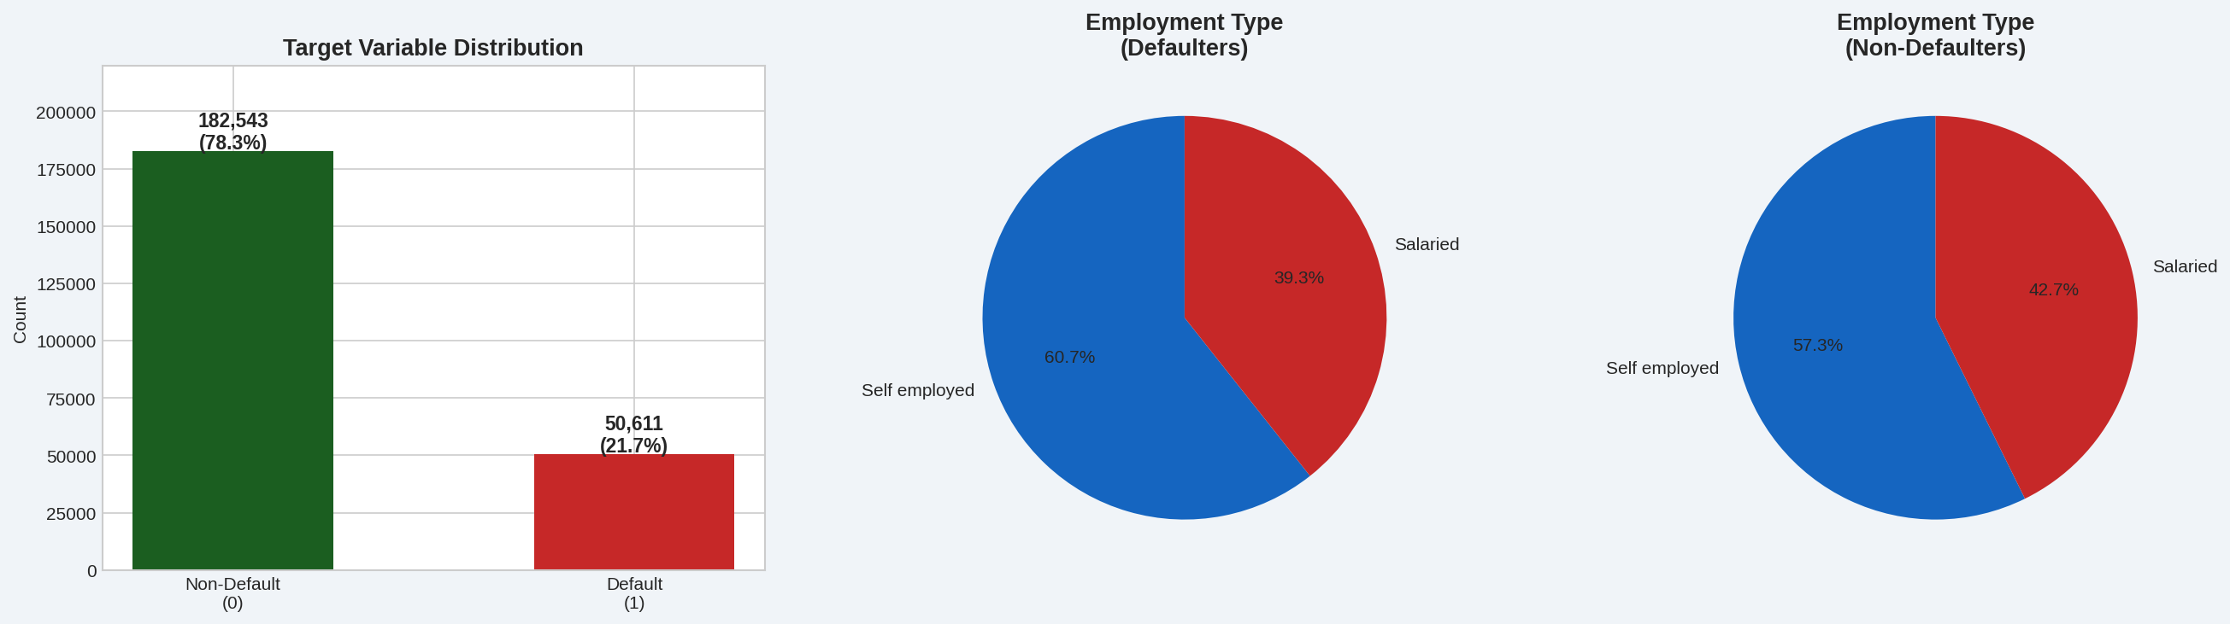
EDA — Target Variable & Employment Type Distribution
💡 Dataset is imbalanced — 78.3% Non-Default vs 21.7% Default (50,611 defaulters). Self-employed customers form ~57% of defaulters vs ~40% salaried. 7,661 missing Employment Type records filled with mode.

Slide 5
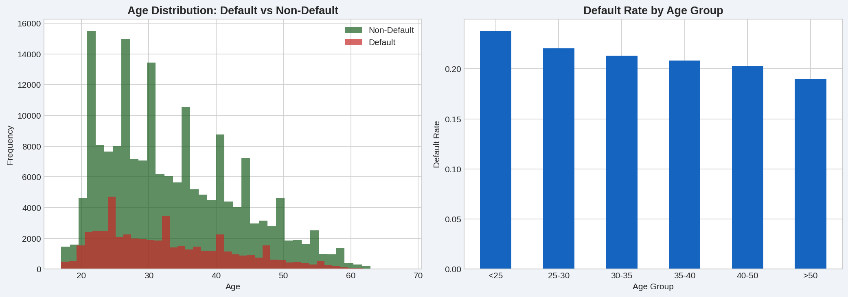
EDA — Age Distribution vs Loan Default
💡 Age range: 17–68 years. Avg age of Defaulters: 32.7 yrs vs Non-Defaulters: 33.5 yrs. Younger customers (18–30) form the largest borrower group and contribute most defaults. Age alone is NOT a strong predictor.

Slide 6
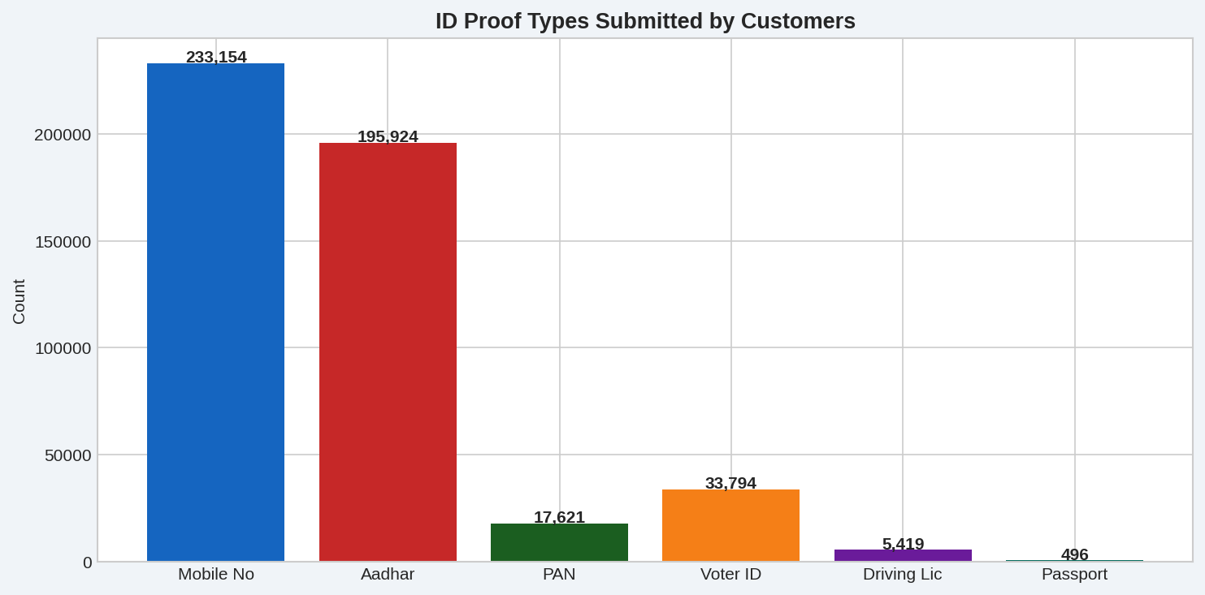
EDA — ID Proof Types Submitted by Customers (Q9)
Mobile No
100%
Aadhar
84%
Voter ID
14.5%
PAN
7.6%
Driving Lic
2.3%
Passport
0.2%

Slide 7
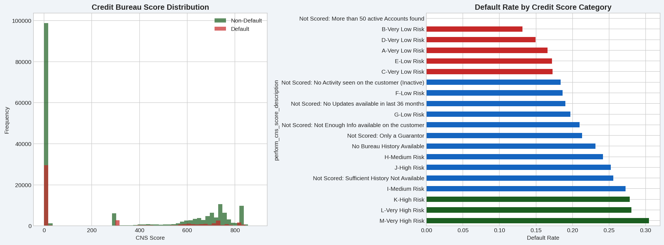
EDA — Credit Bureau Score Analysis (Q10)
💡 Customers with NO bureau history have the HIGHEST default rate. Higher CNS scores strongly correlate with lower default rates. 'M-Very High Risk' category has 30%+ default rate. Credit score is the strongest single predictor.

Slide 8
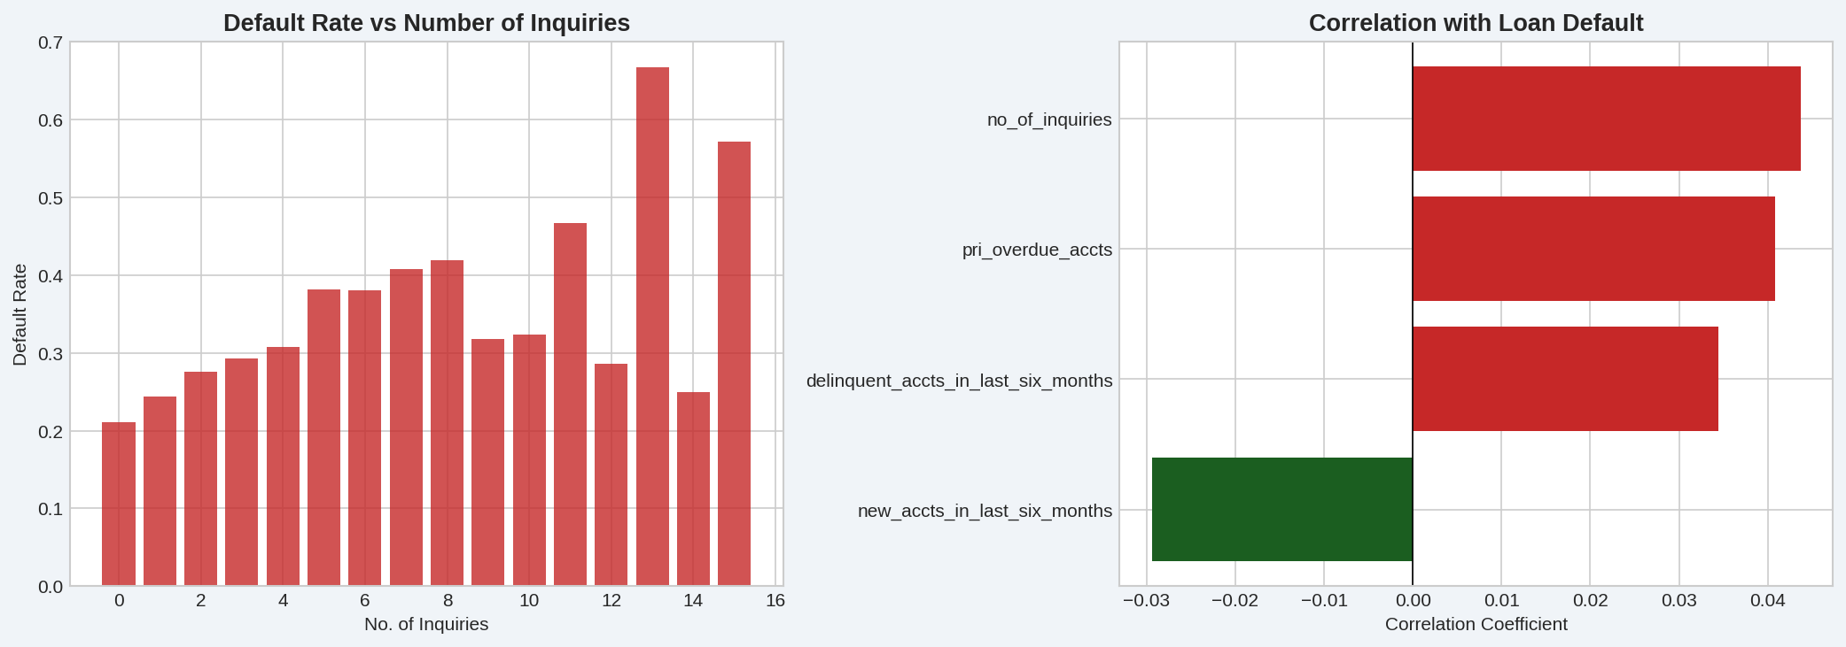
EDA — Inquiries & Credit History Analysis (Q13 & Q14)
💡 More inquiries = Higher default risk — customers making 13+ inquiries show 60%+ default rate. Delinquent accounts in last 6 months show strongest correlation with loan default. Credit history IS a significant predictor.

Slide 9
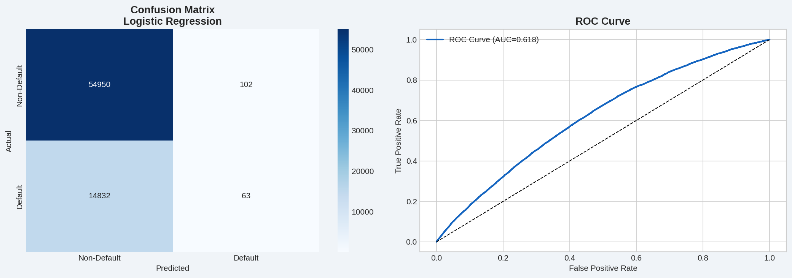
Logistic Regression — Model Building & Validation (Q15)
Raw Data
Preprocessing
& Cleaning
Feature
Selection
Train/Test
Split 70/30
Logistic
Regression
Evaluation
(ROC-AUC)
79%
0.618
88%
79%
Accuracy
ROC-AUC
F1 (Non-Def)
Precision

Slide 10
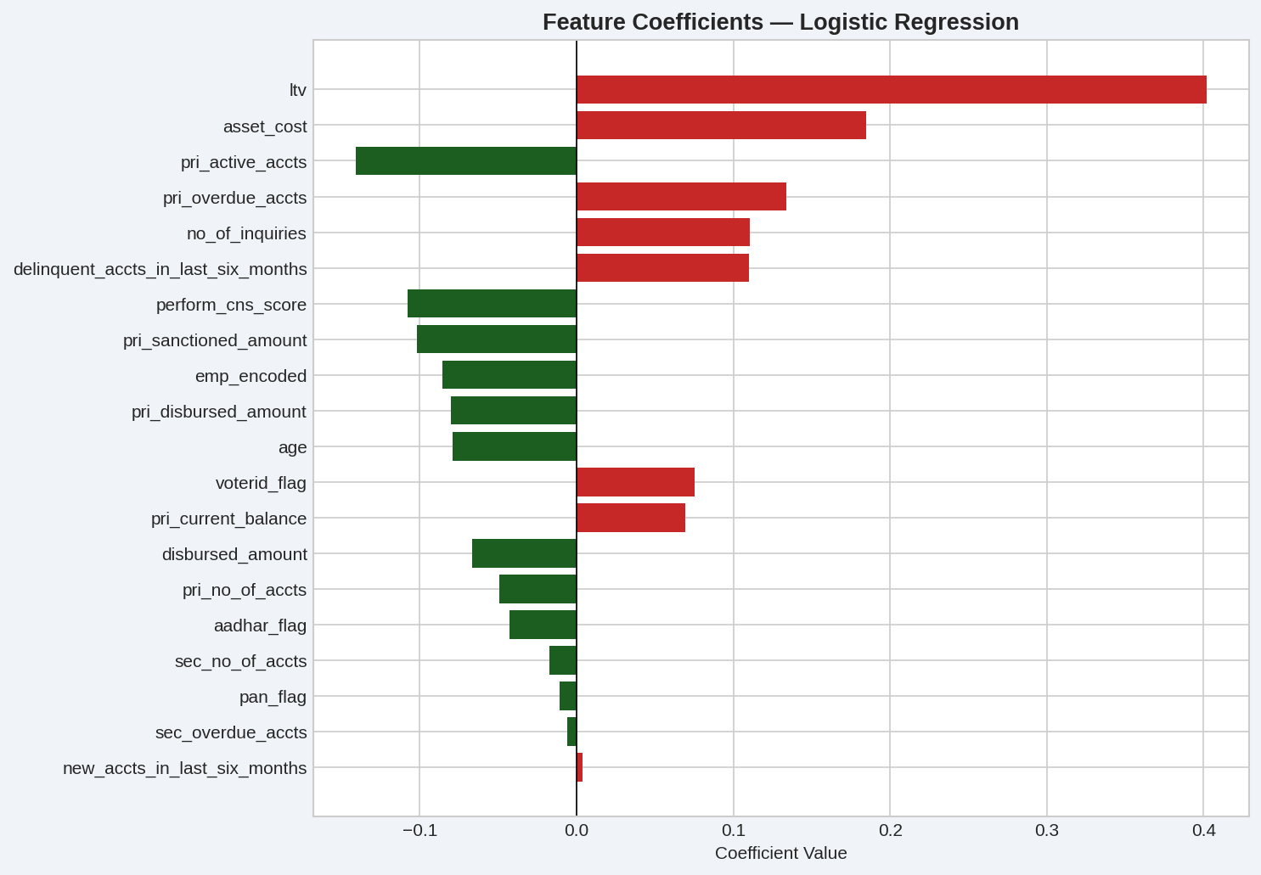
Logistic Regression — Feature Coefficients & Importance
🔴 Top Risk Factors
▲ High No. of Inquiries
▲ Delinquent Accts (6m)
▲ PRI Overdue Accounts
▲ New Accounts (6m)
▲ High LTV Ratio
🟢 Protective Factors
▼ High CNS Score
▼ Salaried Employment
▼ Aadhar Card Submitted
▼ High Disbursed Amount
▼ PAN Card Submitted

Slide 11
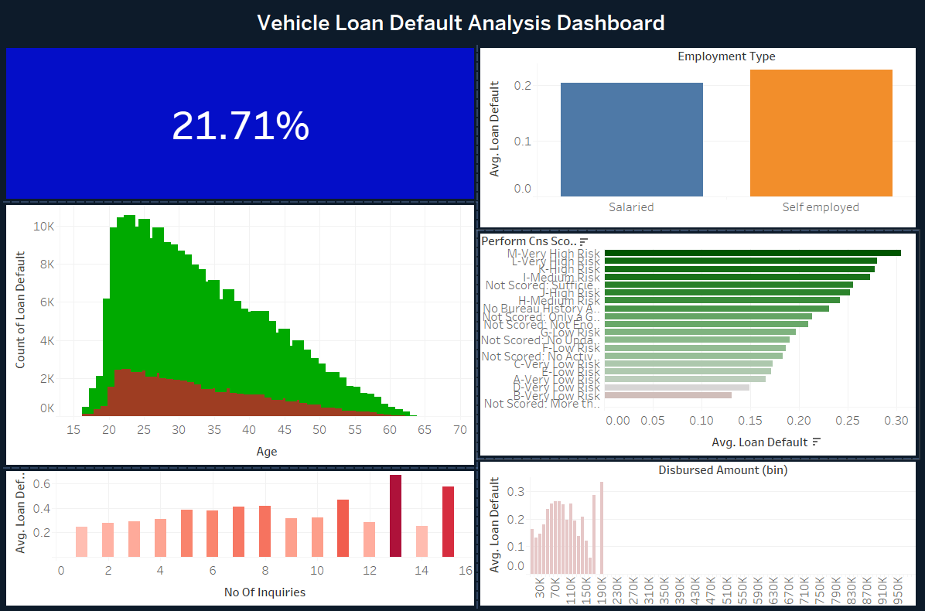
Tableau Dashboard — Vehicle Loan Default Analysis
📊 Dashboard contains 6 interactive charts: Default Rate KPI (21.71%) · Employment Type · Age Distribution · Credit Score · Inquiries Risk · Disbursed Amount

Slide 12
Tableau Dashboard — Chart-by-Chart Analysis
21.71% Default Rate
Credit Score
KPI tile showing overall default rate across all 233,154 records
M-Very High Risk shows 30%+ default rate. Low risk categories <15% default
Employment Type
Inquiries Risk
Self-employed (orange) has higher default rate (~22%) vs Salaried (blue, ~19%)
Clear upward trend — more inquiries = higher default probability (peaks at 13)
Age Distribution
Disbursed Amount
Stacked bar: Green=Non-default, Red=Default. Peak borrowers aged 22-26
Mid-range loans (100K-200K) show highest default rates (~25-30%)

Slide 13
Key Findings & Business Recommendations
📊
Class Imbalance
🔍
Inquiry Red Flag
21.7% default rate — dataset is imbalanced. SMOTE or class weighting needed for better recall on minority class (defaulters).
Customers making 13+ inquiries show 60%+ default rate. Multiple loan inquiries signal financial distress.
🏦
Credit Score is Key
📅
Credit History
CNS score is the strongest predictor. Customers with NO bureau history have the highest default risk (30%+).
Delinquent accounts in last 6 months is the strongest credit history predictor. Overdue primary accounts also critical.
💼
Employment Matters
🎯
Recommendations
Self-employed customers default more (~57% of defaulters). Salaried workers are lower risk — key underwriting factor.
Tighten lending for No-Bureau + High-Inquiry customers. Use XGBoost for better recall. Prioritize CNS score in risk models.

