Slide 1

Fake News Classifier
HackerSpace NLP Project
FINAL PROJECT

Slide 2

The Project
News articles influences people's ideas and opinion on the certain topics. Misleading articles and hoax articles could trigger extreme reactions from the public.
Hence, it is very important to factcheck and use reliable sources for following the latest news affairs. This website uses an ML model to understand news articles and tries to predict if the given article is fake or not.
This model classifies news articles as fake or not using TFIDF and Logistic Regression and had a 96.3% accuracy when classifying dataset from kaggle.com/fake-news.

Slide 3
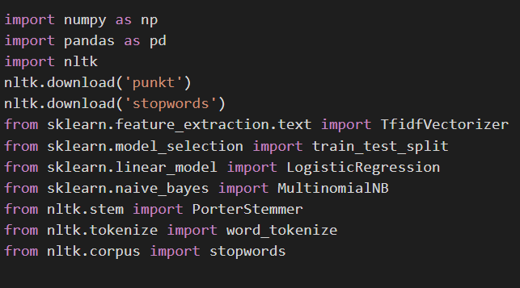
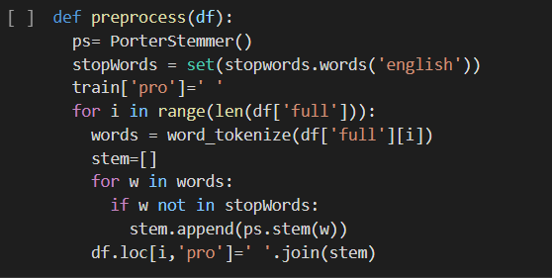
Code
Steps involved:
1)Libraries Used
2)Preprocessing

Slide 4
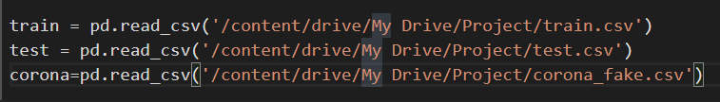
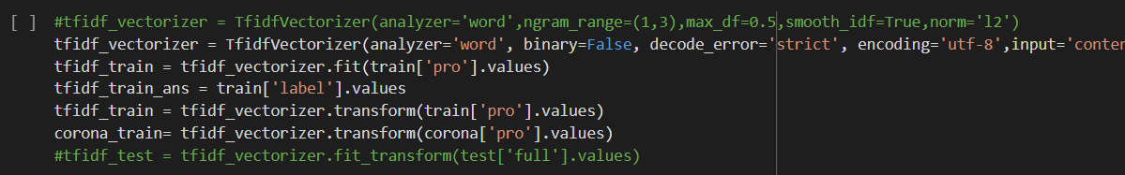

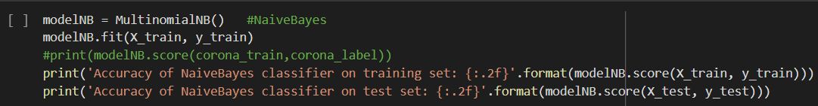
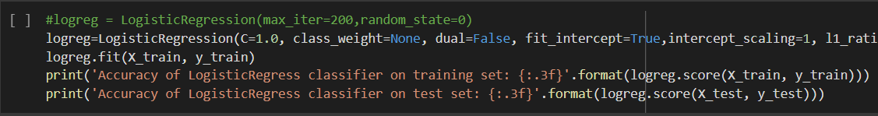
Code
3)Vectorizing text
4)Training the model

Slide 5
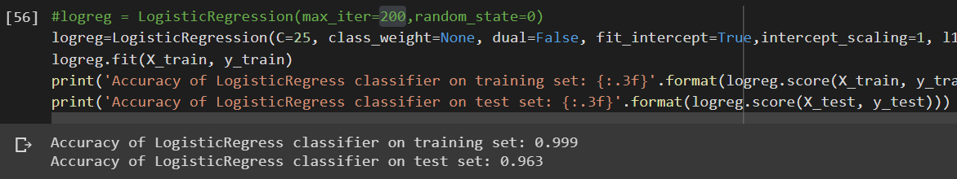
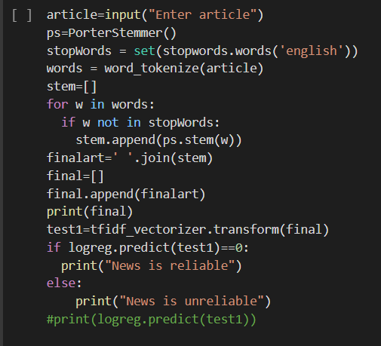
Code
5)Accuracy check for models
4)Predicting using the model

Slide 6
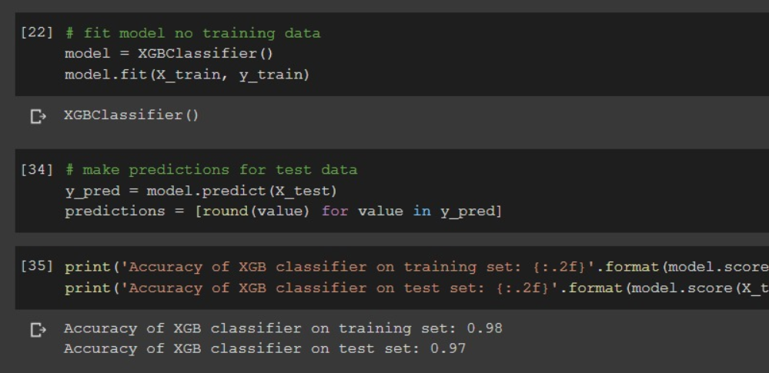
Code
We also used XGBoost model for the classification
It gave better accuracy on the test set but….
It classified all articles as unreliable when used for individual prediction

Slide 7
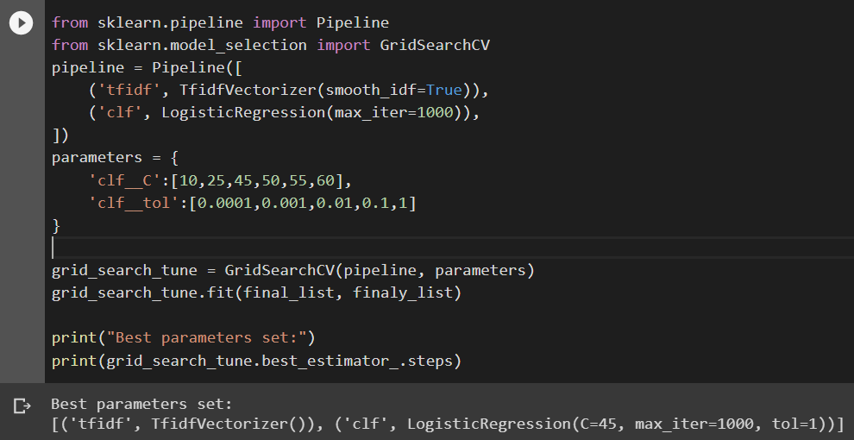
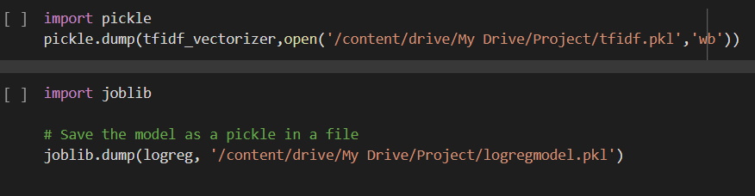
Tuning the Model
We used Grid Search to find the optimum parameters for the model to get best accuracy.
Then we dumped the model for the demo use

Slide 8
DEMO TIME
https://329f5d839de5.ngrok.io/

Slide 9
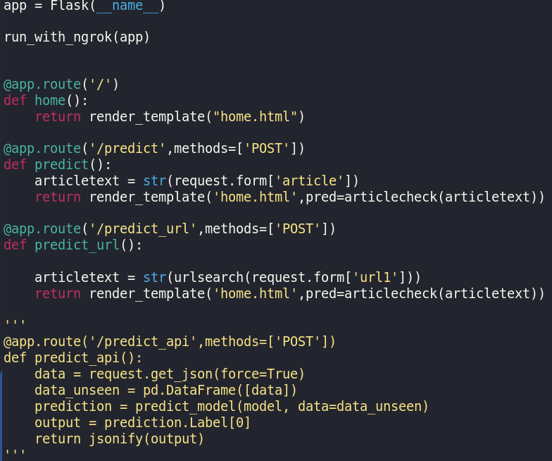
Web Deployment
Web deployment was done in python using the python flask module.
After testing on localhost, we can have a temporary link on the web using flask-ngrok.
Literally a one-line code for web deployment.

Slide 10
Usages
Could be used in social media platforms like WhatsApp and Facebook where fake news is notoriously rampant.
Help news website understand how fake articles could be eliminated through validation .
Act as guide points for individuals to check news reliability.

Slide 11

THANK YOU

