Slide 1
Data Structure

Slide 2
Data Structures
It allows:
  Programs to store, modify, and retrieve data
  Comparing the data with others.
  Some operations based on the data
Built-In and user-defined data structures available in Python
  Built-In Data Structures are List, Dictionary, Tuple, Set
  User-defined data structures are Stack, Queue, Tree, Linked List…

Slide 3
Overview of Lists
- What is a List in Python?
- Importance of Lists in Python programming

Slide 4
What is a List?
- A collection of elements that can grow and shrink dynamically
- Can store different data types (heterogeneous)
- Indexed access using square brackets []
- More flexible than arrays.

Slide 5
Characteristics of Lists
- Can store different data types
- Can grow or shrink as needed
- Flexible: Supports insertion, deletion, and sorting efficiently

Slide 6
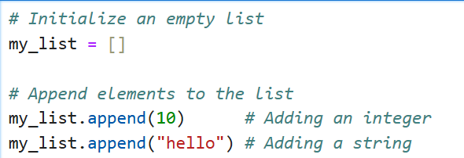

List Operations - Adding Elements
Example:
The append() method adds elements to the end of the list.
Lists support multiple data types, as seen in the output.

Slide 7
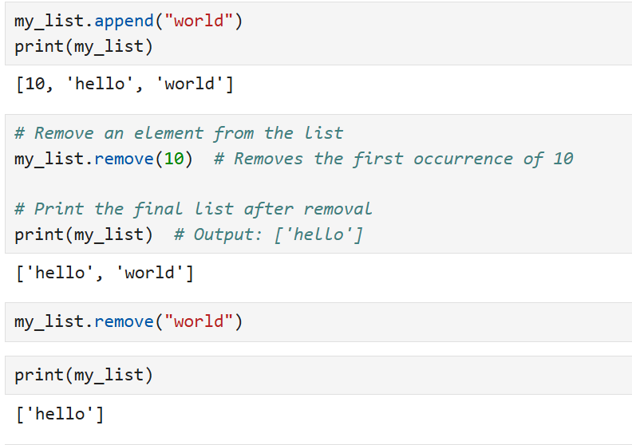
List Operations - Removing Elements
Example:
The remove() method deletes the specified element (10) from the list.
If the element does not exist, it will raise a ValueError.

Slide 8
Indexing in Lists
What is Indexing?
Indexing refers to accessing elements in a list using their position.
In Python, lists use zero-based indexing, meaning the first element is at index 0.

Slide 9
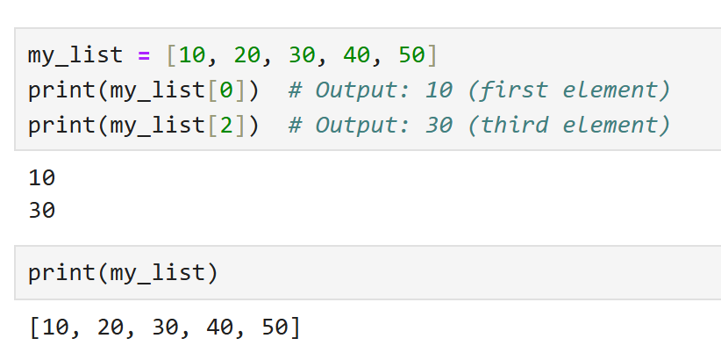
How to Use Indexing in Lists
Accessing Elements by Index

Slide 10
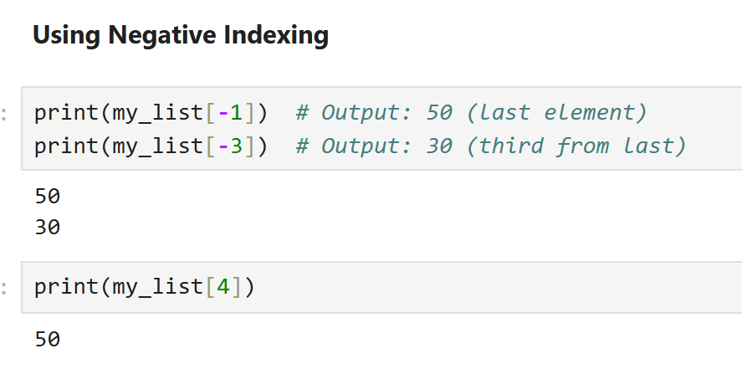
How to Use Indexing in Lists
Using Negative Indexing

Slide 11
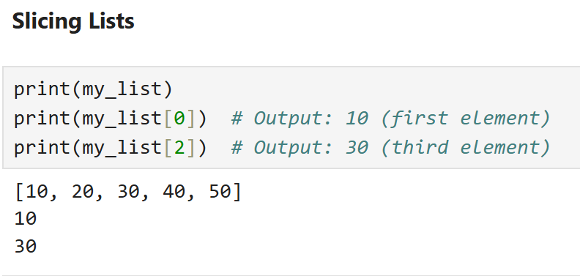
How to Use Indexing in Lists
Slicing Lists

Slide 12
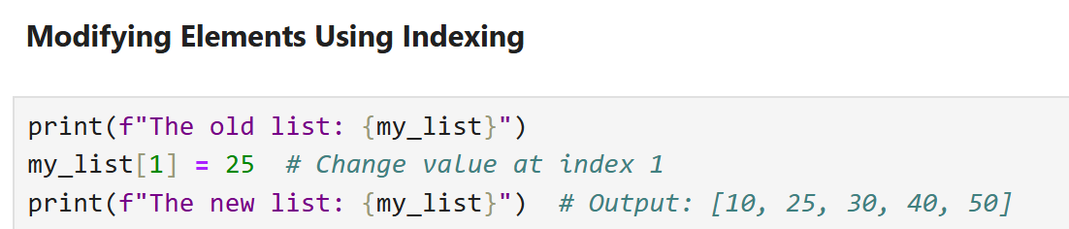
How to Use Indexing in Lists
Modifying Elements Using Indexing

Slide 13
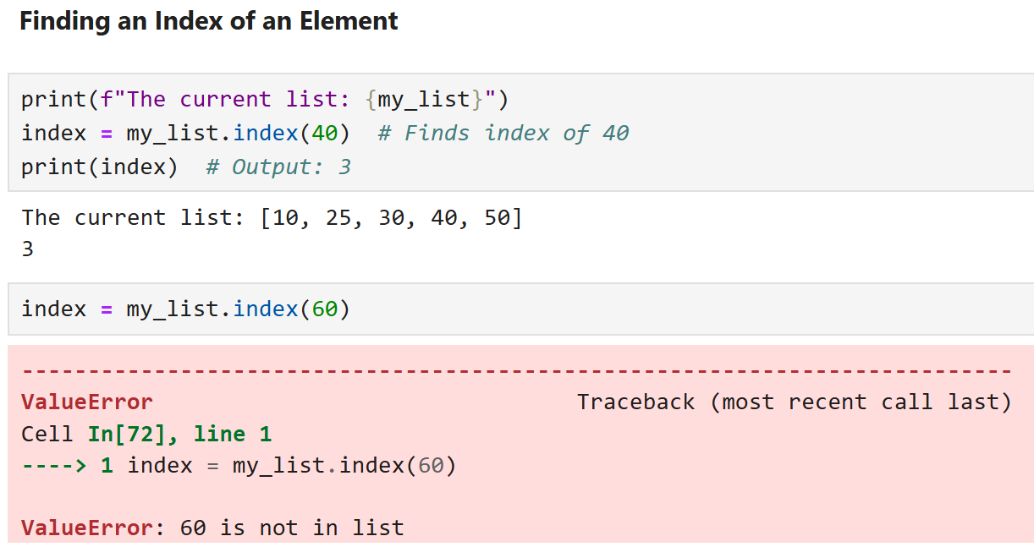
How to Use Indexing in Lists

Slide 14
When to Use Lists in Python?
Use Lists when:
- You need flexibility (dynamic size, different data types)
- You perform frequent insertions or deletions
- You are working with collections of items that change frequently

Slide 15
Overview of Arrays
What is an Array in Python?
- Importance of Arrays in programming
- Difference between Arrays and Lists in Python

Slide 16
What is an Array?
- A collection of elements stored in contiguous memory locations
- Fixed size (in most cases), but not in Python’s array.
- Elements must be of the same data type
- Indexed access using square brackets []

Slide 17
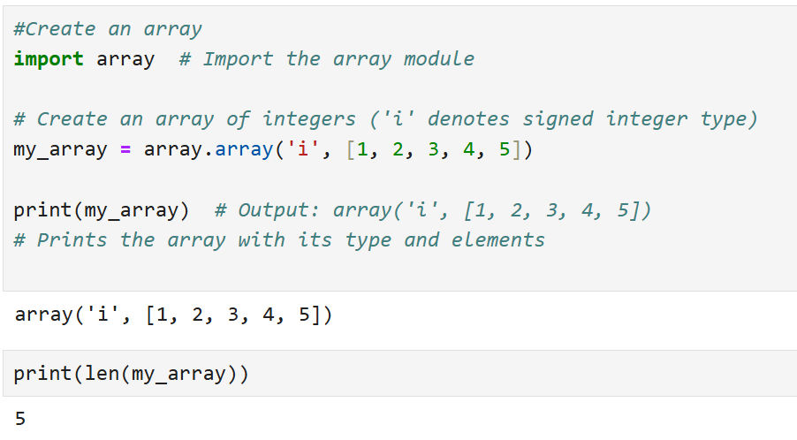
Creating an Array
Example:

Slide 18
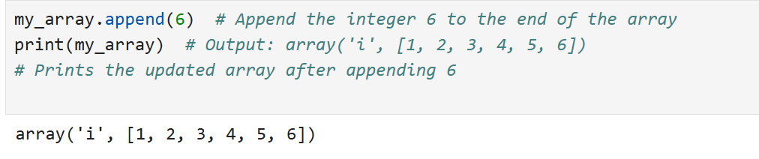
Adding Elements
Example:

Slide 19
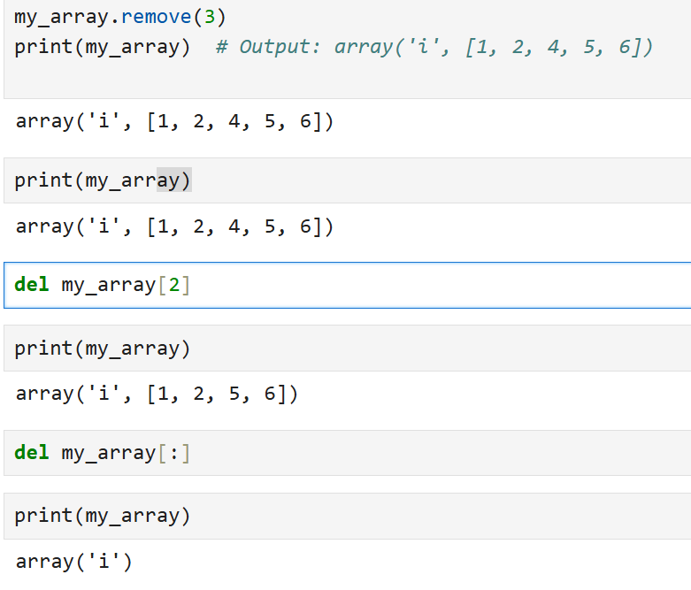
Removing Elements
Example:

Slide 20
When to Use Arrays in Python?
Use Arrays when:
- You need fast access to elements via indexing
- You know the size in advance
- Memory allocation needs to be efficient

Slide 21
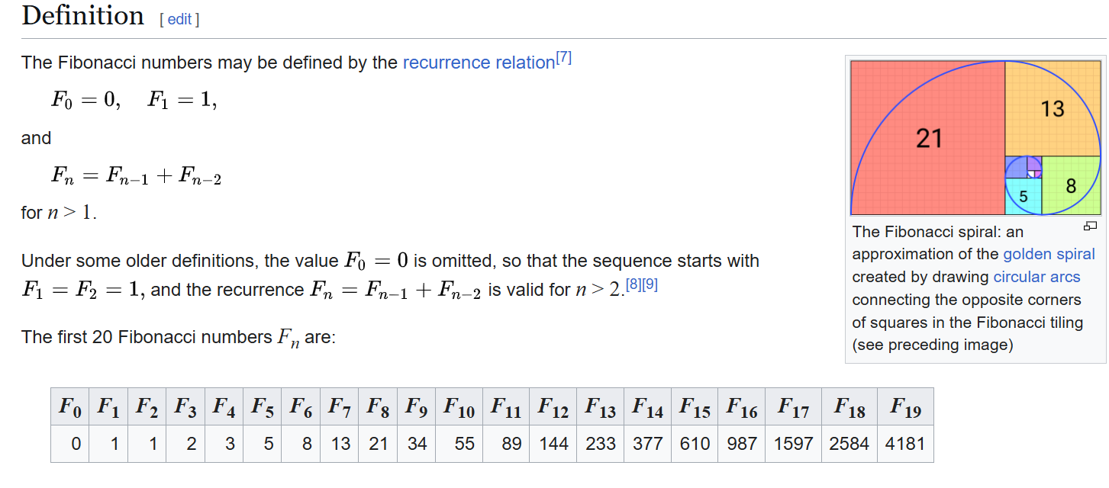
Fibonacci sequence
Link: Fibonacci sequence – Wikipedia

Slide 22
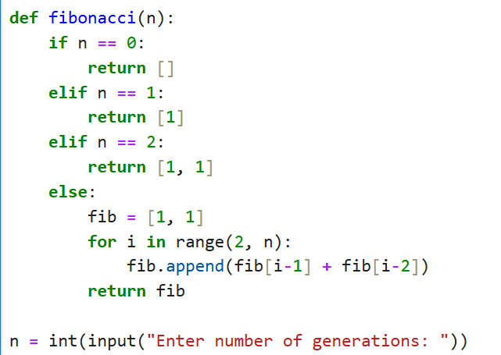
Fibonacci sequence

