Slide 1

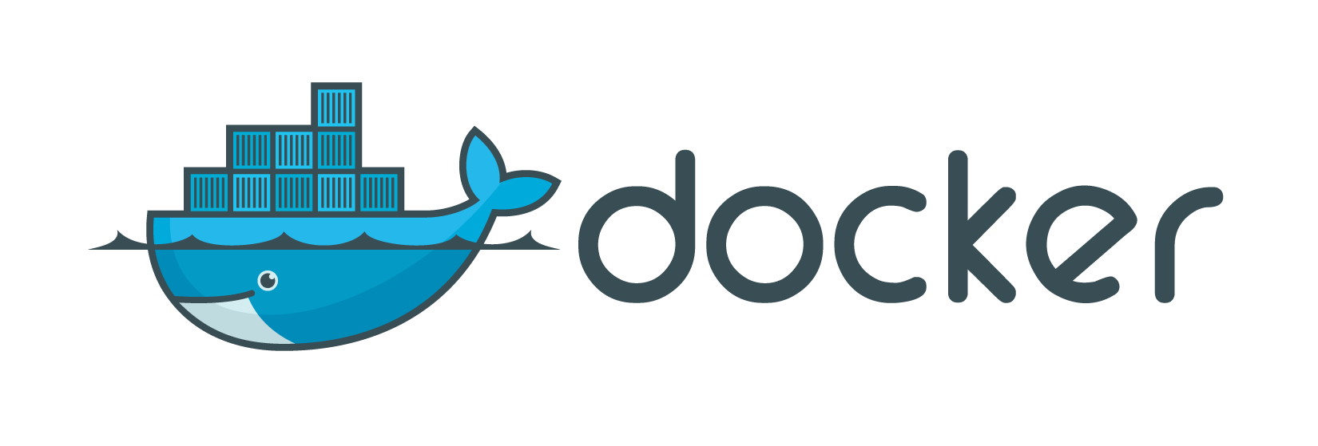
Intermediate
2016-12-14, by Luís Nabais

Slide 2

What did we talk about in Fundamentals?
Docker introduction
What is Docker?
Understanding Docker
How it compares to virtual machines
Practical class/tutorial
Docker Installation
Docker Hub
Creating/downloading an image
Creating a container
Updating application in container
Dockerfile basics

Slide 3
What will we talk about?
Presentation
Microservices
Docker Workflow
Docker Registry (Hub/Store, custom registry)
Networks
Volumes
Practical class/tutorial - Blog (Wordpress)
MySQL/MariaDB database
Apache Web Server with PHP language support & Wordpress
Scale Wordpress, using a Load balancer (PoC)
Upgrade Wordpress, using Blue/Green Deployment (PoC)
Extras
Automation basics (Scripting, Docker Compose, CI/CD, Ansible, DevOps)
NOTE: All resources are available at https://github.com/luisnabais/course_docker

Slide 4
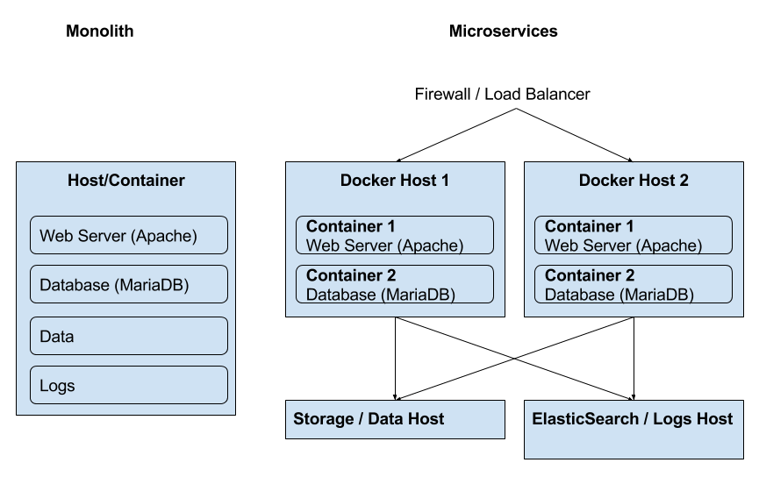
Monoliths vs Microservices

Slide 5
Monoliths vs Microservices
 | Monoliths | Microservices
Pros | Faster initial development Easier integration Easier local deployment | Easier to develop, understand, upgrade and maintain Starts faster Scales individually Easier fault isolation (ex: cpu/memory leaks) Not stuck with any stack
Cons | Stuck with same technology stack Difficult to share with other developers Difficult to scale Difficult to deploy to other environments | Slower initial development

Slide 6
Monoliths vs Microservices
What if I really want a Monolith Application?
Although Microservices’s main rule is One container per process, sometimes a Monolith Application is the only way.
How do I create a Monolith Application?
With a process control tool such as Supervisord. Docker only needs to manage Supervisord process, which by itself keeps the processes running and allows start/stop/restart.
Can’t I just use Systemd?
Docker is not a VM. Can’t have it’s own modules, doesn’t need init as PID 1, doesn’t have syslogd, cron, etc.
Docker uses the host’s kernel (or docker machine’s, if it’s not a Linux Host), it’s processes are visible on the host machine. It’s a glorified chroot, which uses the host’s systemd, Kernel Namespaces (what you can see. Ex: pid, net, mnt, uts, ipc) and Control Groups (how much you can see. Ex: CPU/RAM limits).
That’s why docker processes run in the foreground, not in the background, such as daemons. If a process is started in the background, the container will be stopped.
But please, if possible, use only Microservices. Check more details at https://docs.docker.com/engine/security/security/.

Slide 7
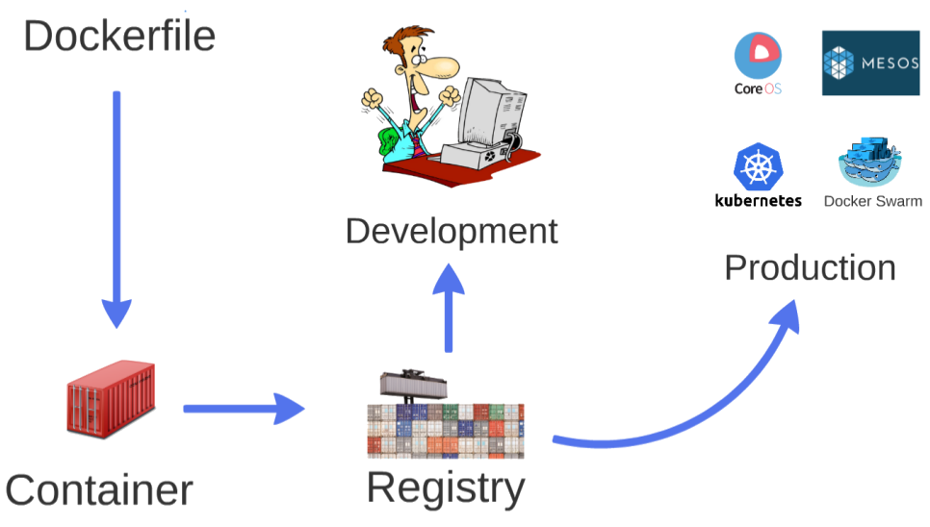
Docker Workflow

Slide 8
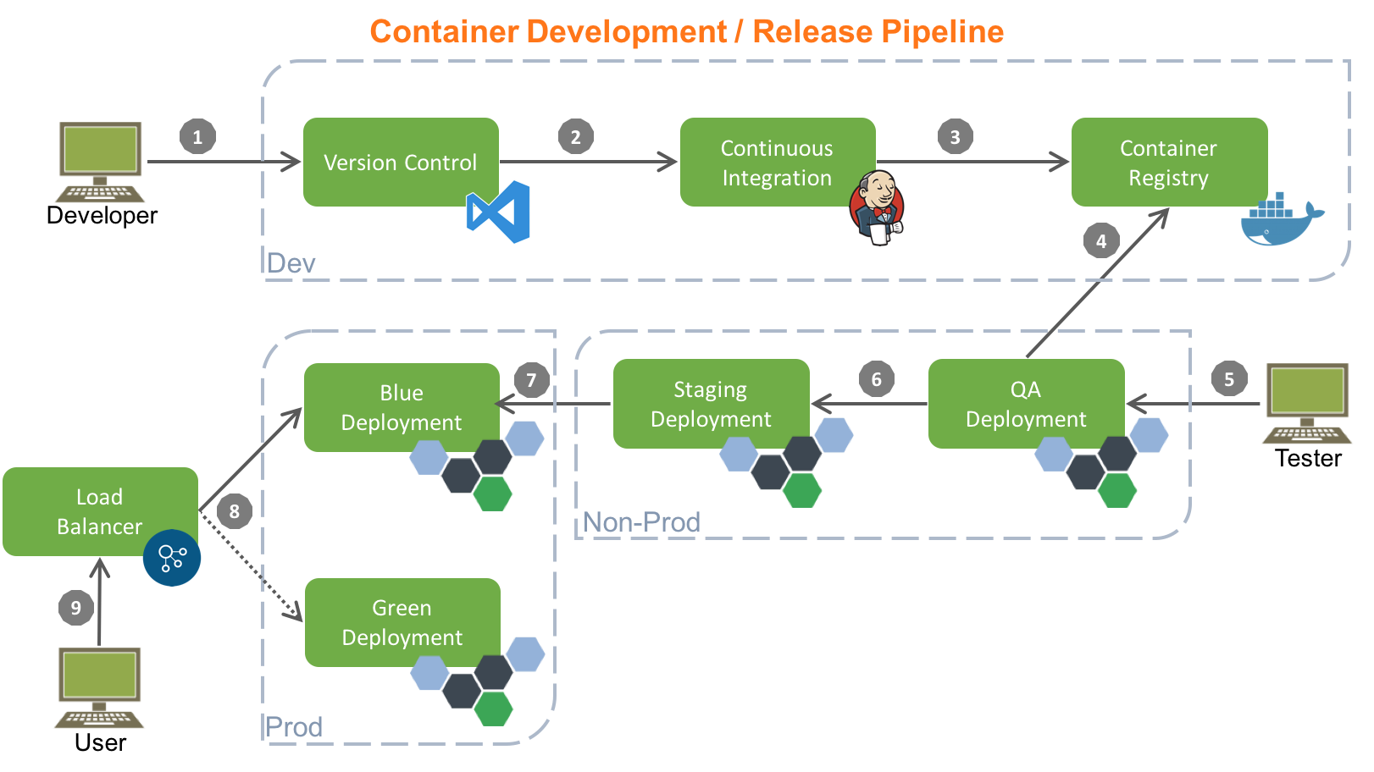
Docker Workflow

Slide 9
Docker Registry
Docker Hub
Docker Hub (https://hub.docker.com) is soon to be rebranded to Docker Store (https://store.docker.com). It allows 1 free private image per user.
Custom Docker Registry
Allows much easier deployment, as it allows sharing images in a network.
The easiest way to create a Registry is to use the registry container, like this:
# docker image pull registry:2.5.1 (check versions at the link above)
# docker container run -d --name fm-registry -p 5000:5000 registry:2.5.1
Push image to custom registry
# docker image pull mariadb:10.1.19
# docker image tag mariadb:10.1.19 localhost:5000/mariadb:10.1.19
# docker image push localhost:5000/mariadb:10.1.19
Pull from custom registry
# docker image pull <hostname/IP>:5000/mariadb:10.1.19
Unfortunately, Docker Registry doesn’t yet allow image deleting.

Slide 10
Dockerfile
FROM alpine:3.4
MAINTAINER Luís Nabais <luis.nabais@findmore.pt>
ENV WORDPRESS_VERSION 4.7
# Setup apache and php
RUN apk --update add apache2 php5-apache2 curl \
php5-json php5-phar php5-openssl php5-mysql php5-curl php5-mcrypt php5-pdo_mysql php5-ctype php5-gd php5-xml php5-dom php5-iconv \
&& rm -f /var/cache/apk/* \
&& mkdir /run/apache2 \
&& sed -i 's/#LoadModule\ rewrite_module/LoadModule\ rewrite_module/' /etc/apache2/httpd.conf \
&& mkdir -p /opt/utils \
&& mkdir -p /app
EXPOSE 80
ADD files/start.sh /opt/utils/
ADD files/info.php /app
ADD files/wordpress-${WORDPRESS_VERSION}.tar.gz /app/
RUN chmod +x /opt/utils/start.sh
ENTRYPOINT ["/opt/utils/start.sh"]

Slide 11
Networks
List Network
# docker network ls
NETWORK ID NAME DRIVER
7fca4eb8c647 bridge bridge
9f904ee27bf5 none null
cf03ee007fb4 host host
All containers with no networks specified are connected to the bridge network.
All bridge connections are created on the host.
Inspect Network
# docker network inspect bridge

Slide 12
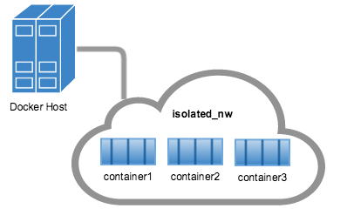
Networks
Network drivers
The bridge driver is the default. It allows port exposure, port binding, and linking containers.
The overlay driver allows multi-host networking. It’s used in Docker Swarm.
User-defined Networks
# docker network create --driver bridge --subnet 172.49.0.0/16 <network_name>
As bridge is the default driver, the option is not needed in the command.
The subnet is automatically configured, so no need for it as well.
So the command could just be only:
# docker network create <network_name>
List and inspect the networks afterwards.
When containers are created, can be associated with the networks,
using the --net flag in the run command.

Slide 13
Data Volumes
What are volumes?
A volume is a specially-designated directory within one or more containers that bypasses the Union File System. Provide several useful features for persistent or shared data:
Can be shared and reused among containers.
Changes will not be included when and image is updated.
Persist even if the container itself is deleted.
Docker never automatically deletes volumes when you remove a container, nor will it “garbage collect” volumes that are no longer referenced by a container.
Listing volumes
# docker volume ls
Creating volumes
# docker volume create
# docker volume create --name <volume_name>
Can be assigned to containers during container creation, using -v flag. docker run … -v path_or_name:container_destination ...

Slide 14
Project - Wordpress Blog
What will we do exactly?
Apache Web Server with PHP language support & Wordpress (older version)
MySQL/MariaDB database
Containers will be connected by the same network
Database data will be kept in volume
Scale Wordpress, using a Load balancer (PoC)
Upgrade Wordpress, using Blue/Green Deployment (PoC)
NOTE: We will create an environment for Development and Testing (QA), not for Staging/Production

Slide 15
Project - Wordpress Blog - Requirements
Files needed
Wordpress (versions 4.6.1 and 4.7), files .tar.gz, copied to files folder, Downloaded here:
https://wordpress.org/wordpress-4.7.tar.gz
https://wordpress.org/wordpress-4.6.1.tar.gz
Network
# docker network create fm-blog
Data volume for the database
# docker volume create --name fm-mariadb

Slide 16
Project - Wordpress Blog - Database (MariaDB)
Run the container
docker container run -d -ti \
--name fm-mariadb \
--net fm-blog \
-v fm-mariadb:/var/lib/mysql \
-e MYSQL_ROOT_PASSWORD=findmore \
-e MYSQL_DATABASE=wordpress \
-e MYSQL_USER=fm_wp_user \
-e MYSQL_PASSWORD=fm_wp_pwd \
mariadb:10.1.19
The image will be downloaded automatically, if it’s not already available locally.
The root password is general, not associated with any project, as MariaDB server can be used for multiple projects/databases.
The other variables are used to create a new database and define a user/password pair associated.

Slide 17
Project - Wordpress Blog - Web Server
Dockerfile
FROM alpine:3.4
MAINTAINER Luis Nabais <luis.nabais@findmore.pt>
ENV WORDPRESS_VERSION 4.6.1
RUN apk --update add apache2 php5-apache2 curl \
php5-json php5-phar php5-openssl php5-mysql php5-curl php5-mcrypt php5-pdo_mysql php5-ctype php5-gd php5-xml php5-dom php5-iconv \
&& rm -f /var/cache/apk/* \
&& mkdir /run/apache2 \
&& sed -i 's/#LoadModule\ rewrite_module/LoadModule\ rewrite_module/' /etc/apache2/httpd.conf \
&& mkdir -p /opt/utils \
&& mkdir -p /app
EXPOSE 80
ADD start.sh /opt/utils/
ADD wordpress-${WORDPRESS_VERSION}.tar.gz /app/
RUN chmod +x /opt/utils/start.sh
ENTRYPOINT ["/opt/utils/start.sh"]

Slide 18
Project - Wordpress Blog - Web Server
Download Wordpress
# wget https://wordpress.org/wordpress-4.7.tar.gz
# wget https://wordpress.org/wordpress-4.6.1.tar.gz
Build the image using the Dockerfile
# docker image build -t fm-wordpress:4.6.1 .
Run the image
# docker container run -d -ti \
--name fm-wordpress \
--net fm-blog \
-p 8001:80 \
fm-wordpress:4.6.1
Notice:
Which web page opens
Is that what we really want?
What if we need to deploy multiple containers like this one?
Is there any better solution?

Slide 19
Project - Wordpress Blog - Web Server
Run the container
# docker container run -d -ti \
--name fm-wordpress \
--net fm-blog \
-e WORDPRESS_DB_HOST=fm-mariadb:3306 \
-e WORDPRESS_DB_USER=fm_wp_user \
-e WORDPRESS_DB_PASSWORD=fm_wp_pwd \
-p 8001:80 \
wordpress:4.6.1
This will download official Wordpress 4.6.1 image, connect it to the same network as the database and automatically apply username, password, host and port for the database.
Note: If the database is already created and with the correct data, the blog will be up automatically. If not, it will ask for the data to create the blog for the first time.

Slide 20
Project - Wordpress Blog - Web Server
What if I want to run multiple containers, for High Availability?
Rename the first container, run a new container, with a new name. Use different external ports, with a load balancer to redirect to one or the other (ex: HAProxy or NGINX)
Rename first node
# docker container rename fm-wordpress fm-wordpress-1
Create second node
# docker container run -d -ti \
--name fm-wordpress-2 \
--net fm-blog \
-e WORDPRESS_DB_HOST=fm-mariadb:3306 \
-e WORDPRESS_DB_USER=fm_wp_user \
-e WORDPRESS_DB_PASSWORD=fm_wp_pwd \
-p 8002:80 \
wordpress:4.6.1

Slide 21
Project - Wordpress Blog - Load Balancer
Copy configuration file (from github) to the same folder as Dockerfile. Remember to adapt the IP Address in the backend section.
Run container
docker container run -d -ti \
--name fm-lb \
-p 80:80 \
-v full_path_to_local_haproxy.cfg:/usr/local/etc/haproxy/haproxy.cfg:ro \
haproxy:1.7.0
Doesn’t need to be in the same network, just to redirect the traffic from port 80 to the hostname and ports used in the web servers.
Test: http://docker_host_ip_or_name in browser.

Slide 22
Project - Wordpress Blog - Upgrade Wordpress
Containers are disposable. When upgrading, the idea is to destroy old containers and replace them with new ones, with the new software versions (new images). But if we do that, we will have downtime, from the moment the containers are destroyed until the new ones are created. That can have undesirable side effects, if issues occur with the new version.
So we will use an approach called the Blue-Green Deployment.
We will:
Leave the old version running.
Create new containers running in parallel, in different ports (ex: 8003).
Test if everything is ok in the new containers.
Change the load balancer, to point to the new ports.
There will be no downtime (many companies don’t know that’s a reality).

Slide 23
Project - Wordpress Blog - Upgrade - Blue-Green Deployment
Create new containers
docker container run -d -ti \
--name fm-wordpress-green \
--net fm-mariadb \
-e WORDPRESS_DB_HOST=fm-mariadb:3306 \
-e WORDPRESS_DB_USER=fm_wp_user \
-e WORDPRESS_DB_PASSWORD=fm_wp_pwd \
-p 8003:80 \
wordpress:4.7
Test container
Open browser, browse the page, admin, etc, and test if everything is OK
Change the load balancer, to point to the new ports
# sed -i 's/8001/8003/g' haproxy.cfg
# docker container restart fm-lb (it will be so fast, any request in the mean time won’t even timeout)

Slide 24
Automation - It’s DevOps time
Scripting
Shell Scripting, Python, or other languages, can be used to automate Docker.
Scripts to build, run, restart, with command line arguments, variables, or simply checkers/validators in crontab can be used to check status and act on the results.
CI/CD
Jenkins can be used to compile code and then build images and deploy software on them. This is usually the choice in corporate environments. It works with the principles of Continuous Integration and Continuous Delivery, among others.
Ansible
Ansible is a configuration management tool like Puppet, Chef or Salt, but with some differences. It’s more usable with Docker than the ones referred.
Docker Compose
It’s an official Docker tool. With a .yml file, much like a Dockerfile, a full integrated group of containers can be built. Right now is going through huge changes, with it’s best functionality now in Experimental state. It will be fully integrated with Docker Swarm soon.

Slide 25
Misc
Other Docker commands
Update
# docker container update --restart always
# docker container update --cpu-shares 512 container_name
# docker container update -m 300M container_name
Stats
# docker container stats container_name
Command line reference https://docs.docker.com/engine/reference/commandline/

Slide 26
Where can I get more information?
Docker Documentation: https://docs.docker.com
Understanding Docker: https://docs.docker.com/engine/understanding-docker/
Networks: https://docs.docker.com/engine/tutorials/networkingcontainers/ Volumes: https://docs.docker.com/engine/tutorials/dockervolumes/
Dockerfile
Dockerfile reference: https://docs.docker.com/engine/reference/builder/
CentOS Dockerfile examples: https://docs.docker.com/engine/reference/builder/
ENTRYPOINT vs ADD: https://www.ctl.io/developers/blog/post/dockerfile-entrypoint-vs-cmd/
ADD vs COPY: https://www.ctl.io/developers/blog/post/dockerfile-add-vs-copy/
Docker Swarm mode
https://docs.docker.com/engine/swarm/
Anatomy of a Container
http://www.slideshare.net/jpetazzo/anatomy-of-a-container-namespaces-cgroups-some-filesystem-magic-linuxcon
GitHub
https://github.com/luisnabais/course_docker

Slide 27

Thank you
(PS: See you in Class 3: Docker Swarm?)

