Slide 1

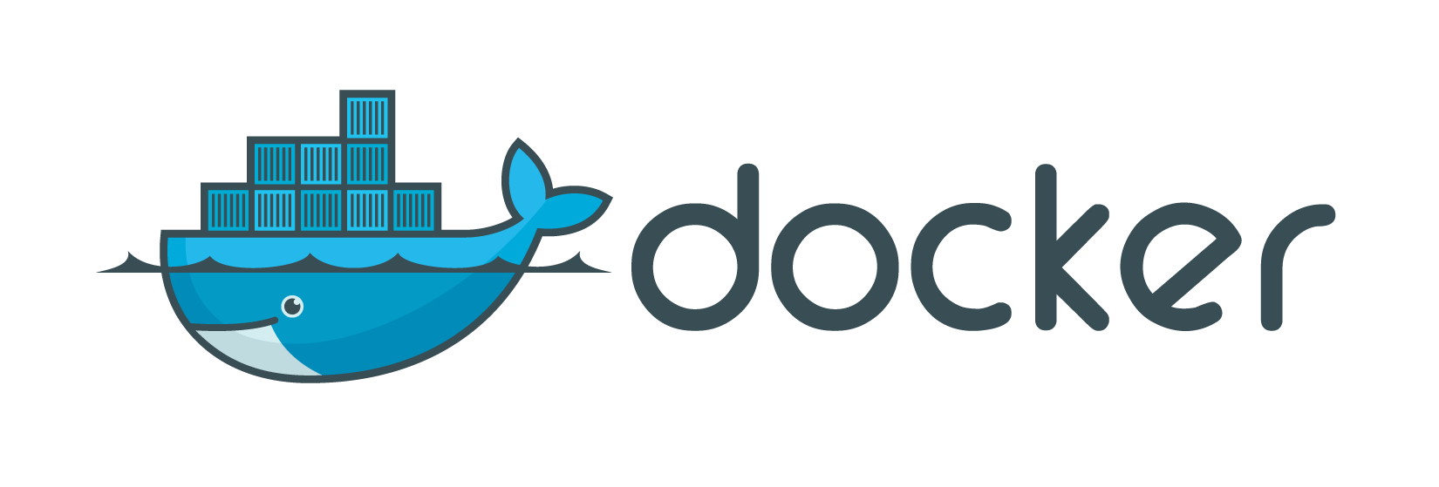
Docker Swarm
2017-06-30, by Luís Nabais (https://www.luisnabais.com)

Slide 2

Introduction
Who am I?
Hello! My name is Luís Nabais (https://www.luisnabais.com), I’m a Findmore Consulting employee.
I’m currently working on a Findmore’s client company, called Indra, where I work as a DevOps Engineer.
My specialties are Linux (I’m a Red Hat Certified Engineer), Docker, DevOps and OpenSource.
Agenda
All the content is publicly available (slides, code samples, scripts)
This workshop will be split in two sessions, of 2h each, on 25th and 27th July 2017, at 19h00.
Notes
Feel free to interrupt for questions at any time
Please correct me if you think the pace is too fast or too slow.
Welcome to this Findmore Consulting Workshop! Enjoy!

Slide 3
What did we talk about in Fundamentals?
Docker introduction
What is Docker?
Understanding Docker
How it compares to virtual machines
Practical class/tutorial
Docker Installation
Docker Hub
Creating/downloading an image
Creating a container
Updating application in container
Dockerfile basics

Slide 4
What did we talk about in Intermediate?
Presentation
Microservices
Docker Workflow
Docker Registry (Hub/Store, custom registry)
Networks
Volumes
Practical class/tutorial - Blog (Wordpress)
MySQL/MariaDB database
Apache Web Server with PHP language support & Wordpress
Scale Wordpress, using a Load balancer (PoC)
Upgrade Wordpress, using Blue/Green Deployment (PoC)

Slide 5
What will we talk about?
Presentation
Understanding Docker Swarm
Create our first Swarm
Running our first Swarm Service
Deploying a local Registry
Build, Ship and Run our Application
Extra (if there is time)
Docker Stacks (Compose)
Rolling Updates
Dealing with Stateful Services
Project
Dockercoins (Digital Coins mining).
All resources for all classes are available at https://github.com/luisnabais/course_docker
Feel free to interrupt me anytime, wether for questions, adjust pace or any other reason.

Slide 6
Pre-requisites
Computer with internet connection and a web browser
Local:
SSH Client to connect to remote machines
Docker Installed (>=v1.13)
Play With Docker:
SSH and Docker installation are not necessary
Some Docker Knowledge (it’s OK if you’re not a Docker expert)
Docker Ecosystem (Engine, Registry, Machine, Compose, Swarm)
Microservices
Cluster basics
5 VMs - The whole environment lasts for 4h
SSH from one to another is possible without passwords
We will use mainly Node 1
You can access HTTP services by clicking the port numbers
Software Versions
Engine: 17.06 - docker version
Compose: 1.14 - docker-compose -v
Machine 0.12.2 - docker-machine -v

Slide 7
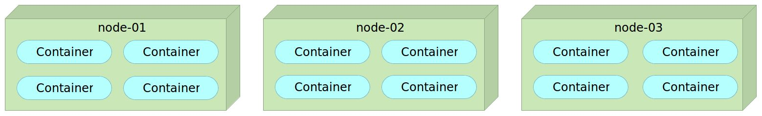
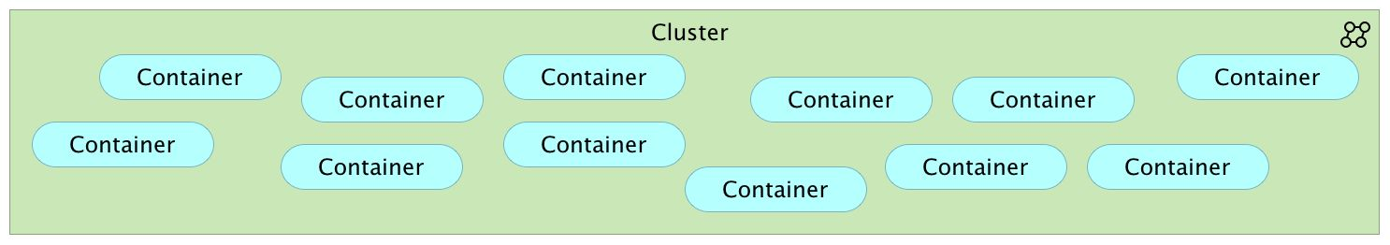
Cluster
Standalone
Cluster

Slide 8
A brief history of Swarm
Docker Swarm, Swarm Mode, SwarmKit?!? Why all the names?
Docker Swarm
Earlier swarm solution
Standalone, not integrated in Docker Engine
Runs in containers
Needs external KV store, like etcd or consul
Communication not secure
Docker Swarm Mode
Appeared in Docker 1.12, July 2016
Integrated with Docker Engine
No need for external KV store
All communication is secure, using TLS
Docker SwarmKit
OpenSource project
Can be used externally (requires building/compiling), using swarmctl CLI
Has some limitations, like no service discovery, load balancing and routing mesh
Libs and functionality fully integrated in Swarm Mode
Note: We will be using only Swarm or Docker Swarm to refer to the new Docker Swarm Mode.

Slide 9
Docker Swarm Concepts & Features
Key Concepts
Node - A node is an instance of Docker Engine participating in a swarm.
Service - A service is the definition of the tasks to execute on the worker nodes. It is the central structure of the swarm system and the primary root of user interaction with the swarm.
Task - A task carries a Docker container and commands to run inside the container. It is the atomic scheduling unit of swarm.
So, what is a Swarm? A swarm is a cluster of Docker Engines (nodes) where you deploy services.
Features
Cluster management integrated with Docker Engine
Scaling
Services managed with a declarative API, implementing a desired state and reconciliaton loop
Integration with overlay networks and load balancing
Service discovery
Rolling Updates
Strong emphasys on security
A Docker Engine node can run in two modes, Standard or Swarm. All the Swarm features are “asleep” in Docker Engine, until enabled.

Slide 10
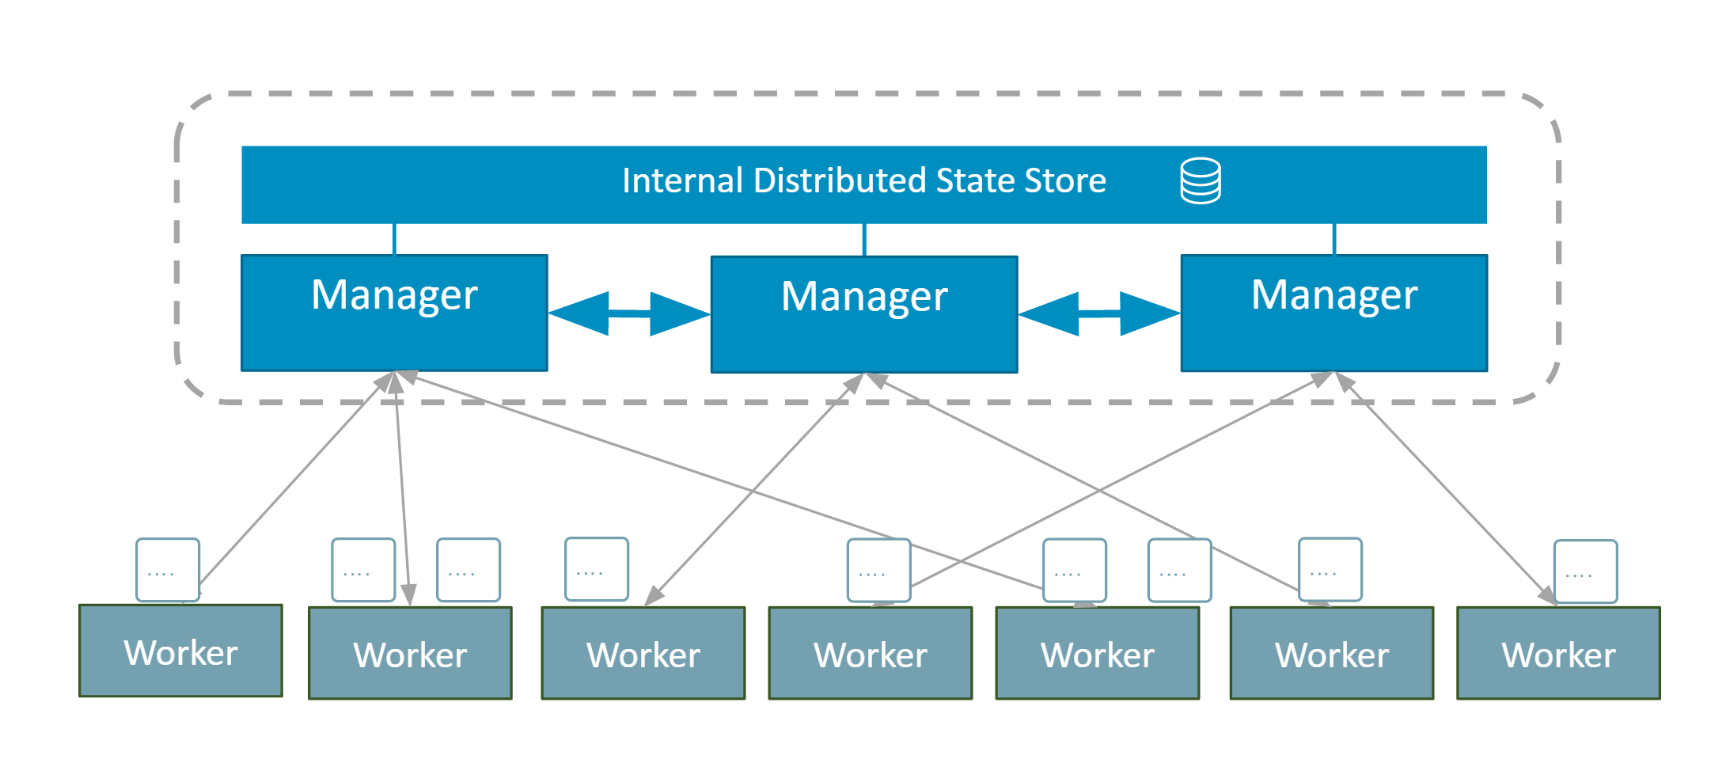
Manager & Worker Nodes
Notes:
A node can be a manager or a worker
A manager actively takes part in the Raft consensus and keeps the Raft log
We can talk to a manager using the Swarm API
One manager is elected leader, other managers merely forward requests to it
Workers get their instructions from the managers
Both managers and workers can run containers

Slide 11
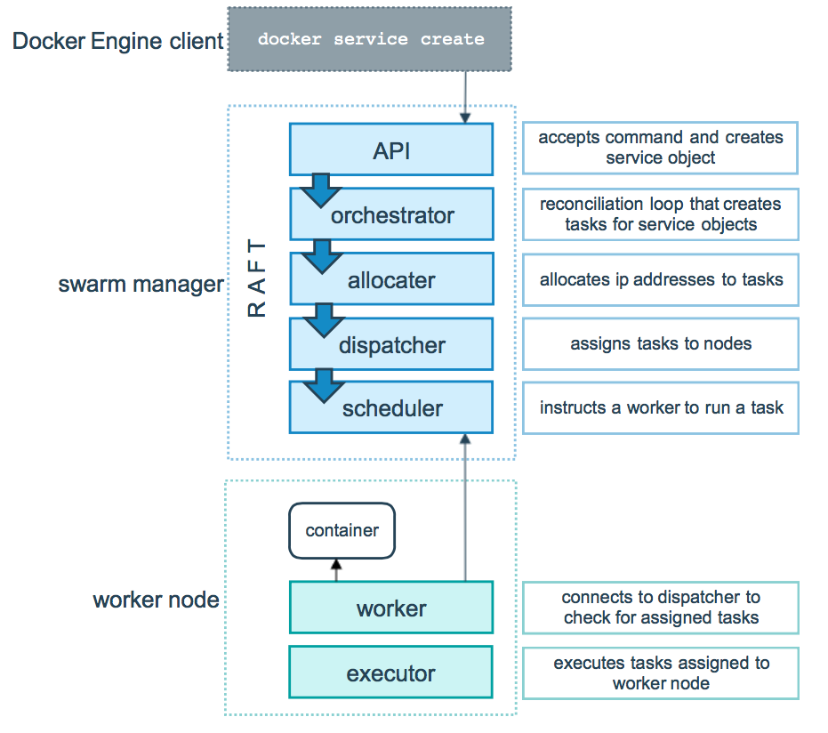
Manager & Worker Nodes
Notes:
A service is specified by it’s desired state: which image, how many instances, etc…
The leader uses different subsystems to break down services into tasks: orchestrator, allocator, scheduler, dispatcher
A task corresponds to a specific container, assigned to a specific node
Nodes know which tasks should be running and starts/stops containers accordingly

Slide 12
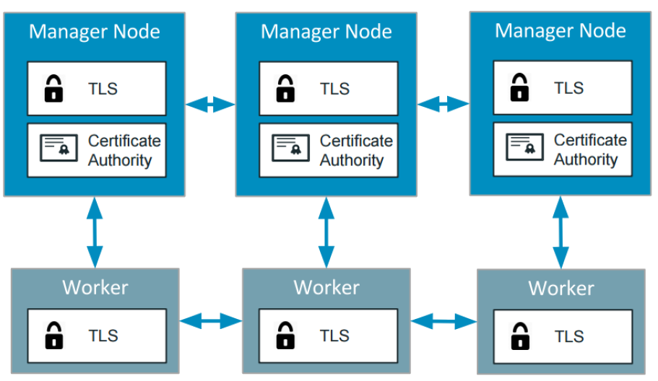
Swarm Security
Cryptographic node identity
Automatic encryption and mutual auth (TLS)
Automatic certificates and keys rotation (keys rotated every 12h, certificates every 90 days)
External CA integration

Slide 13
Manager & Worker Nodes
How many manager nodes we need?
2N+1 nodes can tolerate N failures
1 manager = no failure
Without any manager, cluster goes down
3 managers = 1 failure
2 failures create a network split. Last node can’t differentiate between being isolated and being the last standing node. It has to wait, has it doesn’t have quorum
5 managers = 2 failures (or 1 failure during 1 maintenance)
7 managers and more = no need for this
You can have an even number of managers, but there is no point
Why not have all nodes to be managers?
It’s harder to reach consensus in larger groups
With Raft, writes have to go to all nodes and be acknowledged by all of them
More nodes = more network traffic

Slide 14
Creating our first Swarm Cluster
docker swarm init
keypairs and certificates are created
join tokens are created, both for managers and workers
$ docker swarm init --advertise-addr <PUBLIC_IP_ADDR>
$ docker swarm join-token manager/worker
docker swarm join
it’s own signed keypair is issued
if the node is a manager
joins the Raft consensus
connects to the current leader
accepts connections from worker nodes
if the node is a worker
connects to one of the managers
$ docker swarm join-token manager/worker
docker node ls (Check Cluster state)
Docker visualizer (run command inside manager node)
$ docker run -it -d -p 8080:8080 -v /var/run/docker.sock:/var/run/docker.sock dockersamples/visualizer
Notes:
Task: Create 3 managers and 2 workers
Visualizer container created with run instead of service, to view/manage multiple services without being interfered by Visualizer. As is not a service, it can’t be scaled and it’s not associated with Swarm

Slide 15
Creating a Service
Create service
docker run docker service create
(ex: docker service create alpine ping 8.8.8.8)
Check result
docker service ps <serviceID>
Check service logs
docker service logs <serviceID>
Before Docker Engine 17.05
docker service logs was an experimental feature, had to be activated
docker logs was needed, but could only be used in local containers and in the specific node the container was running

Slide 16
Scale service
Scale service to 10 container replicas:
$ docker service update <Service> --replicas 10
(Every docker service update command is a new service definition.)
Check containers per node
$ docker ps (on each container)
$ docker service ps
Remove service
$ docker service rm <Service>

Slide 17
Expose service
Create service:
$ docker service create --name hello --replicas 5 -p 80:80 --detach=false tutum/hello-world
Check containers per node
$ docker ps (on each container)
$ docker service ps
Check which node is accessed
$ curl http://localhost
$ for i in $(seq 1 10); do curl -s localhost | grep hostname | awk {'print $4'} | cut -d'<' -f1; done
Notes
Load balancing is automatic
External port automatically redirects to whole cluster
Each node runs a load balancer - allows connections to be routed directly to the destination, without extra hops, even among multiple nodes
Each request is served by one of the service’s instantes, in rotation (round robin) - browsers may reuse the same connection, due to HTTP KeepAlive.
TCP routing mesh doesn’t parse HTTP headers
Notes:
TCP routing mesh doesn’t parse HTTP headers - Example: Wordpress HTTP headers make sessions to not be kept between services’s instances

Slide 18
Why do we need to ship our images?
Images exist only on the local node
We need images to be distributed on the whole Swarm
The easiest way to achieve that is to use a Docker Registry
Once our images are on a registry, we can reference them when creating our services
Deploy a Registry
$ docker service create --name registry -p 5000:5000 registry:2.6.2 --detach=false
Docker requires a valid TLS connection when communicating with the registry
except when registry is local (127.0.0.1 or localhost)
or with --insecure-registry Engine flag
How does the command above work?
Check Registry content
$ curl localhost:5000/v2/_catalog
Push image to Registry
$ docker image tag hello localhost:5000/hello
$ docker push localhost:5000/hello

Slide 19
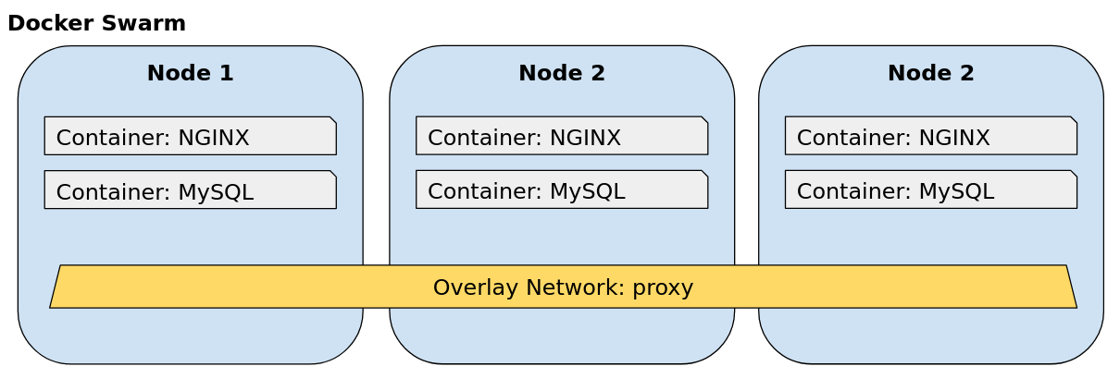
Overlay Networking
Overlay networks are multi-host private networks.
All services in the network can connect to each other, using hostname, which corresponds to service name.
Create an overlay Network
$ docker network create --driver overlay NETWORK_NAME

Slide 20
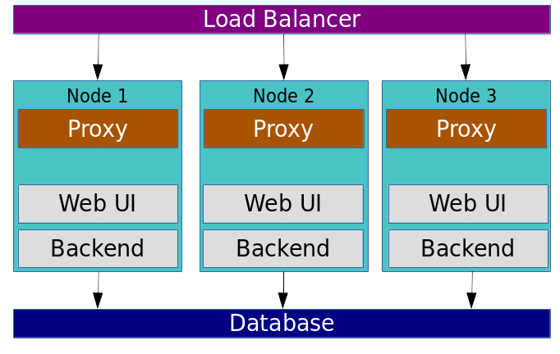
Production Example
Notes:
Proxy should be used, to disable port exposing to outside, just proxy redirecting to services:
using domains (example: www.website.com)
using url address suffixes (ex: www.website.com/service1)

Slide 21
Project Overview - DockerCoins - Mining applic
GitHub repository:
https://github.com/jpetazzo/orchestration-workshop
Services
rng - Web Service generating random bytes
hasher - web service computing hash of POSTed data
worker - background process using rng and hasher
webui - web interface to watch progress
Redis - storage backend
Registry: Where we will keep our custom Docker Images

Slide 22
Project - Dockercoins
Get Project
$ git clone https://github.com/jpetazzo/orchestration-workshop.git
Build images
$ cd orchestration-workshop/dockercoins
$ TAG=0.1
$ for SERVICE in hasher worker webui rng; do \
docker build -t $SERVICE:$TAG $SERVICE; done
Create Registry Service & Push images
$ docker service create --name registry -p 5000:5000 --detach=false registry:2.6.1
$ REGISTRY=localhost:5000
$ for SERVICE in hasher worker webui rng; do \
docker tag $SERVICE $REGISTRY/$SERVICE:$TAG; \
docker push $REGISTRY/$SERVICE:$TAG; done
Check images in Registry
$ curl $REGISTRY/v2/_catalog
Create overlay network
$ docker network create --driver overlay dockercoins
Notes:
docker run -it -d -p 8080:8080 -v /var/run/docker.sock:/var/run/docker.sock dockersamples/visualizer

Slide 23
Project - Dockercoins
Deploy Redis
$ docker service create --network dockercoins --name redis --detach=false redis
Deploy Our services
$ for SERVICE in hasher rng worker webui; do \
docker service create --network dockercoins --detach=false \
--name $SERVICE $REGISTRY/$SERVICE:$TAG; \
done
Publish/Expose WebUI
$ docker service update webui --publish-add 8000:80 --detach=false
(No other service requires exposed ports.)
$ docker service ps webui
Scale Application
$ docker service update --replicas 2 --detach=false worker
$ docker service update --replicas 10 --detach=false worker
Notes:
New service definitions recreates containers, can be visible with docker service ps service_name

Slide 24
Project - Dockercoins
Note
Why did the number of coins increased as much as the number of worker replicas?
Not all applications work the same way.
Examples:
Wordpress has session cookies and HTTP haders validated from server side. If used in Docker Swarm, by default, it’ll keep signing off user
Entropy/Limitations on Operating system, database, programming language, memory, CPU, etc
In our case, the main issue is rng service limitations. Let’s try to scale it as well.
We’ll need one rng instance per node (global scheduling), if we don’t, we’ll have more entropy.
Changing scheduling requires service to be re-created, not updated.
$ docker service rm rng
$ docker service create --name rng --network dockercoins --mode global \
--detach=false $REGISTRY/rng:$TAG
As we learnt, we have to manage each service independently. Is there any way of managing the whole application stack?

Slide 25
Docker Stack
A stack is a collection of services that make up an application in a specific environment.
Docker Compose Stacks
Requires Compose file version 3 (new in Docker Engine 1.13 and Docker Compose 1.10)
A stack file is a file in YAML format, similar to a docker-compose.yml file, that defines one or more services.
Can be directly used by a Swarm cluster with docker stack commands
Under the hood, they map to docker service commands
Stacks must have a name
Each stack gets it’s own overlay network
Services are named <STACK_NAME>_<SERVICE_NAME>
Services get network aliases matching their name in the Compose file
Remove all services for fresh deploy using Docker Stack
$ docker service ls -q | xargs docker service rm
Notes:
https://github.com/jpetazzo/orchestration-workshop/tree/master/stacks

Slide 26
Docker Stack
Deploy Registry
...using service
$ docker service create --name registry --publish 5000:5000 registry:2.6.2
...using Stack
$ docker stack deploy registry --compose-file registry.yml
Stack commands
$ docker stack ls
$ docker stack services registry
$ docker stack ps registry
Notes:
cat ../stacks/registry.yml

Slide 27
Building and pushing stack services
If the compose file has build and image specifications, it can build images and push them to a repository, if the image includes the address for the registry. Example:
webui:
build: webui
image: localhost:5000/webui
We can use docker-compose build and docker-compose push, in order to push the image to our registry:
$ cat dockercoins.yml
Build
$ docker-compose -f dockercoins.yml build
Push
$ docker-compose -f dockercoins.yml push
$ curl localhost:5000/v2/_catalog
Deploy
$ docker stack deploy dockercoins --compose-file dockercoins.yml

Slide 28
Rolling Updates
Update Process
Edit code, or update changed files (if necessary)
Build new image
Push it to the registry
Update our service to use new image
Service update
Build: $ docker build webui localhost:5000/webui
Push: $ docker push localhost:5000/webui
Update: $ docker service update --image webui webui
Stack update
Build: $ docker-compose -f dockercoins.yml build
Push: $ docker-compose -f dockercoins.yml push
Deploy: $ docker stack deploy dockercoins --compose-file dockercoins.yml

Slide 29
Rolling Updates
Change update policy
Update policy can be changed by adding an update_config key under the deploy key, in the Compose file:
deploy:
replicas: 10
update_config:
parallelism: 2
delay: 10s
This way, update is done in 2 containers, waits 10 seconds, 2 more containers, waits 10 seconds… etc.
Rollback update
We can correct code, rebuild and redeploy everything, or we can simply:
$ docker service update SERVICE_NAME --rollback

Slide 30
Dealing with stateful services
We have been dealing with stateless services, which can be recreated, scaled, moved to other nodes, etc. Everytime they behave the same way.
What are stateful services?
Stateful services keep track of changes since it started running, usually by setting values in a storage field/parameters designated for that purpose.
Usually these services lose all information and start like it’s the first time being executed and don’t use the same data any other instances do.
Examples:
Services with configuration files
Databases
So, Docker is only for stateless service, right? Wrong!
We just need to find a way to retain state outside containers that run our services.
Notes:
NFS Server
apk -U add nfs-utils
mkdir -p /opt/share/mysql_data
echo "/opt/share/mysql_data *(rw,sync,no_root_squash,no_subtree_check)" >> /etc/exports
exportfs -ar
rpcbind
rpc.nfsd
rpc.mountd
NFS Client
apk -U add nfs-utils; mkdir -p /opt/share/mysql_data; rpcbind
mount -t nfs NFS_SERVER_IP:/opt/share/mysql_data /opt/share/mysql_data
mount -t nfs 10.0.36.3:/opt/share/mysql_data /opt/share/mysql_data
ls -l /opt/share/mysql_data

Slide 31
Dealing with stateful services
How can they be used in Docker?
Data files must be on a host directory, mounted on the container’s filesystem
If data is on a distributed/networked filesystem, in case a node fails, data is safe elsewhere
Allows the container to be restarted on another node without data loss
Build a stateful service
Create mount point in a distributed/networked filesystem (ex: NFS or CEPH)
Create service, point mount point to
$ docker service create --name registry -p 5000:5000 --mount type=bind,src=/opt/share/registry_data,dst=/var/lib/registry --detach=false registry:2.6.2
Notes
Some services are easy to scale, others have their own clustering systems (ex: databases), others don’t really allow to scale, for many reasons (ex: Wordpress HTTP Headers, Database Transactions, limitations on reading/writing simultaneously, etc).
Usually it’s possible to scale anyway, but require many changes, some very complex.
These services need to be tested much more carefully, as in production workload increases dramatically.
Notes:
https://gist.github.com/luisnabais/7770c48d2943ead4bb74ebe0e5ae2e60

Slide 32
Docker Secrets
Sometimes we need to pass sensitive data to containers, but we don’t want it to be saved in scripts, command line history, Dockerfile, docker-compose YAML files, etc.
So in Docker 1.13 came Secrets. Sensitive data can be centrally managed and securely transmited only to the services we want to.
Secrets can contain data such as:
Usernames and passwords
TLS certificates and keys
SSH keys
Other important data such as the name of a database or internal server
Generic strings or binary content (up to 500 kb in size)
Example:
$ echo "mydatabasepassword" | docker secret create db_pass - $ docker secret ls
$ docker service create --secret db_pass -e DBPASS=”/run/secrets/db_pass” --name secret-test alpine ping 8.8.8.8
Notes:
https://gist.github.com/luisnabais/7770c48d2943ead4bb74ebe0e5ae2e60

Slide 33
Some exercises to try and learn a bit more
Securing services by using a proxy
Do not expose any services, create a proxy overlay network where you install a proxy service (ex: NGINX or HAPROXY) and redirect calls by address to the internal services in the cluster.
Centralized Logging
Try to integrate Elastic Stack (Elasticsearch, Logstash and Kibana) into the cluster, to get logs from services.
Docker Stats Dashboard
Integrate Docker stats (ex: resource usage) into external tools, like Prometheus.

Slide 34
Where can I get more information about Docker Swarm?
Docker Documentation: https://docs.docker.com
Docker Swarm Mode/SwarmKit: https://docs.docker.com/engine/swarm/
Versions: https://blog.docker.com/2017/03/docker-enterprise-edition/
Docker Swarm Security Model: https://docs.docker.com/engine/userguide/networking/overlay-security-model/
GitHub Course Documentation
https://github.com/luisnabais/course_docker
About me: https://www.luisnabais.com

Slide 35
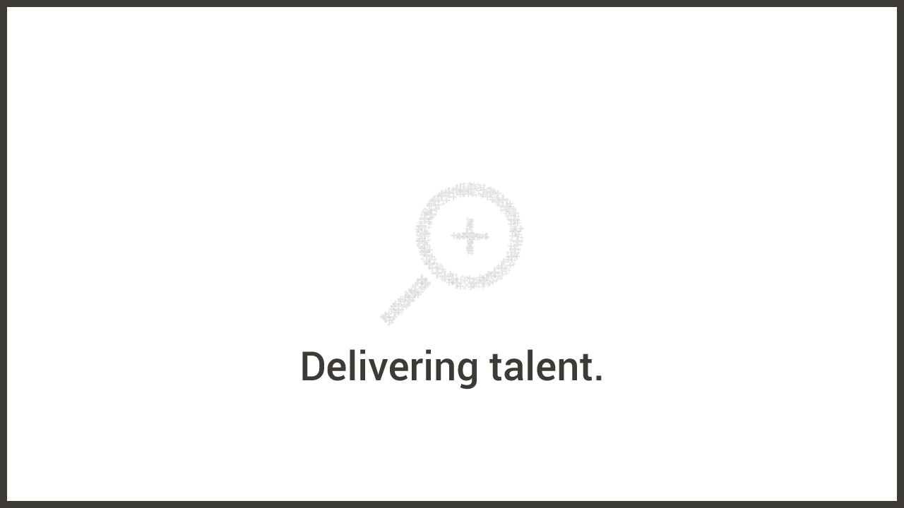
Thank you
PS: What do you think about a full workflow deploy workshop?

