Slide 1

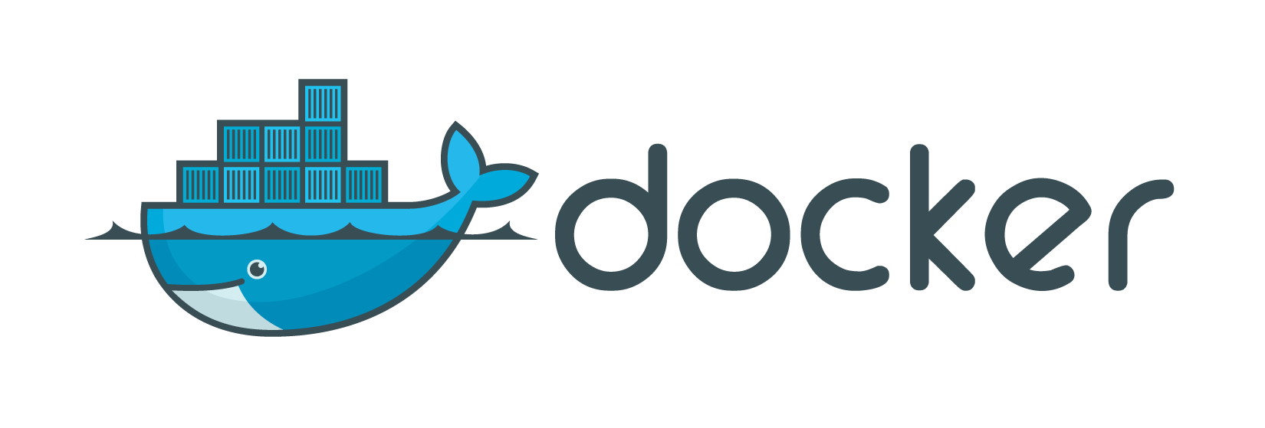
Intermediate

Slide 2

What did we talk about in Fundamentals?
Docker introduction
What is Docker?
Understanding Docker
How it compares to virtual machines
Practical class/tutorial
Docker Installation
Docker Hub
Creating/downloading an image
Creating a container
Updating application in container
Dockerfile basics

Slide 3
What will we talk about?
Presentation
Microservices
Docker Workflow
Docker Registry (Hub/Store, custom registry)
Networks
Volumes
Practical class/tutorial - Blog (Wordpress)
Apache Web Server with PHP language support
MySQL/MariaDB database
Deploy Wordpress
Scale Wordpress, using a Load balancer
Upgrade Wordpress, using Blue/Green Deployment
Extras
Docker update (ex: restart policy)
Automation basics (Scripting, CI/CD, Ansible, DevOps)

Slide 4
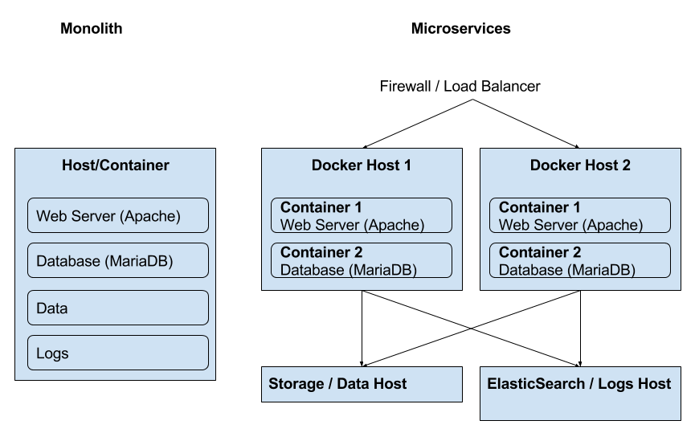
Monoliths vs Microservices

Slide 5
Monoliths vs Microservices
 | Monoliths | Microservices
Pros | Faster initial development Easier integration Easier local deployment | Easier to develop, understand and maintain Starts faster Scales individually Easier fault isolation (ex: cpu/memory leaks) Not stuck with any stack Allows easy and fast deployment, regardless of environment
Cons | Stuck with same technology stack Difficult to share with other developers Difficult to scale Difficult to deploy to other environments | Slower initial development

Slide 6
Monoliths vs Microservices
What if I really want a Monolith Application?
Remember Docker (and microservices) main rule: One container per process. But sometimes a Monolith Application is the only way. Prepare for some complications, though.
How do I create a Monolith Application?
We need to use a tool such as Supervisord, a process control system. That way, Docker only needs to manage Supervisord process, which by itself keeps the processes running, allows start/stop/restart.
Can’t I just use Systemd?
Let’s just go a little bit low level.
Docker is not a VM. It uses the host’s kernel (or docker machine’s, if it’s not a Linux Host), can’t have it’s own modules, doesn’t need init as PID 1, doesn’t need syslogd, cron, etc.
Docker’s processes are visible on the host machine. It’s a glorified chroot, which uses the host’s systemd, Kernel Namespaces, Control Groups (cgroups),
That’s why docker processes run in the foreground, not in the background, such as daemons. If a process is started in the background, the container will be stopped.
Check more details at https://docs.docker.com/engine/security/security/.

Slide 7
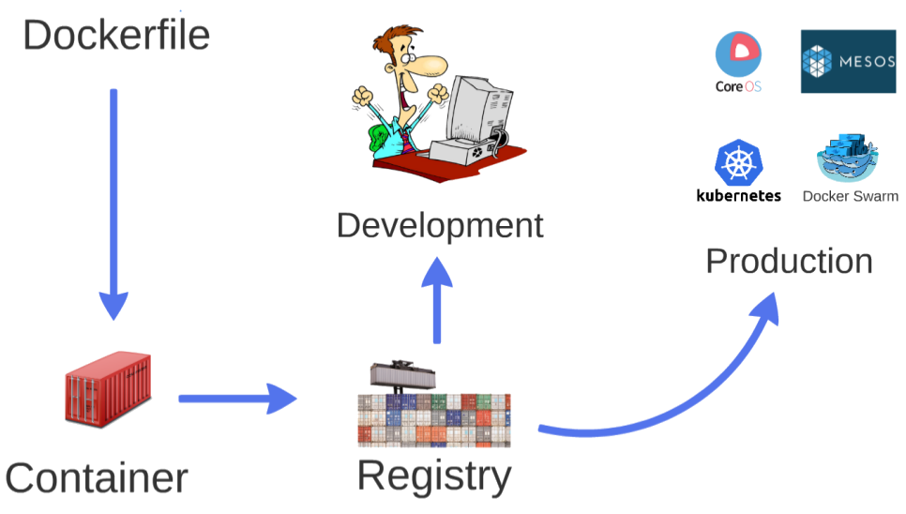
Docker Workflow

Slide 8
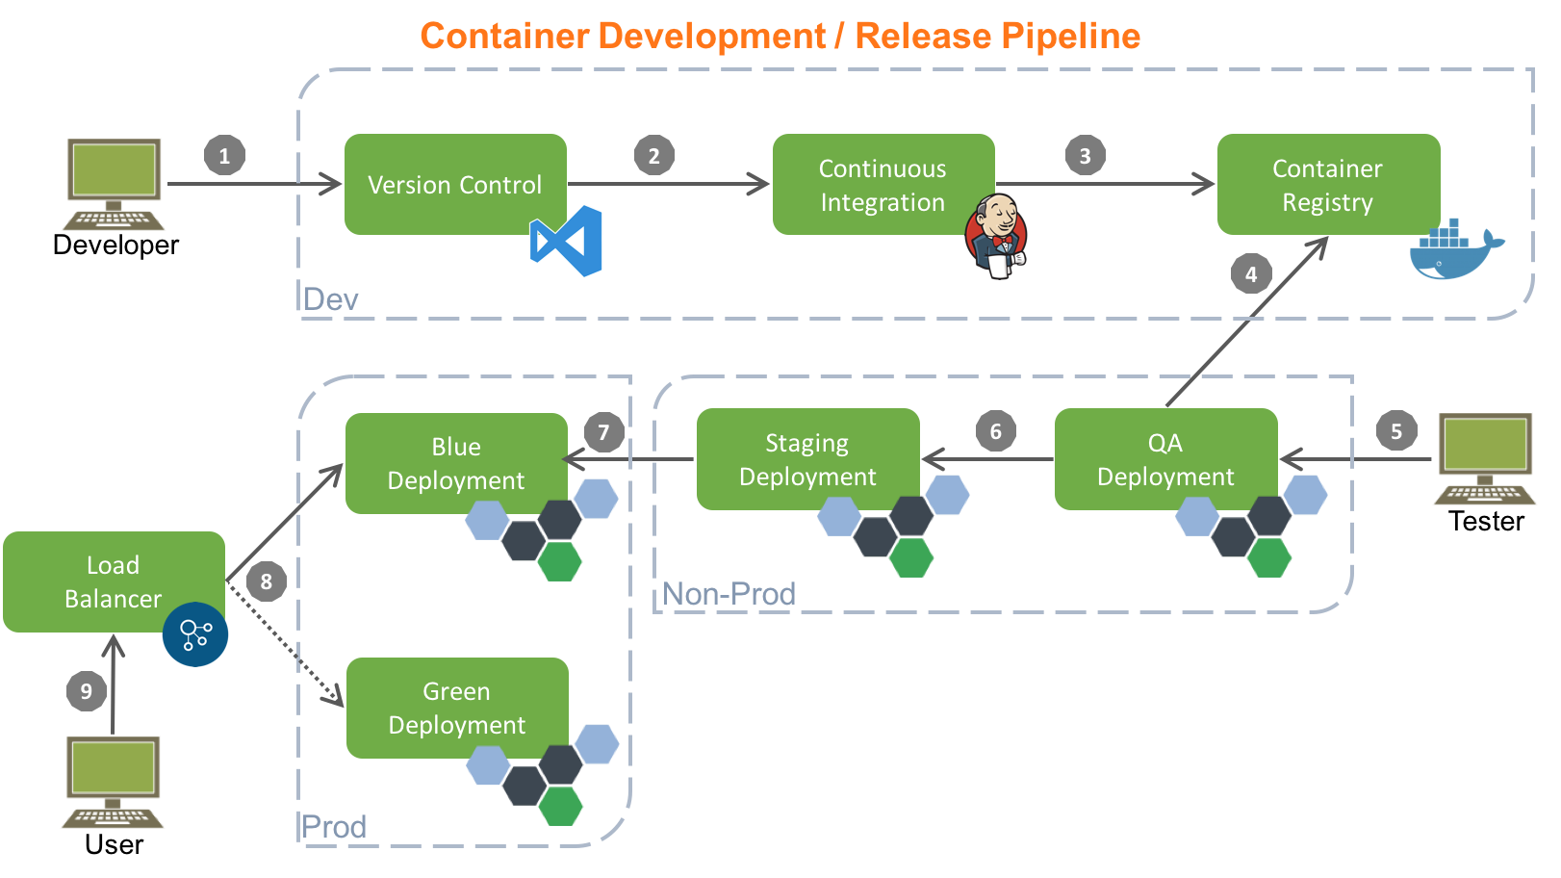
Docker Workflow

Slide 9
Docker Registry
Docker Hub
Docker Hub (https://hub.docker.com) is soon to be rebranded to Docker Store (https://store.docker.com). It allows 1 free private image per user.
Custom Docker Registry
We can create our own Docker Registry. It allows to have the images we need locally, or in an internal network, as many as we want.
A custom registry, regardless of the tool used, if publicly (or in internal network) available, allows much easier deployment, as it allows sharing.
There are plenty of ways to do that. The easiest is to use the registry container, like this:
# docker pull registry:2.5.1 (check versions at the link above)
# docker run -d --name fm-registry -p 5000:5000 registry:2.5.1
Insert image in custom registry
# docker pull mariadb:10.1.19
# docker tag mariadb:10.1.19 localhost:5000/mariadb:10.1.19
# docker push localhost:5000/mariadb:10.1.19
Pull from custom registry
# docker pull <hostname/IP>:5000/mariadb:10.1.19
Unfortunately, Docker Registry doesn’t yet allow image deleting.

Slide 10
Dockerfile
FROM alpine:3.4
MAINTAINER Luís Nabais <luis.nabais@findmore.pt>
ENV WORDPRESS_VERSION 4.7
# Setup apache and php
RUN apk --update add apache2 php5-apache2 curl \
php5-json php5-phar php5-openssl php5-mysql php5-curl php5-mcrypt php5-pdo_mysql php5-ctype php5-gd php5-xml php5-dom php5-iconv \
&& rm -f /var/cache/apk/* \
&& mkdir /run/apache2 \
&& sed -i 's/#LoadModule\ rewrite_module/LoadModule\ rewrite_module/' /etc/apache2/httpd.conf \
&& mkdir -p /opt/utils \
&& mkdir -p /app
EXPOSE 80
ADD files/entrypoint.sh /opt/utils/
ADD files/info.php /app
ADD files/wordpress-${WORDPRESS_VERSION}.tar.gz /app/
RUN chmod +x /opt/utils/start.sh
ENTRYPOINT ["/opt/utils/start.sh"]

Slide 11
Networks
List Network
# docker network ls
NETWORK ID NAME DRIVER
7fca4eb8c647 bridge bridge
9f904ee27bf5 none null
cf03ee007fb4 host host
All containers with no networks specified are connected to the bridge network.
All bridge connections are created on the host. Example:
# ip addr
docker0: <BROADCAST,MULTICAST,UP,LOWER_UP> mtu 1500 qdisc noqueue state UP
link/ether 02:42:ff:ef:a4:f0 brd ff:ff:ff:ff:ff:ff
inet 172.17.0.1/16 scope global docker0
valid_lft forever preferred_lft forever
inet6 fe80::42:ffff:feef:a4f0/64 scope link
valid_lft forever preferred_lft forever
Inspect Network
# docker network inspect bridge

Slide 12
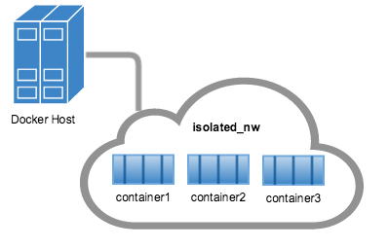
Networks
User-defined Networks
# docker network create --driver bridge --subnet 172.49.0.0/16 <network_name>
The default driver bridge, so the option is not needed in the command.
The subnet is automatically configured, so no need for it as well.
So the command could just be only:
# docker network create <network_name>
List and inspect the networks afterwards.
When containers are created, can be associated with the networks,
using the --net flag in the run command.

Slide 13
Data Volumes
What are data volumes?
A data volume is a specially-designated directory within one or more containers that bypasses the Union File System. Data volumes provide several useful features for persistent or shared data:
Data volumes can be shared and reused among containers.
Changes to a data volume are made directly.
Changes to a data volume will not be included when and image is updated.
Data volumes persist even if the container itself is deleted.
Data volumes are designed to persist data, independent of the container’s life cycle. Docker therefore never automatically deletes volumes when you remove a container, nor will it “garbage collect” volumes that are no longer referenced by a container.
Listing data volumes
# docker volume ls
Creating data volumes
# docker volume create
# docker volume create --name <volume_name>
Data Volumes can be assigned to containers during container creation, using -v flag.

Slide 14
Project - Wordpress Blog
What will we do exactly?
Apache Web Server with PHP language support & Wordpress (older version)
MySQL/MariaDB database
Containers will be connected by the same network
DB data will be kept in volume
Scale Wordpress, using a Load balancer
Upgrade Wordpress, using Blue/Green Deployment

Slide 15
Project - Wordpress Blog - Requirements
Files needed
Wordpress (versions 4.6.1 and 4.7), files .tar.gz, copied to files folder, Downloaded here:
https://wordpress.org/wordpress-4.7.tar.gz
https://wordpress.org/wordpress-4.6.1.tar.gz
Organize Project in folders
mkdir web_server database load_balancer registry
Network
# docker network create fm-blog
Data volume for the database
# docker volume create --name fm-mariadb

Slide 16
Project - Wordpress Blog - Database (MariaDB)
Run the container
docker run -d -ti \
--name fm-mariadb \
--net fm-blog \
-v fm-mariadb:/var/lib/mysql \
-e MYSQL_ROOT_PASSWORD=findmore \
-e MYSQL_DATABASE=wordpress \
-e MYSQL_USER=fm_wp_user \
-e MYSQL_PASSWORD=fm_wp_pwd \
mariadb:10.1.19
The image will be downloaded automatically, if it’s not already available locally.
The container will automatically use the created network and volume.
The root password is defined in a global way, as the MariaDB server can be used for more projects/databases.
The other variables are to create a new database and define a user and password associated with it.

Slide 17
Project - Wordpress Blog - Web Server
Dockerfile
FROM alpine:3.4
MAINTAINER Luis Nabais <luis.nabais@findmore.pt>
ENV WORDPRESS_VERSION 4.6.1
RUN apk --update add apache2 php5-apache2 curl \
php5-json php5-phar php5-openssl php5-mysql php5-curl php5-mcrypt php5-pdo_mysql php5-ctype php5-gd php5-xml php5-dom php5-iconv \
&& rm -f /var/cache/apk/* \
&& mkdir /run/apache2 \
&& sed -i 's/#LoadModule\ rewrite_module/LoadModule\ rewrite_module/' /etc/apache2/httpd.conf \
&& mkdir -p /opt/utils \
&& mkdir -p /app
EXPOSE 80
ADD files/entrypoint.sh /opt/utils/
ADD files/wordpress-${WORDPRESS_VERSION}.tar.gz /app/
RUN chmod +x /opt/utils/entrypoint.sh
ENTRYPOINT ["/opt/utils/entrypoint.sh"]

Slide 18
Project - Wordpress Blog - Web Server
Download Wordpress
# wget https://wordpress.org/wordpress-4.7.tar.gz
# wget https://wordpress.org/wordpress-4.6.1.tar.gz
Build the image using the Dockerfile
# docker build -t fm-wordpress:4.6.1 .
Run the image
# docker run -d -ti \
--name fm-wordpress \
--net fm-blog \
-p $EXTERNAL_PORT:80 \
fm-wordpress:4.6.1
Notice:
Which web page opens
Is that what we really want?
What if we need to deploy multiple containers like this one?
Is there any better solution?

Slide 19
Project - Wordpress Blog - Web Server
Run the container
# docker run -d -ti \
--name fm-wordpress \
--net fm-blog \
-e WORDPRESS_DB_HOST=fm-mariadb:3306 \
-e WORDPRESS_DB_USER=fm_wp_user \
-e WORDPRESS_DB_PASSWORD=fm_wp_pwd \
-p 8001:80 \
wordpress:4.6.1
This will download official Wordpress 4.6.1 image, connect it to the same network as the database and automatically apply username, password, host and port for the database.
Note: If the database is already created and with the correct data, the blog will be up automatically. If not, it will ask for the data to create the blog for the first time.

Slide 20
Project - Wordpress Blog - Web Server
What if I want to run multiple containers, for High Availability?
Rename the first container, run the container again with a new name. Use different external ports, with a load balancer to redirect to one or the other (ex: HAProxy or NGINX)
Rename first node
# docker rename fm-wordpress fm-wordpress-1
Create second node
# docker run -d -ti \
--name fm-wordpress-2 \
--net fm-blog \
-e WORDPRESS_DB_HOST=fm-mariadb:3306 \
-e WORDPRESS_DB_USER=fm_wp_user \
-e WORDPRESS_DB_PASSWORD=fm_wp_pwd \
-p 8002:80 \
wordpress:4.6.1

Slide 21
Project - Wordpress Blog - Load Balancer
Copy configuration file (from github) to the same folder as Dockerfile. Remember to adapt the IP Address in the backend section.
Run container
docker run -d -ti \
--name fm-lb \
-p 80:80 \
-v full_path_to_local_haproxy.cfg:/usr/local/etc/haproxy/haproxy.cfg:ro \
haproxy:1.7.0
Doesn’t need to be in the same network, just to redirect the traffic from port 80 to the hostname and ports used in the web servers.
Test: http://docker_host_ip_or_name in browser.

Slide 22
Project - Wordpress Blog - Upgrade Wordpress
As the project is based in MicroServices, the idea is to destroy old containers and replace them with new ones. But if we do that, we will have downtime, from the moment the containers are destroyed until the new ones are created, which can be a huge deal, if there are any issues with the new version.
So we will use an approach called the Blue-Green Deployment.
We will:
Leave the old version running.
Create a new container (or multiple) in a different port (ex: 8003).
Test if everything is ok in the new container.
Change the load balancer, to point to the new ports.
There will be no downtime (some companies don’t know that’s a reality).

Slide 23
Project - Wordpress Blog - Upgrade - Blue-Green Deployment
Create a new container (or multiple)
docker run -d -ti \
--name fm-wordpress-new-1 \
--net fm-mariadb \
-e WORDPRESS_DB_HOST=fm-mariadb:3306 \
-e WORDPRESS_DB_USER=fm_wp_user \
-e WORDPRESS_DB_PASSWORD=fm_wp_pwd \
-p 8003:80 \
wordpress:4.7
Test container
Open browser, browse the page, admin, etc, and test if everything is OK
Change the load balancer, to point to the new ports
# sed -i 's/8001/8003/g' haproxy.cfg
# sed -i '/8002/d' haproxy.cfg
# docker restart fm-lb (it will be so fast, any request in the mean time won’t even time out)

Slide 24
Where can I get more information?
Docker Documentation: https://docs.docker.com
Understanding Docker: https://docs.docker.com/engine/understanding-docker/
Networks: https://docs.docker.com/engine/tutorials/networkingcontainers/ Volumes: https://docs.docker.com/engine/tutorials/dockervolumes/
Dockerfile
Dockerfile reference: https://docs.docker.com/engine/reference/builder/
CentOS Dockerfile examples: https://docs.docker.com/engine/reference/builder/
ENTRYPOINT vs ADD: https://www.ctl.io/developers/blog/post/dockerfile-entrypoint-vs-cmd/
ADD vs COPY: https://www.ctl.io/developers/blog/post/dockerfile-add-vs-copy/
Docker Swarm mode
https://docs.docker.com/engine/swarm/
GitHub
https://github.com/luisnabais/course_docker

Slide 25

Thank you
(PS: See you in Class 3: Docker Swarm?)

