Slide 1

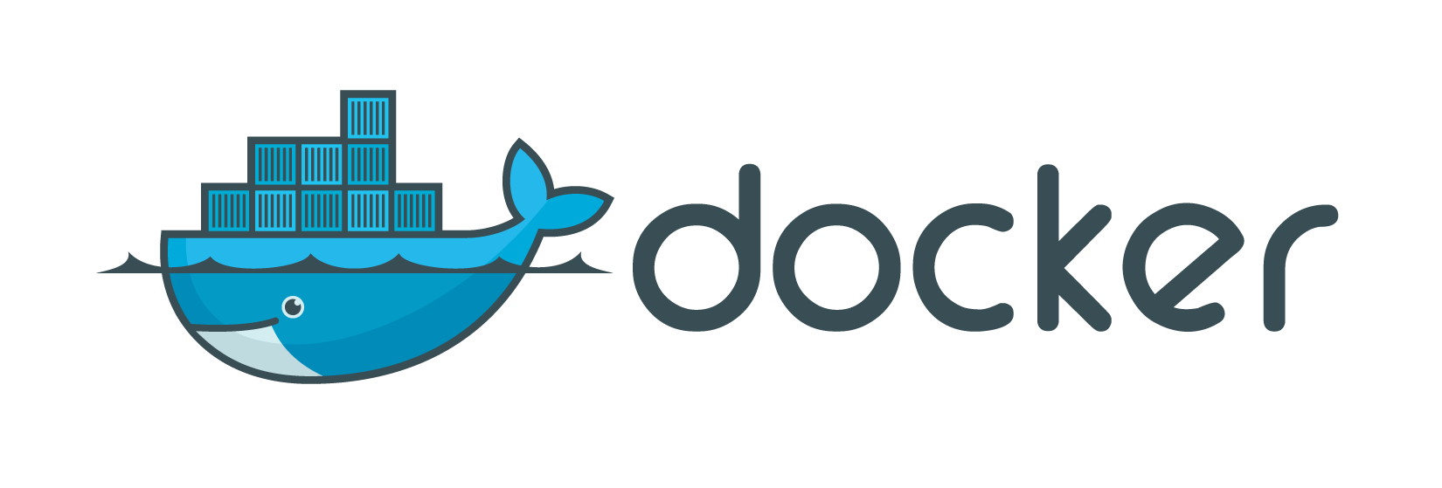
Fundamentals

Slide 2

What will we talk about?
Short Docker introduction
What is Docker?
Understanding Docker
How it compares to virtual machines
Practical class/tutorial
Docker Installation
Docker Hub
Creating/downloading an image
Creating a container
Updating application in container
Some useful commands for containers
Dockerfile – Custom Image
Extras
Docker advantages
More information

Slide 3
What is Docker?
Docker is a platform for developers and sysadmins to develop, ship, and run applications. Docker lets you quickly assemble applications from components and eliminates the friction that can come when shipping code. Docker lets you get your code tested and deployed into production as fast as possible.
Docker provides a way to run almost any application securely isolated in a container. The isolation and security allow you to run many containers simultaneously on your host.

Slide 4
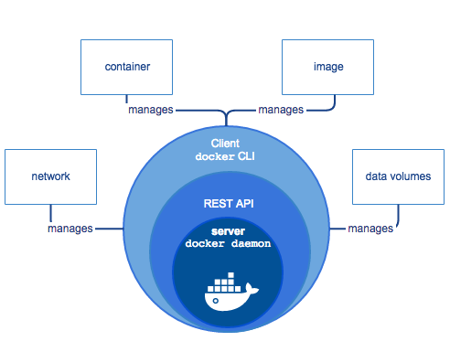
What is Docker Engine?
Docker Engine is a client-server application with these major components:
A server (daemon process).
A REST API which specifies interfaces that programs can use to talk to the daemon
A command line interface (CLI) client.
The CLI makes use of the REST API to control or interact with the daemon through scripting or direct CLI commands.
The daemon creates and manages Docker objects, such as images, containers, networks, data volumes, and so forth.
The user does not directly interact with the daemon, but instead through the Docker client.
The client, in the form of the docker binary, is the primary user interface to Docker. It accepts commands from the user and communicates back and forth with a Docker daemon.

Slide 5
Inside Docker
To understand Docker’s internals, you need to know about three resources:
Docker images
A Docker image is a read-only template. For example, an image could contain an CentOS operating system with Apache and your web application installed. Images are used to create Docker containers. Docker images are the build component of Docker.
Docker registries
Docker registries hold images. These are public or private stores from which you upload or download images. The public Docker registry is provided with the Docker Hub.
Docker containers
Docker containers are similar to a directory. A Docker container holds everything that is needed for an application to run. Each container is created from a Docker image. Docker containers can be run, started, stopped, moved, and deleted. Each container is an isolated and secure application platform. Docker containers are the run component of Docker.

Slide 6
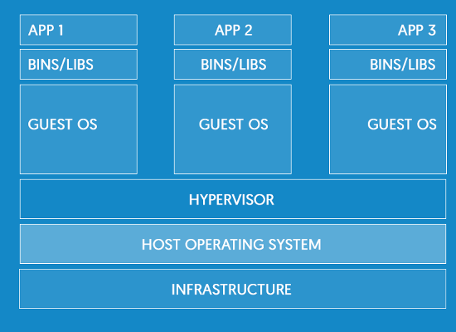
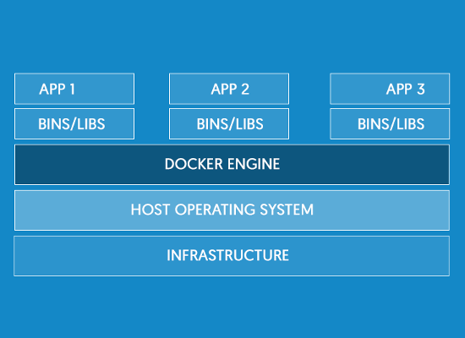
Containers vs Virtual Machines
Virtual Machine Architecture
Docker Architecture

Slide 7
Docker Hub
What is Docker Hub?
Docker Hub is a cloud-based registry service which allows you to link to code repositories, build your images and test them, stores manually pushed images, so you can deploy images to your hosts.
Docker Hub provides the following major features:
Image Repositories: Find, manage, and push and pull images from community, official, and private image libraries.
Automated Builds: Automatically create new images when you make changes to a source code repository.
Webhooks: A feature of Automated Builds, Webhooks let you trigger actions after a successful push to a repository.
Organizations: Create work groups to manage access to image repositories.
GitHub and Bitbucket Integration: Add the Hub and your Docker Images to your current workflows.
Can be accessed at website https://hub.docker.com/

Slide 8
Docker Installation
Docker Engine is supported on Linux, Cloud, Windows, and OS X.
Installation instructions are available at https://docs.docker.com/engine/installation/
CentOS Linux
- Create repository as indicated in website above
# yum update & yum install docker-engine
# systemctl start docker && systemctl enable docker
General Linux installation (should work in most Linux distributions)
# curl -fsSL https://get.docker.com/ | sh
# systemctl start docker && systemctl enable docker
Test installation
# docker image ls
# docker container ls
Give access to other user than root
# usermod -a -G docker <user>
(login with user – if user is already login, must logout first)

Slide 9
Creating/downloading an image
Downloading an image
# docker image pull <image_name_like_ind_docker_registry>
# docker image ls
Multiple images
# docker image pull <other_image_name>
# docker image ls
Multiple versions of the same image
# docker image pull <image_name>:<version>
# docker image ls

Slide 10
Creating a container
Running a container
# docker image ls
# docker container run <image_name> (it will be in the foreground)
# docker container ls (-a)
Running a container in background
# docker container run -ti -d --name my_webserver httpd
# docker container ls (-a)
- try to open http://container_ip
Expose ports for access
# docker container run -ti -d -p 80:80 --name my_webserver httpd
Mount an external mount point inside container
docker container run -ti --name servidorweb -v /opt/external_mount/code/:/var/www/html:ro -d httpd
Access container’s Command Line
# docker container exec -ti my_webserver bash

Slide 11
Updating container
Saving changed container to a new image
(Change website content)
# docker container commit findmore_apache findmore_apache:v2
# docker image ls
Export image to a file
# docker image save -o image_save.tar <image_name>
Export container to a file
# docker container export -o /home/container_save.tar <container_name>
(loses history, flattens image)
Run container with new version
# docker container stop <container>
# docker container rm <container>
# docker container run -ti -d -p 80:80 --name my_webserver findmore_apache:v2
Load a saved image
# docker image load -i <container_file>

Slide 12
Other Docker Commands
Events
# docker events
Inspect Container
# docker container inspect my_webserver
Logs - Container
# docker container logs my_webserver
History - Image
# docker image history findmore_web:v2

Slide 13
Dockerfile
FROM centos:7
MAINTAINER Luís Nabais <luis.nabais@findmore.pt>
RUN yum -y update
RUN yum install -y curl vim net-tools httpd git
RUN yum clean all
RUN git clone https://github.com/luisnabais/findmore_course_docker.git /var/www/html/
EXPOSE 80 443
COPY run-httpd.sh /run-httpd.sh
RUN chmod -v +x /run-httpd.sh
CMD ["/run-httpd.sh"]t
Creating image from Dockerfile
# docker image build -t findmore_apache:v1 .
Running container
# docker container run -ti -d --name findmore_apache findmore_apache:v1

Slide 14
Docker Advantages
Technical advantages
Lightweight
Containers running on a single machine share the same operating system kernel; they start instantly and use less RAM.
Images are constructed from layered filesystems and share common files, making disk usage and image downloads much more efficient.
Open
Docker containers are based on open standards, enabling containers to run on all major Linux distributions, Microsoft Windows, Apple macOS -- and on top of any infrastructure.
Secure
Containers isolate applications from one another and the underlying infrastructure, while providing an added layer of protection for the application.

Slide 15
Docker Advantages
Advantages for developers
No more “It works on my machine”
Accelerated Development
Stop wasting hours setting up developer environments, spinning up new instances, and making copies of production code to run locally.
With Docker, you simply take copies of your live environment and run them on any new endpoint running a Docker engine.
Eliminate environment inconsistencies
Packaging an application in a container with its configs and dependencies guarantees that the application will always work as designed in any environment: locally, on another machine, in test or production.
No more worries about having to install the same configurations into different environments.

Slide 16
Docker Advantages
Advantages for Operations Team
Less effort for maintaining environments
The creation of an environment is automated. Hence, less manual actions are necessary. This reduces the risks and increases the reliability.
Manually maintaining a consistent environment on multiple servers is error-prone and can be a nightmare. With Docker it’s easy to create several instances of an environment, because we just have to execute the image on the servers. This way it is easy to add further nodes to a cluster and to scale horizontally.
Easy updating
Using traditional approaches for setting up an environment (like install scripts) run into trouble when there is already an existing environment. Considering the update path in the script can be a very complex task (e.g. checking the existence of files and cleanup unused files). With Docker we don’t have to take an existing environment into account (except for the database). We just stop the running container and start the new updated one. This simplifies the setup because we always start with an empty environment.

Slide 17
Where can I get more information?
Docker Documentation: https://docs.docker.com
Understanding Docker: https://docs.docker.com/engine/understanding-docker/
Dockerfile
Dockerfile reference: https://docs.docker.com/engine/reference/builder/
CentOS Dockerfile examples: https://docs.docker.com/engine/reference/builder/
ENTRYPOINT vs ADD: https://www.ctl.io/developers/blog/post/dockerfile-entrypoint-vs-cmd/
ADD vs COPY: https://www.ctl.io/developers/blog/post/dockerfile-add-vs-copy/
Docker Swarm mode
https://docs.docker.com/engine/swarm/

Slide 18

Thank you

