Slide 1


Fundamentals
2017-10-11, by Luís Nabais (https://www.luisnabais.com)

Slide 2


Introduction
Who am I?
Hello! My name is Luís Nabais (https://www.luisnabais.com), I’m a Findmore Consulting employee.
I’m currently working on a Findmore’s client company, called Indra, where I work as a DevOps Engineer.
My specialties are Linux, Docker, DevOps and OpenSource.
I am a Red Hat Linux Certified Engineer and an ITIL Foundations certified professional.
Agenda
This workshop will be done in a single session 2h long, on 24th October 2017, at 19h00.
All the content is publicly available (slides, code samples, scripts) on the following addresses:
Slides: https://github.com/luisnabais/course_jenkins
Sample Code: https://github.com/luisnabais/course_jenkins_code
Code Gist: https://gist.github.com/luisnabais/66cff7101b6df39528accf3e77e3118e)
Notes
Feel free to interrupt for questions at any time
Please correct me if you think the pace is too fast or too slow.
Welcome to this Findmore Consulting Workshop! Enjoy!

Slide 3
What will we talk about?
Introduction
What is Continuous Integration/Delivery?
Why CI/CD?
How to implement CI/CD
What is Jenkins?
Jenkins History
Jenkins’s Features
Getting Started
Jenkins Installation
Jenkins Configuration, Security & Plugins
Project
Create/Update/Run Job
Import code from a GitHub repository
Deploy code to Web Server
Trigger build if there’s change in Git

Slide 4
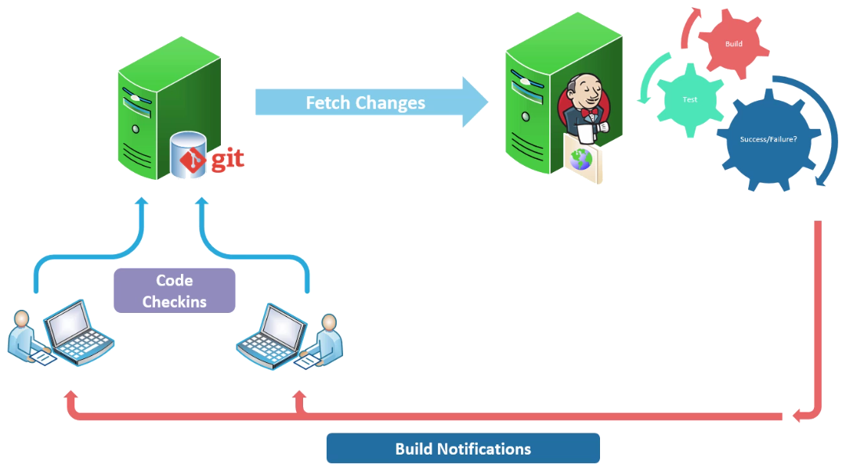
What is Continuous Integration?
Continuous Integration (CI) is a software engineering practice that requires developers to
integrate code into a shared repository, several times a day. Each commit/push is then verified
by an automatic build, allowing teams to detect problems early.
By integrating regularly, you can detect errors quickly and locate them easily.

Slide 5
Continuous Integration
Why should we consider CI?
Reduced Risk
Better Quality Code
Ready to Ship Code
Systematic Versioning
Code quality trend analisys
Time to market
Reduced Cost
How can we implement CI?
There are many tools which allow CI, some OpenSource, some paid, some on the cloud, some on local servers.
One of the best, which is free and OpenSource, is the one we will talk about: Jenkins

Slide 6
Jenkins
What is Jenkins?
Jenkins is a self-contained, open source automation server and continuous integration tool, which can be used to automate all sorts of tasks, such as building, testing and deploying software.
Jenkins History
Jenkins was first released in Feb 2005, by Sun Microsystems (acquired by Oracle during 2009/2010), as the Hudson project.
Around 2007 Hudson became known as a better alternative to CruiseControl and other open-source build-servers.
At the JavaOne conference in May 2008, Hudson won the Duke’s Choice Award in the Developer Solutions category.
In November 2010, an issue arose in the Hudson community, which grew to encompass questions over the stewardship and control by Oracle.
Negotiations between the main project contributors and Oracle took place, with Oracle claiming the name Hudson. So, a call for votes was made to change the project name from Hudson to Jenkins.
However, Oracle said they intended to continue development of Hudson and considered Jenkins a fork rather than a rename.
Both projects continue independent, claiming the other is the fork. As of Dec 2013, Jenkins on GitHub had 567 project members (now 639) and 1100 public repositories (now 1846), compared to Hudson’s 32 project members (now 29) and 17 public repositories (now 20).

Slide 7
Jenkins
Features
OpenSource and Free
Cross platform
Widely used
Allow a distributed master/slave architecture
Scalable
Configurable
Extensible

Slide 8
Jenkins Installation
Pre-Requisites
Java 8
RAM needed is very dependent on the usage, can be from 256MB to 70GB+
Disk Space needed is also very dependent on the usage, depends on Code Pulls, external files needed, plugins, number of jobs. Basic installation takes about 250MB.
Installation
Jenkins has two release lines, LTS and weekly.
Installation can be done through:
War file
Native system package/repository
Docker image/container
In this presentation, we will use:
Linux Ubuntu Server 16.04.3 LTS x86_64 (Virtual Machine)
Java 8
Jenkins LTS repository/package for Ubuntu

Slide 9
Jenkins Installation
Installation
Configure repository
Install package
Start Jenkins
Post-Installation
Unlock Jenkins
Base/suggested plugins
Create first admin user
Configuration
Jenkins Management
Global Tool Configurations
Credentials
Nodes
Reload Configuration from Disk
Manage Plugins
Security / Access Control
JNLP
Security Realm
Authorization
Manage Users

Slide 10
Project
Project Requirements
Git Repository with code
Apache Web Server with PHP support
Access to transfer files from Jenkins to Web Server (we will use SSH/SCP)
Create Project
Project type: Freestyle
Import code from Git
Deploy Code to Web Server
Docker usage example
Build Docker Image
Deploy to new Container
Update Project
Update code, deploy new version to Web Server
Trigger build automatically, if there’s change in repository’s code
Notes:
Git: https://github.com/luisnabais/course_jenkins_code.git
Build (Shell):
ssh apache "rm -rf /var/www/html/*"
scp * apache:/var/www/html/

Slide 11
Where can I get more information?
Jenkins Documentation: https://jenkins.io/doc/
Jenkins Plugins: https://plugins.jenkins.io/
Next steps:
Jenkins Pipeline: https://jenkins.io/doc/book/pipeline/
Jenkins Blue Ocean Project: https://jenkins.io/projects/blueocean/
Some challenges
Deploy a full website, like a wordpress blog, with database configuration
Deploy everything to Docker containers, rebuild images, remove old image, start new image

Slide 12

Thank you

