Slide 1

IMAGE SEGMENTATION
DIGITAL SIGNAL PROCESSING

Slide 2
Introduction to Image Segmentation
 The purpose of image segmentation is to partition an image into meaningful regions with respect to a particular application
 The segmentation is based on
and
measurements taken from the image
might be grey level, colour, texture, depth or
motion

Slide 3
Introduction to Image Segmentation
Usually image segmentation is an initial and vital step in a series of processes aimed at overall image understanding
Applications of image segmentation include
Identifying objects in a scene for object-based measurements such as size and shape
Identifying objects in a moving scene for object-based video compression (MPEG4)
Identifying objects which are at different distances from a sensor using depth measurements from a laser range finder enabling path planning for a mobile robots

Slide 4
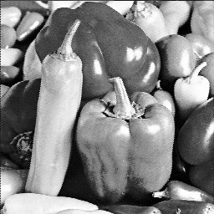
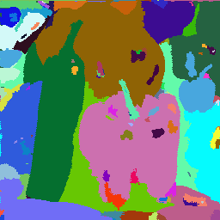
Introduction to Image Segmentation
Example 1
Segmentation based on greyscale
Very simple ‘model’ of greyscale leads to inaccuracies in object labelling

Slide 5
Introduction to Image Segmentation
Example 2
Segmentation based on texture
Enables object surfaces with varying patterns of grey to be segmented

Slide 6
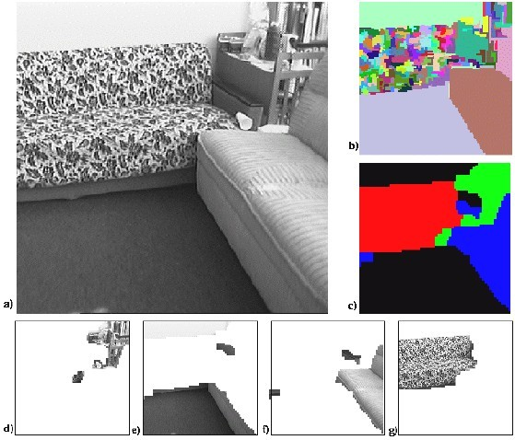
Introduction to Image Segmentation

Slide 7
Introduction to Image Segmentation
Example 3
Segmentation based on motion
The main difficulty of motion segmentation is that an intermediate step is required to (either implicitly or explicitly) estimate an optical flow field
The segmentation must be based on this estimate and not, in general, the true flow

Slide 8
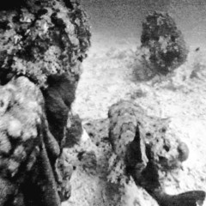

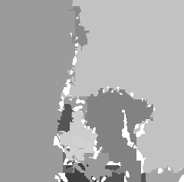
Introduction to Image Segmentation

Slide 9
Introduction to Image Segmentation
Example 3
Segmentation based on depth
This example shows a range image, obtained with a laser range finder
 A
segmentation based on the range (the object
distance from the sensor) is useful in guiding mobile robots

Slide 10
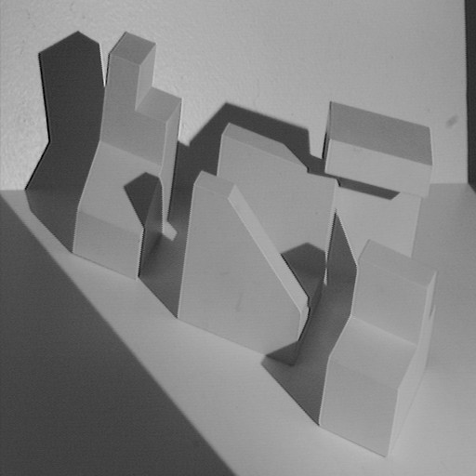
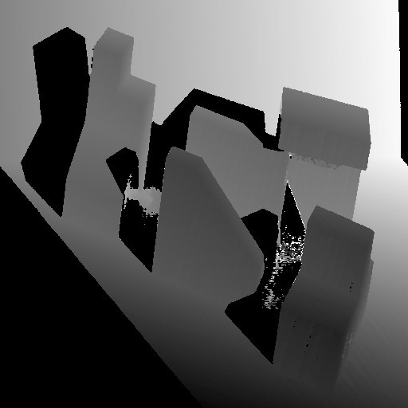
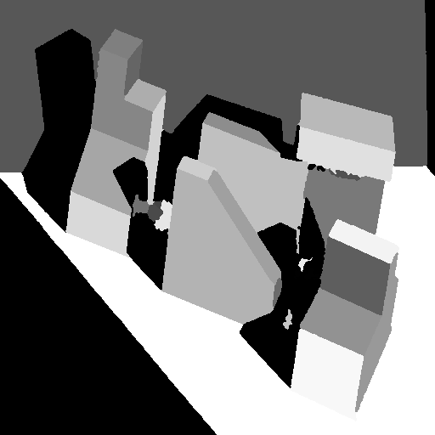
Introduction to Image Segmentation
Original image
Range image
Segmented image

Slide 11
Segmentation techniques

Slide 12
Segmentation Techniques
We will look at two very simple image segmentation techniques that are based on the greylevel histogram of an image
Thresholding
Clustering

Slide 13
Segmentation Techniques
A. THRESHOLDING

One of the widely methods segmentation. It is useful in
used for image
discriminating
foreground from the background. By selecting an adequate threshold value T, the gray level image can be converted to binary image.

Slide 14
Segmentation Techniques
5 THRESHOLDING TECHNIQUES
E | MEAN TECHNIQUE- This technique used the mean value pixels as the threshold value and works well in strict cases images that have approximately half to the pixels belonging objects and other half to the background. | of of to | the the the
r | P-TILE TECHNIQUE- Uses knowledge about the area size desired object to the threshold an image. | of | the
o
HISTOGRAM DEPENDENT TECHNIQUE (HDT)- separates the two homogonous region of the object and background of an image.
EDGE MAXIMIZATION TECHNIQUE (EMT)- Used when there are more than one homogenous region in image or where there is a change of illumination between the object and its background.
VISUAL TECHNIQUE- Improve people’s ability to accurately search for target items.
n
n

Slide 15
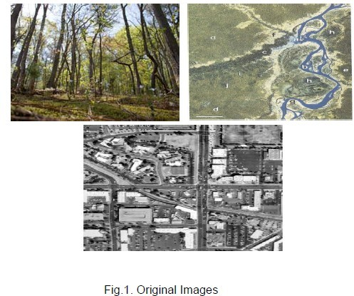
Segmentation Techniques

Slide 16
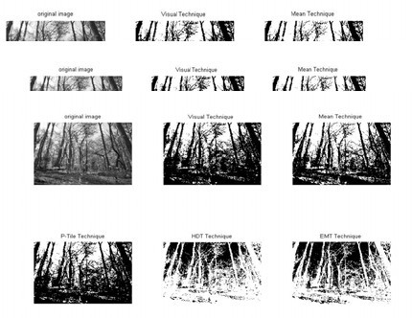
Segmentation Techniques
Threshold techniques from left to right original image, Vis technique T
= 127,
Mean Technique, P-Tile technique T
= 127, I
Technique and EMT Technique

Slide 17
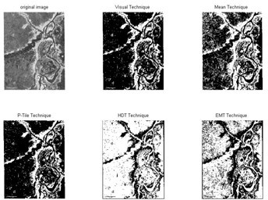
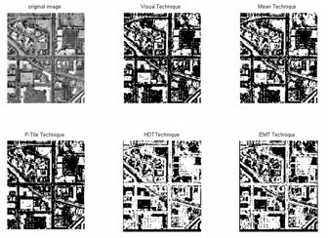
Segmentation Techniques
T = 167
T = 43

Slide 18
Segmentation Techniques
A. CLUSTERING

Defined as the process of identifying groups of similar image primitive.
It is a process of organizing the objects into groups based on its attributes.

➢
An image can be grouped based on keyword (metadata) or its content (description)
➢
KEYWORD- Form of font which describes about the image keyword of an image refers to its different features
CONTENT- Refers to shapes, textures or any other information that can be inherited from the image itself.
➢

Slide 19
Segmentation APPROACHES

Slide 20
Segmentation Approaches
A.WATER BASED SEGMENTATION
Steps:
1. Derive surface image:
A variance image is derived from each image layer. Centred at every pixel, a 3x3 moving window is used to derive its variance for that pixel. The surface image for watershed delineation is a weighted average of all variance images from all image layers. Equal weight is assumed in this study.

Slide 21
Segmentation Approaches
Delineate watersheds
From the surface image, pixels within a homogeneous region form a watershed
Merge Segments
Adjacent watershed may be merged to form a new segment with larger size according to their spectral similarity and a given generalization level

Slide 22
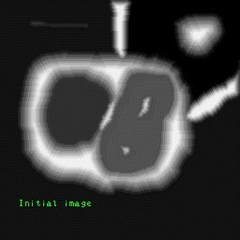
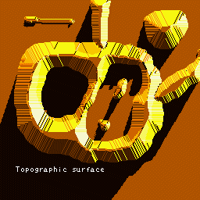
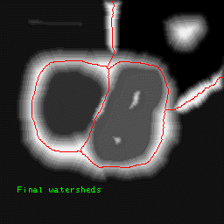
Segmentation Approaches
Initial Image
Topographic Surface
Final watersheds
22

Slide 23
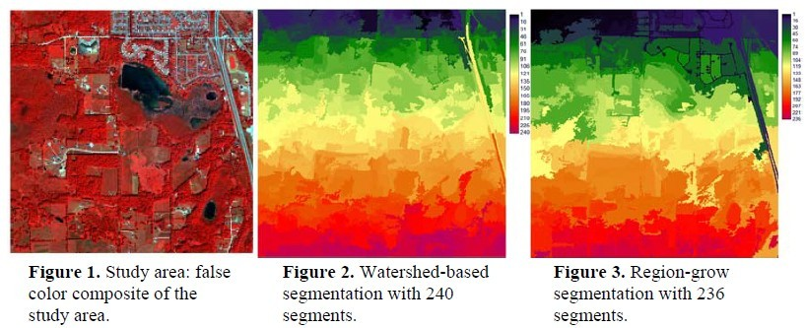
Segmentation Approaches
QuickBird multispectral
satellite
imagery was used. The
image consisted of
four bands, at
the waves of blue, green, red and near infra-red.

Slide 24
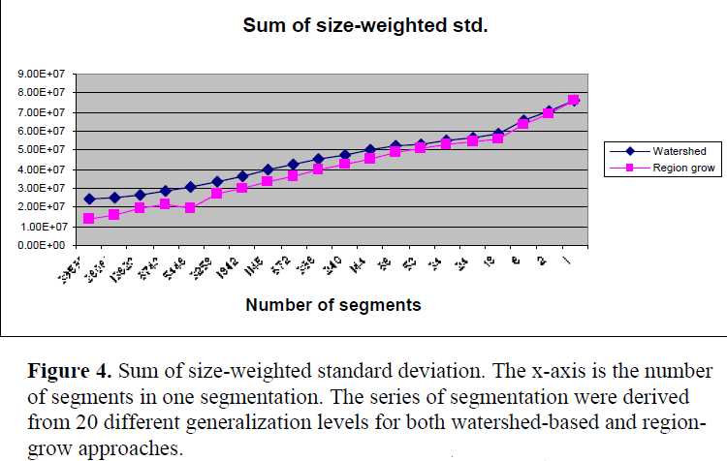
Segmentation Approaches

Slide 25
Segmentation Approaches
B. REGION-GROW APPROACH

This approach relies on the homogeneity of spatially localized features
It is a well-developed technique for image segmentation. It postulates that neighbouring pixels within the same region have similar intensity values.
The general idea of this method is to group pixels with the same or similar intensities to one region according to a given homogeneity criterion.



Slide 26
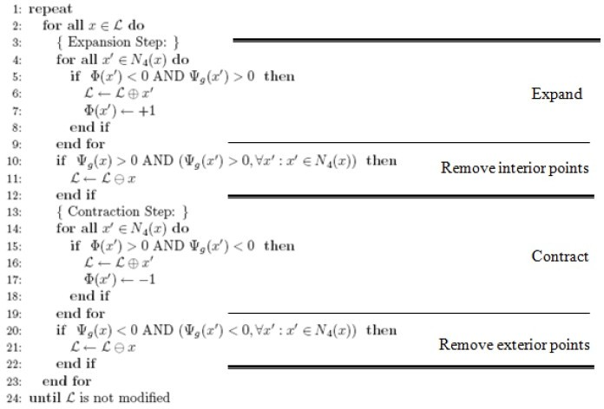
Segmentation Approaches
The region growing algorithm of the image which was shown on the next
slide.

Slide 27
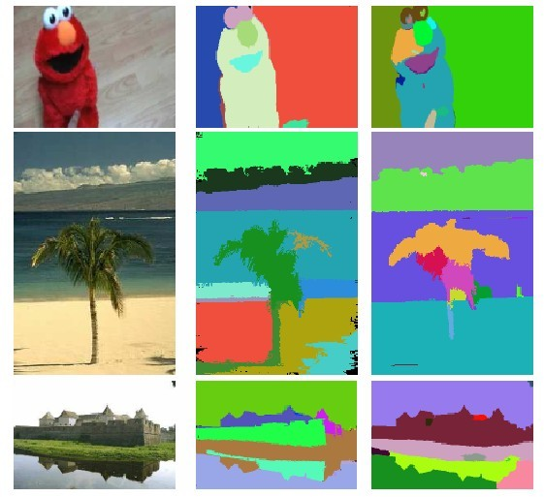
Segmentation Approaches
Segmentation result of region growing
algorithm compared with other results.
Original Image
Region growing based on algorithm
Mean Shift based
on algorithm
I
II
III

Slide 28
Segmentation Approaches
C. EDGE-BASED METHODS

Edge-based methods center around contour detection: their weakness in connecting together broken contour lines make them, too, prone to failure in the presence of blurring.

Slide 29
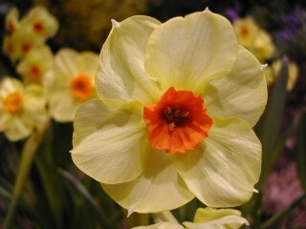
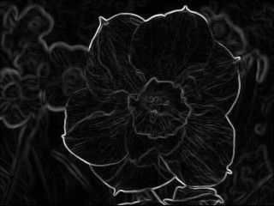
Segmentation Approaches
D. EDGE-BASED METHODS

Slide 30
Segmentation Approaches
E. CONNECTIVITY-PRESERVING RELAXATION- BASED METHOD


Referred as active contour model
The main idea is to start with some initial boundary shape represented in the form of spline curves, and iteratively modify it by applying various shrink/expansion operations according to some energy function.

Slide 31
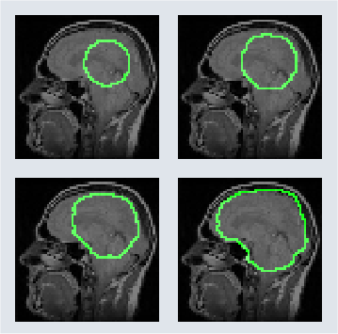
Segmentation Approaches
Partial Differential Equation (PDE) has been used for segmenting medical images
active contour model (snake)

