Slide 1




Quasi Static Shear Loading on a Single Edged 2D plate
Seminar : Fracture Mechanics
Jatandeep Singh

Slide 2
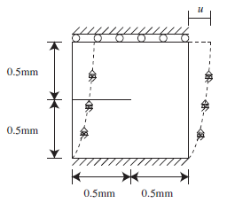
Problem Statement
Given : Quasi-static shear loading in 2D plate with plain strain and induced crack.
Goal : To find unknown displacement and phase field.
Output : Evolution of fracture upon loading

Slide 3
Problem Statement
Other given conditions:
Griffith critical energy (G_{c}) = 2700 J/m²
Poisson ratio (nu) = 0.3
Young’s modulus (E) = 210 GPa
No viscous damping.
Staggered algorithm for displacement and phase field.

Slide 4
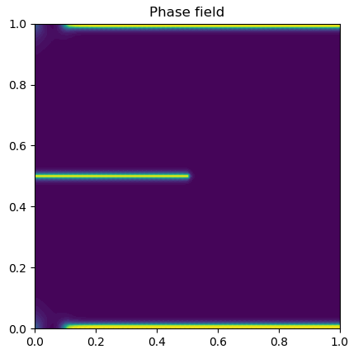
Case 1:
Conditions :
Mesh refined.
L₀= 7.5x10⁻⁶
History function - 0.5*lmbda*(tr(epsilon(u)) )**2 + mu*tr(dev(epsilon(u))*dev(epsilon(u)))
Variational Problem (Hirshikesh,2018)
E_u = ( pow((1-c_old),2) + 1e-6)*inner(grad(v), sigma(u))*dx
E_c = ( Gc*l_0*inner(grad(p),grad(q))+ ((Gc/l_0) + 2.*hist(u_new))*inner(p,q)- 2.*hist(u_new)*q)*dx

Slide 5
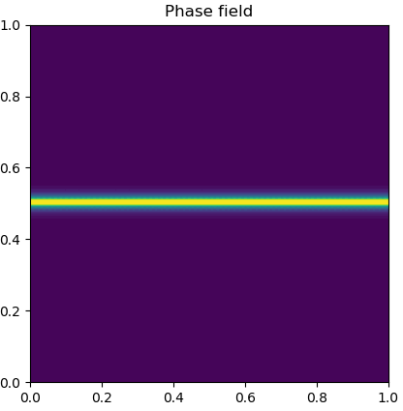
Case 2:
Conditions :
Mesh refined.
L₀= 0.011
History function - 0.5*lmbda*(tr(epsilon(u)) )**2 + mu*tr(dev(epsilon(u))*dev(epsilon(u)))
Variational Problem (Hirshikesh,2018)
E_u = ( pow((1-c_old),2) + 1e-6)*inner(grad(v), sigma(u))*dx
E_c = ( Gc*l_0*inner(grad(p),grad(q))+ ((Gc/l_0) + 2.*hist(u_new))*inner(p,q)- 2.*hist(u_new)*q)*dx

Slide 6
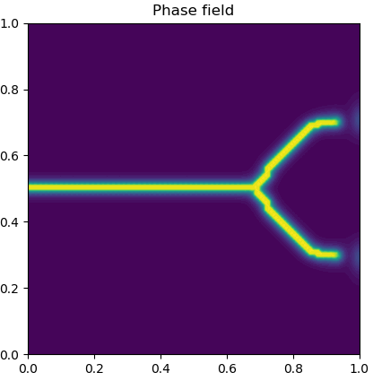
Case 3:
Conditions :
Mesh refined.
L₀= 0.011
History function (Amor,2009)-0.5*kn*(tr(epsilon(u)) )**2 + mu*tr(dev(epsilon(u))*dev(epsilon(u)))
Variational Problem (Hirshikesh,2018)
E_u = ( pow((1-c_old),2) + 1e-6)*inner(grad(v), sigma(u))*dx
E_c = ( Gc*l_0*inner(grad(p),grad(q))+ ((Gc/l_0) + 2.*hist(u_new))*inner(p,q)- 2.*hist(u_new)*q)*dx

Slide 7
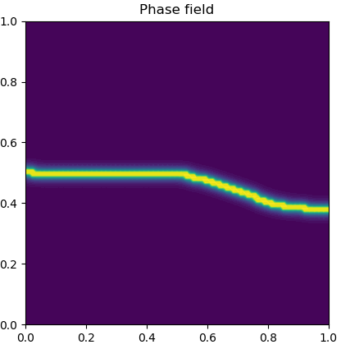
Case 4:
Conditions :
Mesh refined.
L₀= 0.011
History function (Amor,2009)-0.5*kn*( 0.5*(tr(epsilon(u)) + abs(tr(epsilon(u)))) )**2 + mu*tr(dev(epsilon(u))*dev(epsilon(u)))
History function consists of ramp up function in first part and deviatoric in second part.
Variational Problem (Hirshikesh,2018)

Slide 8
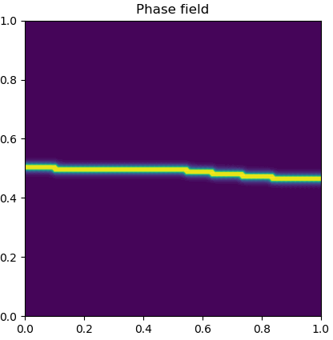
Case 5:
Conditions :
Mesh refined.
L₀= 7.5x10⁻⁶
History function (Amor,2009)-0.5*kn*( 0.5*(tr(epsilon(u)) + abs(tr(epsilon(u)))) )**2 + mu*tr(dev(epsilon(u))*dev(epsilon(u)))
History function consists of ramp up function in first part and deviatoric in second part.
Variational Problem (Hirshikesh,2018)

Slide 9
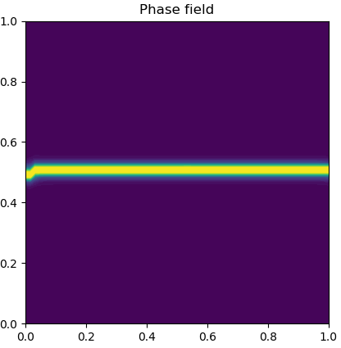
Case 6:
Conditions :
Mesh not refined.
L₀= 0.011
History function (Amor,2009)-0.5*kn*( 0.5*(tr(epsilon(u)) + abs(tr(epsilon(u)))) )**2 + mu*tr(dev(epsilon(u))*dev(epsilon(u)))
History function consists of ramp up function in first part and deviatoric in second part.
Variational Problem (Hirshikesh,2018)

Slide 10
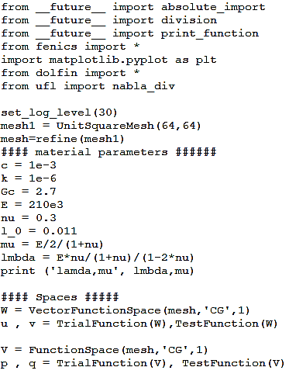
Program:

Slide 11
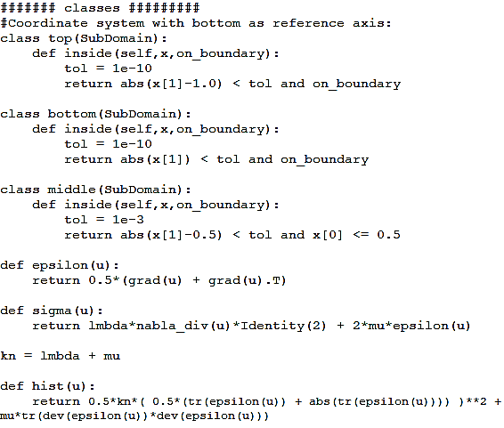
Program:

Slide 12
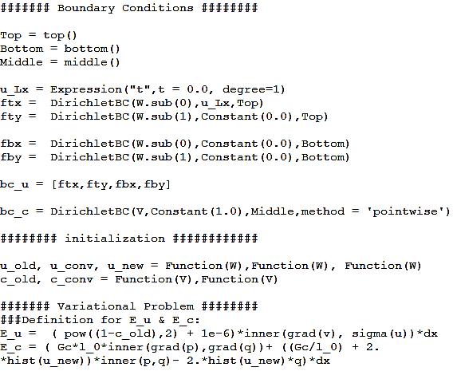
Program:

Slide 13
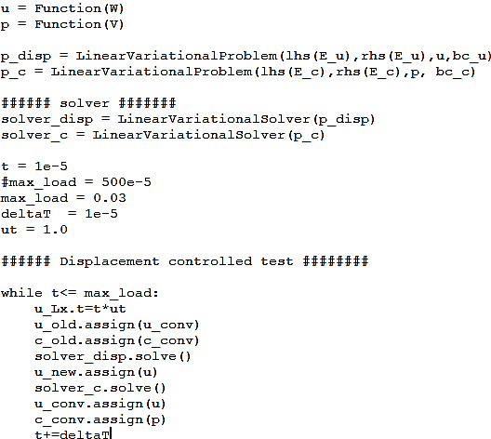
Program:

Slide 14
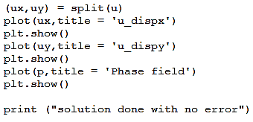
Program:

Slide 15
References
HIRSHIKESH, Sundararajan NATARAJAN*,Ratna Kumar ANNABATTULA*. A FEniCS implementation of the phase field method for quasi-static brittle fracture. Frontiers of Structural and Civil Engineering,2018,
Amor H, Marigo J J, Maurini C. Regularized formulation of the variational brittle fracture with unilateral contact: numerical experiments. Journal of the Mechanics and Physics of Solids, 2009, 57(8): 1209–1229.
Miehe C, Welschinger F, Hofacker M. Thermodynamically consistent phase-field models of fracture: variational principles and multi-field FE implementations. International Journal for Numerical Methods in Engineering, 2010, 83(10): 1273–1311.

