Slide 1



End-to-End Azure Data Pipeline for Retail Optimization at XYZ Inc
COMPANY
NeoStats
Bangalore
CANDIDATE
Jatan Sahu
Date : 24/08/2024

Slide 2

PROJECT INTRODUCTION
XYZ Retail Inc., a prominent player in the retail industry, faces the challenge of efficiently managing and analyzing its sales data. The company operates through multiple channels—online platforms, physical stores, and mobile apps.
Our main goal is to handle data with seamless integration with PowerBI, allowing stakeholders to gain important insights on city-related real estate trends.

Slide 3
PROBLEM STATEMENT
Building ETL Pipelinefor managing and analyzing sales data across multiple channels.
Need for data-driven insights to optimize retail operations.

Slide 4
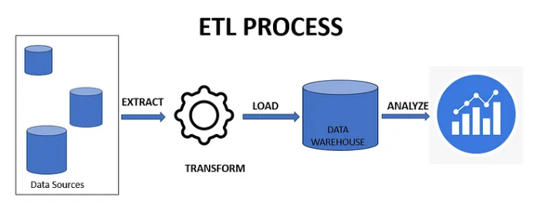
OBJECTIVE
My objective is to develop a robust and efficient Extract, Transform, Load (ETL) pipeline to streamline data integration processes, ensuring seamless data flow, transformation, and loading within systems.
Image Source

Slide 5
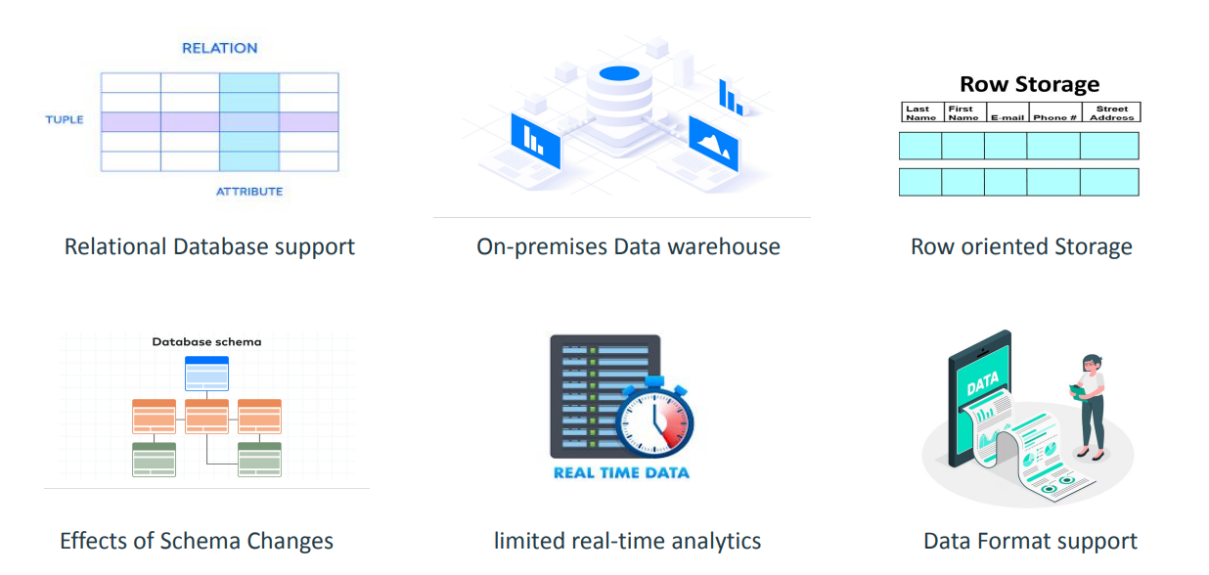
LIMITATIONS OF TRADITIONAL ETL ARCHITECTURE

Slide 6
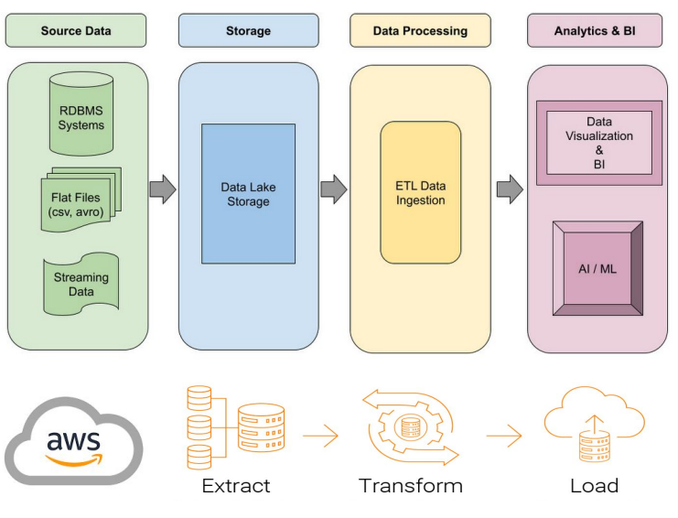
SOLUTION: CLOUD ETL PIPELINE

Slide 7
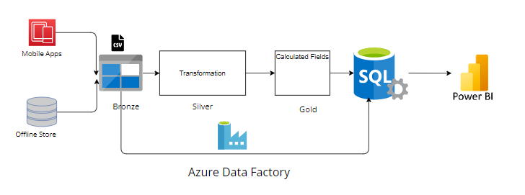
DATA PIPELINE ARCHITECTURE
Fig: Whole Pipeline of Project

Slide 8
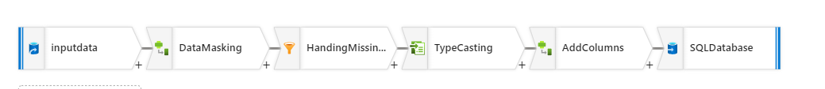
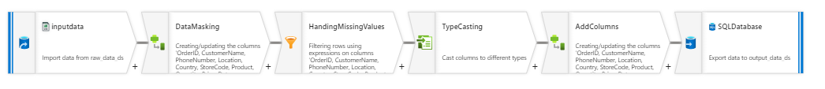
AZURE DATA FLOW

Slide 9
Components
Bronze Layer: Raw data ingestion (Local to ADLS)
Silver Layer: Data transformation (masking, handling missing values, typecasting).
Golden Layer: Business data creation (calculating sales, formatting dates).
Power BI Integration: Connecting Azure SQL to Power BI for visualization.

Slide 10
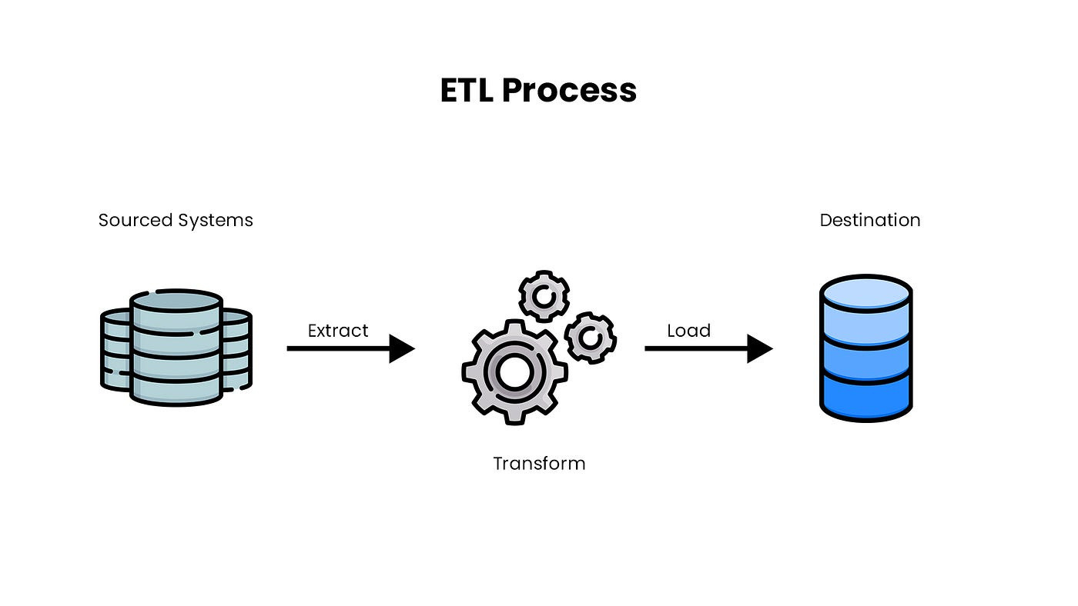

SCALE OF DATA
Azure Blob ( Bronze )
Azure SQL DB( Gold )
File Format : csv
File Size : 12 KB
Total Rows : 99
Total Columns : 12
File Format : csv
File Size : 12 KB
Total Rows : 99
Total Columns : 13

Slide 11
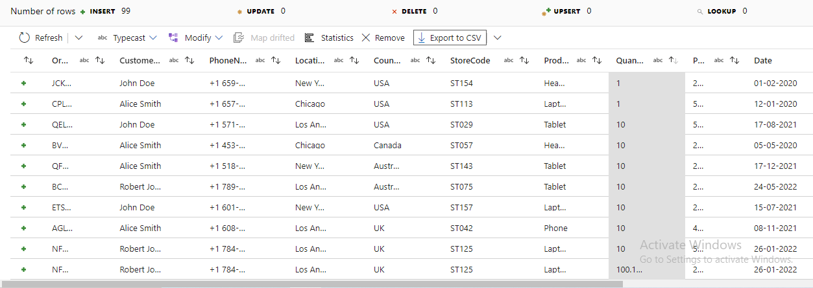
SALES DATASET
Fig : Dataset

Slide 12
Data Ingestion
Description
Ingest sales data from a local storage using ADF.
Store raw data in Azure Data Blob Storage.
Justification:
Azure Blob Storage can easily scale to accommodate large volumes of data, which is important as XYZ Retail’s operations grow. It supports a wide range of data types and sizes, allowing seamless storage of raw sales data from various channels (online platforms, physical stores, mobile apps).

Slide 13
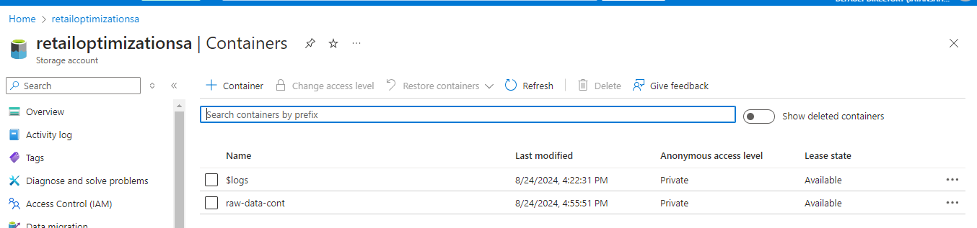
Azure Blob Storage( Bronze)
Fig : Azure Blob Storage

Slide 14
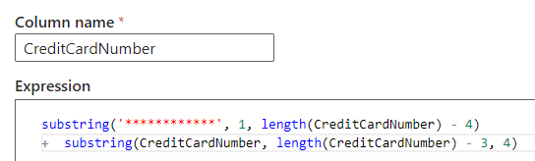
Data Transformation
Key Processes:
Data Masking: Protecting PII (e.g., credit card numbers) using custom logic.
This expression is used to mask all but the last four digits of a credit card number with asterisks (*).

Slide 15
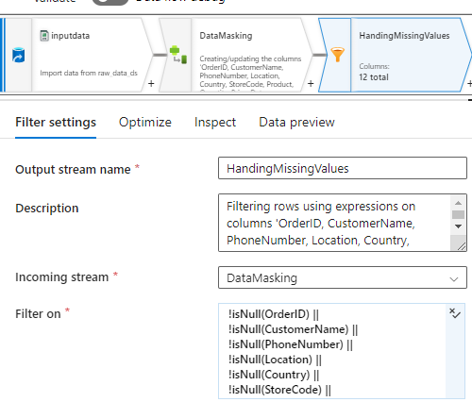
Data Transformation
Key Processes:
Handling Missing Values: Strategies used to manage missing data.
This expression checks whether at least one of the specified fields (OrderID, CustomerName, PhoneNumber, Location, Country, StoreCode) is not null. If any of these fields have a value (i.e., are not null), the whole expression will return true.

Slide 16
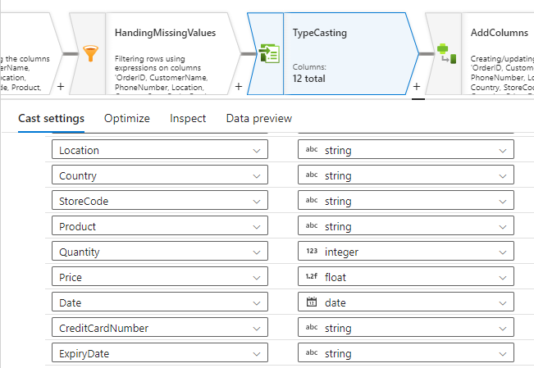
Data Transformation
Key Processes:
Typecasting: Ensuring correct data types for further analysis.

Slide 17
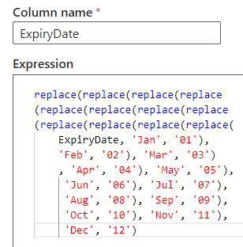
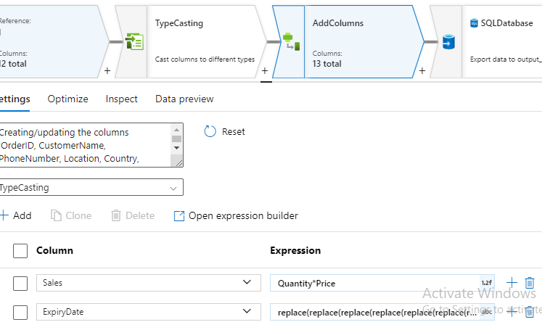
Business Logic Implementation (Golden Layer)
Key Metrics:
Sales Calculation: Quantity * Price
Expiry Date Formatting: Converting month names to numbers.

Slide 18
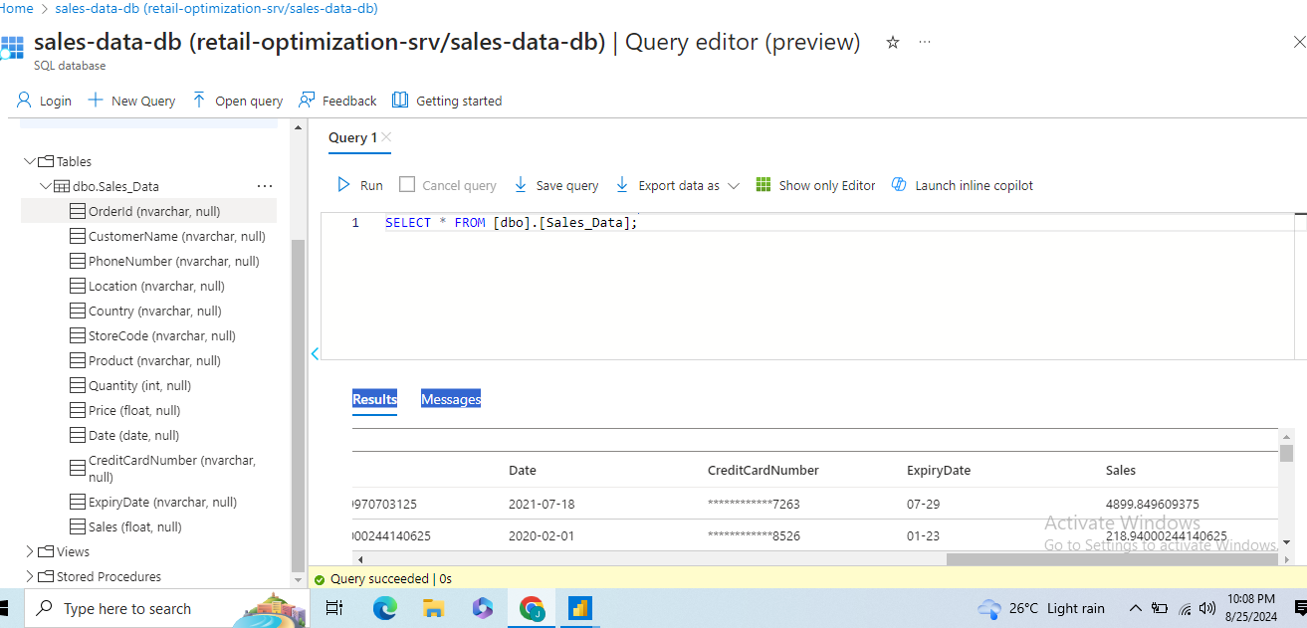
Azure SQL Database and Power BI Integration

Slide 19
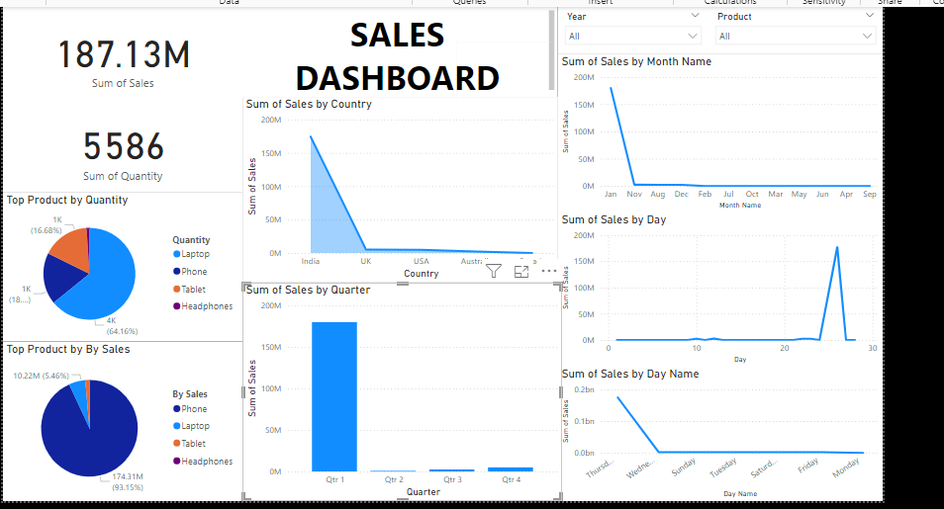
PowerBI Insight: Whole Data

Slide 20
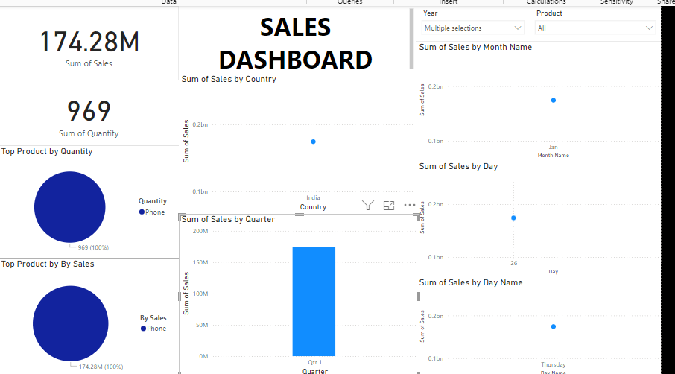
POWER BI : For Year 2023

Slide 21
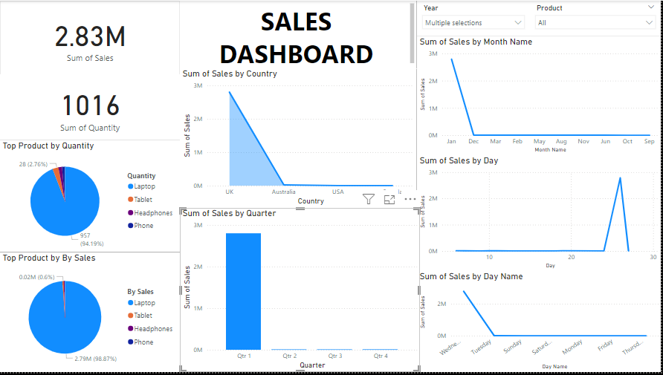
POWER BI : For Year 2022

Slide 22
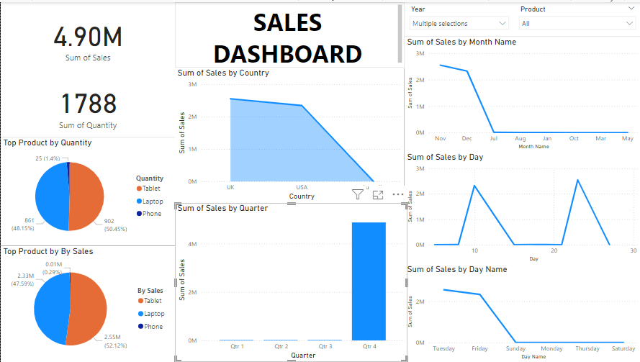
POWER BI : For Year 2021

Slide 23
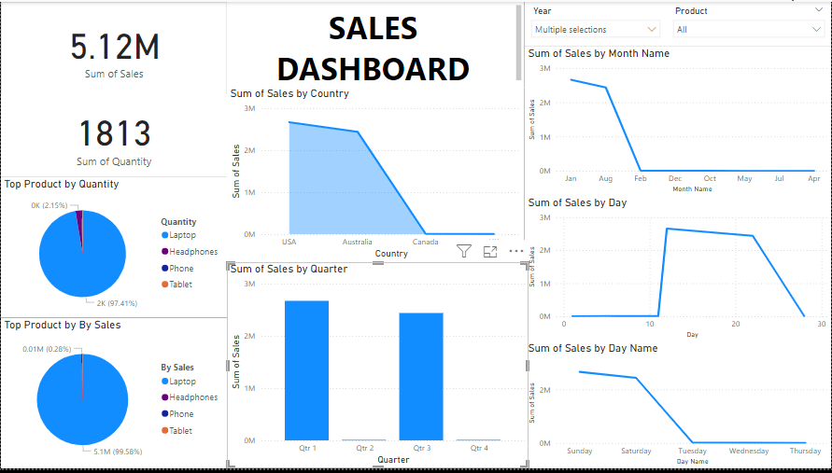
POWER BI : For Year 2020

Slide 24
CHALLENGES
Forgetting about long-term maintenance​
Data formats changing over time​.
An increase in data velocity​.
The time cost of adding new data connections​.
The time cost of fixing broken data connections​.
Requests for new features, including new columns, dimensions, and derivatives.
Building ETL process based on current data scale
ETL system needs to be able to scale; otherwise, it'll outgrow the infrastructure and be stuck in rebuilding.

Slide 25
CONCLUSION
In conclusion, this data engineering project exemplifies the transformative potential of leveraging advanced technologies and best practices to unlock valuable insights from complex Datasets.
By seamlessly integrating Azure Blob storage, Apache Data Factory, Azure SQL DB, and PowerBI, our project has effectively implemented a comprehensive ETL pipeline. This pipeline demonstrates adeptness in processing, transforming, and analyzing the Redfin dataset from start to finish, facilitating enhanced decision-making and strategic insights

Slide 26
OTHER DATA ENGINEERING PROJECTS
Streamline Redfin Data: A AWS cloud based ETL Solution using AWS EC2, S3, Snowflake, Airflow, PowerBI :
Report Link
2. ETL Pipilene Design using Talend :

Slide 27

THANK YOU

