Slide 1

Buzzer

Slide 2
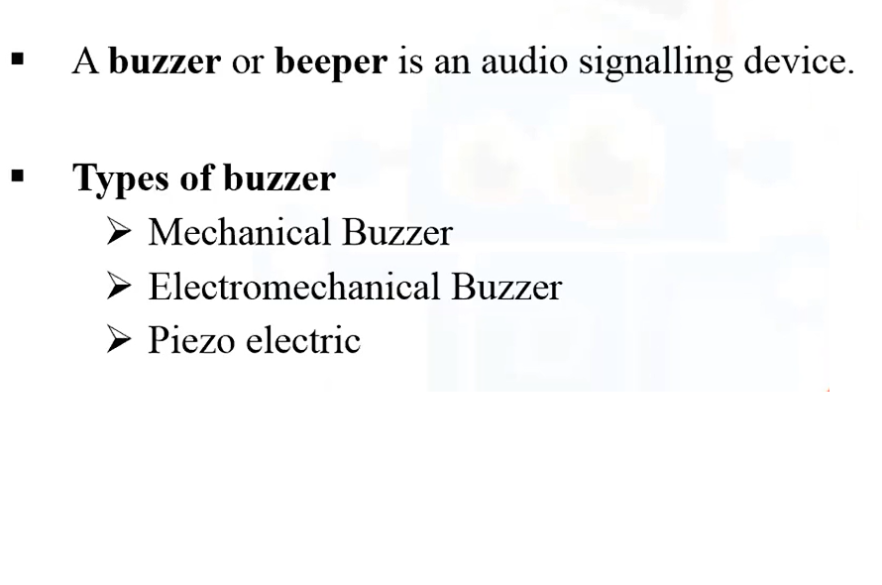
Buzzer and it’s types

Slide 3

Real-Time Application

Slide 4
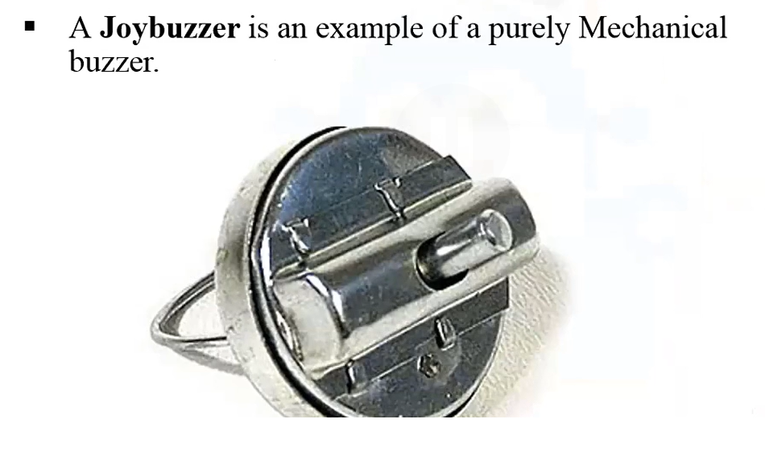
Mechanical Buzzer

Slide 5
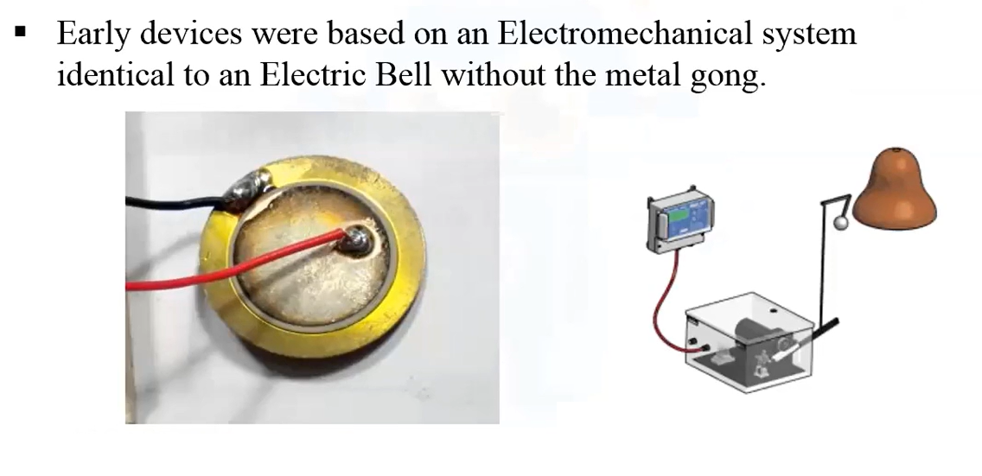
Electromechanical or piezoElectric buzzer

Slide 6
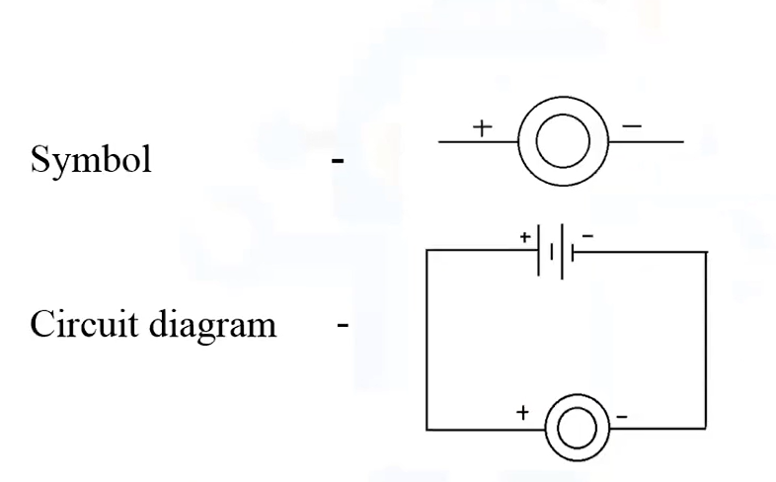
Circuit Symbol and Diagram of Buzzer

