Slide 1
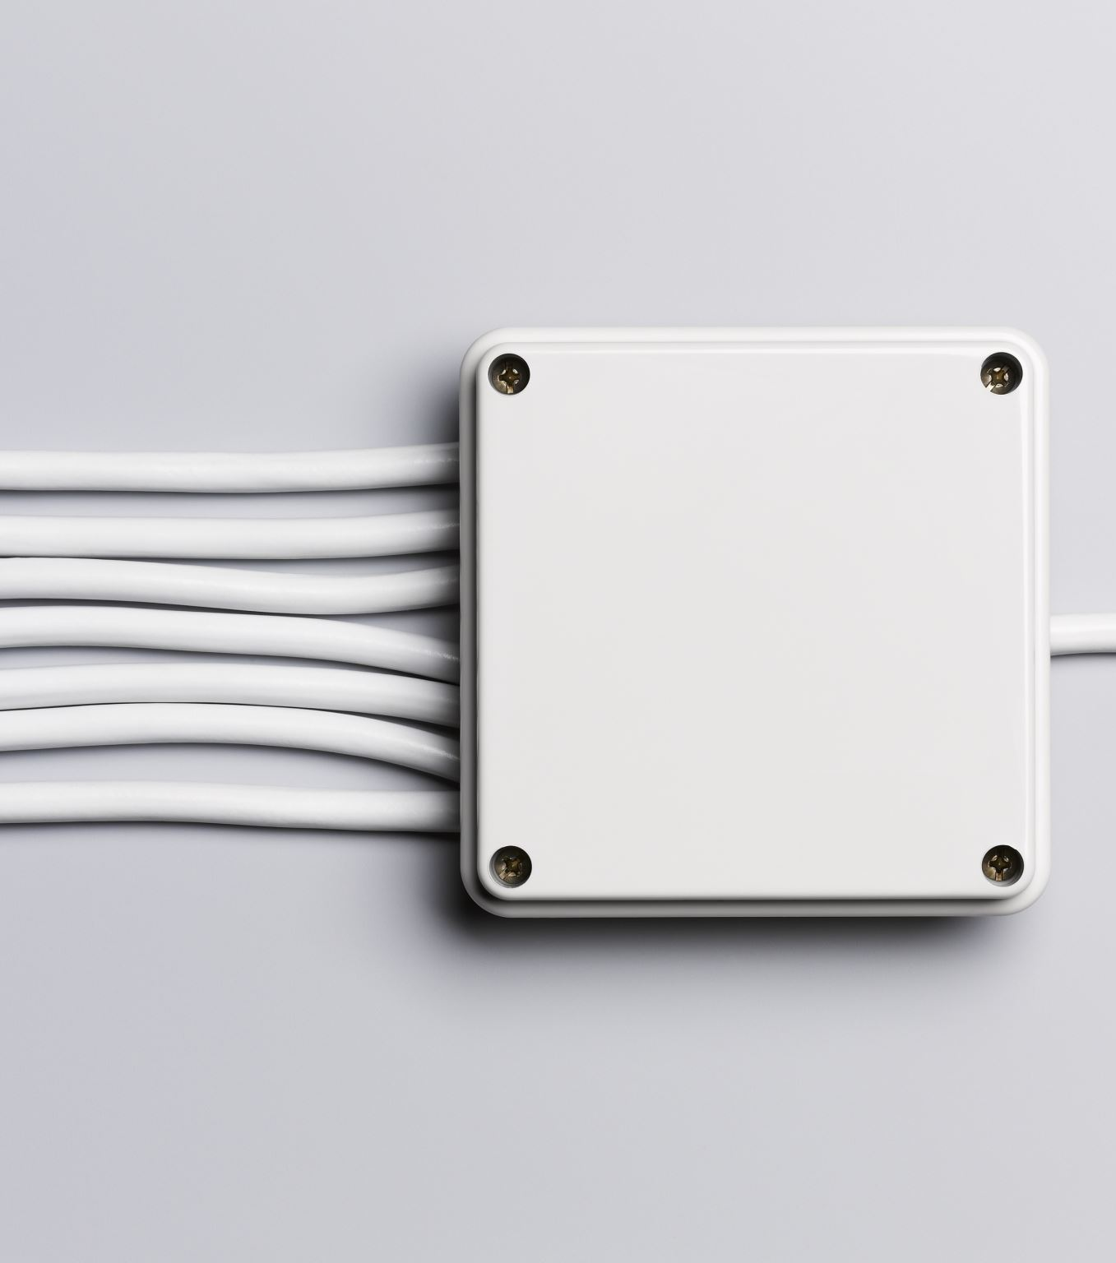

Capacitor

Slide 2
What is a Capacitor
A capacitor stores energy in the form of an electrostatic field between its plates.
Originally known as a condenser.
The capacitor is also known as a cap and filter.
It is sometimes used to avoid fluctuations.

Slide 3


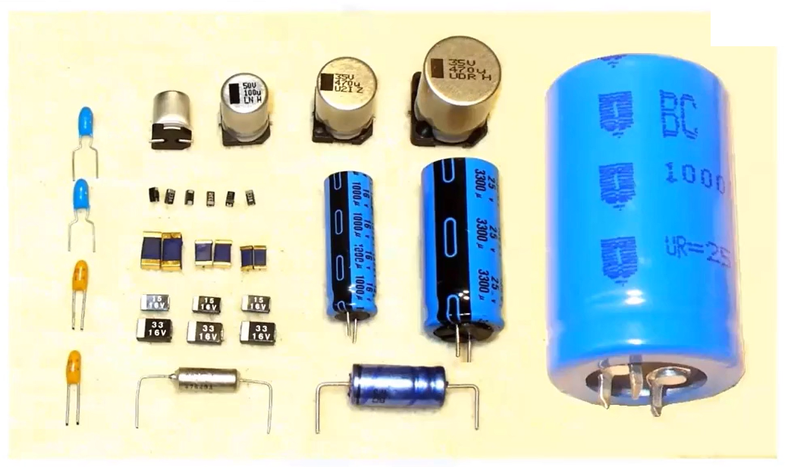
Types of Capacitors

Slide 4
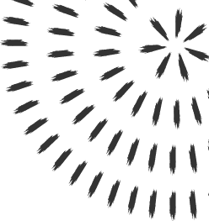
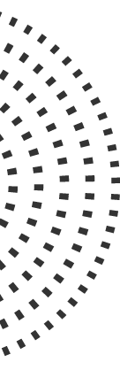
Tasks of the Capacitor
Electrostatic (non-Polarized)
Capacitance is the task done by the capacitor.
Unit of capacitance is FARAD.
The Symbol of capacitance is F.
2 types of Capacitor
Electrolytic (Polarized)

Slide 5
Difference between electrolytic and electrostatic capacitor
Electrolytic Capacitor
Electrostatic Capacitor
We have to connect the positive filament to the positive terminal of the battery and as well as the negative
In this, we have a positive and a negative filament
You can connect any filament to any of the terminals (if you have connected a filament to the positive terminal then should connect the other one to the negative terminal)
In this, we don't have any positive or negative filament

Slide 6
Overall Gist
What is Capacitor?
Its type?
Usage of capacitor?
Circuit Symbol?
Unit of Capacitance
Non formal names

Slide 7
Thank You

