Slide 1
Diode
By Jatasya Raval

Slide 2
What is Diode?
A diode is used to make the current flow in a single direction.
A diode is a specialized electronic component with two electrodes called the Anode and the Cathode.
Most diodes are made with semiconductors materials such as silicon, germanium, or selenium.
Rectifiers (Circuit used to convert AC current to DC current).

Slide 3
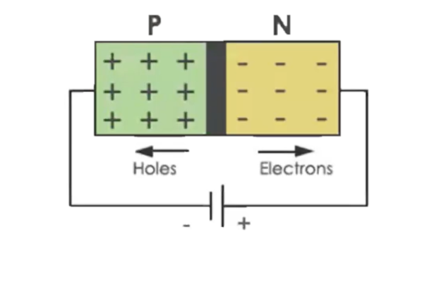
P-N Junction Diode
P-N Junction is a boundary or interface between two types of semiconductor material, P-type and N-type, inside a single crystal of semiconductor.

Slide 4

Circuit Symbol of Diode

Slide 5
Thank You

