Slide 1
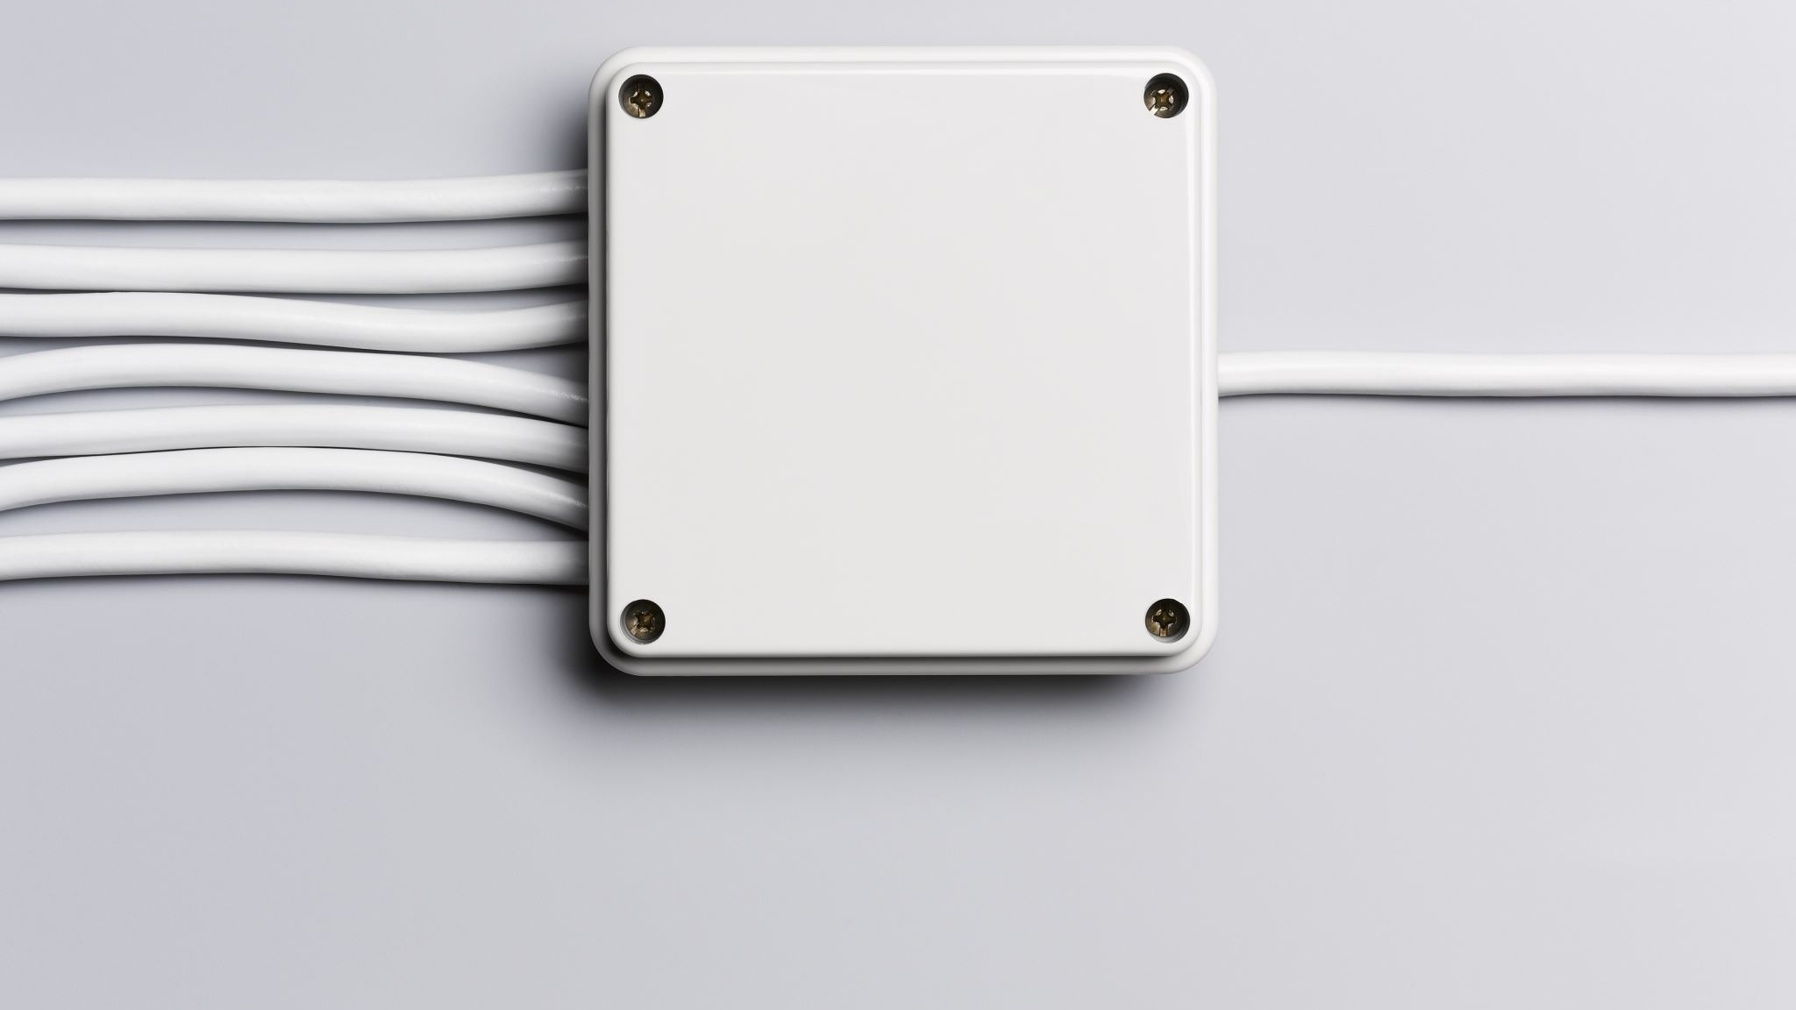
LED (Light Emitting Diode)

Slide 2

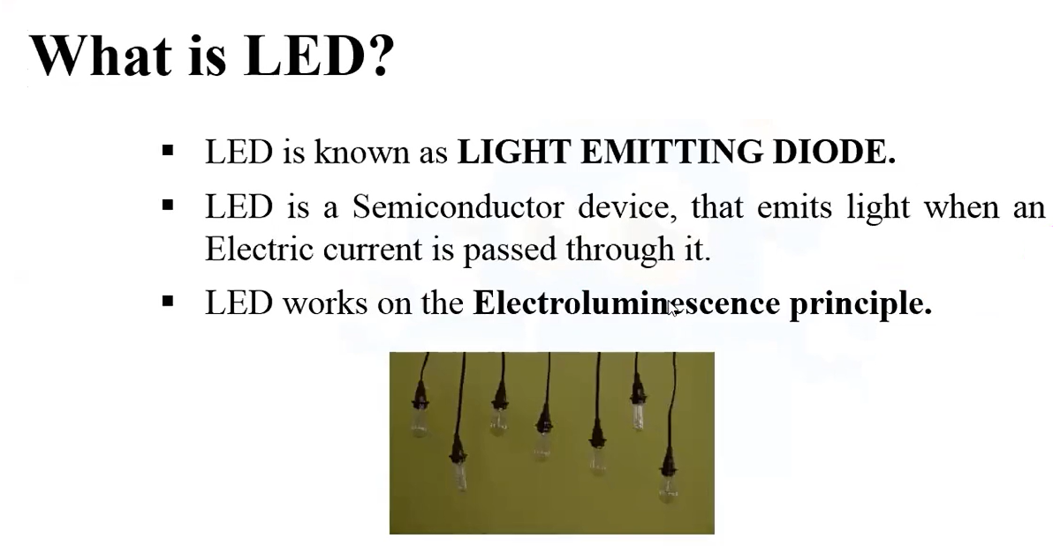
What is LED?

Slide 3
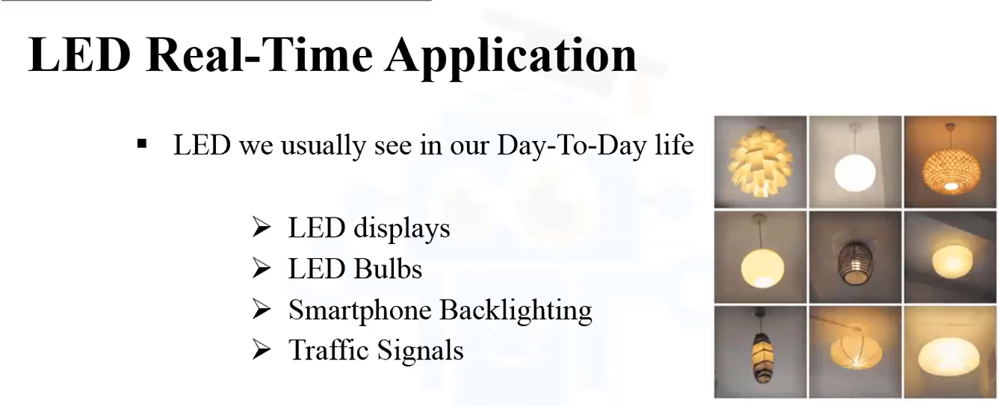
Real-Time Application of LED

Slide 4
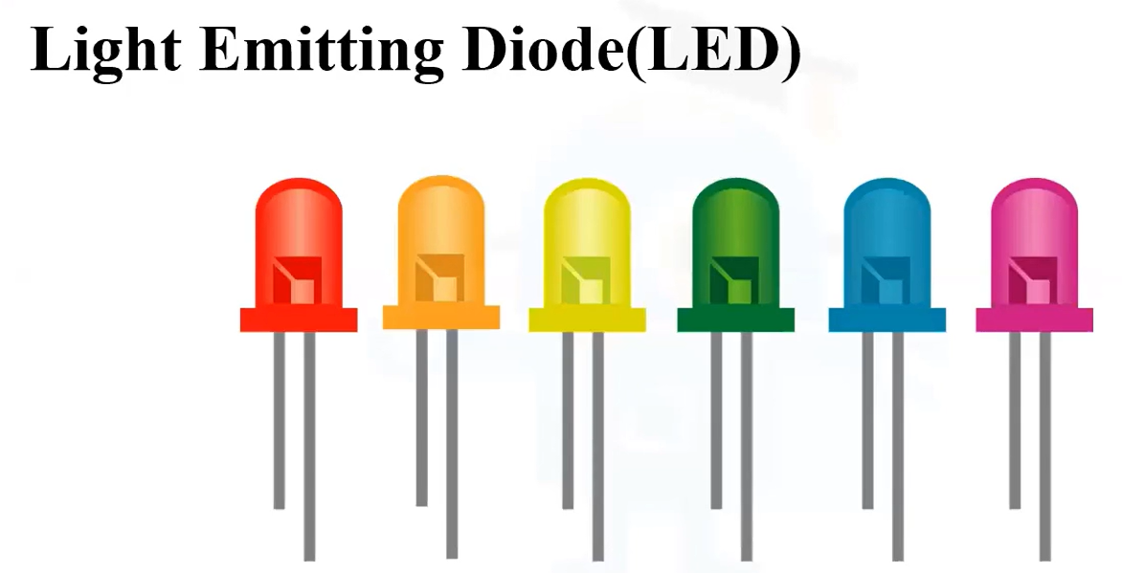
Example

Slide 5
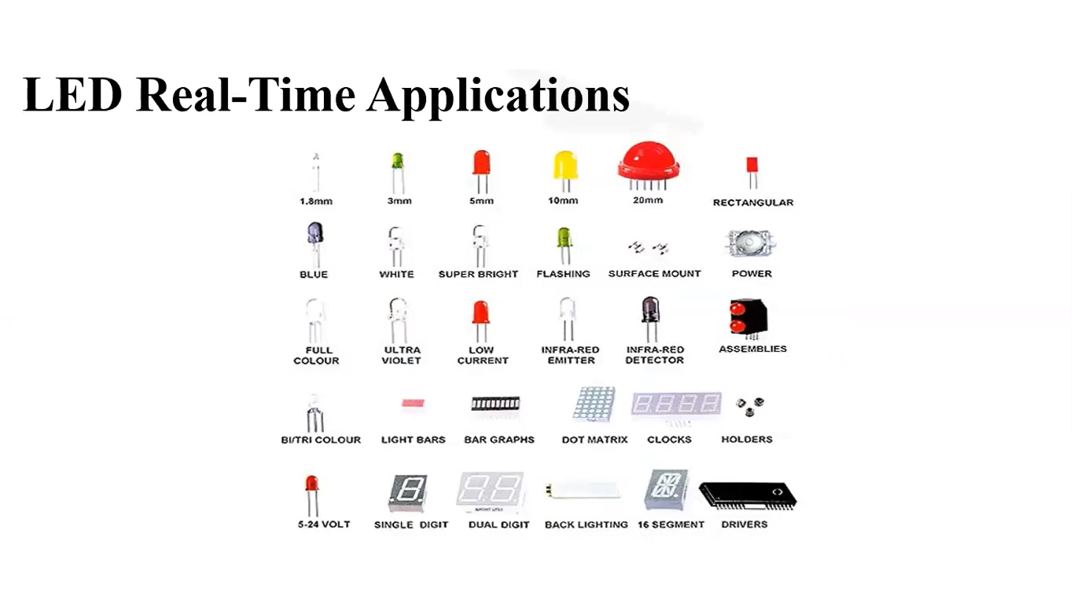

Slide 6
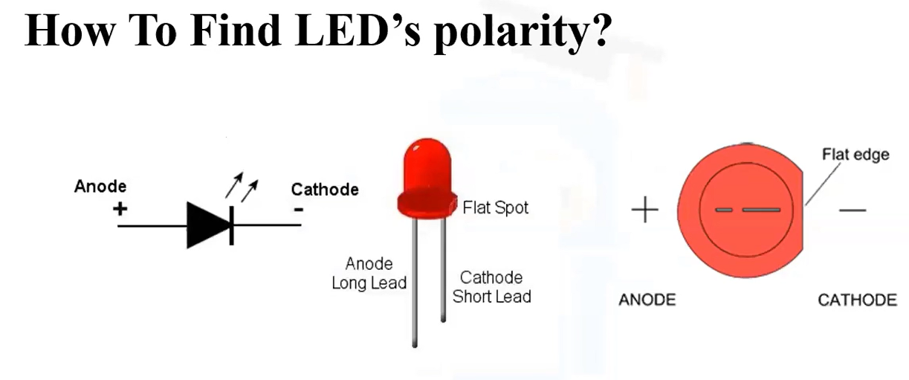
To find LED's Polarity

Slide 7
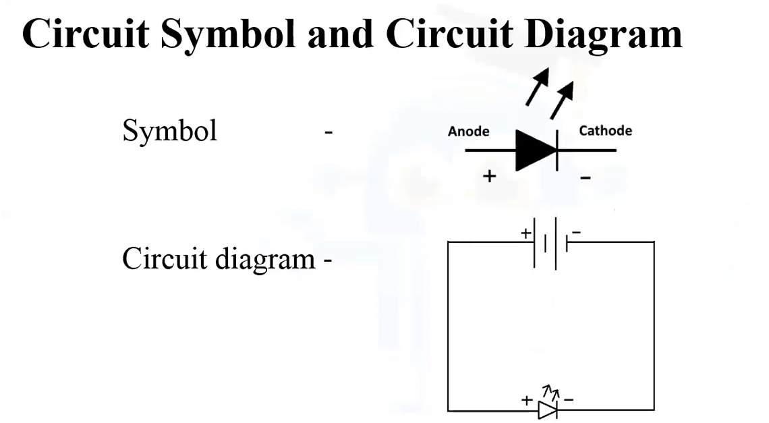
Circuit Symbol and Circuit Diagram of LED

