Slide 1

Potentiometer
By Jatasya Raval

Slide 2
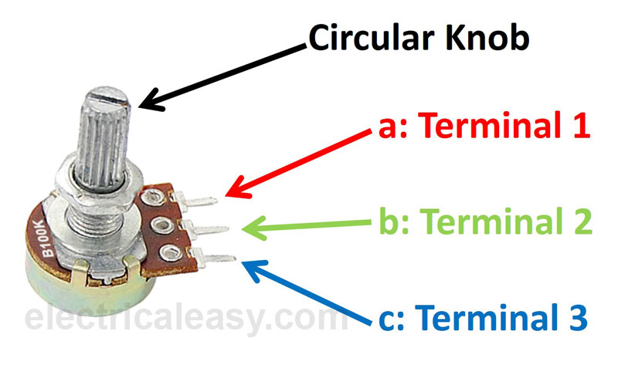
What is Potentiometer?
If only two terminals are used, one end and the wiper, it acts as a Variable Resistor or Rheostat.
A potentiometer informally a Pot, is a three-Terminal Resistor.

Slide 3
Difference between a Potentiometer and a Rheostat
Potentiometer
Rheostat
A potentiometer is a three-terminal variable resistor.
A potentiometer can be used as a rheostat.
Potentiometers are often used to vary voltage.
a Rheostat is a two-terminal variable resistor.
a rheostat can’t be used as a potentiometer.
rheostats are used to vary current.

Slide 4
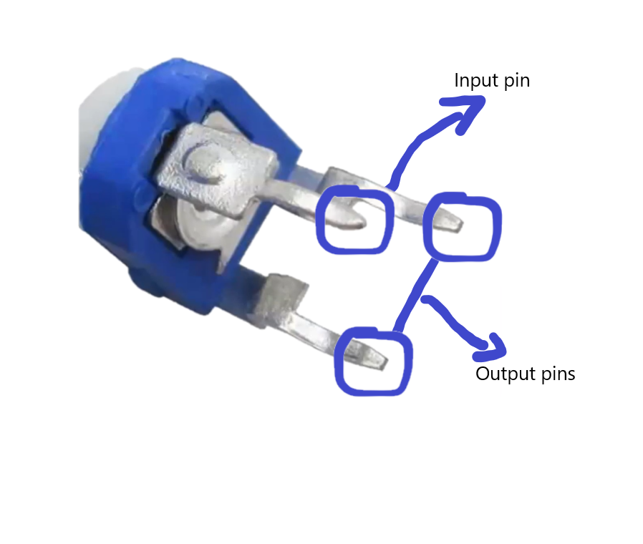
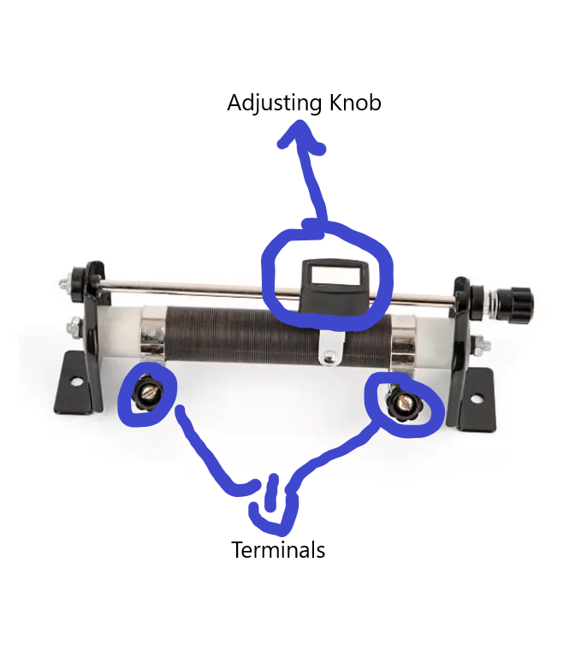
Images of Potentiometer and Rheostat
Potentiometer
Rheostat

Slide 5
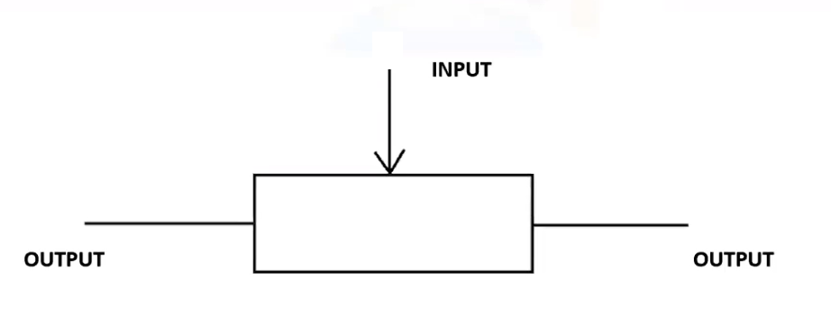
Circuit Symbol of Potentiometer

Slide 6
Thank You

