Slide 1

Resistor
By Jatasya Raval

Slide 2
What is a Resistor
Resistor is used to resist the flow of current.
1
Resistance is the task done by resistor.
2
Unit of Resistance is Ohms
3

Slide 3
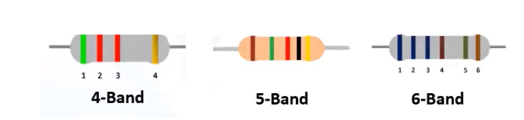
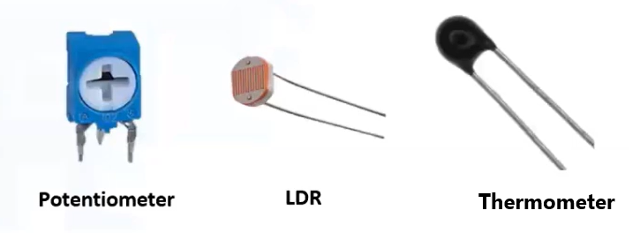
Types of Resistor
Resistor
Fixed Value Resistor
Variable Resistor

Slide 4
Classification of Resistor
Four Band
Two digits, One Multiplier, One Tolerance.
Five Band
Three digits, One Multiplier, One Tolerance.
Six Band
Three digits, One Multiplier, One Tolerance, One Temperature co-efficient.

Slide 5

Symbol of Ohms

Slide 6
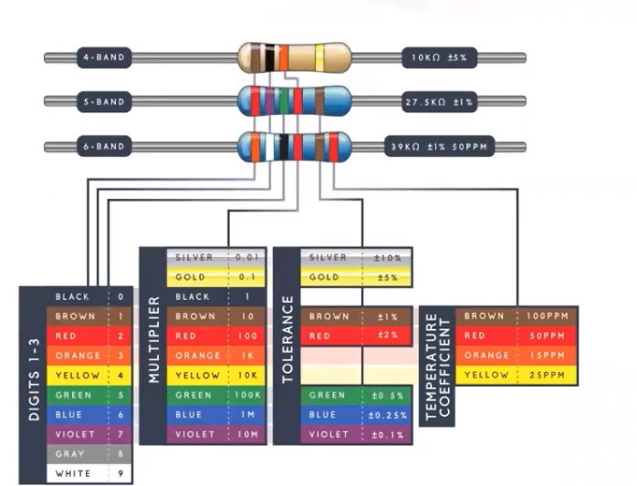

How to find resistance value
Color Coding Mnemonic

Slide 7
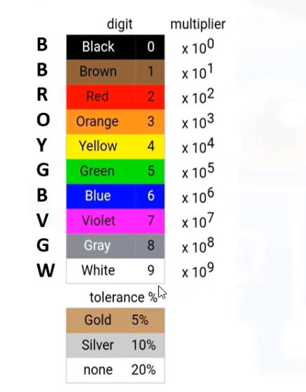
Color Code Mnemonic

Slide 8
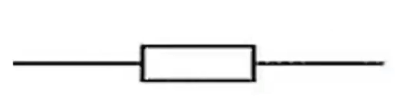
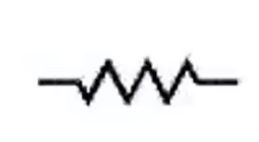
Symbol of Resistor
New Symbol
Old Symbol

Slide 9
Thank You

