Slide 1

Switch
By Jatasya Raval

Slide 2

What is a Switch?
A switch is an electronic device used to make or break a complete electric circuit using an on and off switch.

Slide 3
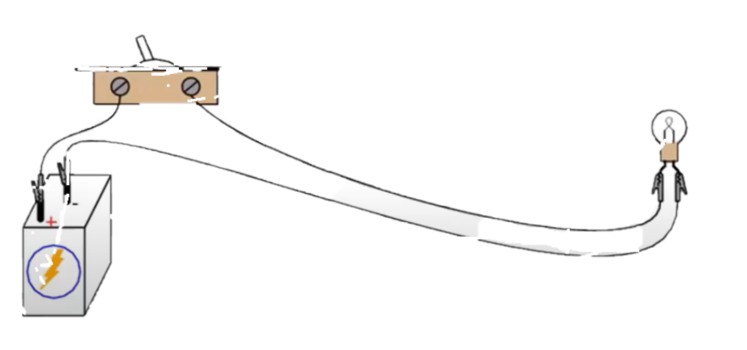
Switch Working Principle

Slide 4
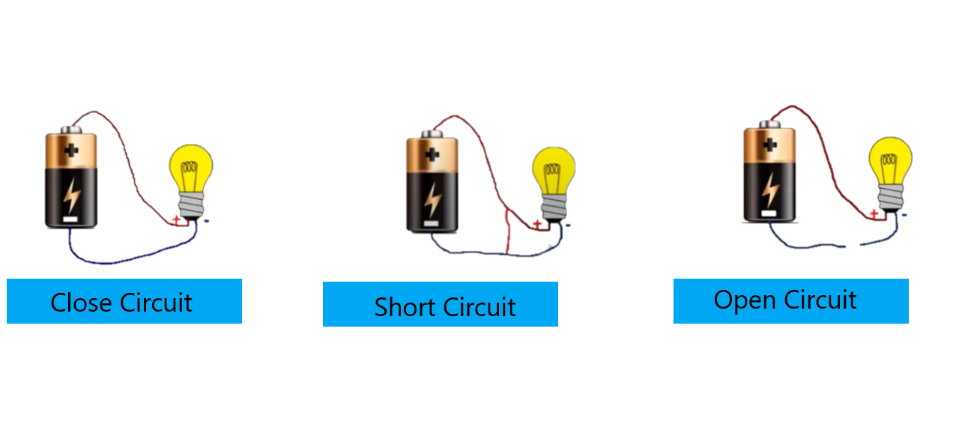
Types of Circuits
The LED is glowing in Close Circuit

Slide 5
Types of Switches
Single Pole Single Throw (SPST)
Single Pole Dual Throw (SPDT)
Dual Pole Single Throw (DPST)
Dual Pole Dual Throw (DPDT)
Push Switch
Reset Switch

Slide 6
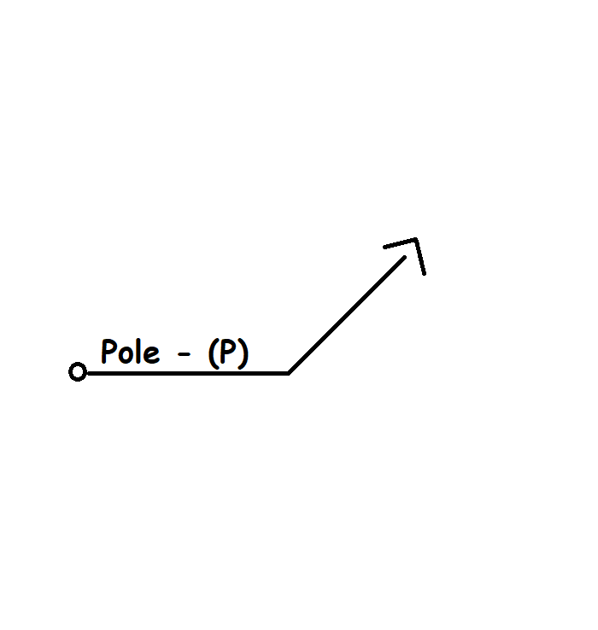
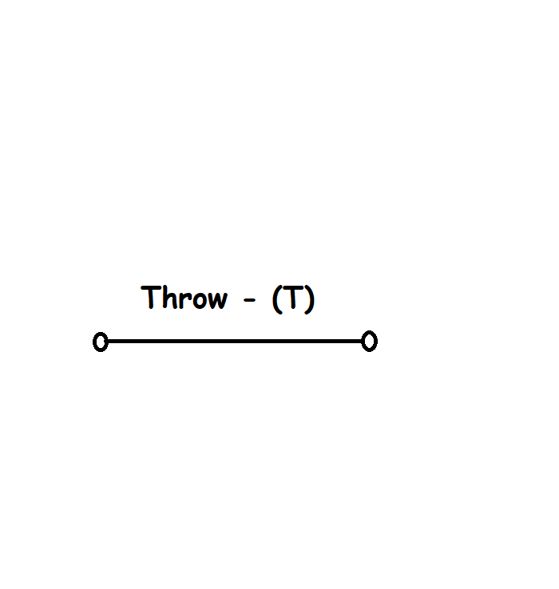



Circuit Diagrams of Pole and Throw

Slide 7


Circuit Diagrams of Switches PT-1
SPST
SPDT

Slide 8


Circuit Diagrams of Switches PT-2
DPST
DPDT

Slide 9
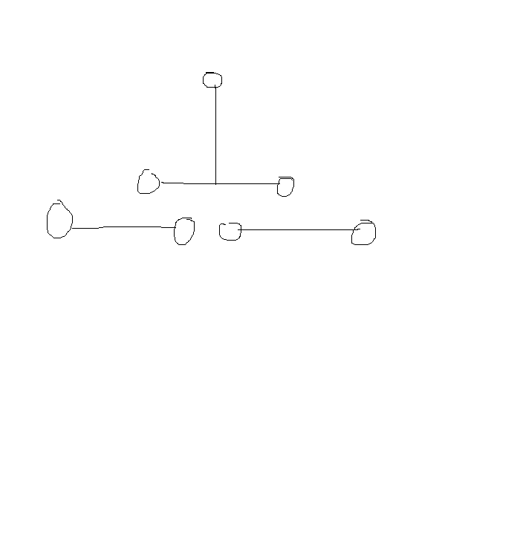
Circuit Diagrams of Switches PT-3
Push or Reset Switch

Slide 10
Real-Time Applications
It is used just to on and off electronics

Slide 11
Overall Gist
Definition of Switch
Types of Switch
SwitchWorking Principle
Circuit Symbols
Real-Time Applications

Slide 12
Thank You

