Slide 1


Thermistor
By Jatasya Raval

Slide 2
What is a Thermistor
Thermistors are widely used as inrush current limiters, temperature sensors, self-resetting overcurrent protectors, and self-regulating heating elements.
a thermistor is a type of resistor whose resistance varies significantly with temperature, more so than in standard resistors.

Slide 3
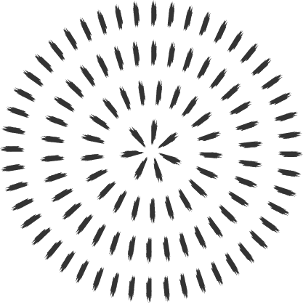
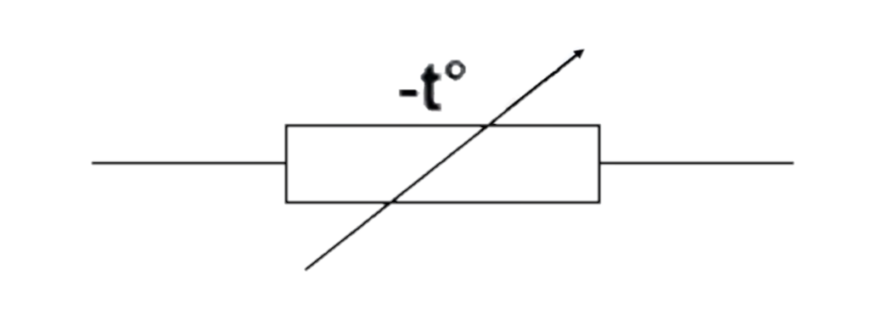

Circuit symbol of Thermistor

Slide 4

Thank You

