Slide 1

Transistors
By Jatasya Raval

Slide 2
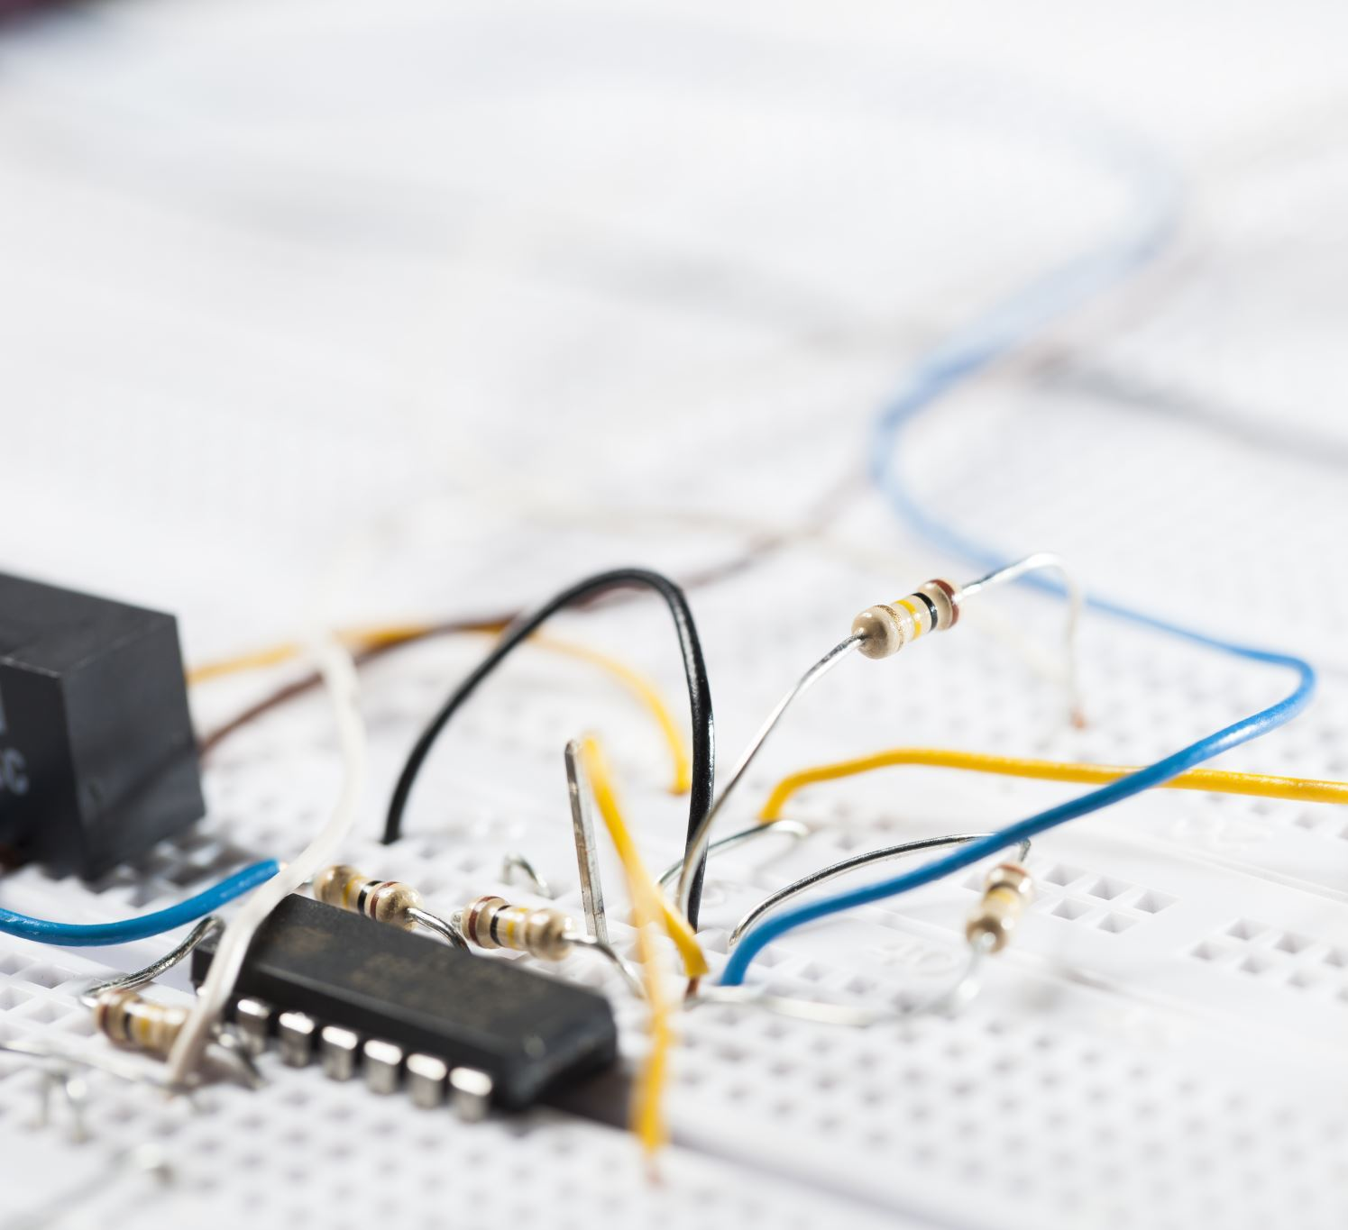
What is Transistor?
A Transistor is a semiconductor device used to amplify and switch electronic signals and electrical power.
It is composed of semiconductor material with at least three terminals for connection to an external circuit.

Slide 3
Types of Transistor
PNP (Positive Negative Positive)
557 ,558
NPN (Negative Positive Negative)
547 ,548

Slide 4
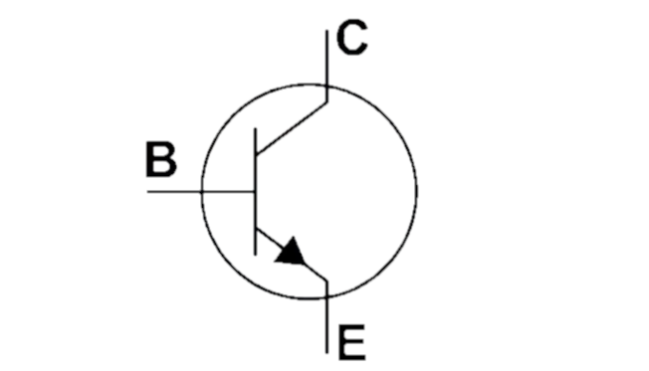
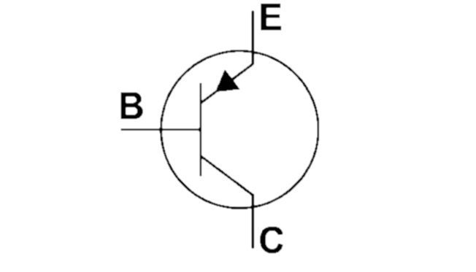
Transistor Pin Diagram
NPN
PNP

Slide 5
Overall Gist
What is Transistor
Types of Transistor
Transistor Pin Diagram
Transistor Real Time Applications

Slide 6
Thank You

