Slide 1

House Marketplace
Jateen Tirlotkar 20104091
Raj Solkar 20104087
Devesh Zope 20104086
Project Guide
Ms. Yaminee Patil

Slide 2
Contents
Introduction
Objectives
Scope
Literature Survey
Proposed System
Project Outcomes
Block Diagram
Use Case/DFD
Technology Stack
Suggestion in Review-I
Result and Discussion
Conclusion and Future Scope
References

Slide 3
1. Introduction
House marketplace is a location where people can regularly gather for the purchase and sale of Flats.
It is a property portal which deals with every aspect of the consumers’ needs in the real estate industry.
One stop solution for Residential properties for rent,buy,sell without Brokerage.
House marketplace app is a Revolutionary Tech Platform that helps you Sell or Rent your property quickly, easily and more securely.

Slide 4
2. Objectives
To provide information about real estate like residential houses for rent and sale.
To provide a platform where user can buy and rent house in one application.
To provide platform that offers end-to-end one-stop solution for property seekers.

Slide 5
3. Scope
The user will able to use search bar functionality to get information.
Filter for searching the property as per location, pricing,carpet area wise will be added.
Can be useful to students/employees for finding nearby apartments.
We will see the entire system more interactive and try to bridge between user and developer.
One can easily navigate and visit numerous properties digitally in a matter of seconds.

Slide 6
4. Literature Survey
The site of such has nobroker have main aim of eliminating the middle man in the deal which costs 1/2 months rent as a commision.It provides a vast range of options for the buyers from wide range of locations and helps directing contacting the sellers.
Sopranzetti explained hedonic approach is one of the most used conventional approaches to the housing market analysis.
Liao & Wang examined the relationship between the view orientation of an apartment and its property value in the context of the Shanghai housing market.

Slide 7
5. Proposed System
The House Marketplace System is designed in order to eliminate the problem of the current system. This accessibility of the information will be a great advantage as it reduced effort.
Registeration - After filling the required data, the client can register in our proposed system. User will be able to Login into the system with his unique username and password.
Add Property- Property can only be added by the authenticated users.
Manage Profile- User can view, update or delete the profile of their own.
Manage Property- Property management can be done by the user in which the user has a facility to view, edit or delete it.

Slide 8
6. Outcome of Project
User Can Register and Log in.
User can buy and sale within one interface.
Buyers can choose between Rental/Sale appartment
User can choose for near by apartment
User can choose your house for best offers

Slide 9
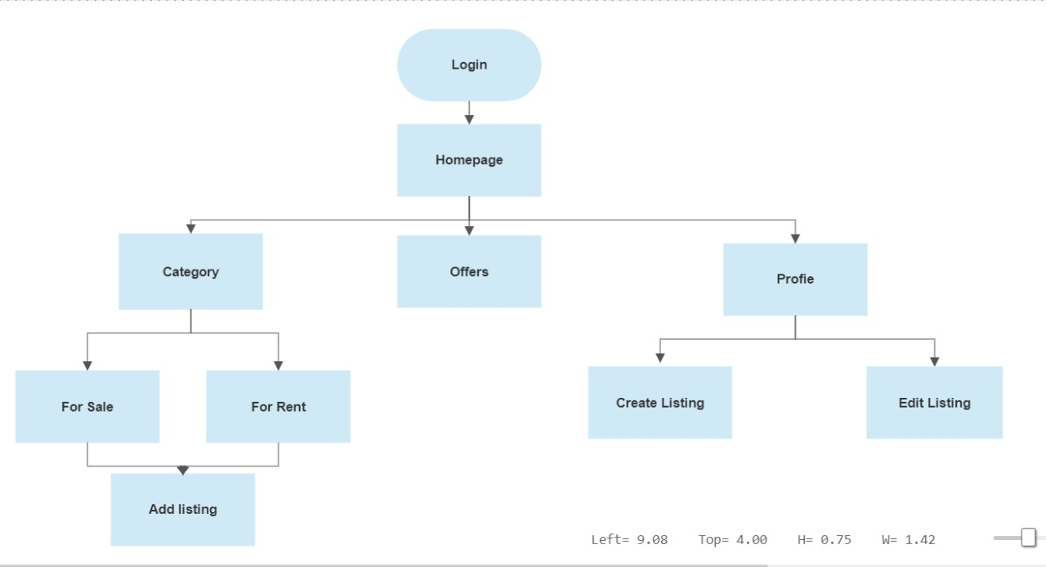
7. Block Diagram

Slide 10
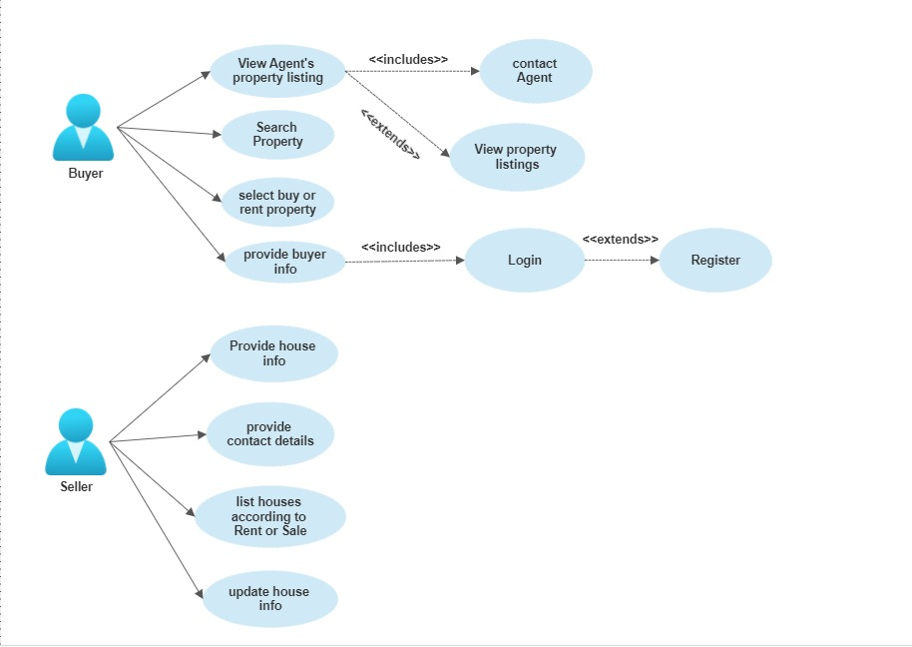
8. Use Case/Data Flow Diagram

Slide 11
9. Technology Stack
Technology Stack-
HTML5
Css3
React-Js
Firebase

Slide 12
10.Suggestions in Review-1
To add edit Listing Page.
View Listing
To improve Your UI.
To add Contact Page.
All Project are design.
Google Authentication
You can see your listings

Slide 13
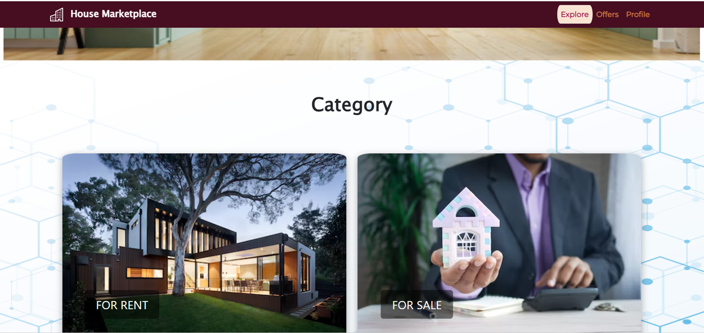
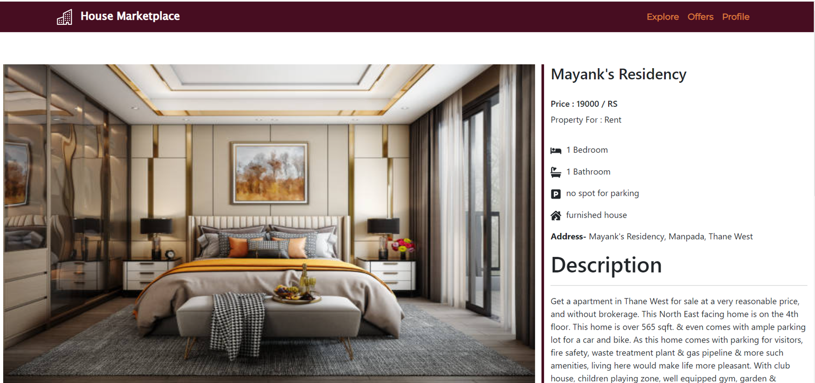
11.Result and Discussion

Slide 14
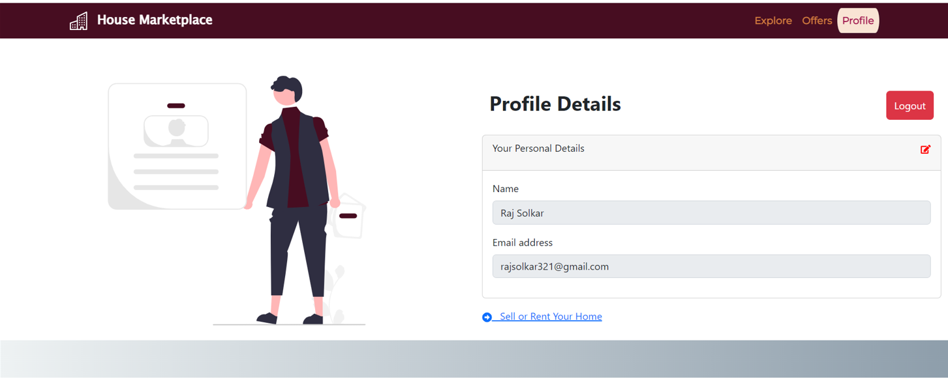
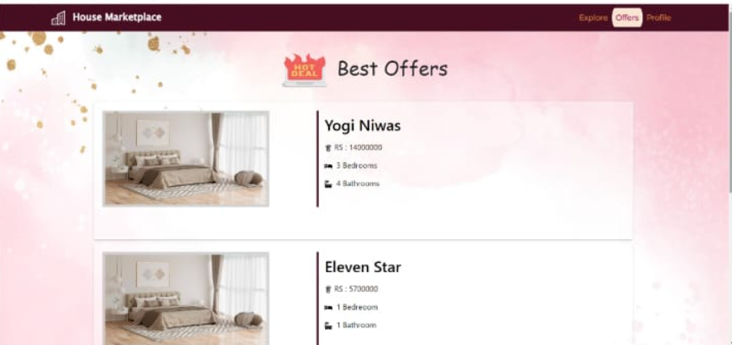
Result and Discussion

Slide 15
12.Conclusion and Future Scope
House marketplaces take time and effort to build, but they generate high demand among users.
User can view, update or delete the profile of their own.
House marketplaces take time and effort to build, but they generate high demand among users.
Future Scope-
Integration of maps
Legal authentication
Search filters

Slide 16
13.References
https://www.w3schools.com/REACT/react_components.asp
https://www.youtube.com/watch?v=CoyUhBy2qMo
http://shodh.inflibnet.ac.in:8080/jspui/bitstream/123456789/3495/3/03_litreature%20review.pdf
https://getbootstrap.com/
https://stackoverflow.com/

Slide 17
Thank You...!!

