Slide 1
自我介紹

Slide 2
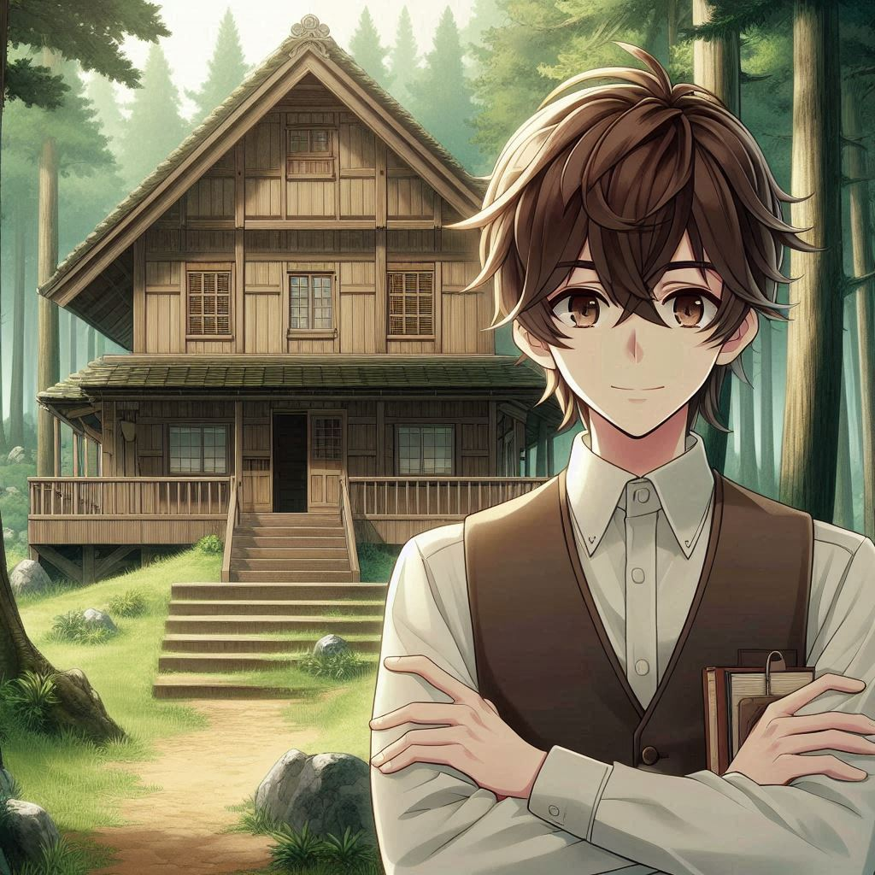
1. 目標
Notes:
Draw me a brown haired teenage boy being a librarian of an ancient wooden house in the forest. I want the character be in the middle of the portrait and facing us. Also I want it in anime style.

Slide 3
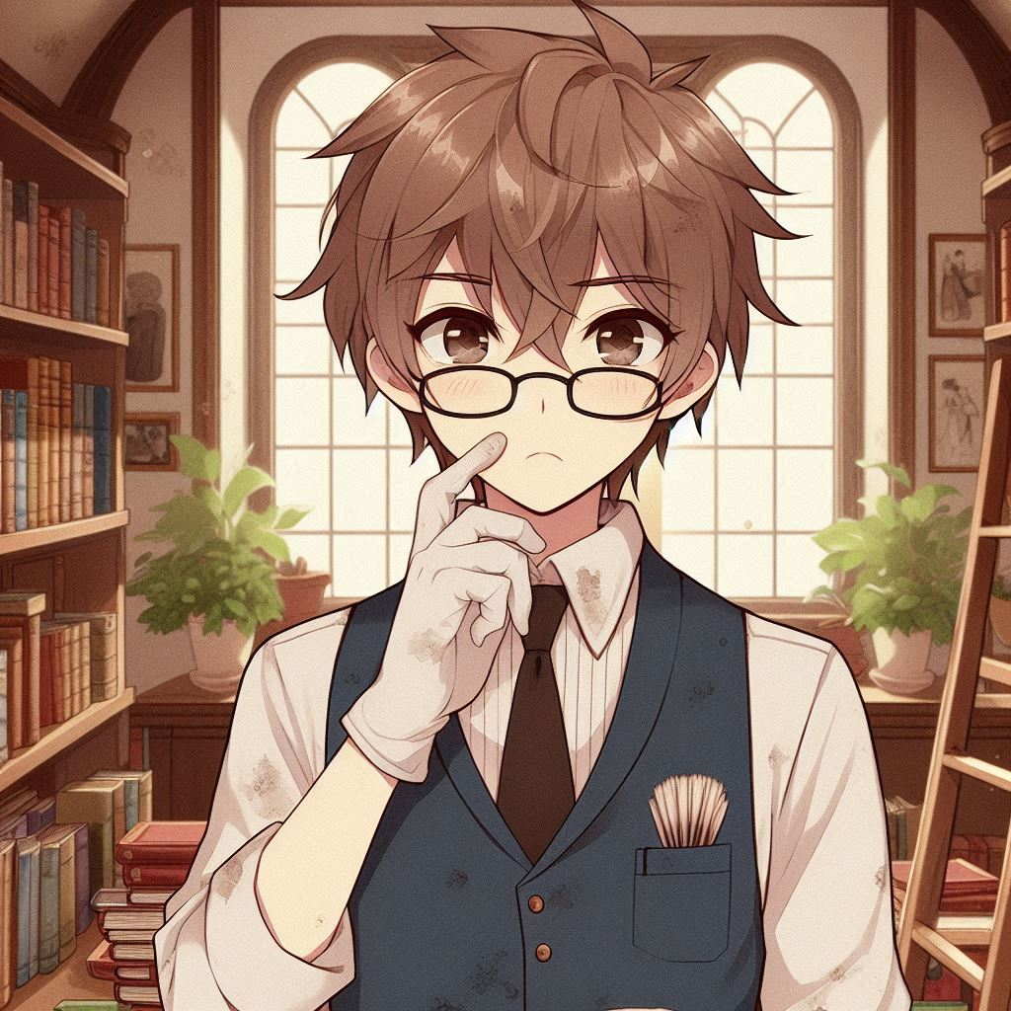
2. 阻礙
Notes:
Draw me the same librarian teenage boy, but a little bothered with some dirts in the house and on the books because both of them are very old. Also in anime style.

Slide 4
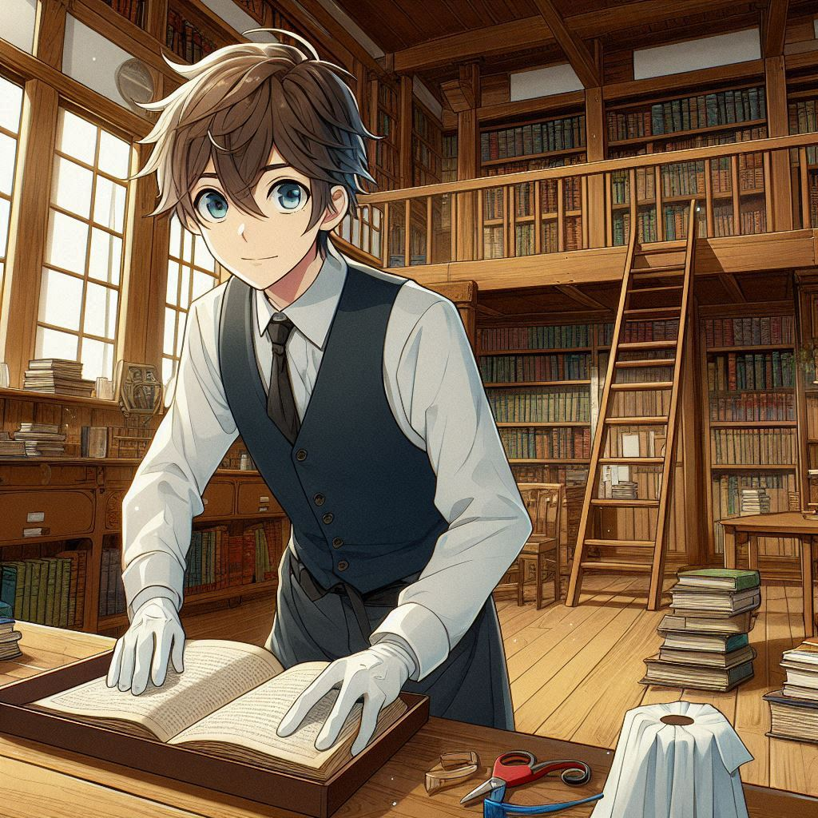
3. 努力
Notes:
Draw me the same librarian teenage boy, but this time cleaning the whole wooden house and protecting the old books. Also in anime style.

Slide 5
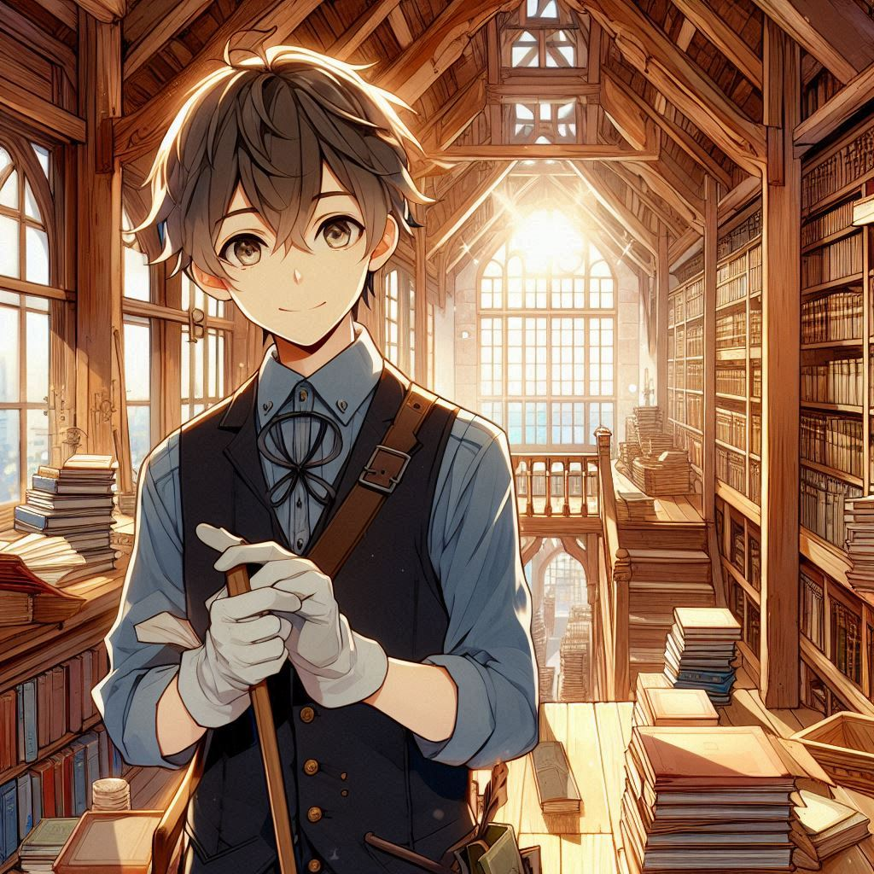
4. 結果
Notes:
Now I want the same single librarian teenage boy, after cleaning the ancient wooden house and sorting the books, now with a brilliant view of the house. Also in anime style.

Slide 6
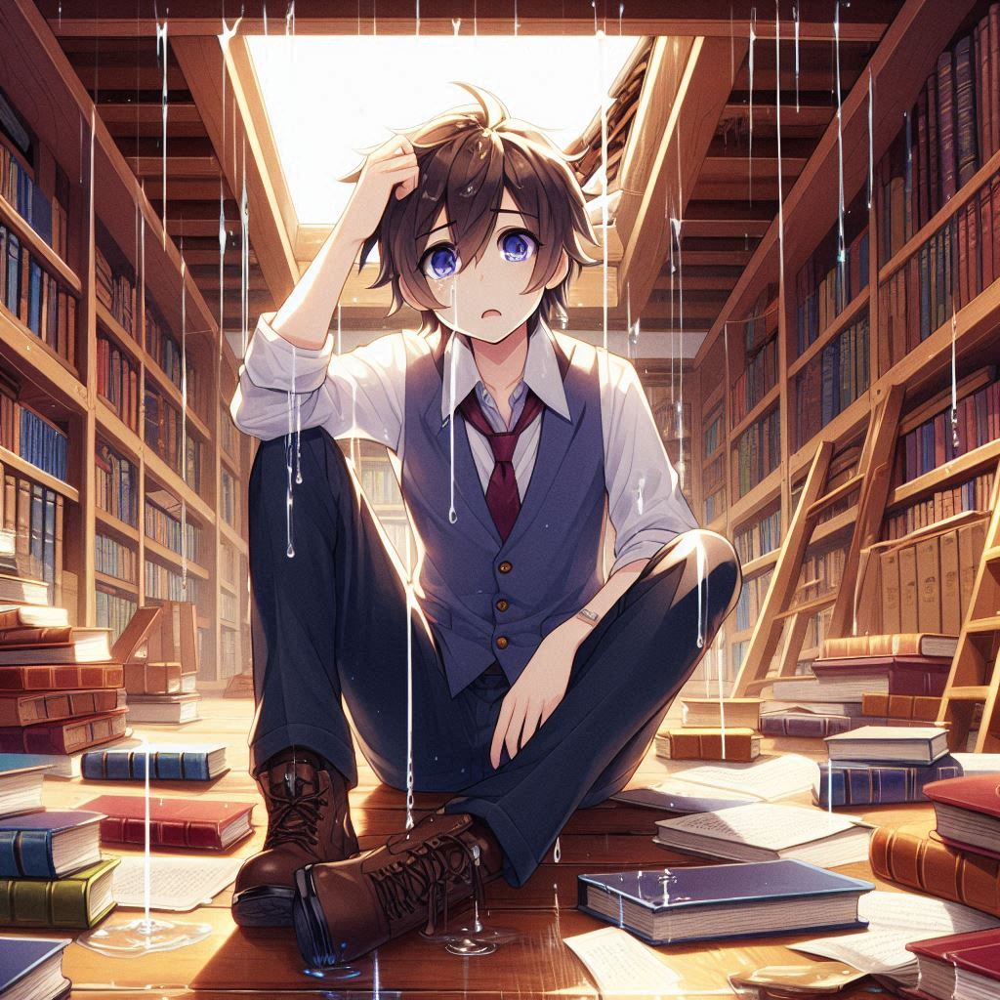
5. 意外
Notes:
Now draw me the same boy, but this time bothered with some water leakage on the roof, potentially harms the old books. Also in anime style.

Slide 7
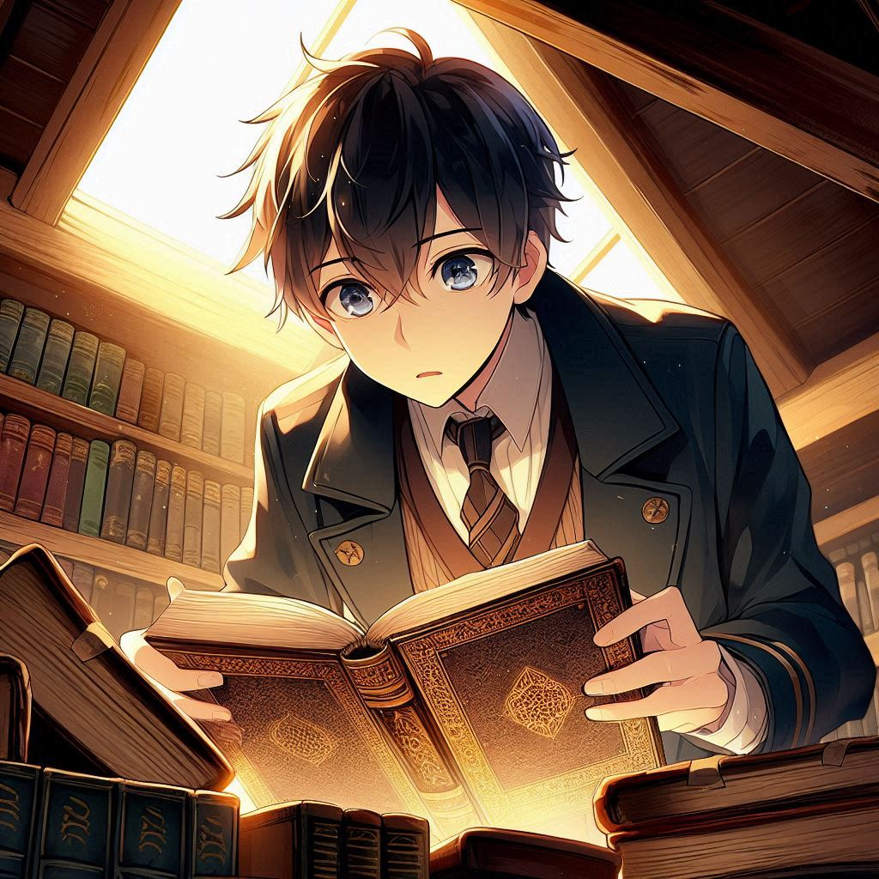
6. 轉彎
Notes:
Now draw me the same boy, finding out that there is a special ancient book in the hidden attic of the house. Also in anime style.

Slide 8
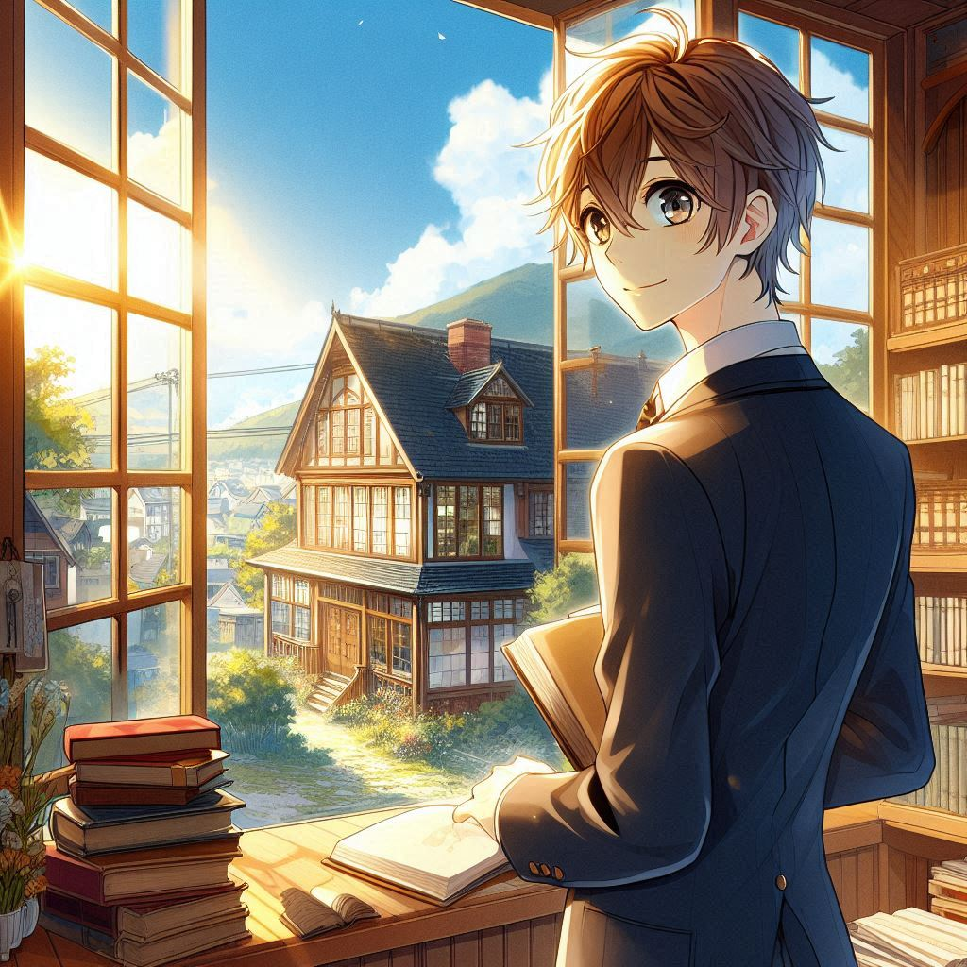
7. 結局
Notes:
Now draw me the same boy, this time with the brilliant view of the old house together with the boy. Also in anime style.

