Slide 1
冒險故事

Slide 2
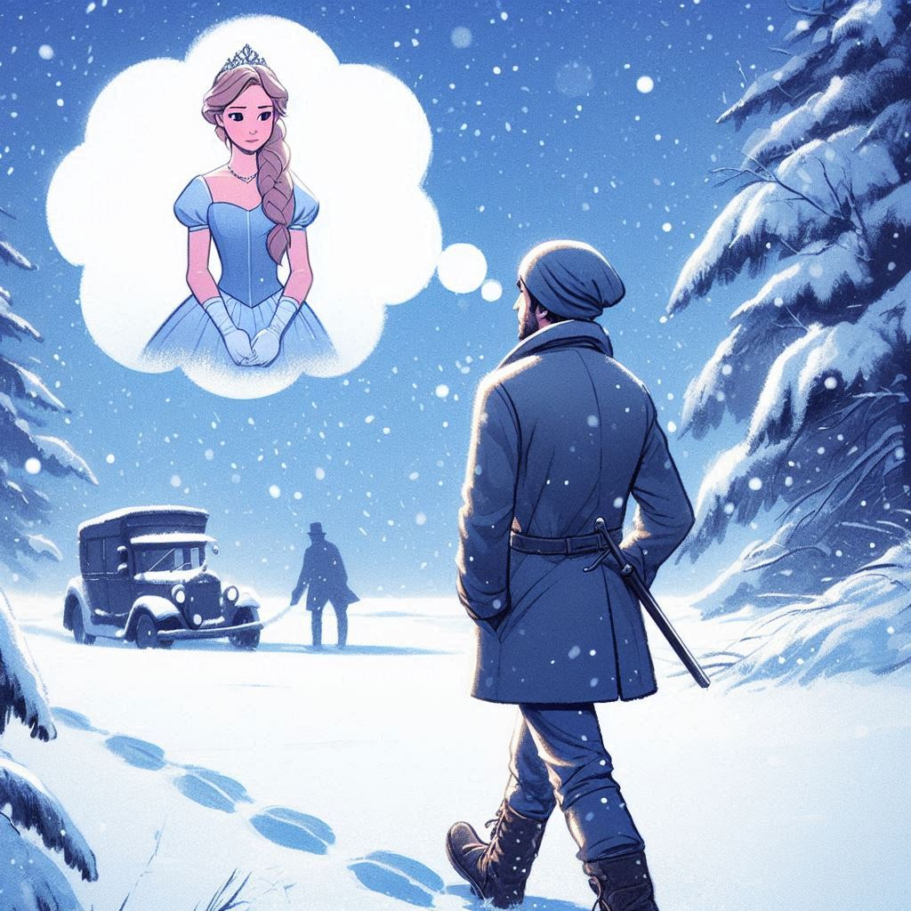
1. 目標
Notes:
Draw me a man walking in the snow, thinking of a princess waiting for him.

Slide 3
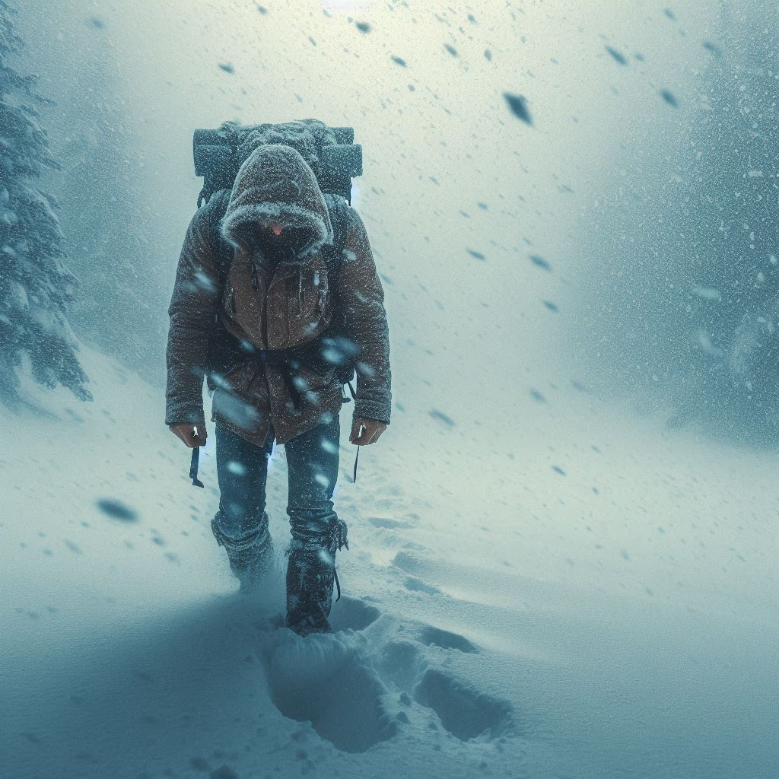
2. 阻礙
Notes:
Draw me the same man that walks hardly because of the heavy snow.

Slide 4
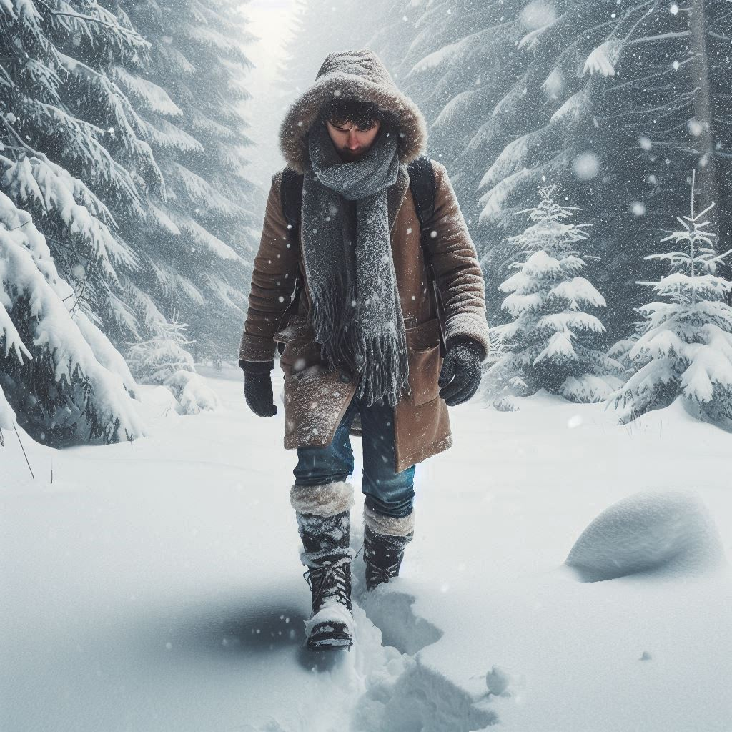
3. 努力
Notes:
Draw me the same man consisting walking through the harsh snow.

Slide 5
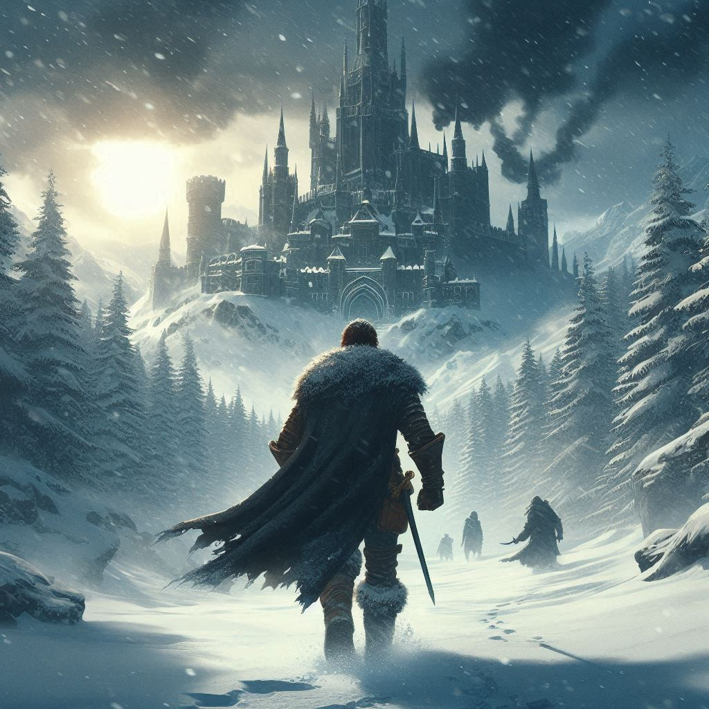
4. 結果
Notes:
Draw me the same man, after walking for a long time, finally see the castle far away.

Slide 6
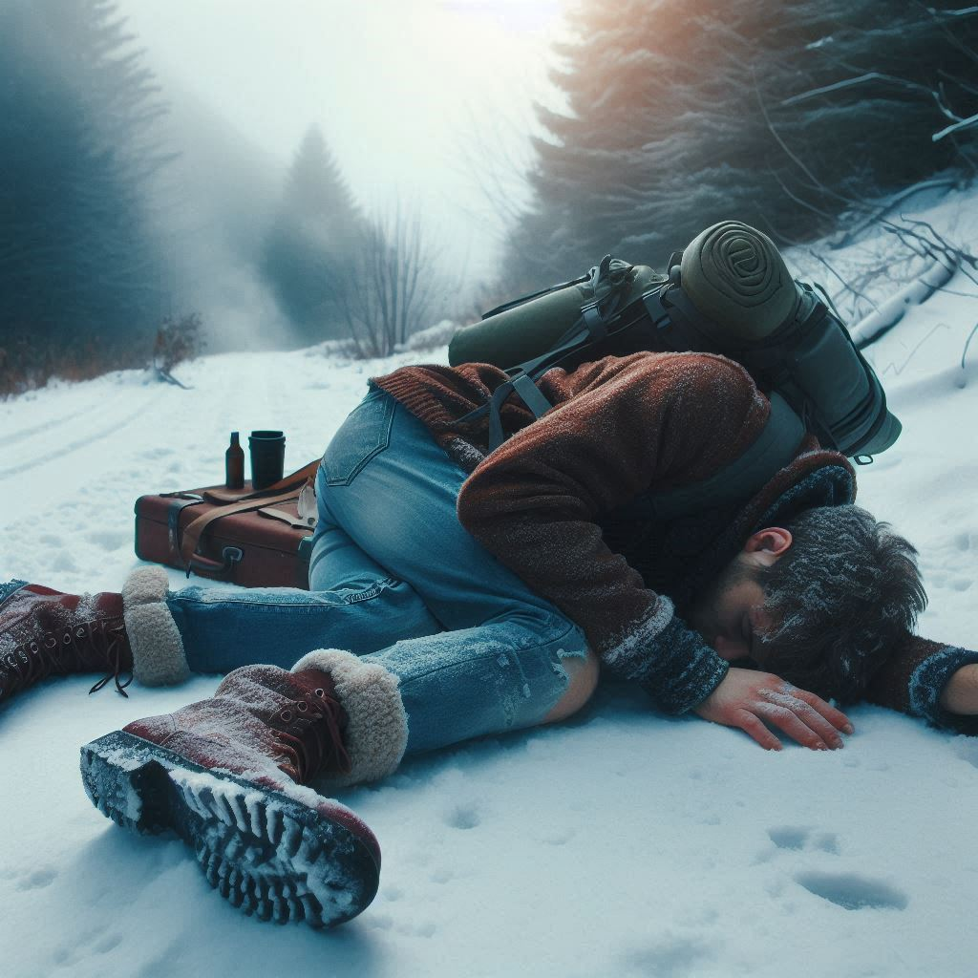
5. 意外
Notes:
Draw me the same man, finally collapsed and fainted on the snow after walking for a long time.

Slide 7
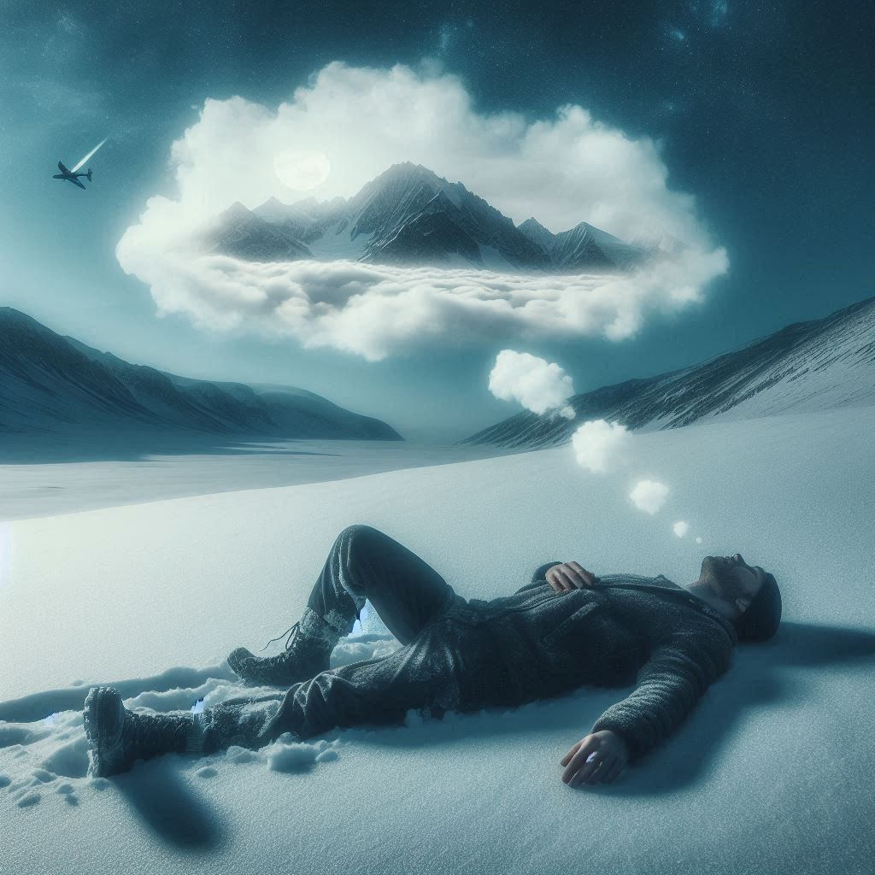
6. 轉彎
Notes:
Draw me the same man, after collapsing on the snow, dreaming of a dream that he've walked for a long time.

Slide 8

7. 結局
Notes:
Draw me the same man, finally wake up on his bed, figuring out that it was all a dream.

