Slide 1




Azure Event Grid

Slide 2


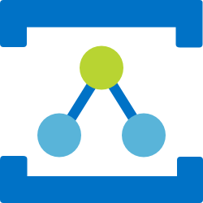
Azure Messaging Services
Service Bus
Event Hubs
Relay
Event Grid
Asynchronous enterprise messaging
Distributed data streaming
Secure two way communication without changes to your network
Cross cloud reactive eventing
Notes:
When we look at what we have in Azure today for messaging services, we have many options. Some of them include:
Service Bus – a messaging platform for the enterprise, similar to MSMQ or Tibco for those who are familiar with those offerings.
Event Hubs – a distributed data streaming platform. Very similar to Kafka
Relay – a service that facilitates hybrid applications by securing two-way communication within a corporate network and Azure. This is actually one of the oldest services in Azure.
Event Grid - a messaging platform that is intended to bring events to the cloud, just like what we are accustomed to with operating systems and user interfaces.
A common question is “why do we have all these different services?”. The answer is that each one is designed to support a specific type of messaging task. This is by design instead of trying to make one service do many things, which in some cases might end up being unnatural.

Slide 3

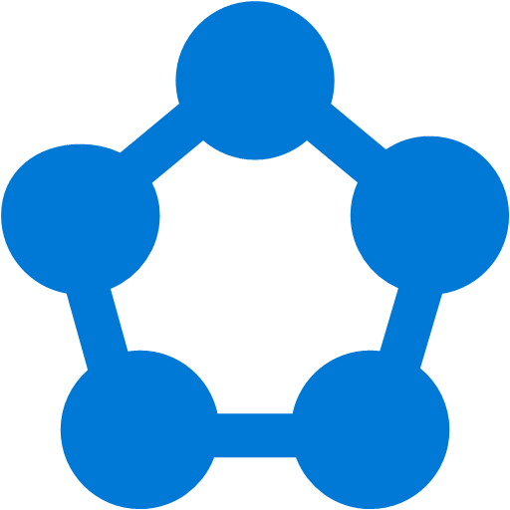









Modern computing is all about events
Notes:
Modern computing today is distributed, more than ever. As a result, all these services can be viewed as islands.

Slide 4
?
Managing events is important but cumbersome
?
?
?
?
?
?
?
?
?
?
?
Notes:
Because they are disconnected, we are responsible for tying them together and this can end up being cumbersome. In fact, a great deal of time is often invested in managing the events that need to make these services work together and it can be quite taxing for the development process.

Slide 5
What if all these events could be managed and directed from one place?
Notes:
One of the principal tenants of Event Grid is to bring all these events together in one place. Instead of using webhooks to tie everything together, we can use a centralized service instead.

Slide 6



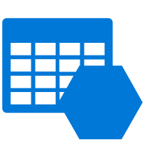

Discovering events is expensive
IoT Devices
1st party events
Storage
Cloud Subscriptions
Application
Resource Groups
Streaming Data
Tables

Slide 7
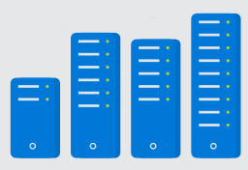
Processing events is cumbersome
IoT Devices
1st party events
Storage
Application
Cloud Subscriptions
Code
</>
Resource Groups
Streaming Data
Tables
Infrastructure

Slide 8
Communication between app components is complicated
IoT Devices
1st party events
Custom app specific events
Storage
Service 1
Service 2
Cloud Subscriptions
Code
</>
Code
</>
Resource Groups
Streaming Data
Tables
Infrastructure
Infrastructure

Slide 9

What if it could be simpler?
IoT Hub
1st party events
Custom app specific events
Blob Storage
Serverless
Function 1
Serverless
Function 2
Azure Subscriptions
Resource Groups
Code
</>
Code
</>
Event Hubs
Event Grid
Functions
Event Grid
Functions
Storage (GPv2)

Slide 10
Azure Event Grid
Fully-managed event routing
Near real-time event delivery at scale
Broad coverage within Azure and beyond
Backbone of event-driven computing
Notes:
If you’ve done any UI work in the past, you might be familiar with delegates and event-driven programming. This has been a solved problem for a long time within application, now it is finally coming to the cloud.

Slide 11
Benefits
Focus on innovation and pay per event
Ensure reliability and performance for your apps
Unlock new scenarios for your apps
Manage all events in one place

Slide 12




Manage all events in one place
Event publishers
Event handlers
Blob Storage
Azure Functions
Resource Groups
Logic Apps
Azure Subscriptions
Azure Automation
Event Hubs
WebHooks
Custom Events
Notes:
It comes down to having a collection of event publishers and event handlers.

Slide 13

Manage all events in one place
IoT Hub
Blob Storage
Azure Functions
Azure Subscriptions
Logic Apps
Resource Groups
Azure Automation
Event Hubs
WebHooks
Custom Topics
Event Hubs
Storage (GPv2)

Slide 14
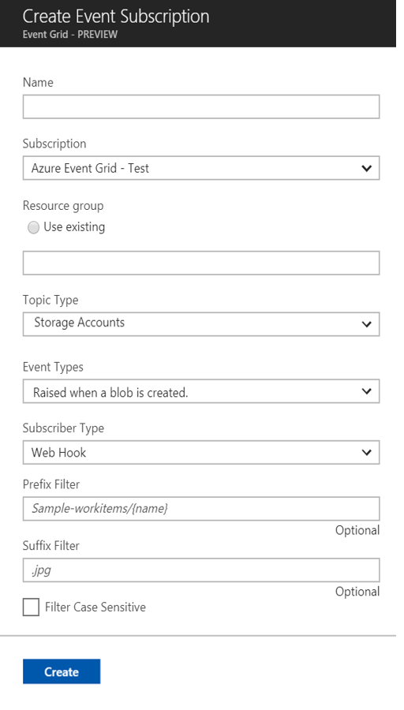
Manage all events in one place
Event publishers
Event handlers
Subscribe to pre-defined system events in Azure or create your own custom topics
Route events to any end-points, Azure or even beyond
Enable filtering and efficient routing of events

Slide 15
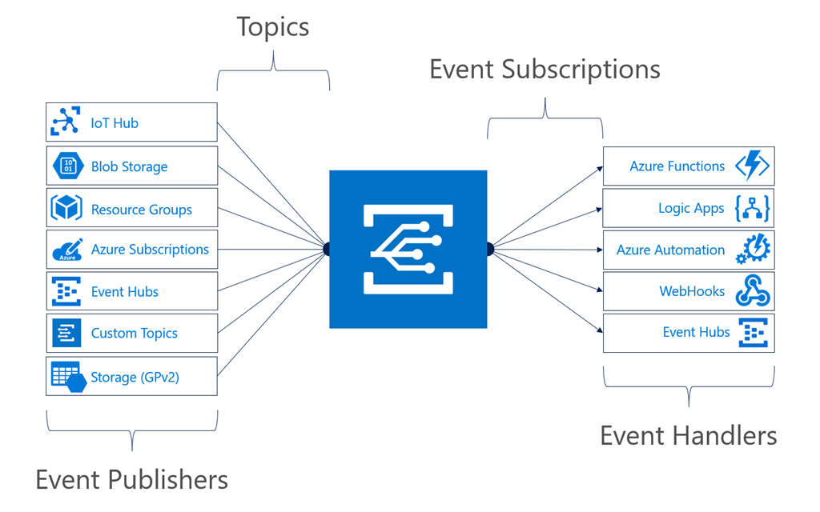
Manage all events in one place
Notes:
It comes down to having a collection of event publishers and event handlers.

Slide 16
Manage all events in one place
Event publishers
Event handlers
Subscribe to pre-defined system events in Azure or create your own custom topics
Route events to any end-points, Azure or even beyond
Enable filtering and efficient routing of events
Notes:
This is a simplified view of what managing events looks like.

Slide 17
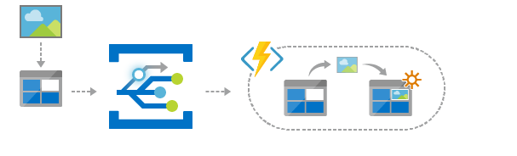
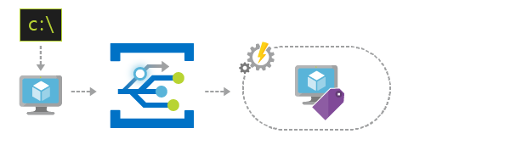
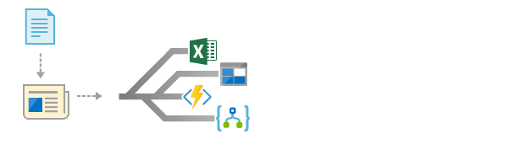
Scenarios
Serverless apps
Ops automation
Application integration
Instantly trigger a serverless function to run analysis when a new file is added to a blob storage container.
Speed up automation and simplify policy enforcement by notifying Azure Automation when underlying infrastructure is provisioned
Connects your app with other services. Create an application topic to route your app’s event data to any desired destination
Notes:
Serverless apps turns out to be one of the areas with the most impact. Event Grid can trigger many of these scenarios.
Ops automation – most people use Lambda for this and we anticipate this being used in concert with ARM.
Application integration – probably the most obvious one, integration between applications and organizations.

Slide 18




Build applications efficiently
Management SDKs
Publish SDKs
Event Schema Store
Consumption SDKs
.Net Python Java Node.js Ruby Go

Slide 19
Ensure reliability and performance in your apps
Sub-second end-to-end latency in the 99th percentile
10,000,000 events per second per region
24-hour retry with exponential back off for events not delivered
Near real-time
Massive scale-out
High reliability
Notes:
We want to deliver reliable notification in near real-time, at massive scale. It needs to be highly reliable, you should be able to create items/messages that you can’t afford to lose.

Slide 20
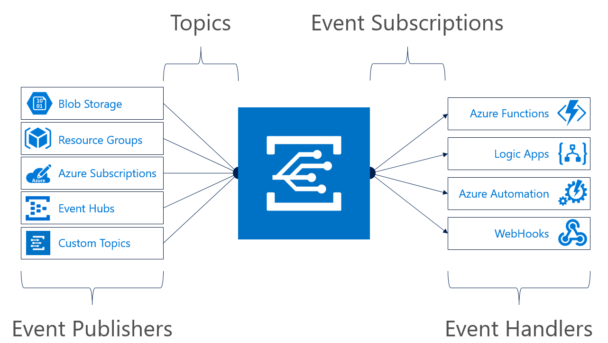
Concepts
Events: what happened
Event Publishers: where it took place
Topics: where publishers send events
Event Subscriptions: how you receive events
Event Handlers: the app or service reacting to the event
Notes:
Most topics in Event Grid are implicit unless you are using custom topics.

Slide 21
Event Grid guiding principles
Events are independent
Always available
Near real-time event delivery
At least once delivery
Dynamic scale
Platform agnostic (WebHook)
Language agnostic (HTTP protocol)

Slide 22
Target performance
Sub-second end-to-end latency in the 99th percentile
99.99% availability
10,000,000 events per second per region
100,000,000 subscriptions per region
50 ms publisher latency
24 hour retry with exponential back off for events not delivered
Transparent regional failover
Notes:
24 hour retry is the GA target, today it is just for 2 hours.

Slide 23
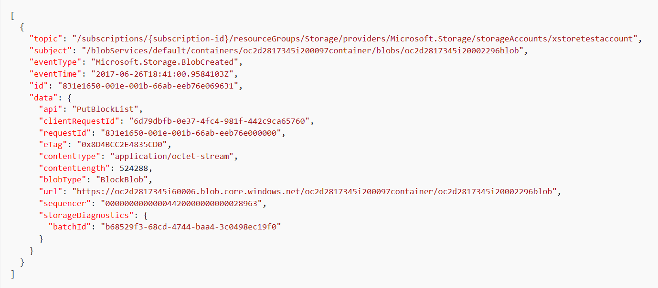
Event Schema
Notes:
This is an example of a storage event.
The data property contains contextual information about the payload from the publisher.

Slide 24

Resource model: extension resource
ARM calls are made to a parent resource
ARM reroutes all Event Grid calls to the Event Grid RP
Notes:
When you are interacting with Event Grid, you are actually communicating with an extension of the resource provider for that service.

Slide 25
Key Takeaways
Loosely coupled
Using the right tool for the right task
Events vs. Commands
Knowing the difference between Events and Telemetry / streams
Idempotent

Slide 26
Learn more at azure.com/EventGrid

