Slide 1

LLaMA 2 Blog Generator: Automating Content Creation
This presentation explores the LLaMA 2 Blog Generator, a revolutionary tool that streamlit and enhances content creation.

Slide 2
Problem: The Content Creation Bottleneck
Creating high-quality content is time-consuming and resource-intensive.
Generating engaging blog posts requires significant effort, research, and writing skills.

Slide 3

Solution: LLaMA 2 Powered Blog Generation
1
Our LLaMA 2 Blog Generator tackles content creation challenges.
2
It utilizes the advanced language model to automate blog post generation.
3
This tool streamlit the content creation process, saving time and resources.

Slide 4
How it Works: Streamlit Interface and User Inputs
Users interact with a Streamlit interface, which is easy to use.
They provide input for the blog topic, word count, and target audience.

Slide 5
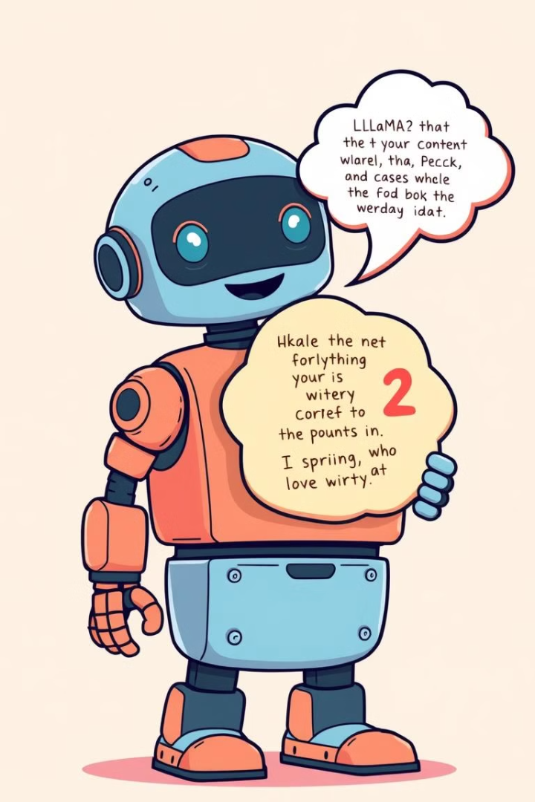
LLaMA 2's Role: Generating Coherent and Relevant Content
The LLaMA 2 model is trained on a massive dataset of text and code.
It can understand context, generate coherent text, and create engaging blog posts.

Slide 6




Key Features: Customization, Word Count, Target Audience
Users can customize various aspects of the generated blog post.
They can specify the desired word count, ensuring content length is suitable.
They can select the target audience, tailoring the content for the right demographic.

Slide 7

Use Cases: Content Creators, Researchers, Professionals
1
Content creators can quickly produce high-quality blog posts for their websites.
2
Researchers can generate summaries of their findings and disseminate information.
3
Professionals can create engaging and informative content for their industries.

Slide 8




Future Enhancements & Call to Action
We plan to add features like image generation and topic suggestion.
We're also exploring integration with SEO tools for optimized content.
Try the LLaMA 2 Blog Generator today and experience the power of AI content creation!

Slide 9



business impacts and challenges
1
Increased efficiency and reduced costs for content creation.
2
Enhanced reach and audience engagement through engaging blog posts.
Challenges: ensuring ethical use of AI, maintaining content quality, and addressing potential job displacement.
3

