Slide 1



Slide 2

P300 Speller Data Analysis
t25_Wanderers
Jathurshan. P
Prakanth. T
Mithunjha. A

Slide 3
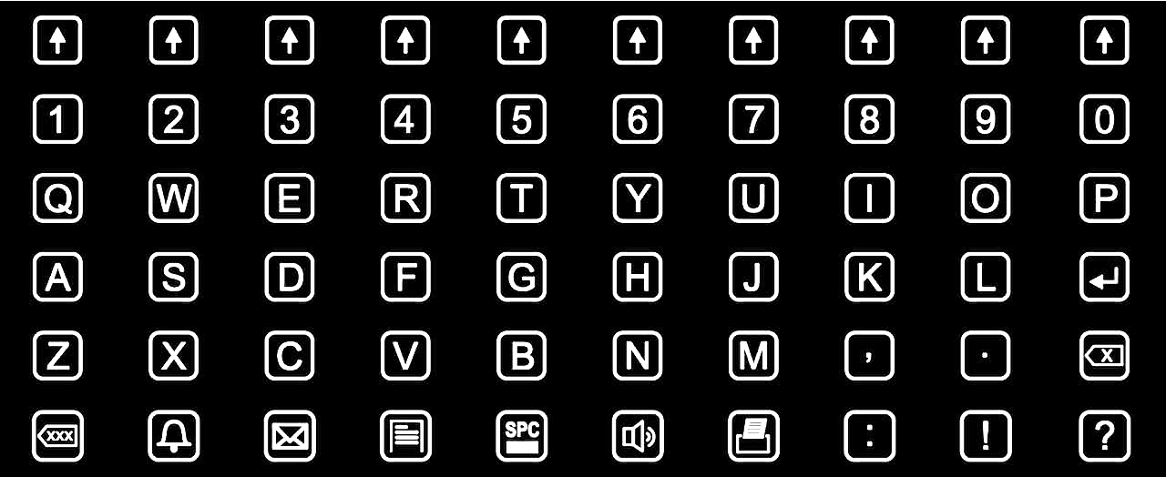
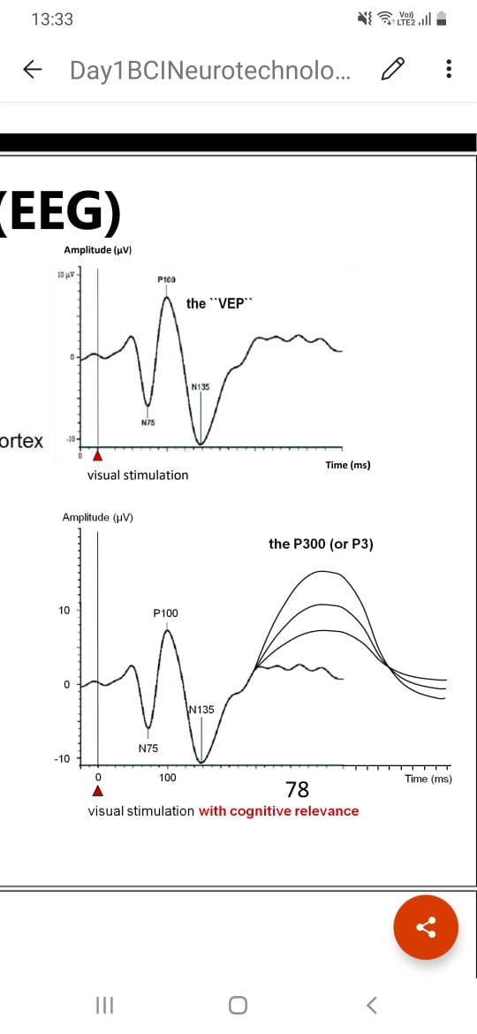
INITIAL SITUATION INTRODUCTION…
Speller
P300 is a positive deflection in the EEG/ERP that appears approximately 300ms after the presentation of an attended stimulus.
P300 based BCI for spelling devices
To aid disabled individual with communication
Why P300?
High speed & Accuracy

Slide 4
IDEA/SOLUTION…
Rapid Decoding
Temporal Information
Combination of Temporal and Statistical Information
Effect of Spectral Whitening
05
Classification
Data Analysis
01
04
Feature
Extraction
Data Preprocessing
02
03
Segmentation

Slide 5
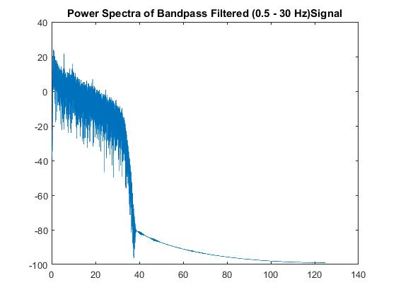
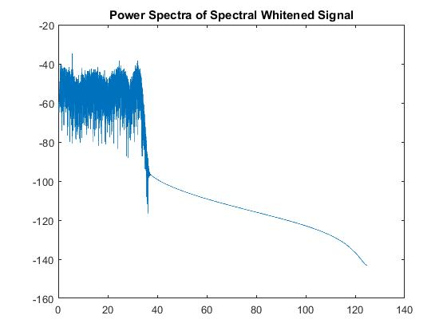
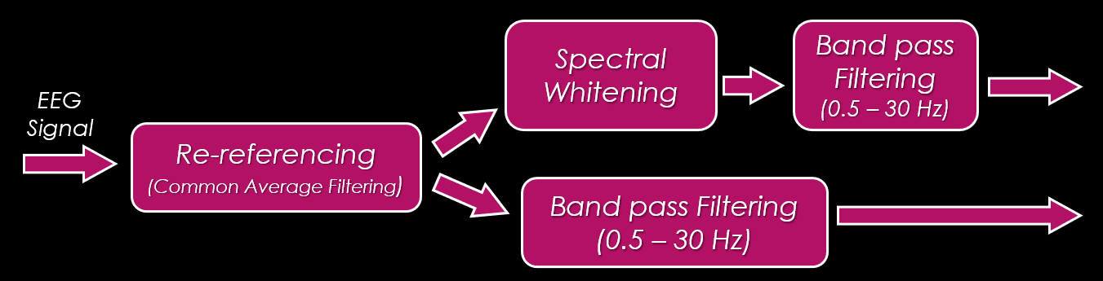
IMPLEMENTATION REALIZATION…
Data Analysis
Visual Inspection
Raw EEG Signal
Trigger Signal
Preprocessing

Slide 6
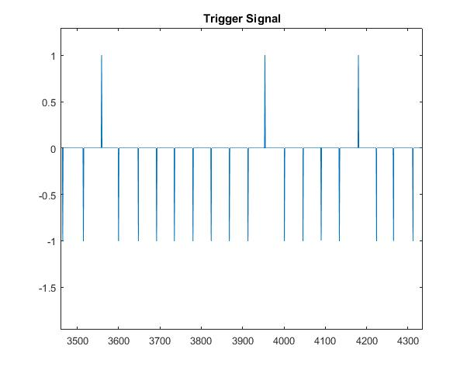
IMPLEMENTATION REALIZATION…
Segmentation
600ms time window (-100ms from flash onset to +500ms post onset)
600ms time window Spectral Whitened
800ms time window (-100ms from flash onset to +700ms post onset)
800ms time window Spectral Whitened
Binary Problem: Target or Non-Target

Slide 7
FEATURE EXTRACTION & CLASSIFICATION…
1)
Preprocessed EEG Signal
(Time x Channel(8)) Matrix
Classification
LDA
Preprocessed EEG Signal
(Time x Channel(8)) Matrix
Feature Extraction Using 1D CNN
RNN Model
Classification
2)

Slide 8
FEATURE EXTRACTION & CLASSIFICATION…
Preprocessed EEG Signal Separated into
4 frequency Bands
(Time x Channel (8 x 4)) Matrix
Feature Extraction Using 1D CNN
RNN Model
Classification
3)
Preprocessed EEG Signal Separated into 2 Lower frequency Bands
(Time x Channel(8x2)) Matrix
Feature Extraction Using 1D CNN
RNN Model
Classification
4)

Slide 9
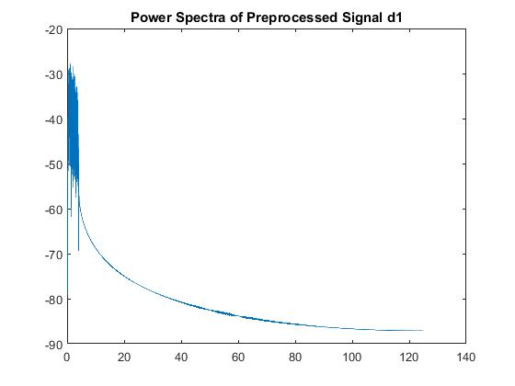
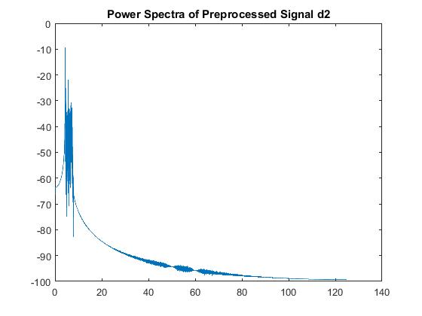
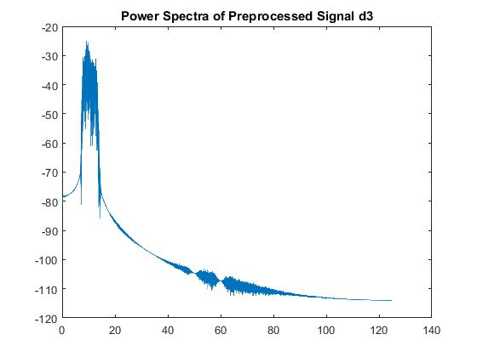
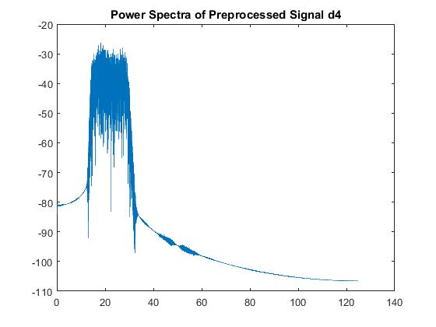
FEATURE EXTRACTION & CLASSIFICATION…
0.5 – 4 Hz
4 – 8 Hz
8 – 13.5 Hz
13.5 – 30 Hz

Slide 10
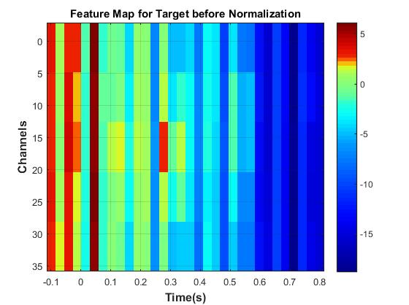
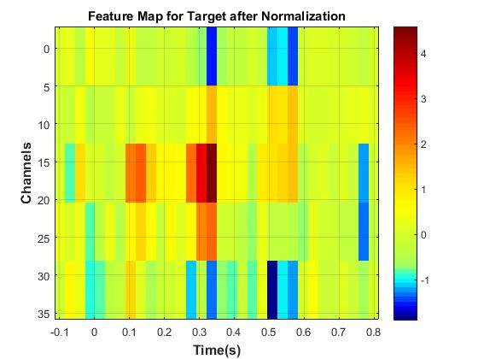
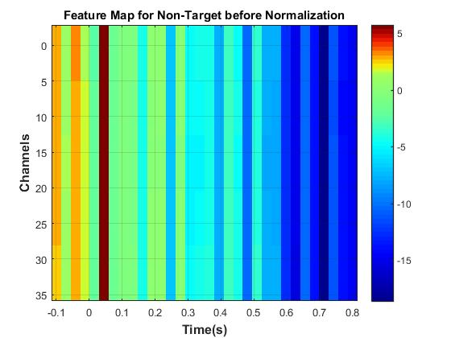
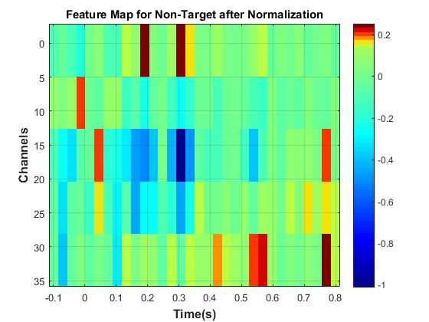
FEATURE EXTRACTION & CLASSIFICATION…
RNN Model
Classification
5)
PSD Based Features
(Time Segments x Channel(8 x 4 (Frequency Bands)) Matrix
800ms time window broken into segments with window size of 400ms and stride of 100ms

Slide 11
FEATURE EXTRACTION & CLASSIFICATION…
Statistical Features:
PSD Mean for each Freq Band-4
Mean
Max and Min
Root mean square of the signal
Preprocessed EEG Signal
(Time x Channel(8)) Matrix
Feature Extraction Using 1D CNN + RNN
6)
Concatenate
DNN
Classification
Statistical Features(8)
(8 x Channel(8)) Matrix
Dense Layer

Slide 12
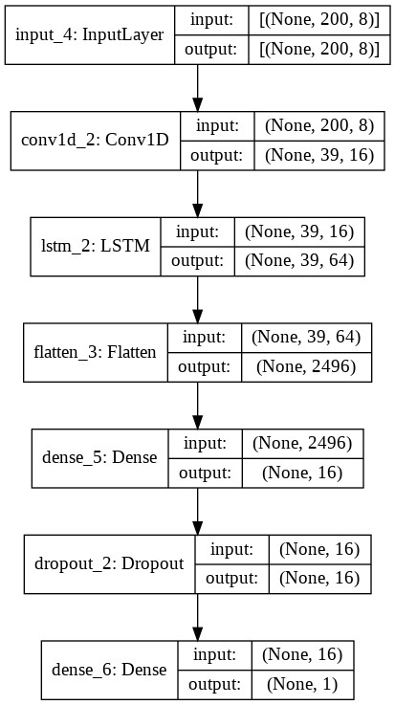
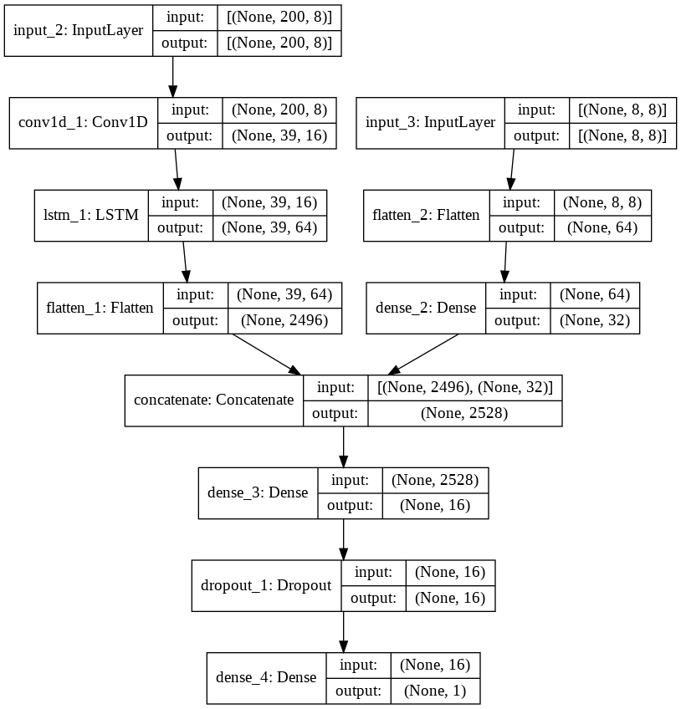
FEATURE EXTRACTION & CLASSIFICATION…
1D CNN
+
RNN Model
1D CNN
+
RNN Model
+
Statistical Features

Slide 13
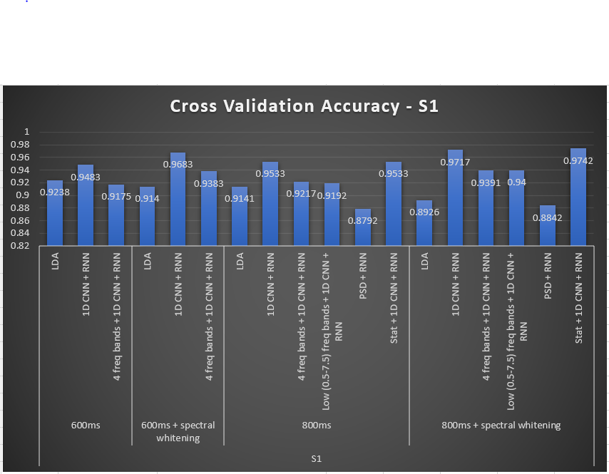
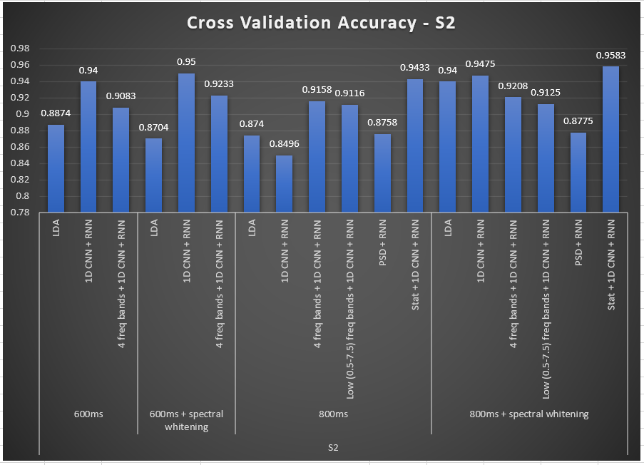
RESULTS & DISCUSSIONS

Slide 14
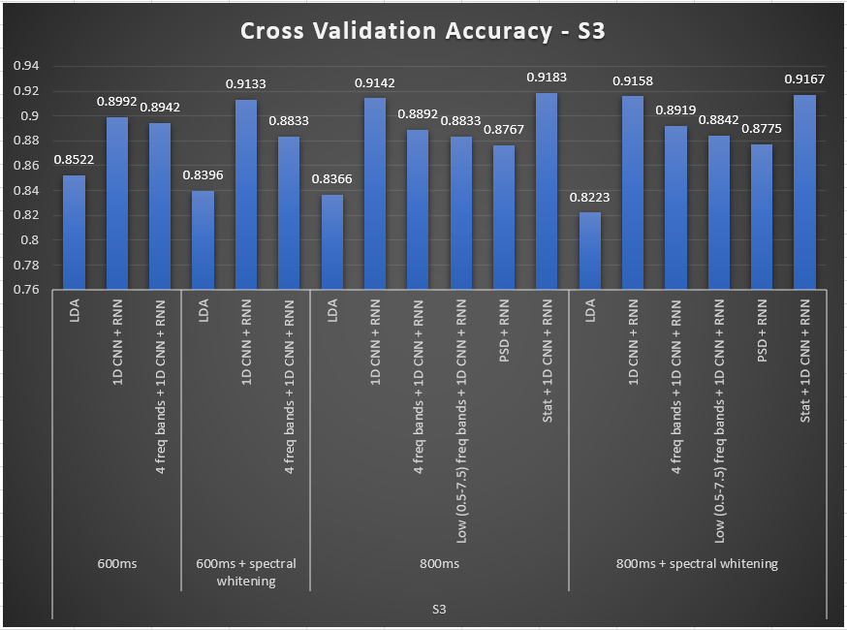
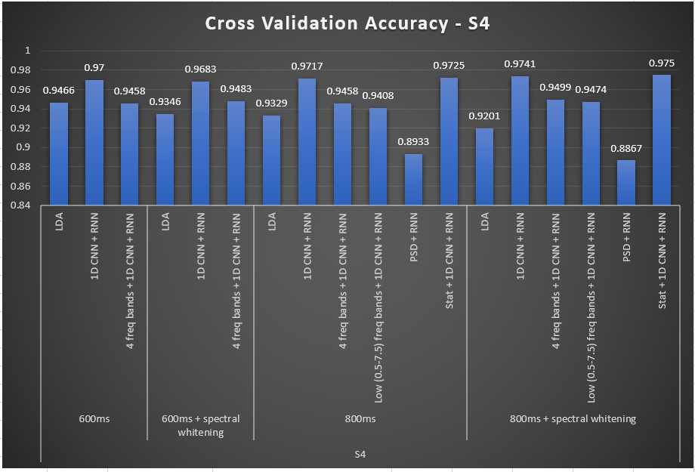
RESULTS & DISCUSSIONS

Slide 15
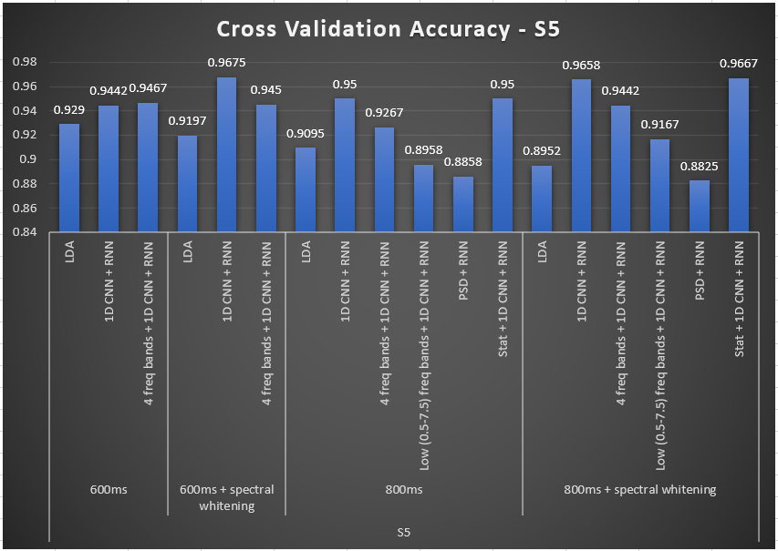
RESULTS & DISCUSSIONS

Slide 16
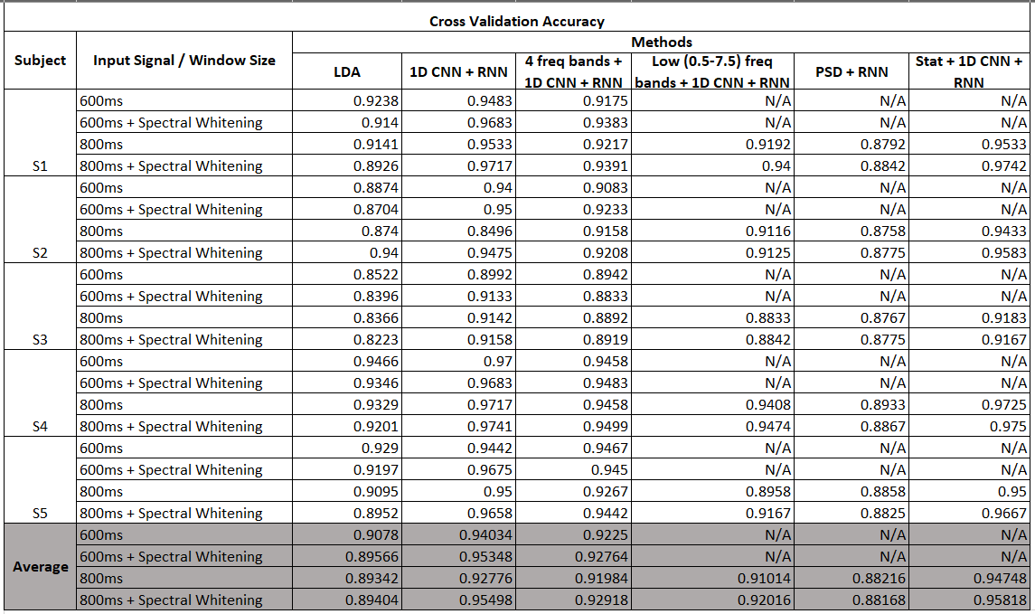
OVERALL RESULTS
1D CNN + RNN
800ms : 92.76
800ms+SW : 95.50
1D CNN + RNN with Statistical Features
800ms : 94.748
800ms+SW : 95.82

Slide 17
Reflection
Temporal Information
Spectral Whitening
Statistical Features
Feature Extraction using 1D CNN
Future Implementations
Artefact removal and Denoising to improve performance.
Dimensional Reduction.
Combining Feature Extraction using 1D-CNN with TVLDA.

Slide 18


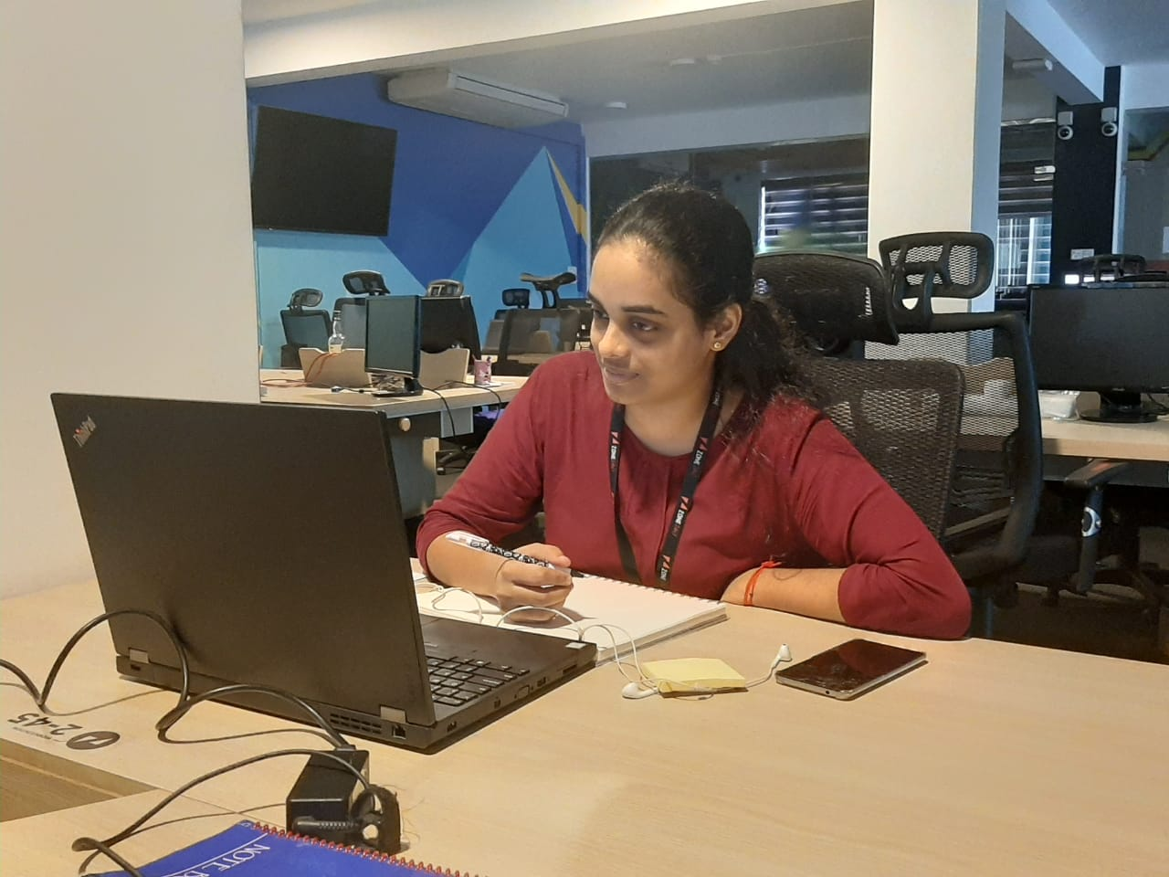
GROUP PICTURE PICS OF YOU WORKING…
Jathurshan. P
Prakanth. T
Mithunjha. A

Slide 19
P300 Speller Data Analysis
t25_Wanderers
Jathurshan. P
Prakanth. T
Mithunjha. A

Slide 20
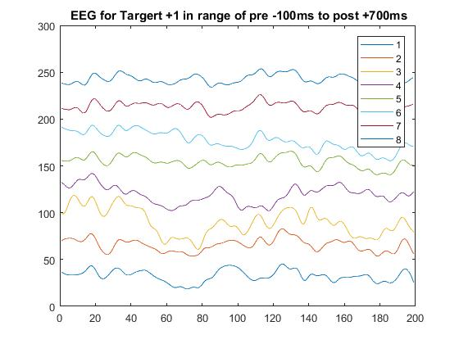
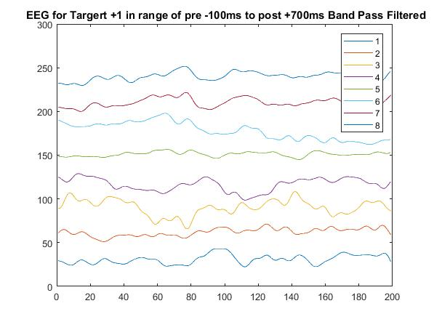
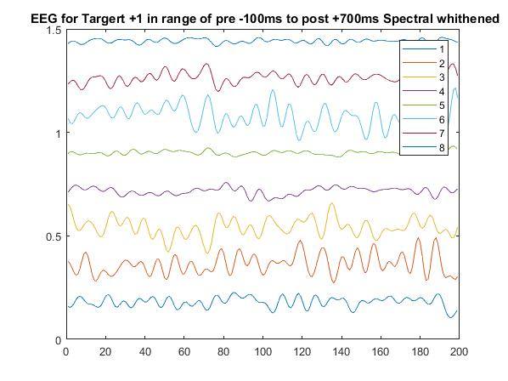
IMPLEMENTATION REALIZATION…

