Slide 1
Handwritten tamil character recognition using convolutional Neural network
Supervisor: Dr. M. Siyamalan
Name: S. jathurshan
Registration No: 2014/csc/003

Slide 2
Outline
Introduction
Objectives
Related work
Methodology
Result
Discussion & conclusion
Future work
References

Slide 3
Introduction
Tamil is a language, which has rich history more than 2000 years [9] and is widely spoken in India, Sri Lanka.
Tamil alphabet consists of 12 vowels and 18 consonants and one special character called “Aaytham”, Totally, Tamil alphabet consists 247 characters its own.
More than that, we are using borrowed consonants, which came from Grantham ([ ] \ = ` ~\).
In off-line character recognition takes the digitalized documents or scanned image as an input and on-line character recognition system use live input

Slide 4
common issues in this area
Most of the errors in such system arise because of the confusion among the similar shaped characters.
Another problem specified area in this topic is different individuals can write different letters in similar shaped.
Shape variation and Unknown shapes of characters
Character discontinuity
A single character combine with double letter
With the writing issues, recognition will difficult.

Slide 5
objectives
Tamil character recognition is not well-explored area, in past less numbers of researches have been reported to support this research area.
Although, many of earlier proposed methods of TCR system have given good recognition rate (more than 90%) with traditional and modern approaches.
propose an efficient method with high recognition rate for Tamil character recognition using Convolutional Neural Network.
reach the goals for better recognition rate of Tamil character recognition.

Slide 6
Related work
Prashanth Vijayaraghavan et al. proposed a method for Tamil character recognition using convolutional neural networks into 35 different classes
Methodology: ConvNetJS library for learning features by using stochastic pooling, probabilistic weighted pooling, and local contrast normalization
Dataset: IWFHR-10
result: 94.4% accuracy

Slide 7
Related work
Ahmed El-Sawy, Mohamed Loey et al. proposed the optimization methods were implemented to increase the performance of CNN for Arabic letter recognition
Methodology: common combination of machine learning methodologies apply a combination of feature extractor and trainable classifier
Result: This proposed CNN is giving an average 5.1% misclassification error on testing data, 94.9% accuracy

Slide 8
Related work
Harpreet Kaur et at. have introduce a scheme for offline handwritten Gurumukhi character recognition using CNN classifier
Methodology: Zoning based features and CNN Classifier
Result: 92.08% accuracy

Slide 9
Dataset for this study
HPL Isolated Handwritten Tamil Character Dataset
the data were collected from different individuals, different individuals can have different font styles, font size, and different variations on their writing styles
Each and every single characters have been scanned and taken as set of images
Same set of characters have labeled with unique code
The dataset contains 156 unique characters from 169 different individuals

Slide 10
Proposed Methodology
Pre-processing Data
Using convolutional neural network
Feature extraction
classification

Slide 11
Methodology cont..
Pre-processing
Each images of characters are contained by the folder with particular user-name
Each images are re-named with the user-name and Unicode of the character.
Collect the same set of character with proper folder named with Unicode
Re-size the image

Slide 12
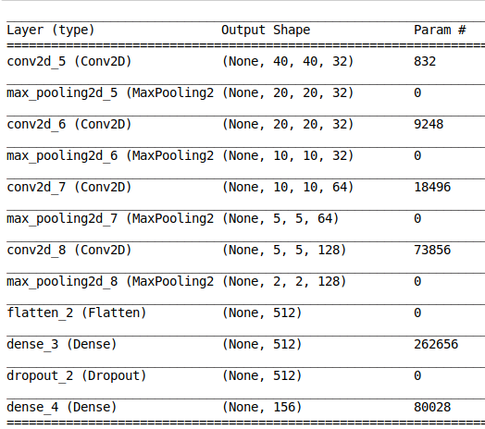
Methodology cont..
Feature extraction
Conv2d layers
Pooling layers
Max-pooling layers
Classification
Dense layer

Slide 13

results
With 156 class of character from 169 users
Number of epochs: 60
Number of train images: 58,112
Number of test images: 19,254
Number of validation images: 15,600
Result:

Slide 14
Discussion and conclusion
Handwritten character recognition for tamil characters is an active research area which always needs an improvement in accuracy.
This work based on recognition of tamil characters using convolutional neural network.
CNN can able to manage large dimensions of inputs and share their weights.
With this experiment the result is 95% accuracy

Slide 15
Future work
in future the performance of the handwritten tamil character recognition will be improved using the pre-trained model
Plan to Compare the result between, Resnet50 and Densnet architecture methodology

Slide 16
References
Ahmed El-Sawy, Mohamed Loey, Arabic Handwritten Character Recognition using Convolutional Neural Network, WSEAS TRANSACTION on COMPUTER RESEARCH, E-ISSN: 2415-1521, Volume 5.
K.Punitharaja, and P.Elango, Tamil Handwritten Character Recognition: Progress and Challenges, IJCTA, 9(3), 2016, pp. 143-151
P. Singh, A. Verma, and N.S. Chaudhari, Deep Convolutional Neural Network Classifier for Handwritten Devanagari Character Recognition,Information Systems Design and Intelligent Applications:Proceedings of Third International Conference INDIA ,2 , 2016, pp. 551-561
S. Acharya, A.K. Pant, and P.K. Gyawali, Deep learning based large-scale handwritten Devanagari character recognition, 2015 9th on Software, Knowledge, Information Management and Applications (SKIMA), 2015, pp. 1-6.
Dhanya Sudarsan, Shelbi Joseph, 2018, A Novel Approach for Handwriting Recognition in Malayalam Manuscripts using Contour Detection and Convolutional Neural Nets, 2018 International Conference on Advances in Computing, Communications and Informatics (ICACCI), 978-1-5386-5314-2/18.

Slide 17
Thank you

