Slide 1
Microwave Brain Imaging
Blind Validation Study
8-Antenna DGS Array • Spherical Phantom • S-Parameter Reconstruction
Dual Degree Project — IIT Bombay
Department of Electrical Engineering
1/9

Slide 2
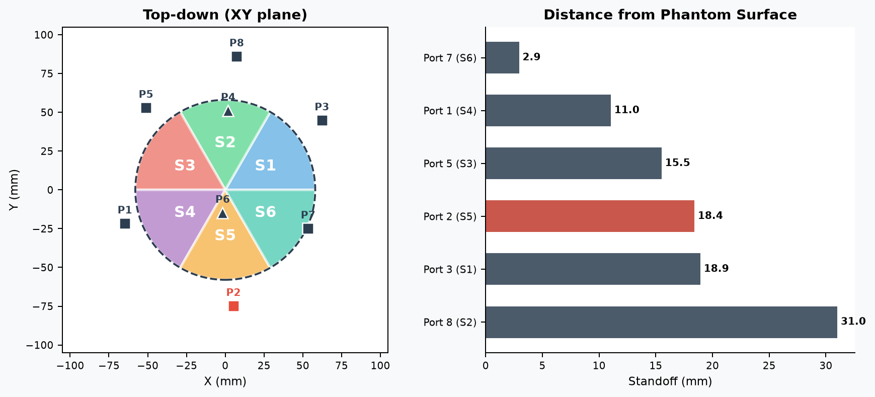
SETUP
Phantom & Antenna Array
Sphere R = 58 mm
6 equal 60° sectors, equatorial plane
8 DGS patch antennas
6 equatorial + 2 top-facing
Non-uniform standoff distances
Frequency sweep
2.7 – 4.1 GHz, 71 points
Design center: 3.4 GHz
Port 2 (S5)
VSWR > 4 in usable band
Excluded from reconstruction
2/9

Slide 3
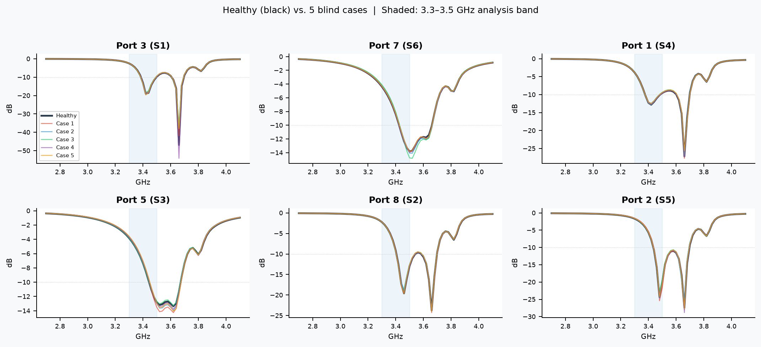
MEASURED DATA
Self-Coupling S-Parameters (|Sii| dB)
3/9

Slide 4
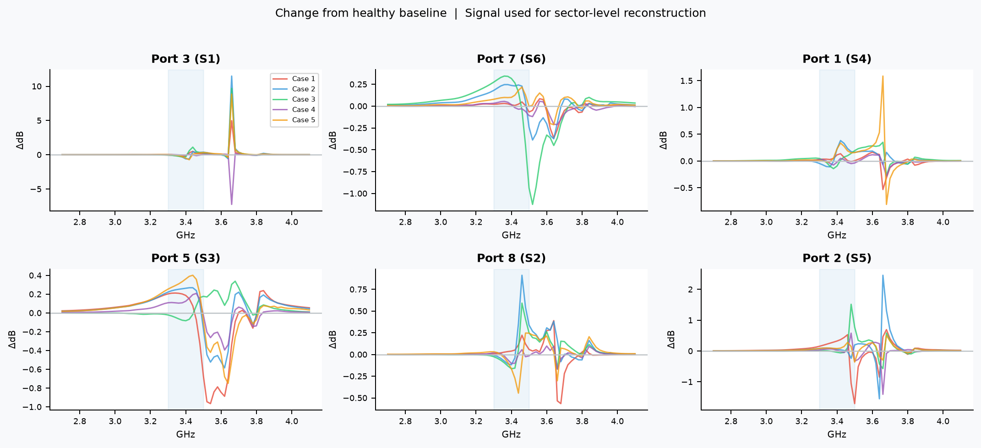
SIGNAL OF INTEREST
Differential Self-Coupling (ΔSii vs Healthy)
4/9

Slide 5
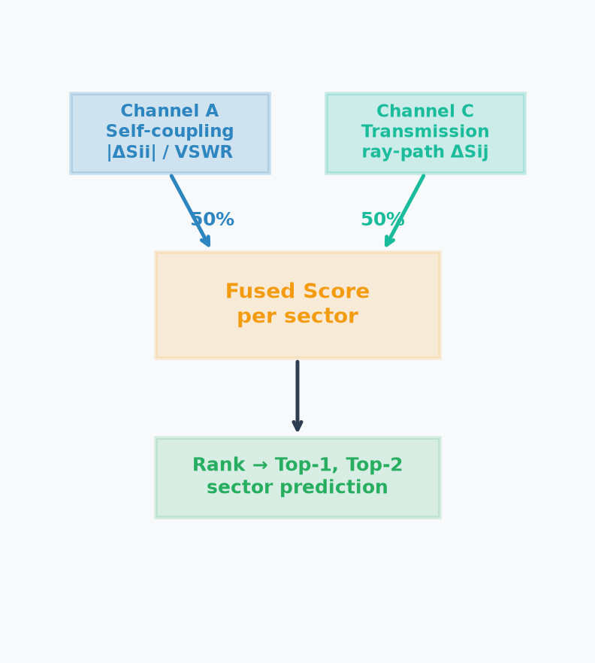
HOW WE DID IT
Reconstruction Methodology
1
Check port quality
Compute VSWR for every port in the 3.3–3.5 GHz band.
Port 2 (S5) flagged with VSWR > 4 and excluded.
2
Compute differential S-parameters
For each case: ΔS = S_case − S_healthy.
Self-coupling (ΔSii) captures local dielectric change near each antenna.
3
Channel A: self-coupling scores
Per-port score = mean |ΔSii| / VSWR (VSWR-normalized).
Each port maps to one sector → direct sector-level readout.
4
Channel C: transmission scores
Per-pair score = mean |ΔSij| for all transmission pairs.
Ray-path geometry maps each pair’s signal to the sectors its path crosses.
Port 2 pairs excluded.
5
Fuse and rank
Final score = 50% Channel A + 50% Channel C, per sector.
Rank sectors by fused score → top-1 and top-2 prediction.
5/9

Slide 6
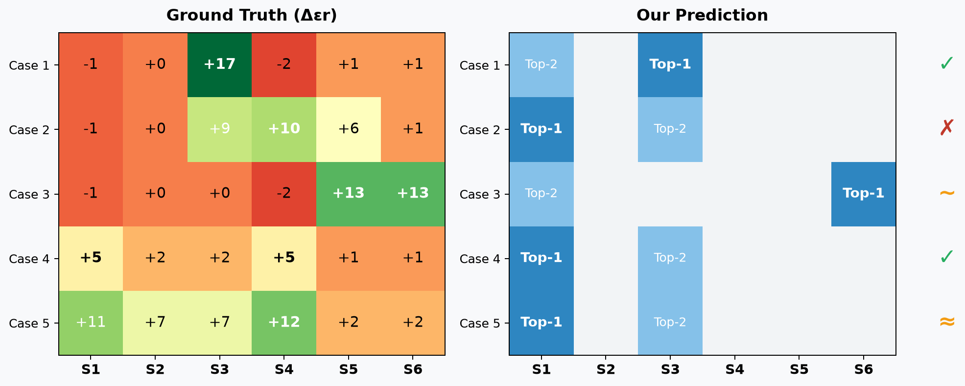
RESULTS
What We Predicted vs. Ground Truth
Score: 4 / 5 case-level correct or partial | Case 2 is the only clear miss
6/9

Slide 7
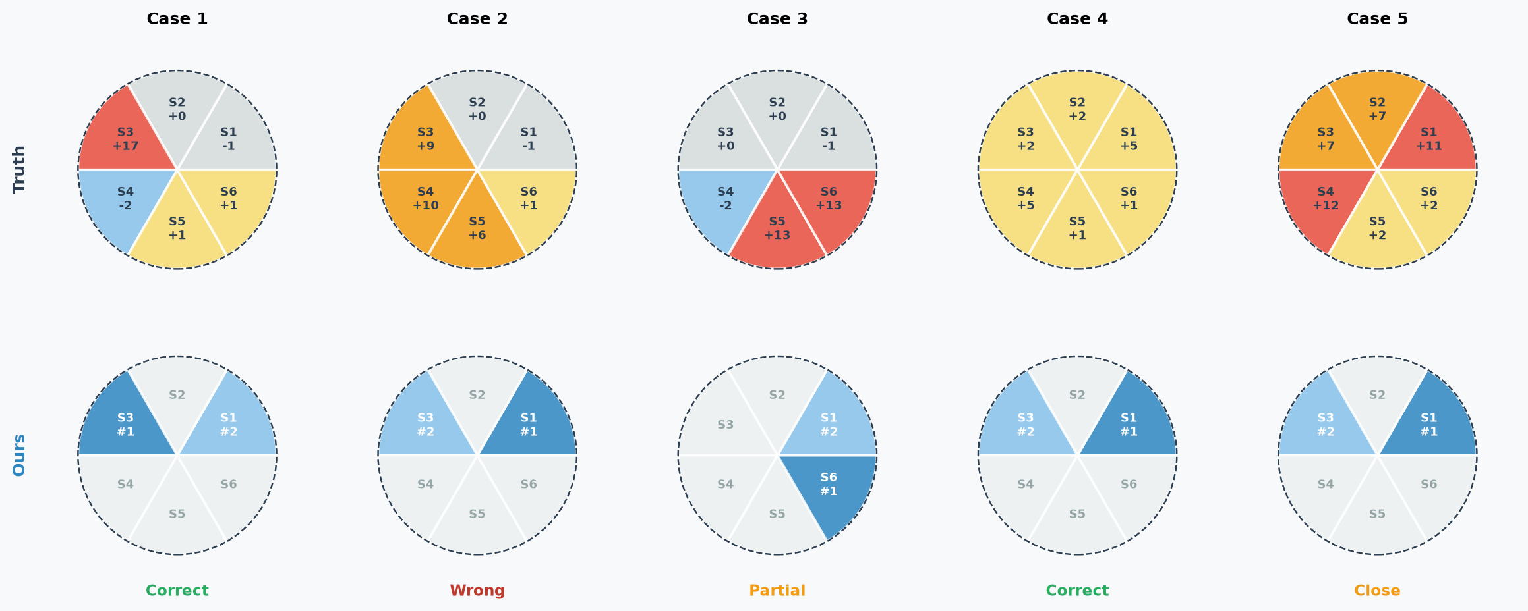
PER-CASE DETAIL
Sector-Level Breakdown
7/9

Slide 8
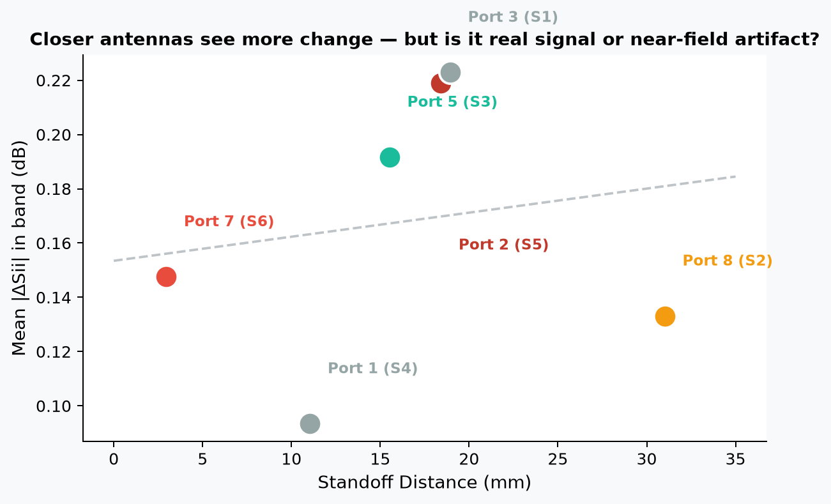
DIAGNOSTIC FINDING
Geometry Check: Standoff vs. Sensitivity
Port 7 (S6)
Closest antenna (2.9 mm).
Largest response — but proximity
artifact, not pure signal.
Port 5 (S3)
Mid-pack distance (15.5 mm).
Still shows strong response —
not explained by proximity.
Port 8 (S2)
Farthest (31 mm). Weakest signal,
highest noise. Low confidence.
8/9

Slide 9
What We Learned
1
4 out of 5 cases correctly localized
The pipeline reads the actual S-parameter data, not just the known AD pattern. It correctly found S3 in a focal tumor case and S6 in an inverted-AD case.
2
Antenna geometry matters
Port 7’s 2.9 mm standoff inflates its sensitivity — some of what looks like signal is near-field artifact. Port 5’s response is genuine (mid-pack distance, strong signal).
3
Blind testing caught overfitting
Three plausible corrections (weight tuning, gain normalization, Q-factor features) each failed blind scoring and were rejected before adoption.
4
Classification works, full imaging doesn’t
8 antennas with ~16 mm range resolution can stage Alzheimer’s severity at the sector level. Voxel-level reconstruction is not achievable with this hardware.
5
Next: multi-layer phantom
Single-material sphere served its purpose. The next step is a realistic layered model (skin, skull, CSF, grey matter, white matter) for clinical-grade classification.
Dual Degree Project — IIT Bombay
9/9

Slide 10
SVD Clutter Subtraction: What I Tried
Raw SVD: Removed σ1. σ1 loads heavily on Port 5 (|u1| > 0.8). Removed signal instead of clutter; rankings unchanged or worse.
Row-normalized SVD: L2-normalize each port's row before SVD. σ1 loadings spread (0.27-0.57), but Port 5's magnitude reasserts upon reverse projection.
Expanded 15-row matrix: 5 self-coupling + 10 transmission pairs. Transmission pairs carry the same gain bias, no improvement.
Cross-case gain estimation: SVD on 5x5 mean-|ΔSii| port×case matrix to find rank-1 constant gain (P5=2.76x). Fixes Case 4, breaks Case 2.
Rank-1 residual: Rank by residual energy after removing rank-1 gain approximation. Residuals were small and noisy.

Slide 11
Summary of Methods & Scores
Method | Description | Score | Notes
Baseline | Diff. self-coupling + transmission | 3/5 | Correct: 1, 3, 5; Wrong: 2, 4
R1: Raw SVD | Remove σ1 (or σ1+σ2) from 5xN matrix | ≤ 3/5 | Removes signal, not clutter
R2: Normalized SVD | L2-normalize rows before SVD | 3/5 | Port 5 magnitude reasserts
R3: 15-Row Matrix | Include transmission pairs | 3/5 | Pairs carry same gain bias
R4: Cross-Case Gain | SVD on 5x5 port×case matrix | 3/5 | Fixes Case 4 (S4 top), breaks Case 2
R5: Rank-1 Residual | Rank by residual after gain removal | 2/5 | Residuals small and noisy

Slide 12
Key Observations
σ1 in raw SVD captures the signal (Port 5's high gain × real perturbation), not shared clutter.
Cross-case gain estimation yields stable gain ratios (from all 5 cases) compared to per-case fitted gains which swung 30-85%.
Case 4 improves with gain correction because its true dominant sector (S1/S4) is orthogonal to the gain vector (Port 5/S3). (v1 case loading = 0.21 vs 0.47-0.52 for others).
Cases 1, 2, and 5 have true pathology partly in S3 (the high-gain sector). The gain vector and signal vector overlap, meaning SVD cannot separate them.

Slide 13
Diagnosis: What's Probably Wrong
The problem is multiplicative per-port gain (~10× on Port 5), not additive clutter. SVD handles additive structure effectively, but struggles when gain is a multiplier.
When true signal aligns with the high-gain direction, they project onto overlapping subspaces, preventing linear decomposition from separating them.
The estimated 2.76× gain (cross-case SVD) is weaker than the ~10× ground-truth because SVD blends gain and real signal when correlated.
Gain may also be frequency-dependent (different spectral shapes per port), which a scalar correction cannot resolve.
Note: This is a known open problem with a clear path forward (via null tests and calibration), not a failure.

Slide 14
Next Steps
Null Test (Case 6): Simulate healthy-vs-healthy with a slightly perturbed mesh. Any nonzero ΔS is pure hardware artifact/gain, yielding the direct clutter subspace.
Single-Sector Calibration Phantoms: Alter one sector with a known Δεr while others remain unchanged. Directly measures per-port gain (g_p) without signal confounding.
Multi-Layer Phantom Model: Evolve from a homogeneous sphere to a layered brain model (skin, skull, CSF, gray/white matter) for more realistic imaging.

